Slide 1
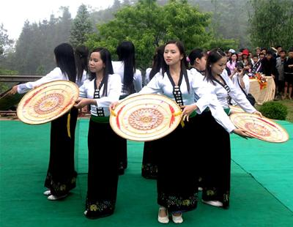
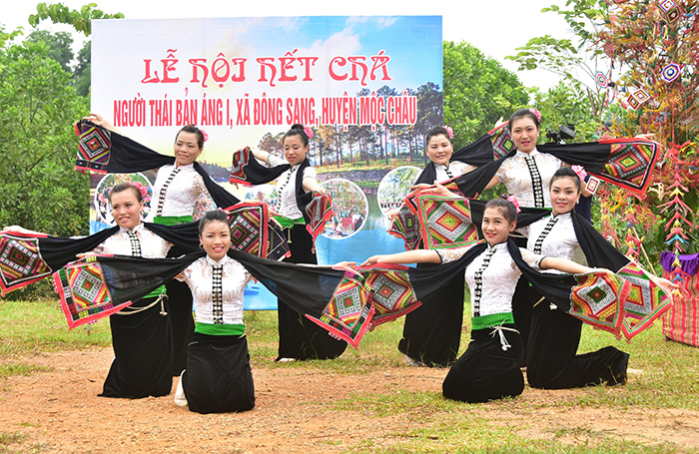
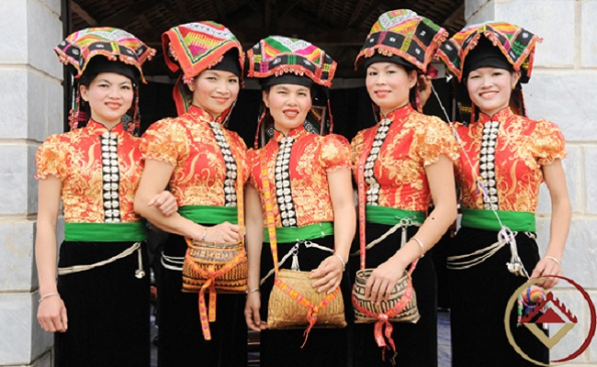
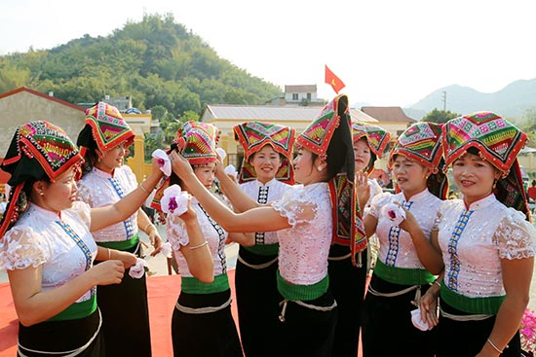

Slide 2
Tell the class what you know about theThai people :
- What provinces they live in
Their population
Their traditional costumes

Slide 3
- Thai People live in the northern mountainous provinces, such as : Lai Chau, Son La, Hoa Binh, Thanh Hoa and Nghe An
- Their population is about 1,5 million people
- Their traditional costumes are shawls, short blouses, long skirts, scarves and ornaments

Slide 4
THE ANSWER :
Yes, they do
2. Their main food is rice.
3. It is well-known for being unique, colorful and strong.
4. Thai women do
5. They worship their ancestors.

Slide 5
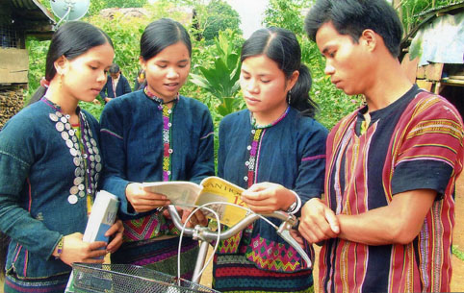
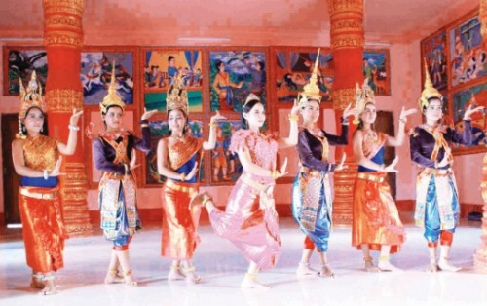
The Bru-Van Kieu people
The Khmer people

Slide 6
Talk about one of the two ethnic groups
The Bru-Van Kieu people
The Bru-Van Kieu people have a population of about 74,500 people …
(2) The Khmer people

Slide 7
THE THAI PEOPLE
The Thai people have a population of about one and a half million people. They mostly live in the provinces of Lai Chau,Son La,Yen Bai,Hoa Binh, Thanh Hoa, and Nghe An. Their language belongs to the Tay-Thai group .
They grow other crops on burnt-out land.They raise cattle and poultry for their own use.
Every year they hold festivals and ceremonies.

Slide 8
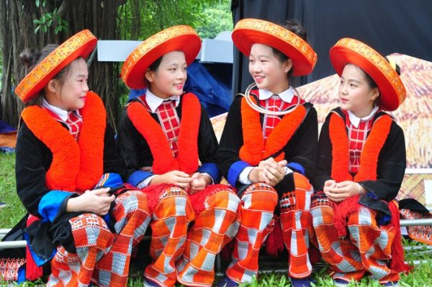
DAO ĐỎ (Hà Giang, Yên Bái,Lào Cai...)

Slide 9
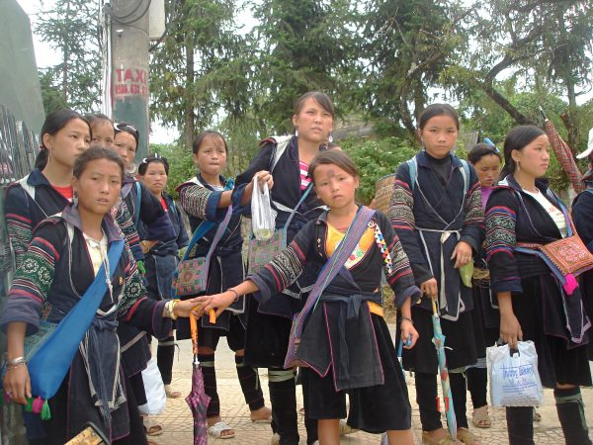
Ethnic group : Mông (northern provinces)

Slide 10
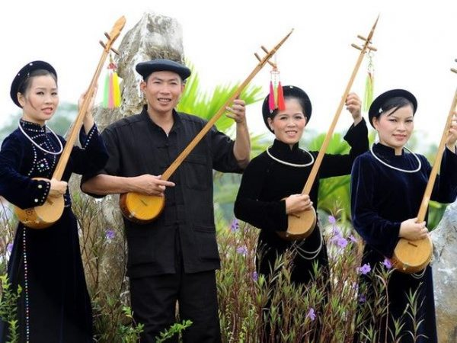
Ethnic group : Tày

Slide 11
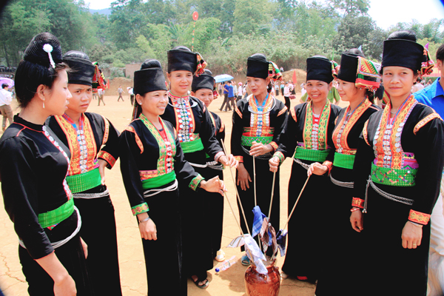
Ethnic group : Khơ Mú (Yen Bai, Son La, Lai Chau)

Slide 12
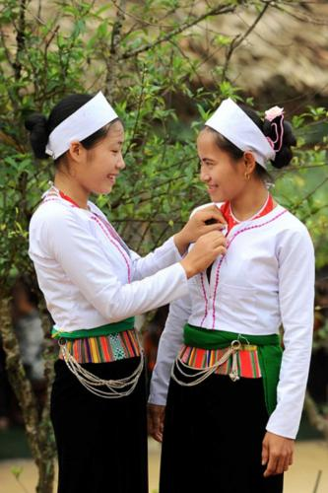
Ethnic group : Mường (Thanh Hoa, Hoa Binh ...)

Slide 13
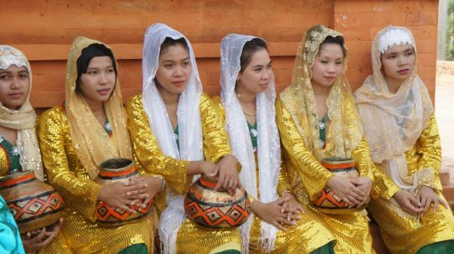
Ethnic group : Cham (Khanh Hoa, Gia Lai, Ninh Thuan , Binh Thuan, An Giang ...)

