Slide 1
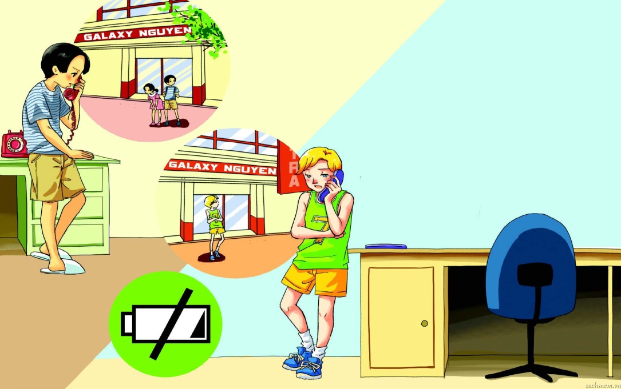
English 8
UNIT 10: COMMUNICATION
LESSON 7: LOOKING BACK AND PROJECT

Slide 2

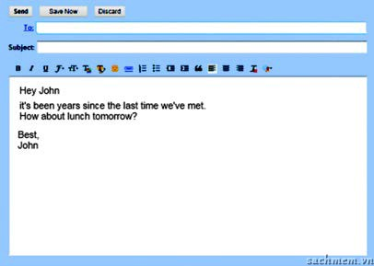
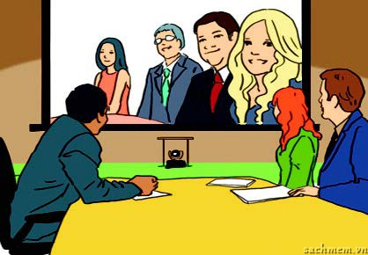
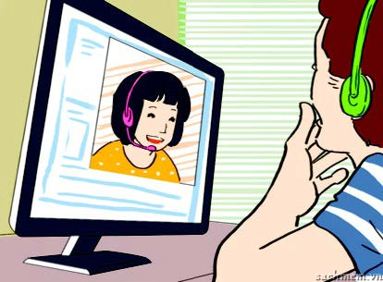


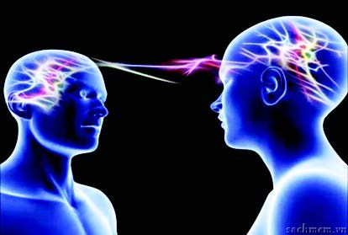


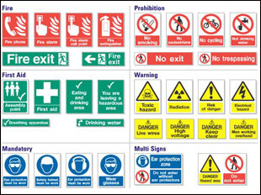
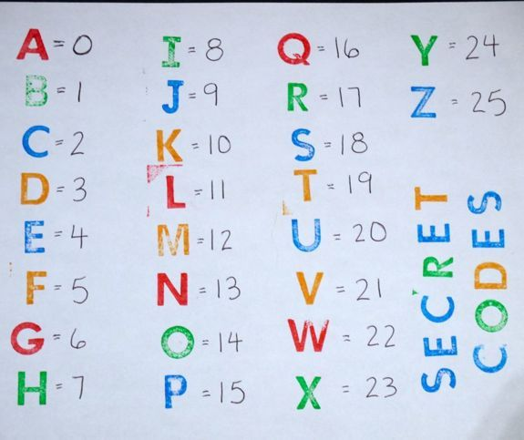
Warm up
having a video conference
video chatting
emailing
meeting face-to-face (F2F)
using social media
Ways of communication
using telepathy
using signs
sending letters (snail mail)
using body language
using codes

Slide 3

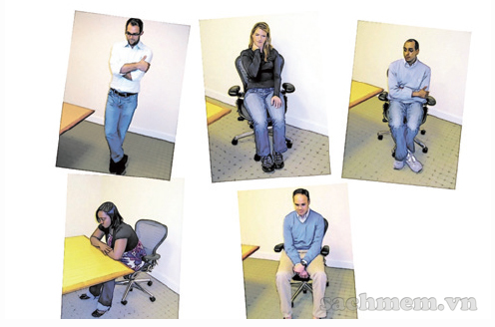


I. Vocabulary
Activity 1. Complete the sentences using the cues provided
anguage
Using b___ l________is an effective way for communication as long as you understand it.
M________ technology makes today’s communication so exciting with not only text but also sound, video, and graphics.
A lot of people prefer working f____________ than online.
ody
ultimedia
ace - to - face

Slide 4
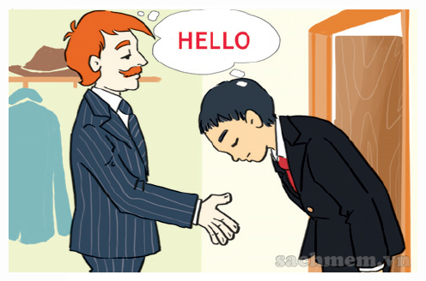

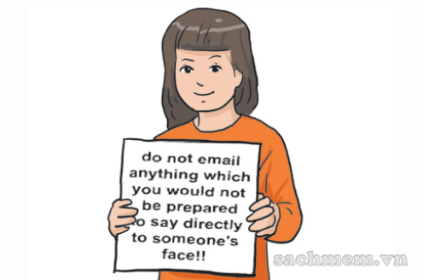
Communication breakdown may happen due to c______ d__________.
In the future we won’t need to learn different languages to communicate if we use t________.
Everyone needs to learn n________ when we communicate online.
ultural
ifferences
elepathy
etiquette

Slide 5

Activity 2. Write the following text messages/ chat lines in shorthand form.
Thanks for your gift.
By the way, what are you doing this weekend?
Please call me right now.
Laugh of loud.
See you tonight.
Thx 4 ur gift.
BTW, wot r u doin this wkd?
Pls call me rite now.
LOL!
C U 2nite.

Slide 6
Activity 3. Have you ever used music, art, codes, signs or any non-verbal way to communicate? Tell a partner what you did. Was the coomunication successful
Example:
I used music to express my love to my Mom.
The song is about the love of a daughter for her mother.
She was happy .

Slide 7
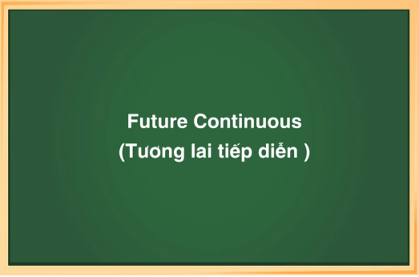
II. Grammar

Slide 8
1. Định nghĩa thì tương lai tiếp diễn
Thì tương lai tiếp diễn được dùng để nói về 1 hành động đang diễn ra tại một thời điểm xác định trong tương lai.
2. Cách dùng thì tương lai tiếp diễn
-Dùng để diễn tả một hành động hay sự việc đang diễn ra tại một thời điểm xác định trong tương lai.
Dùng để diễn tả một hành động, một sự việc đang xảy ra thì một hành động, sự việc khác xen vào trong tương lai.
Hành động sẽ diễn ra và kéo dài liên tục suốt một khoảng thời gian ở tương lai
Hành động sẽ xảy ta như một phần trong kế hoạch hoặc một phần trong thời gian biểu

Slide 9
3. Công thức thì tương lai tiếp diễn
Câu khẳng định : S + will + be + V-ing
Câu phủ định : S + will not / won’t + be + V-ing + O
Câu nghi vấn : Will + S + be + V-ing + O ?
Yes, S will
No, S won’t
4. Dấu hiệu thì tương lai tiếp diễn
Trong câu có các trạng từ chỉ thời gian trong tương lai kèm theo thời điểm xác định:
– at this time/ at this moment + thời gian trong tương lai: Vào thời điểm này ….
– At + giờ cụ thể + thời gian trong tương lai: vào lúc …..

Slide 10
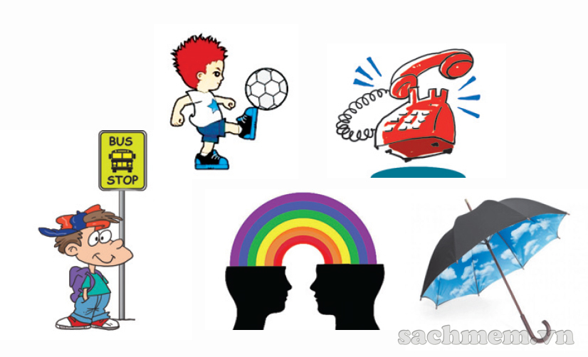
Activity 4. Underline the correct answer.
She ( will not be sleeping / was not sleeping) if you call at 9 p.m.
They ( play/ will be playing) football at 10 a.m tomorrow.
What ( will he be doing/ will he do) this time next Monday?
I ( am waiting/ will be waiting) at the bus stop when you arrive.
In 200 years we ( will not be using/ do not use ) mobile phones any more. We ( will be using/ will use ) telepathy.
They’ve decided ( rains/ will be raining ) later today.

Slide 11
Bài 2: Complete these sentences using the future continuous tense.
1.This time next year I (live)______ in London.
will be living
2.At 8PM tonight I (eat)_________ dinner with my family.
will be eating
3.(you/wait)______ at the station when she arrives tomorrow?
Will you be waiting
4.My parents (visit) __________Europe at this time next week
will be visiting

Slide 12
V-V.ing
V- to V
Try
Plan
Hard
Decide
Want
Like
Love
Enjoy
Mind
stop

Slide 13
Activity 5. Gerund or to-infinitive?
talking
I don’t mind ( talk) _________ to her about this.
We plan (use) __________ video chatting to keep in touch with our family.
He’s tried very hard (show) ____________ his love to her by sending lots of flowers and presents.
She dislikes (communicate) ________________ through message boards or online meetings.
Lena enjoyed (chat) ____________ on the phone with her friends.
They’ve decided (have) ____________ a video conference with their colleagues right away.
to use
to show
communicating
chatting
to have

Slide 14

III. Communication
Activity 6. Choose any three form of communication in this unit and work with a partner to decide if people will be using them in year 2100 or not. Give at least two reasons for each decision
Example:
Will we be using music to communicate in the year 2100?
I think so. People will always express themselves through music.

Slide 15

IV. Project
In groups, prepare two versions of a short sketch involving a communication breakdown to perform in class.
Perform version 1 where the communication breakdown takes place.
Then ask the adience to explain what went wrong and how it could be avoided.
Next perform version 2, this time where no communication breakdown takes place.
You can ask yuor teacher for help with sketch ideas.

Slide 16
V. Homework
Prepare Unit 11 - Lesson 1: Getting started

Slide 17







Thanks for your attendance
Goodbye

