Slide 1


Slide 2

Nowadays, there are many leisure activities such as:

Slide 3
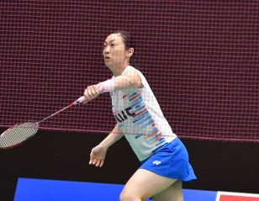

Playing badminton
Listening to music

Slide 4
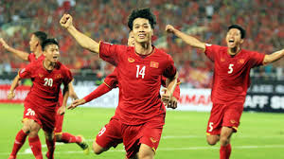

Playing football
Reading book

Slide 5

But We think , the leisure activity we like best is:

Slide 6
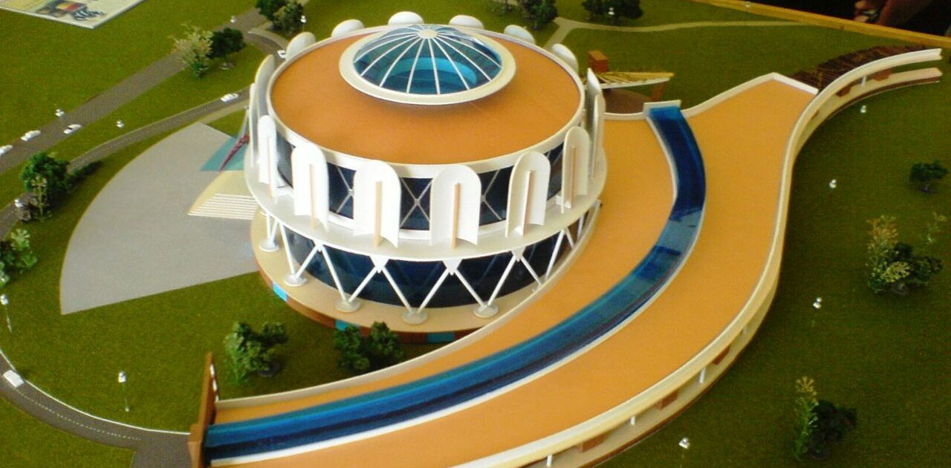
Making model

Slide 7

This the kitchen It was made by us. We made it over 4 hours.It is made of:

Slide 8
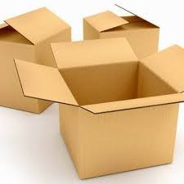
Cartoon

Slide 9
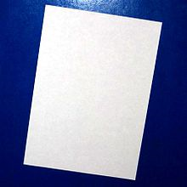
paper

Slide 10
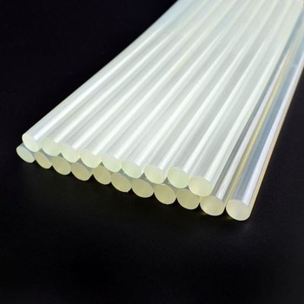
glue

Slide 11

Making model has a lot of advantages. Firstly, It help me relax after school or after tired time.

Slide 12
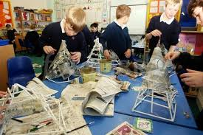

Slide 13
Secondly, It helped me to be more creative, more skillful when making model.

Slide 14
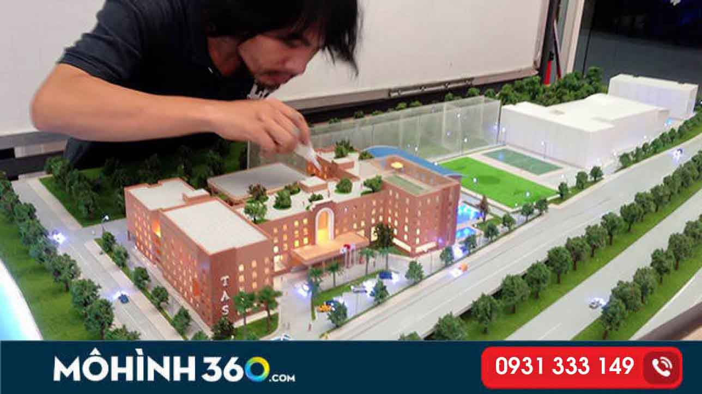

Slide 15
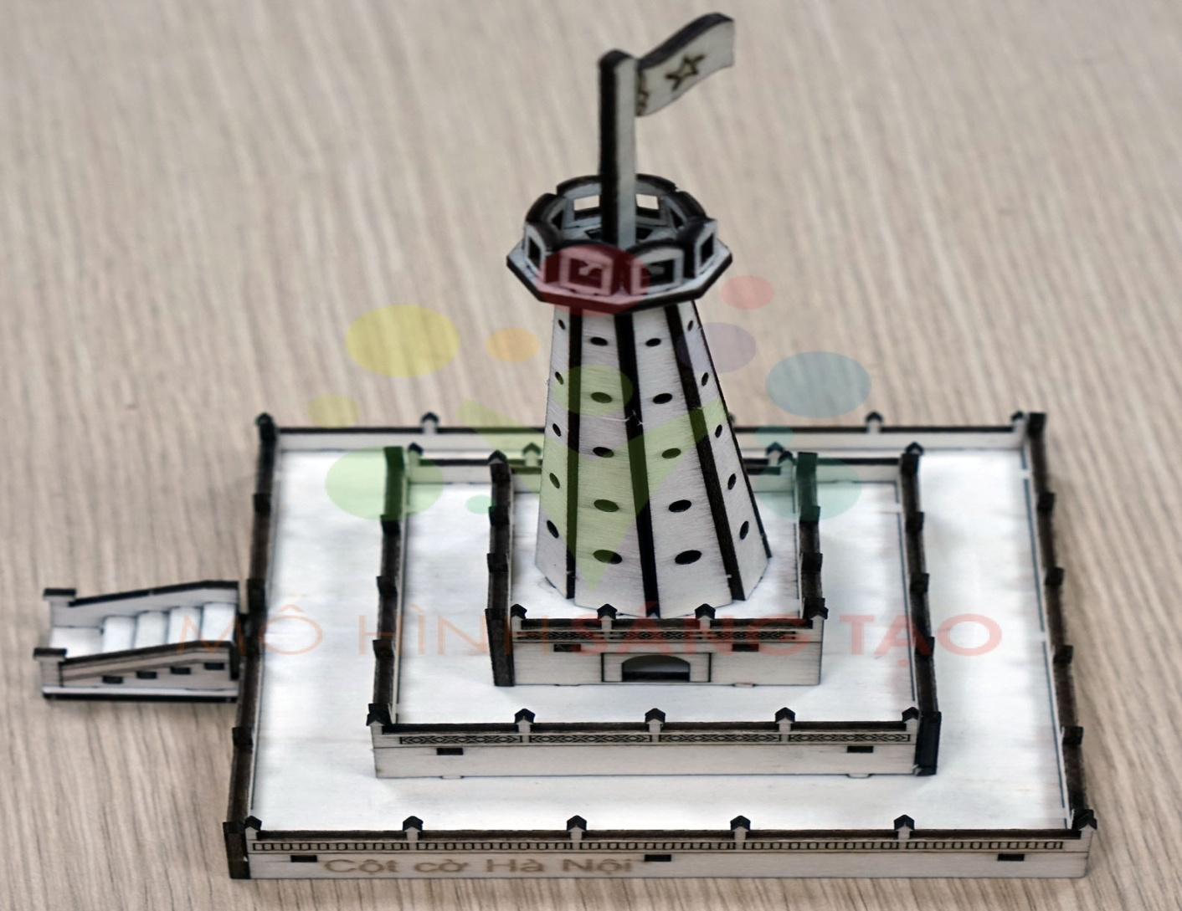
Finally, It helps me pursue my dream

Slide 16

In short, making model has a lot of advantages. So I think you should making model in your free time to more creative.

Slide 17

Do you want to play game with us ?

Slide 18


All class split 2 teams. You have to answer our question. Each team has 3 times to answer
If 3 times wrong, team remain has right to answer. If right, clap your hands. If wrong, try again. Are you ready?

Slide 19

1
2
6
7
3
5
4

Slide 20

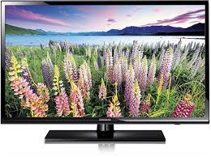
It’s the most famous leisure activity
Watching TV

Slide 21
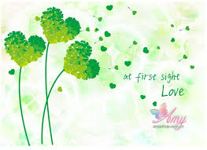

Widen our knowledge
Reading books

Slide 22

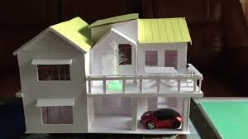
You can make some models with many materials
Making models

Slide 23
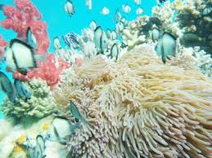
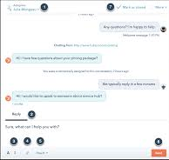
Talking with friends by letters and mobile phones
Chatting

Slide 24

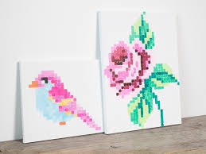
What is it ?
Doing
DIY

Slide 25

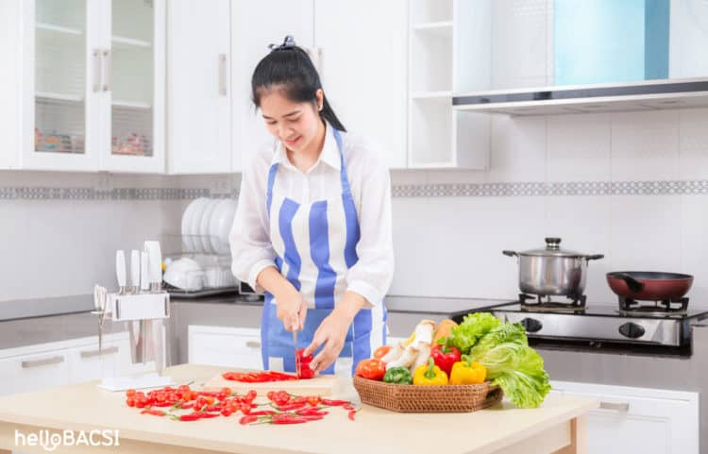
What is she doing?
Cooking

Slide 26


A modern generation
Playing computer games

Slide 27
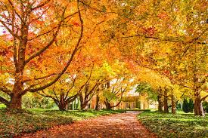
Are you interesting when play this game?
Always, it doesn’t have an absolute.
So, can you give our some opinion to perfect this project?

Slide 28
