Slide 1

WELCOME TO OUR CLASS
Teacher: Le Thi Giang

Slide 2

HANG MAN
This is a type of natural disaster
1
2
T
Y
P
H
O
O
N
3
4
(There are 7 letters)
5
6
A
B
C
D
E
F
G
H
I
7
J
K
L
M
N
O
P
Q
R
S
T
U
V
W
X
Y
Z

Slide 3

Unit 9: Natural disasters
Period 73: Lesson 6: Skills 2

Slide 4

I, Vocabulary
- injured (adj) /ˈɪndʒəd/ :
Bị thương
- weaken (v) /ˈwiːkən/ :
Yếu đi
- Rain- free (v) /reɪn-friː/
Không mưa
- operation (n) /ɒp. ərˈeɪ.ʃən/ :
Sự hoạt động, ca phẫu thuật
- property (n) /ˈprɒp.ə.ti/ :
Tài sản

Slide 5
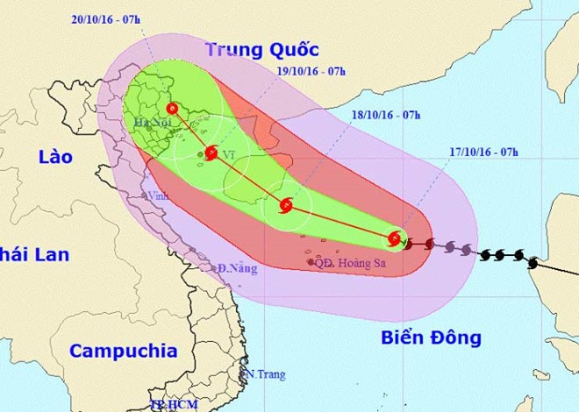

Slide 6
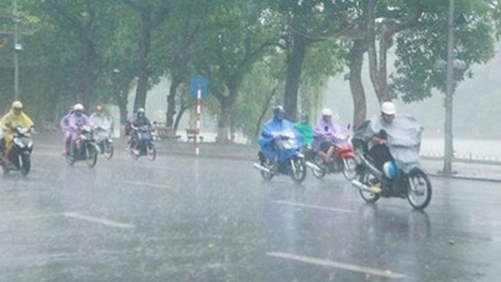
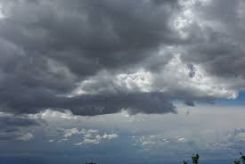
Rain
Rain- free

Slide 7

Fill in the blank
Property
Tài sản
Rain- free
Không mưa
operation
Sự hoạt động
weaken
Yếu đi
Injured
Bị thương

Slide 8

Listening

Slide 9

Ex1: Listen to the news report and correct the following statements
1. A typhoon hit Nghe An province early this morning.
last night
A
B
C
c
2. Only a few people were seriously injured in the storm.
Dozens of people
A
A
B
C
3. There wasn’t any damage to property in Cua Lo
was extensive damage
A
B
A
C
had already weakened
4. The storm had not weakened when rescue workers arrived
in the area.
A
B
C
A
5. According to the weather bureau, the area will be rain-
free over the next few day
Heavy rain will continue
B
A
B
C

Slide 10

1. Listen to the news report and correct the following statements
A typhoon hit Nghe An province last night.
Dozens of people were seriously injured in the storm.
There was extensive damage to property in
Cua Lo
4. The storm had already weakened when
rescue workers arrived in the area.
According to the weather bureau, heavy
rain will continue over the next few day

Slide 11
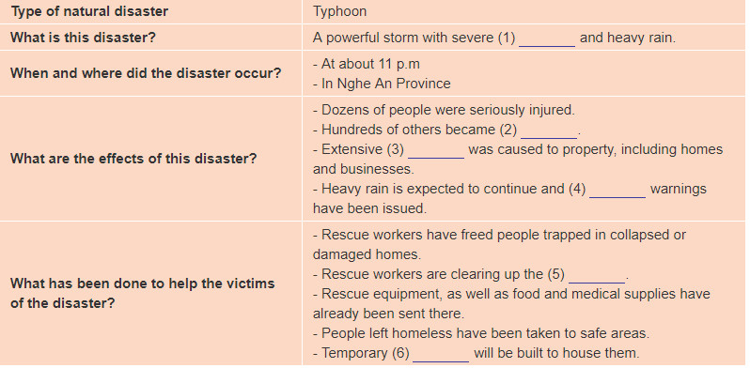
2. Listen again and complete the chart
(n)
(adj)
(n)
(n)
(n)
(n)

Slide 12
Type of natural disaster | Typhoon
What is this disaster? | A powerful storm with severe and heavy rain
When and where did the disaster occur? | At about 11 p.m In Nghe An province
What are the effects of this disaster? | -Dozens of people were seriously injured. - Hundreds of others became - Extensive was caused to property, including homes and businesses - Heavy rain is expected to continue and warning have been issued
What has been done to help the victims of the disaster | -Recue workers have freed people trapped in collapsed or damaged homes. - Recue workers are clearing up the - Recue equipment, as well as food and medical supplies have already been sent there. - People left homeless have been taken to safe areas - Temporary will be to house them
winds
homeless
damage
flood
debris
accommodation

Slide 13

Forest fire
Flood
Tsunami
Natural disasters
Tornado
Earthquake
Drought

Slide 14
EX3: Make notes about a natural disaster in the table
Type of natural disaster
What is this disaster
When and where did the natural disaster?
What are the effects of this disaster?
What has been done to help the victims of the disaster?

Slide 15
Type of natural disaster | Droupt
What is this disaster | There was no rain for 6 months and the temperature was over 40 selcius degree
When and where did the natural disaster? | - in the early of 2013 - in Long An province
What are the effects of this disaster? | -The trees and animals died without water. -The rice paddies were dry and died -The soil was broken.
What has been done to help the victims of the disaster? | The rescue workers brought water tanks to villages to provide warer - People were limited to go out on day

Slide 16
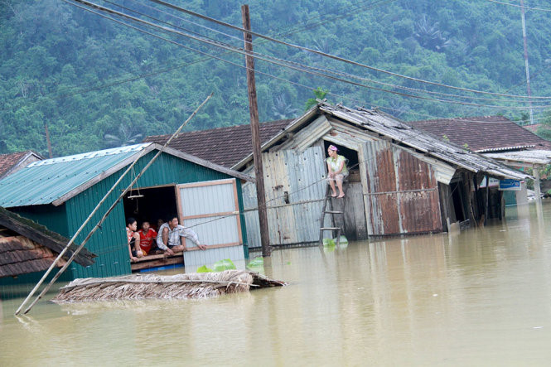
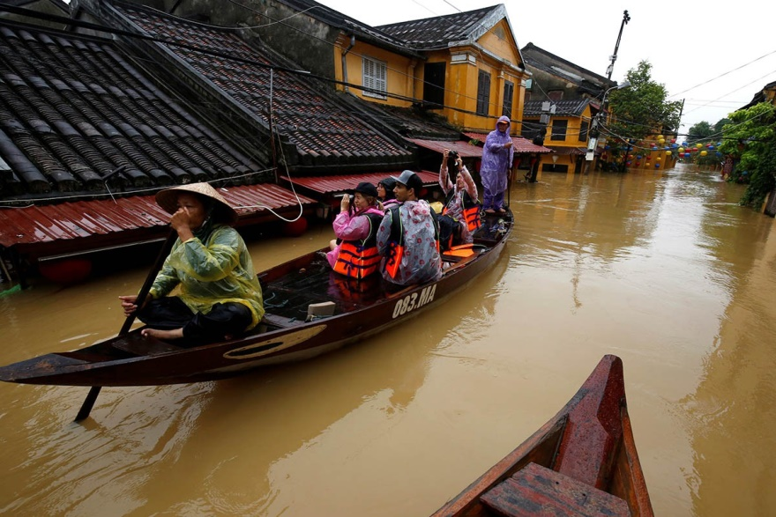
4a. Use your notes in EX3 to write a news report.

Slide 17
Type of natural disaster
Example:
In November and early December 2016,
there were 5 major floods with heavy
rains for many days occured in Binh Dinh
province. It caused many serious effects
on people' life: 39 people believed to be
dead or missing, over 97,000 houses damaged
and inudated, more than 128km of roads
damaged, 17,300ha of winter- spring rice creps
destroyed and over 200,000 heads of cattle and
poulntry washed away.Local authorites worked
hard to rescue workers freed people trapped in
the floods, and evacuate people from dangerous
areas. Besides, to help people, local military an local
authorities provided food for the victims, and
cleared up mud and debris
when
What is this disaster?
where
What are the effects of this disaster?
What has been done to help the victims of the disaster?

Slide 18

Homework
Write the news report on your notebook
Listen again the audios
Prepair looking back and project

Slide 19

Thank you

