Slide 1
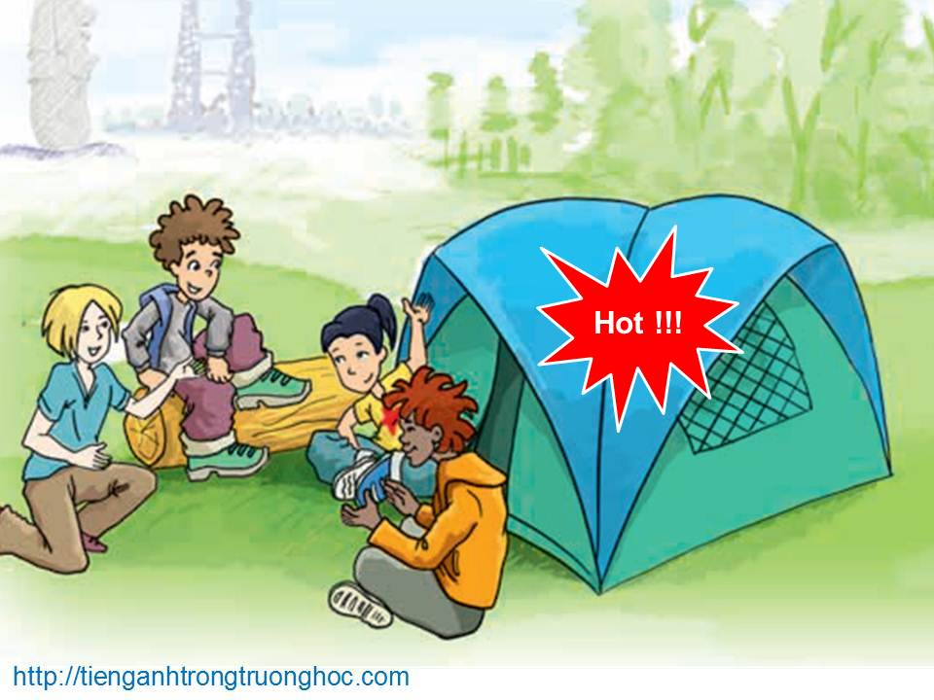
      UNIT 8: ENGLISH SPEAKING COUNTRIES
      LESSON 4: COMMUNICATION
English 8

Slide 2

Warm up
The USA
England
Scotland
Canada
Singapore
Australia
New Zealand
Wales
Ireland
The American
The English
The Scottish/Scots
The Canadians
The Singaporeans
The Australian
The New Zealanders
The Welsh
The Irish

Slide 3


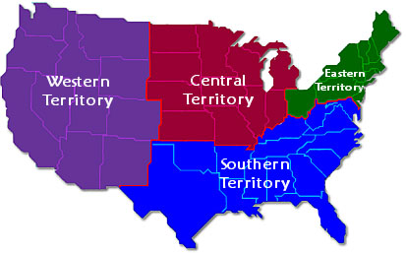
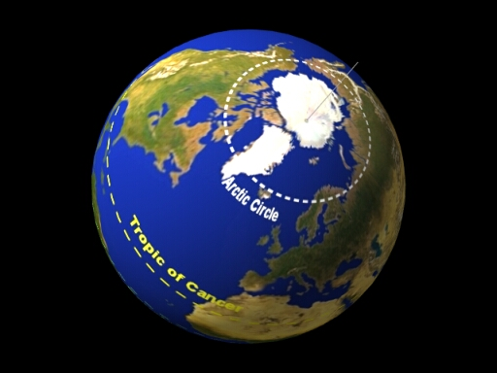
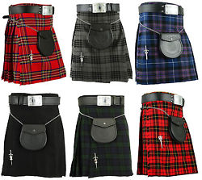
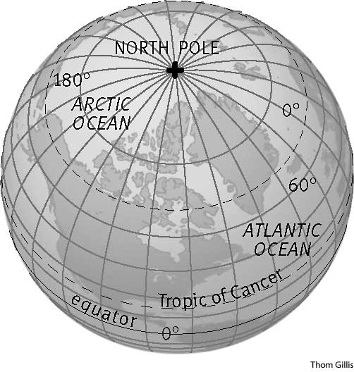
I. Extra vocabulary
territory (n) /ˈter.ɪ.tər.i/
North Pole (n)
Arctic Circle (n) /ˈɑːk.tɪk/
kilt (n) /kɪlt/
lãnh thổ
Cực Bắc
Vòng Bắc cực
váy ca-rô của
đàn ông Scotland

Slide 4
I. Extra vocabulary
territory (n):
North Pole (n):
Arctic Circle (n):
kilt (n):
land that is under control of a particular country
the point on the surface of the Earth that is furthest north
the line of latitude 66° 33′ North
a skirt with many folds, made from tartancloth and traditionallyworn by Scottish men and boys

Slide 5
Game:
Activity 1. Do the quiz and choose the correct answers.
Do the quiz
Activity 2. Write the names of the countries next to their facts.
Names of the countries
Activity 3a. Work in groups. Choose a country and together find out as much about it as possible. Then prepare a small introduction of that country. Don’t say the name of the country.
How much do you know

Slide 6



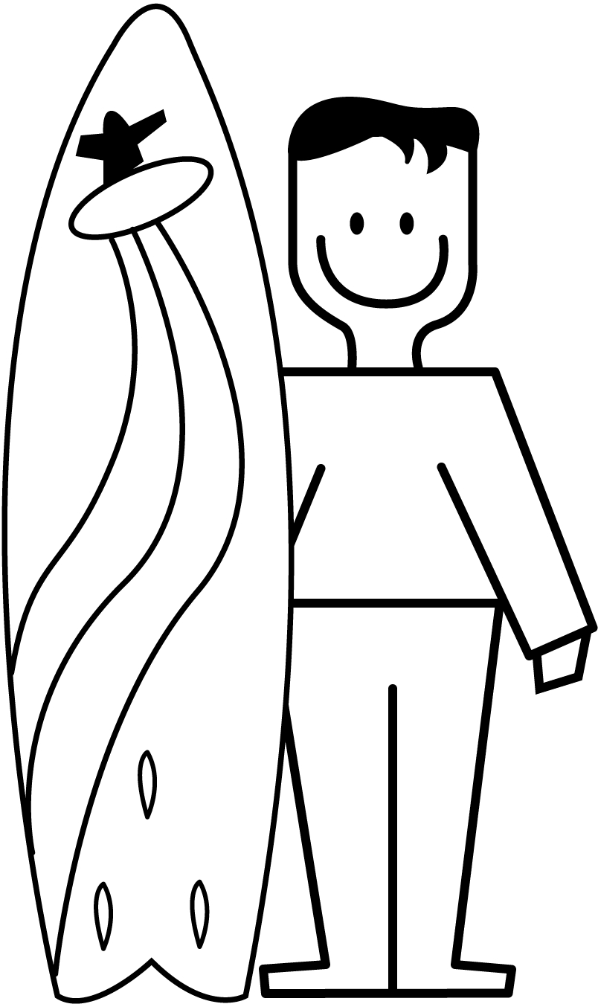
Welcome To
Big Board Facts

Slide 7
Do the quiz
NEXT

Slide 8
Names of the countries
NEXT

Slide 9
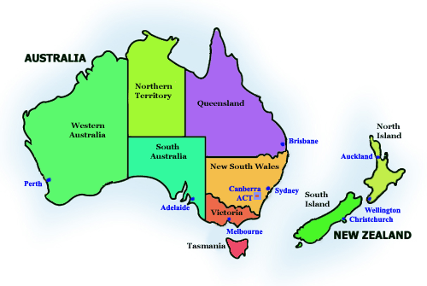
Do the quiz
Question for 5 Points
1. _______ are both surrounded by the sea.
  A. The UK and the USA
B. Canada and New Zealand
C. Australia and New Zealand
  D. The USA and Australia
Back to board
Notes:
Key: 1C

Slide 10
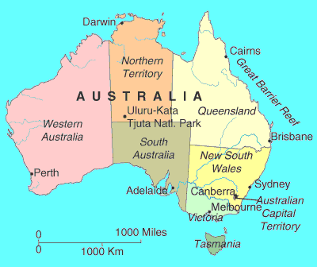
Do the quiz
Question for 10 Points
2. Of these countries, _______ is the youngest
  A. Australia
B. Canada
C. the USA
  D. the United Kingdom
Back to board
Notes:
Key: 2A

Slide 11
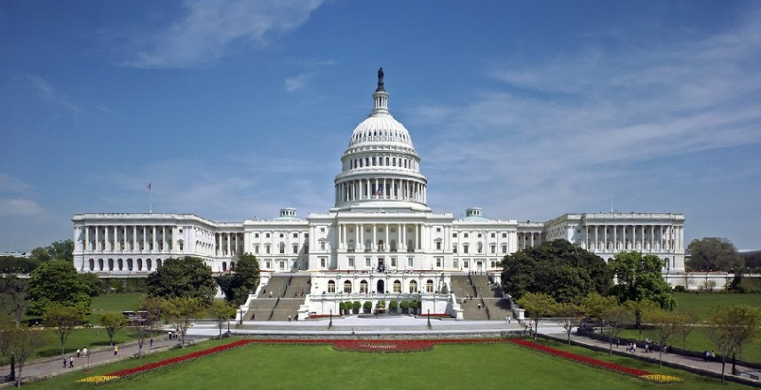
Do the quiz
Question for 15 Points
3. The capital of New Zealand is _______
A. Canberra
B. Washington D.C.
C. Wellington
D. Ottawa
Back to board
Notes:
Key: 3C

Slide 12
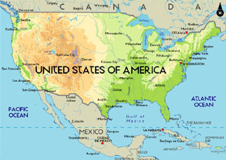
Do the quiz
Question for 20 Points
4. _______ is the most diverse in geography and climate.
A. Canada
B. The USA
C. The United Kingdom
D. New Zealand
Back to board
Notes:
Key: 4B

Slide 13
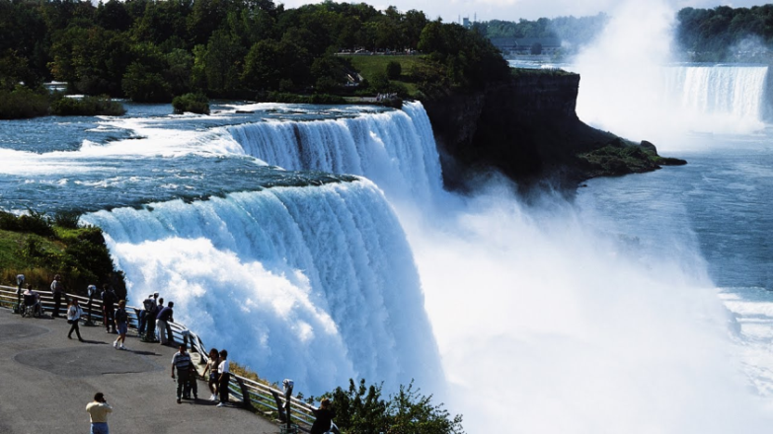
Do the quiz
Question for 25 Points
5. Niagara Falls is a spectacular waterfall in ____
A. Wales
B. Canada
C. England
D. Australia
Back to board
Notes:
Key:5B

Slide 14
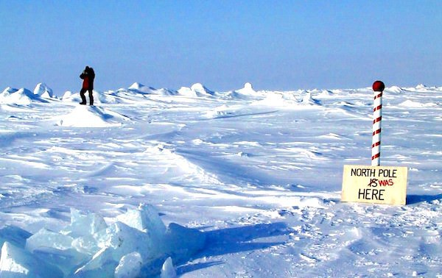
Do the quiz
Question for 5 Points
6. __________ is closest to the North Pole.
A. America
B. Canada
C. New Zealand
D. Australia
Back to board
Notes:
Key: 6B

Slide 15
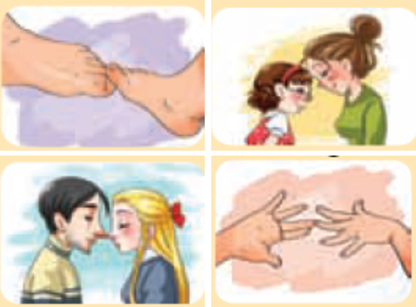
Do the quiz
Question for 10 Points
7. Which picture below illustrates the way the Maori of New Zealand greet each other?
A. touching toes
B. touching foreheads
C. touching noses
D. touching hands
Back to board
Notes:
Key: 7C

Slide 16
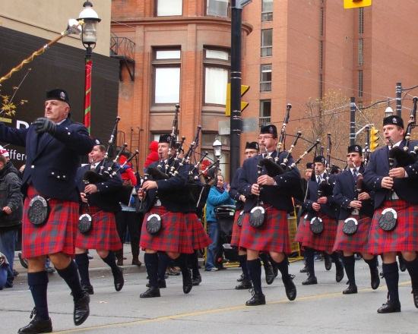
Do the quiz
Question for 15 Points
8. A kilt is the traditional garment for _______ .
A. Scottish men
B. the Maori in New Zealand
C. the Americans
D. the Aborigines in Australia
Back to board
Notes:
Key: 8A

Slide 17
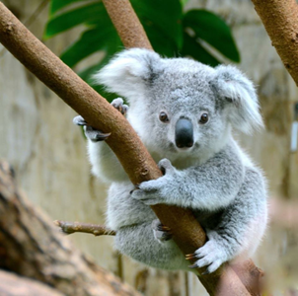
Do the quiz
Question for 20 Points
9. This animal, the _______ , is a symbol of Australia.
A. kangaroo
B. koala
C. rabbit
D. emu
Back to board
Notes:
Key: 9B

Slide 18
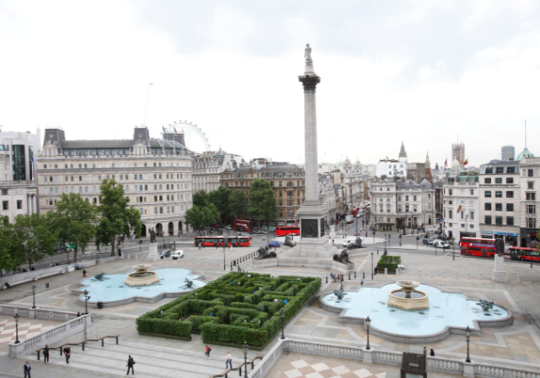
Do the quiz
Question for 25 Points
10. _______ is in London
A. Trafalgar Square
B. Times Square
C. Sky Tower
D. Ayers Rock
Back to board
Notes:
Key: 10A

Slide 19
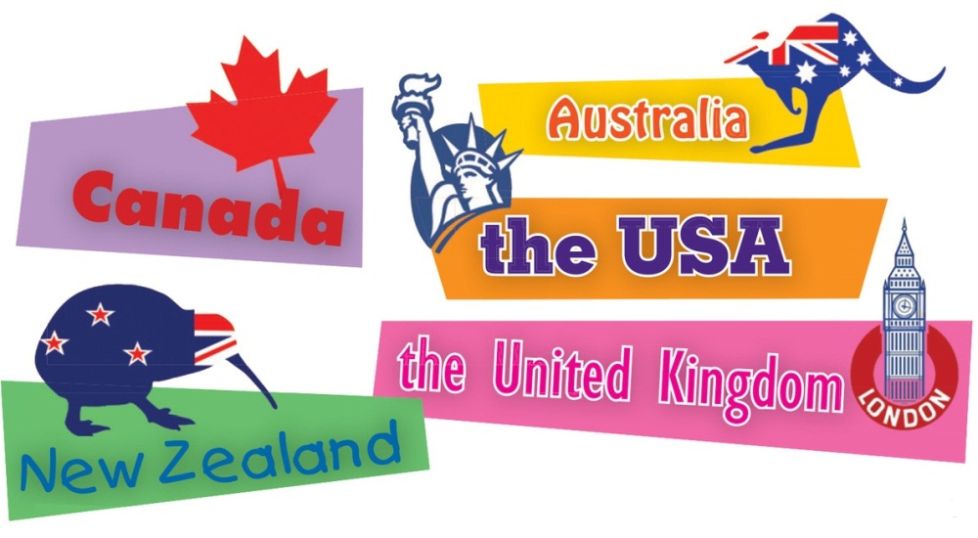
Names of the Countries
Question for 5 Points
Information | Country
1. It is made up of 50 states.
the USA
Back to board

Slide 20
Names of the Countries
Question for 10 Points
Information | Country
2. It has the smallest population.
New Zealand
Back to board

Slide 21
Names of the Countries
Question for 15 Points
Information | Country
3. It has the most famous football clubs in the world.
United Kingdom
Back to board

Slide 22
Names of the Countries
Question for 20 Points
Information | Country
4. It has part of its territory inside the Arctic Circle.
Canada
Back to board

Slide 23
Names of the Countries
Question for 25 Points
Information | Country
5. It is both a country and a continent.
Australia
Back to board

Slide 24
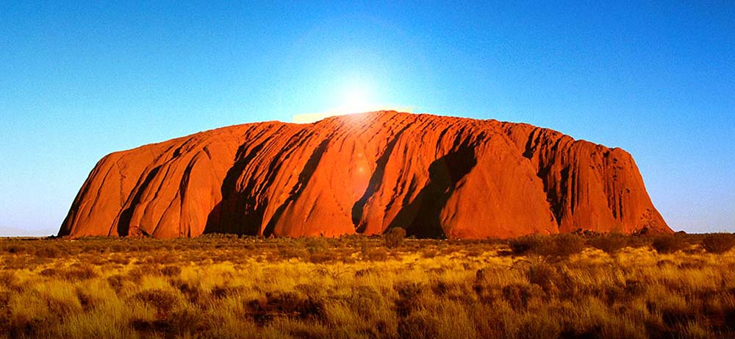
How much do you know
Question for 5 Points
It is one of the most photographed natural wonders in this country.
Uluru (formerly Ayers Rock)/
Back to board

Slide 25
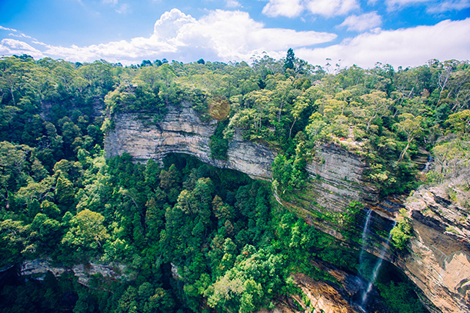
How much do you know
Question for 10 Points
It is A UNESCO World Heritage Site.
Blue Mountains National Park
Back to board

Slide 26
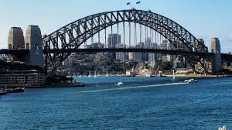
How much do you know
Question for 20 Points
It is one of this country most famous icons and is the largest steel arch bridge in the world
Sydney Harbour Bridge
Back to board

Slide 27
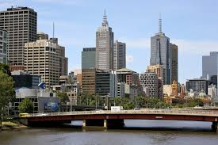
How much do you know
Question for 25 Points
It is the second largest city of this country.
Melbourne
Back to board

Slide 28
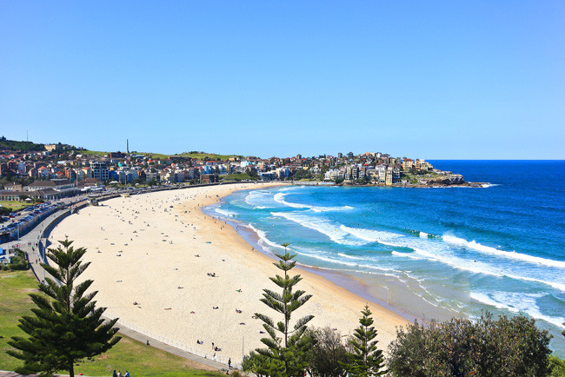
How much do you know
Question for 5 Points
It is one of the world’s most famous beaches
Bondi Beach
Back to board

Slide 29
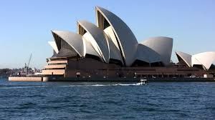
How much do you know
Question for 10 Points
It in Sydney is one of the most distinctive and famous 20th-century buildings, and one of the most famous performing arts venues in the world.
The Sydney Opera House
Back to board

Slide 30
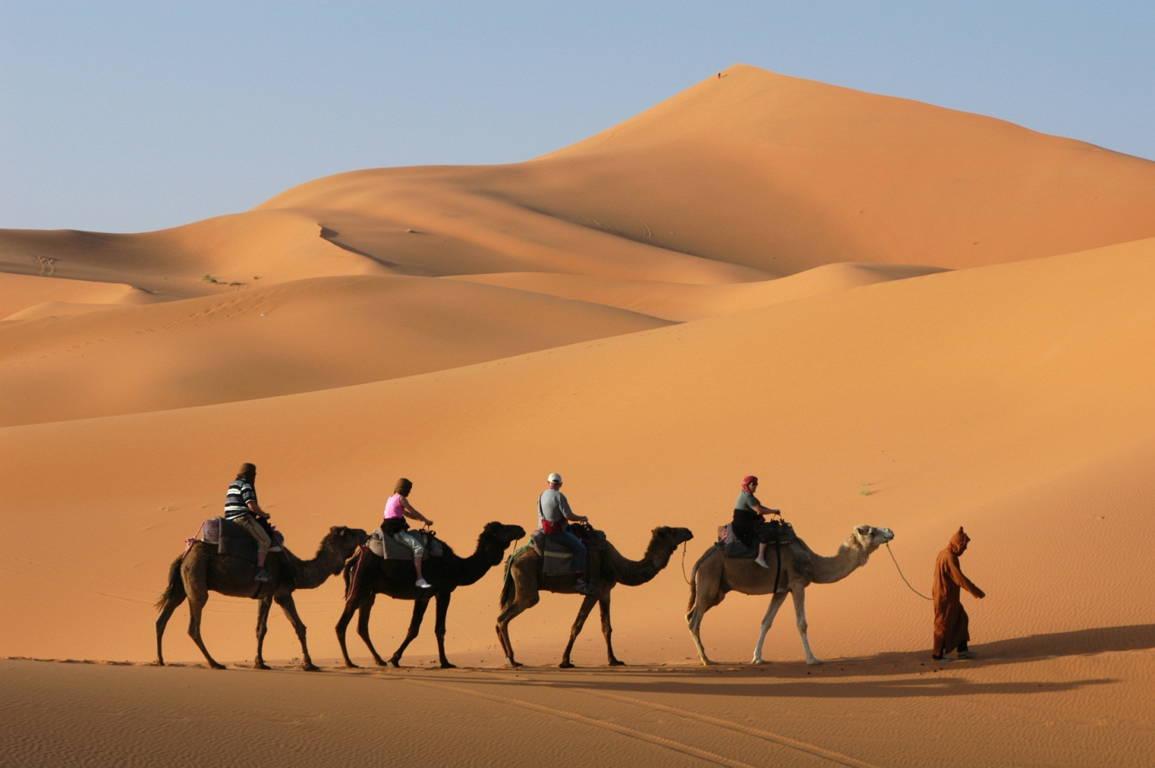
How much do you know
Question for 15 Points
It is the world’s largest hot desert?
The Sahara Desert
Back to board

Slide 31
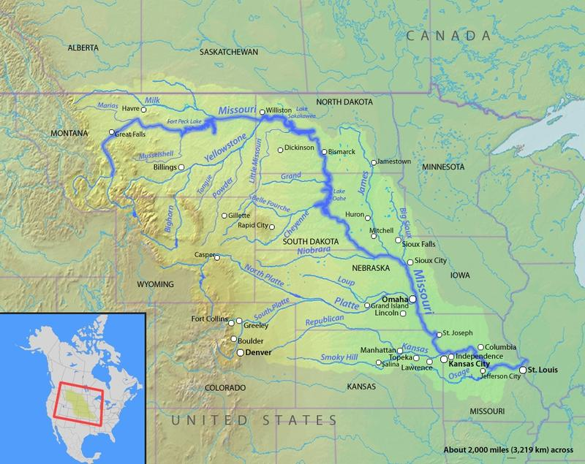
How much do you know
Question for 20 Points
It is the longest river in the USA
Missouri River
Back to board

Slide 32
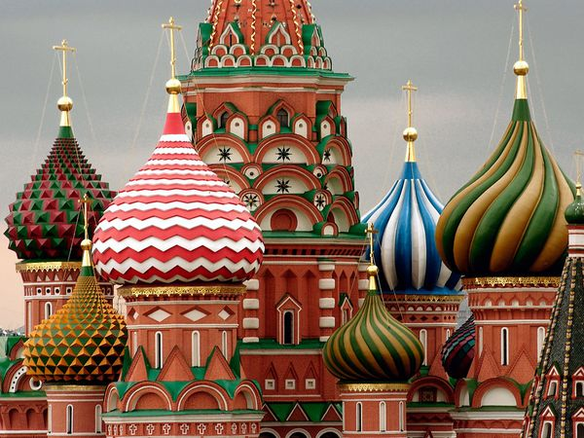
How much do you know
Question for 25 Points
It is the largest country in the World
Russia’s 17.1 million square kilometres
Back to board

Slide 33
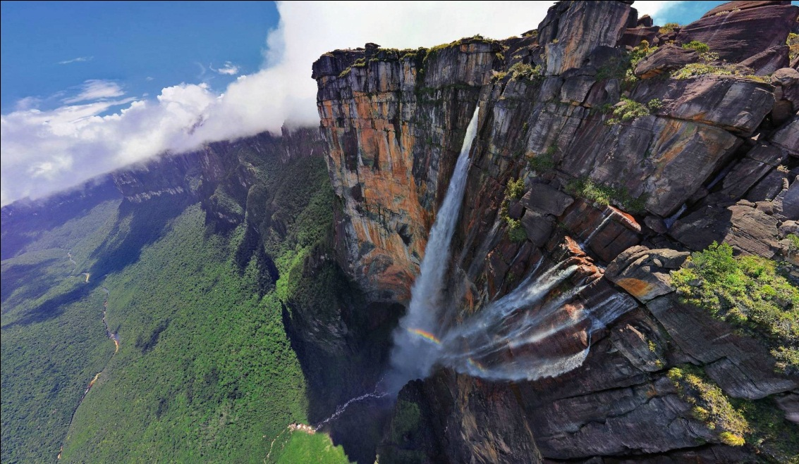
“Big Points - 30”
Question
This Venezuelan waterfall drops 3,212 feet. That is 15 times higher than Niagra Falls. Name this waterfall.
25
30
29
28
27
26
24
23
22
21
20
19
18
17
16
15
14
13
12
11
10
9
8
7
6
5
4
3
2
1
Angel Falls
Back to board

Slide 34
Activity 3b. Each group then presents their introduction to the class. The class...
1. tries to find out which country it is
2. votes for the most informative and interesting introduction

Slide 35

II. Homework
  Learn new words by heart and write three lines for each.
  Do C1, 2 (P14-15)
  Prepare for the next lesson Skills 1

