Slide 2
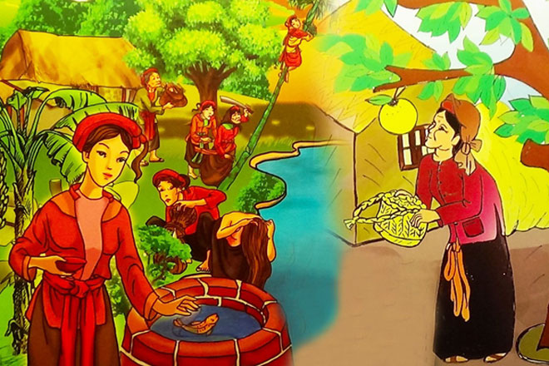

Slide 3

UNIT 6: FOLK TALES
Lesson 1: Getting started

Slide 5
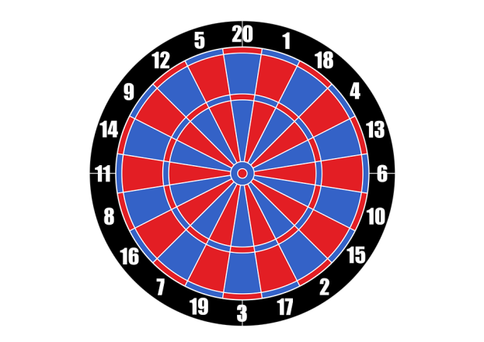
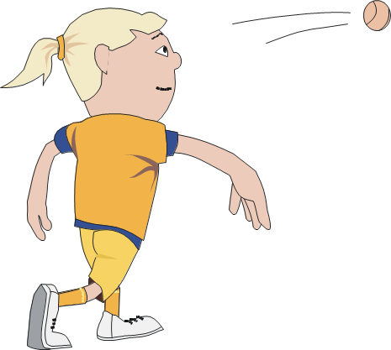
Game: Throw the ball

Slide 6
CHOOSE THE CORRECT ANSWER
What was Duong doing at 9 p.m last night?
He was coming to Nick’s house.
He was phoning Nick.
He was talking to Nick.

Slide 7
CHOOSE THE CORRECT ANSWER
2. What was Nick doing at 9 p.m last night?
He was watching a TV show.
He was talking about his project.
He was searching for information on the Web.

Slide 8
CHOOSE THE CORRECT ANSWER
3. What legend did Duong recommend to Nick?
A legend about how Viet Nam began.
A legend about Vietnamese people being original.
A legend that isn’t well-known.

Slide 9
CHOOSE THE CORRECT ANSWER
4. Who was Lac Long Quan?
A fairy
Au Co’s father
The dragon king of the ocean

Slide 10
CHOOSE THE CORRECT ANSWER
5. Where did Au Co take half of the sons?
To the mountains
To the sea
To Lac Long Quan’s land

Slide 11

COMPLETE THE TABLE
00:07
00:05
00:10
00:09
00:08
00:02
00:04
00:06
00:01
00:03
Time’s up!
WORD | DEFINITION | EXAMPLE
Title |  | Lac Long Quan and Au Co
Genre
Main characters
Plot |  | Lac Long Quan married Au Co
The content of the story
The content of the story
The name of the story
The people the story is about

Slide 12
EXCLAMATORY SENTENCES
What an interesting legend it is!
What awful weather!
What clever boys they are!

Slide 13

TALK SHOW
Our favourite story

Slide 14
HOMEWORK
Learn by heart vocabulary
Write your favourite story
Prepare for next lesson: A closer Look 1

Slide 15

THANK YOU
FOR YOUR ATTENTION!

