Slide 1

WELCOME TO
MY CLASS
Good afternoon Everybody

Slide 2

* WARM UP: BRAINSTORMING
The Crystal Pearl
FOLK TALES
The story of Tam and Cam
The Hundred-knot Bamboo Tree

Slide 3
Date
UNIT SIX
FOLK TALES
Period 44
GETTING STARTED
A SUGGESTION FOR NICK’S PROJECT

Slide 4
I. NEW WORDS
- A legend
: truyền thuyết
- A fable
: truyện dân gian, cổ tích
- A genre
: thể loại
- To give birth
: sinh ra
- To research on
: nghiên cứu về
- Origin (n)
: nguồn gốc

Slide 5
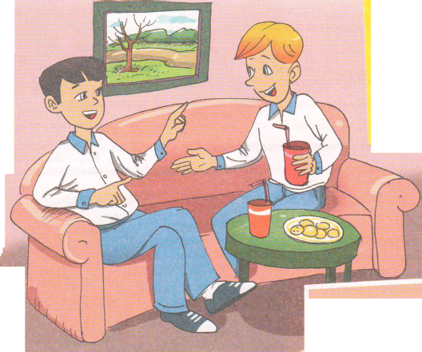
II. LISTEN AND READ
1. Where are Duong and Nick?
2. What are they doing?
3. What are they talking about?

Slide 6
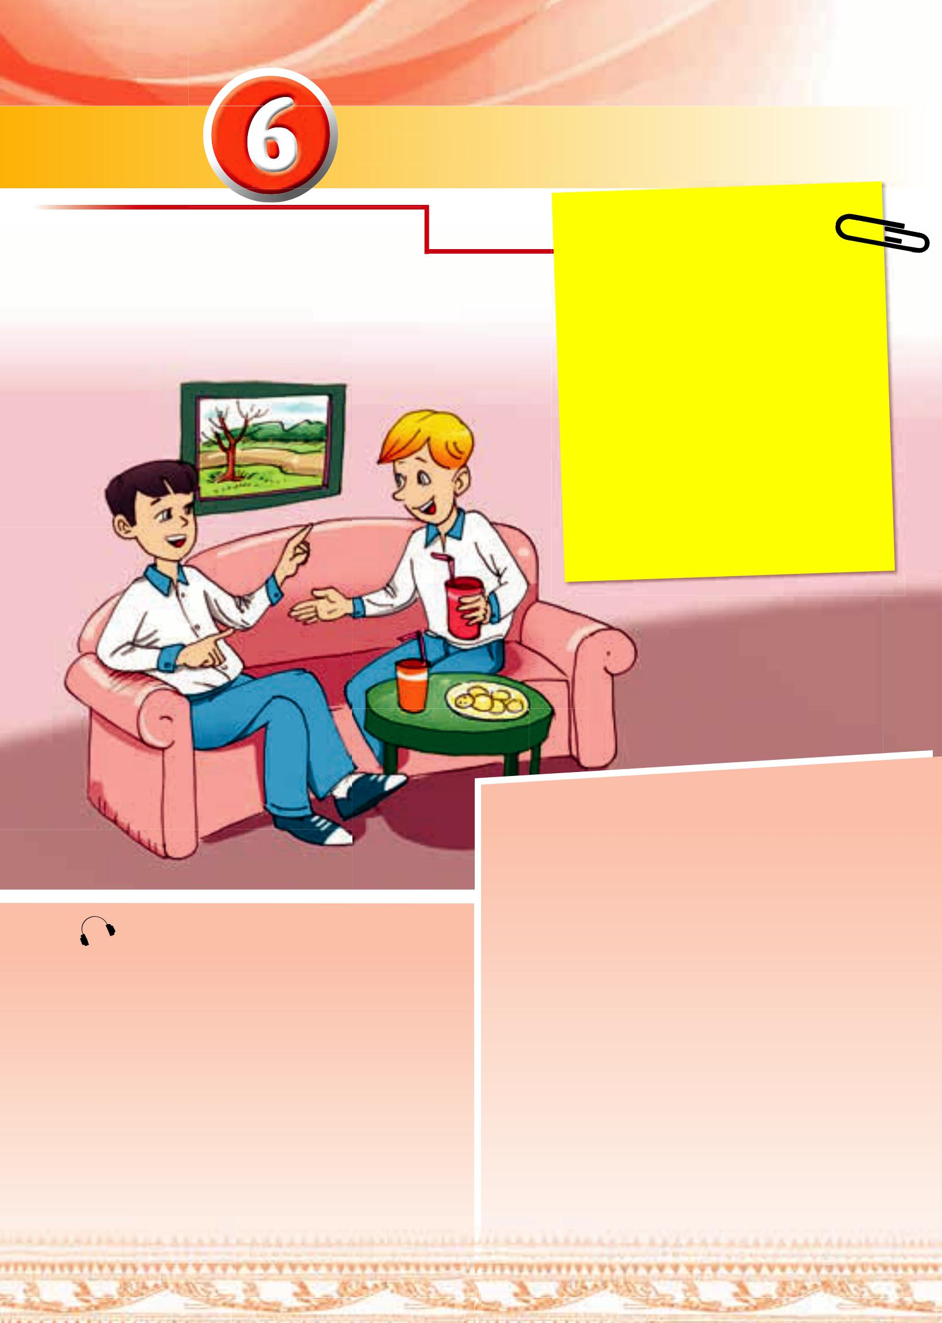
II. LISTEN AND READ
Duong: Well, it’s about the origins of the
Vietnamese people.
Nick: Who are the main characters?
Duong: Lac Long Quan – the dragon king
of the ocean, Au Co – a fairy, and
their sons.
Nick: And what’s the story?
Duong: Let me see… Lac Long Quan
married Au Co. She gave birth to
a bag of one hundred eggs, which
produced one hundred baby boys.
Nick: One hundred baby boys? That’s a lot.
Duong: And some years later, Lac Long
Quan missed the sea so he took
fifty of their sons to the sea, and Au
Co took the others to the mountains.
Those boys were the ancestors of the
Vietnamese.
Nick: What an interesting legend it is! I think
I’ve found the subject of my project!
Duong: I phoned you around 9 p.m.
last night, but no reply.
Nick: Oh, I was doing some
Internet research on
Vietnamese legends for my
project.
Duong: Have you found one you like
yet?
Nick: Not really. Can you suggest
anything?
Duong: We have lots of legends, folk
tales, and fables. A popular
one is the legend of Lac Long
Quan and Au Co.
Nick: Oh yeah? What’s it about?

Slide 7
II. LISTEN AND READ
Read the conversation again and choose the correct answers.
(Ex. a/ p. 59)

Slide 8




EX. a
/ P. 59
1. What was Duong doing at 9 p.m. last night?
A
WHAT A PITY !
He was coming to Nick’s house.
B
He was phoning Nick.
PERFECT
C
He was talking to Nick.
SORRY !

Slide 9
EX. a
/ P. 59
2. What was Nick doing at 9 p.m. last night?
A
He was watching a TV show.
WHAT A PITY !
He was talking about his project.
B
SORRY !
He was searching for information on the web.
C
PERFECT

Slide 10
EX. a
/ P. 59
3. What legend did Duong recommend to Nick?
A
SORRY !
A legend about how Viet Nam began.
A legend about Vietnamese people being original
B
Well - done
C
A legend that isn’t well - kno
WHAT A PITY !

Slide 11
EX. a
/ P. 59
4. Who was Lac Long Quan?
A
A fairy
WHAT A PITY !
Au Co’s father
B
SORRY !
C
The dragon king of the ocean
Well - done

Slide 12
EX. a
/ P. 59
5. Where did Au Co take half of the sons?
A
To the mountains
PERFECT
B
To the sea
WHAT A PITY !
C
To Lac Long Quan’s land
SORRY !

Slide 13

2. Match the words to their meanings. (Ex. b/ p. 59)
1. title
2. Genre
3. main characters
4. plot
the people the story is about
b. the content of the story
the name of the story
d. the type of story it is
1. c
2. d
3. a
4. b

Slide 14
3. Find the information in the conversation to complete the table. (Ex. a/ p. 7)
Title | Lac Long Quan and Au Co
Genre
Main characters
Plot | Lac Long Quan married Au Co.
Legend
Lac Long Quan, Au Co and their sons
Au Co gave birth to one hundred baby boys.
Lac Long Quan missed the sea.
Lac Long Quan took 50 their sons to the sea.
Au Co took the others to the mountains.

Slide 15

4. What does this sentence from the conversation express? (Ex. d/ p. 59)
It’s an exclamatory sentence
Nick: What an interesting legend it is!
REMEMBER!
Exclamatory sentences are used to express surprise or strong feelings. We use what in exclamatory sentences:
What + a / an + adjective + N (singular countable) + S + V!
Example: What a naughty boy he is!
What + adjective + N (uncountable/ plural countable) + S + V!
Example: - What naughty boys they are!
- What beautiful weather it is!
We don’t always use an adjective or a subject and a verb in exclamatory sentences.
Example: What a day!

Slide 16

II. PRACTICE
1. Match the words with their definitions. Then listen, check and repeat. (Ex. 2/ p. 59)
A
LEGEND
1. traditional, imaginary short story that legend teaches a moral lesson; typically using animal characters.
B
FOLK TALE
2. an imaginary story typically involving magic or fairies, usually for children.
C
FABLE
3. a very old, traditional story from a particular place that was originally passed on to people in a spoken form.
D
FAIRY TALE
4. an ancient story about brave people or fairy tale magical events that are probably not true.

Slide 17
2. GAME: GUESS THE STORY. (Ex. 3/ p. 59)
* Work in pairs. Interview each other and try to guess the title of the story.
Example:
What kind of story is it?
It’s a fairy tale.
Who are the main characters?
Cinderella, her stepsisters, her stepmother, and a prince.
What’s it about?
It’s about Cinderella, a kind and beautiful girl who finally gets
married to a prince.
Is it Cinderella?
Yes!

Slide 18
III. AT HOME
Learn by heart new words and structures.
Do Ex. 3a in your notebooks.
Be ready for A CLOSER LOOK 1.

Slide 19




The bye bye song
Bye, bye.
See you tomorrow.
Bye, bye.
See you tomorrow.
Bye, bye.
See you tomorrow.
Bye, bye. Bye, bye.
The bye bye
song
Notes:
19

