Slide 1


Thursday, January 27th, 2022
Unit 7: TRAFFIC
Period 59- Lesson 5: SKILLS 1
Class: 7A2

Slide 2

OBJECTIVES:
-Reading for specific information
about traffic rules.
- Speaking about traffic rules about road safety ( guide SS to do at home)

Slide 3
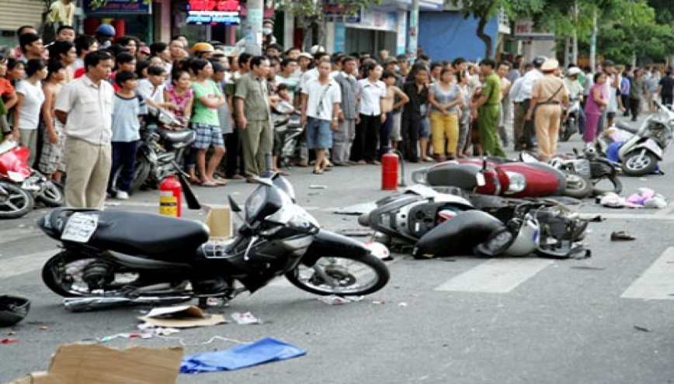
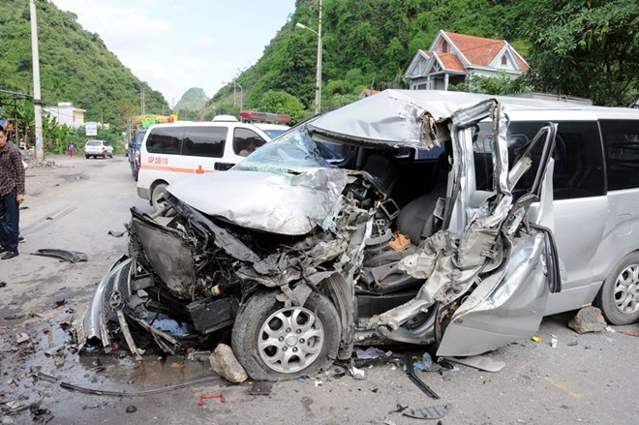
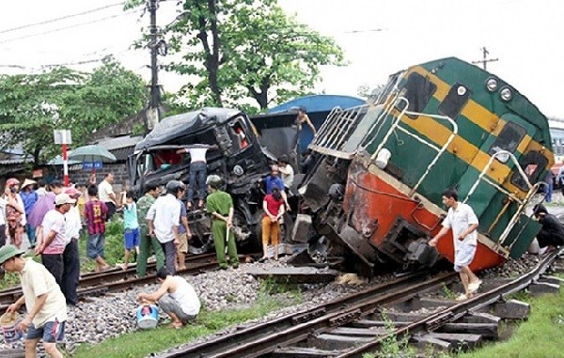
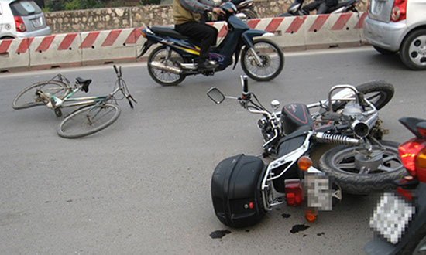

Slide 4


GAME:
Look at the pictures. Say what we should/shouldn’t do
* We should
* We shouldn’t
“When we use the roads, we should OR shouldn’t ……….”

Slide 5
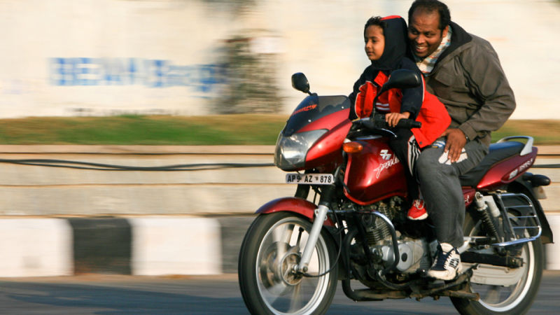
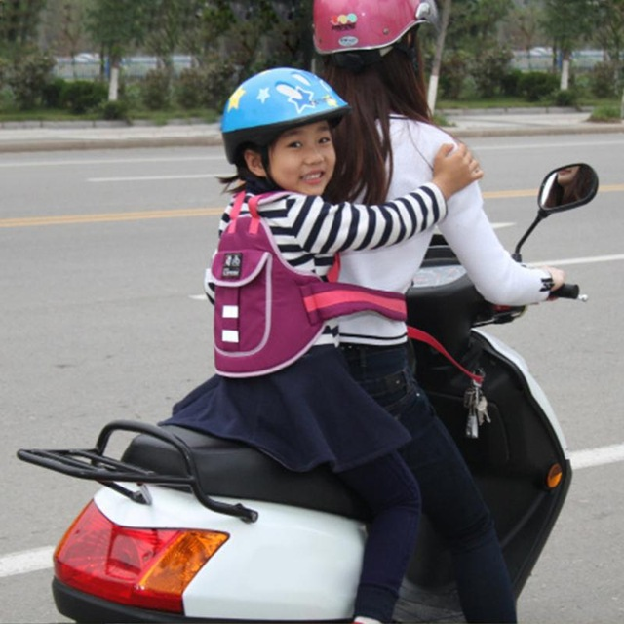
When you take your children to school , what should you do/ not do?

Slide 6
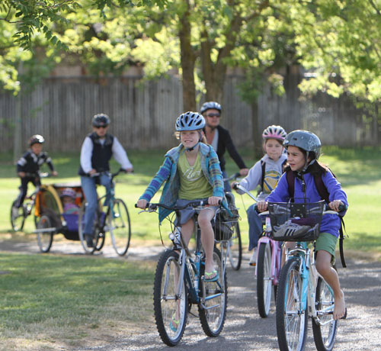
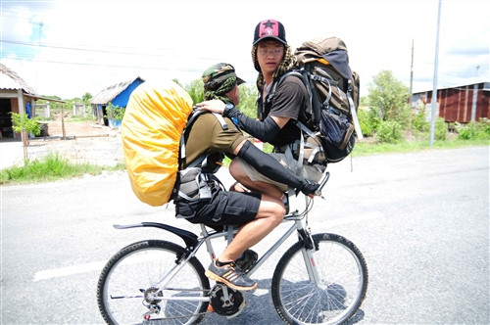
When you are a road user, you should OR shouldn’t

Slide 7
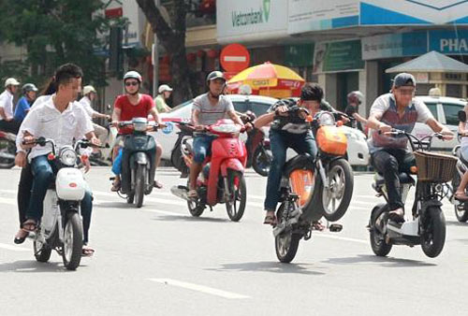
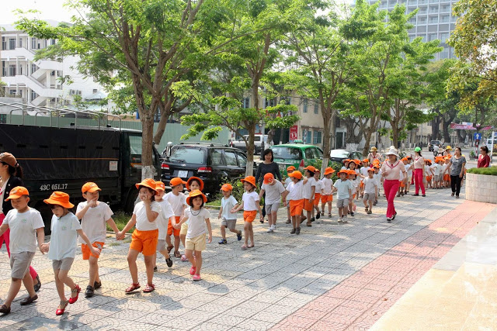
When you are a road user, you should OR shouldn’t

Slide 8
I. READING:
ROAD SAFETY
1. New words:

Slide 9

Thursday, January 27th, 2022 Unit 7: Traffic Period 59- Lesson 5: Skills 1 ( p.12)
New words:

Slide 10
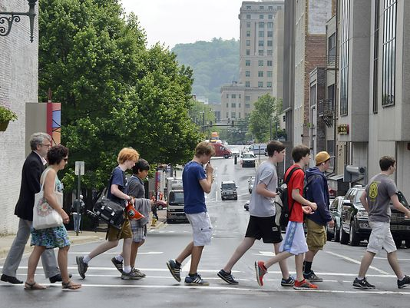


pedestrian (n) /pəˈdestriən/: người đi bộ

Slide 11
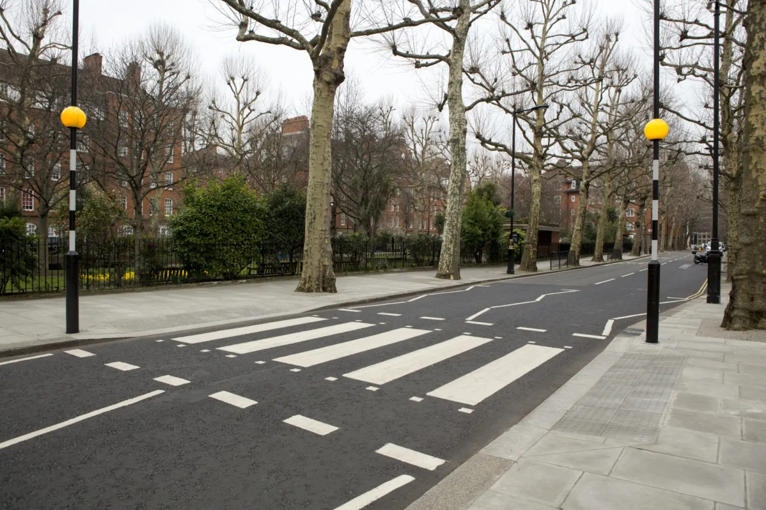

zebra crossing (n) /ˌziːbrə ˈkrɒsɪŋ/: vạch qua đường dành cho người đi bộ

Slide 12
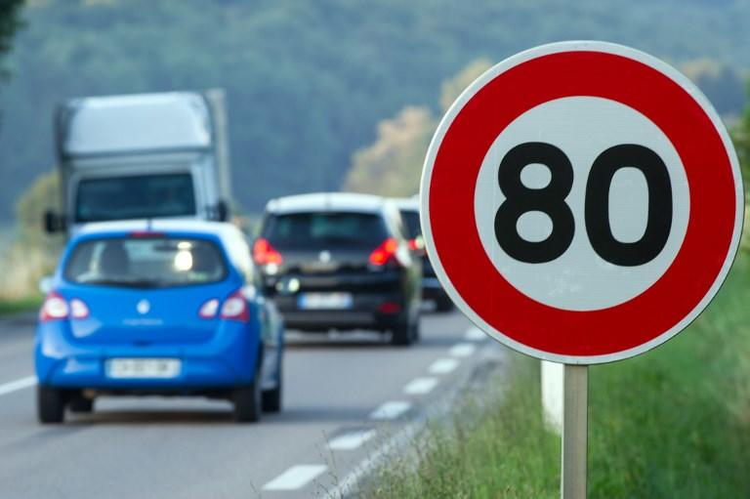
speed limit (n) /ˈspiːd lɪmɪt/: giới hạn tốc độ

Slide 13
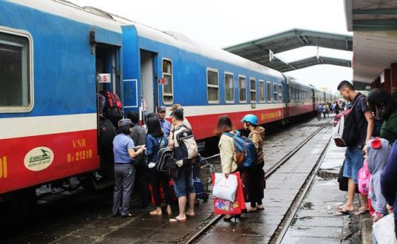
passenger (n) /ˈpæsɪndʒə(r)/ : hành khách

Slide 14
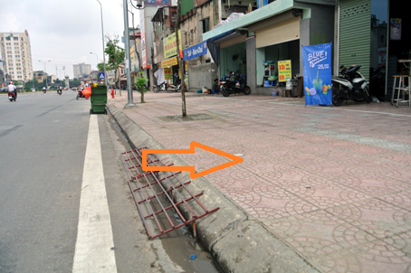
pavement (n) /ˈpeɪvmənt/ vỉa hè
=sidewalk/ footpath

Slide 15
Thursday, January 27th, 2022 Unit 7: Traffic Period 59- Lesson 5: Skills 1 ( p.12)
New words:
pedestrian (n) /pəˈdestriən/ : người đi bộ
zebra crossing (n) /ˌziːbrə ˈkrɒsɪŋ/: vạch qua đường dành cho người đi bộ
speed limit (n) /ˈspiːd lɪmɪt/: giới hạn tốc độ
passenger (n) /ˈpæsɪndʒə(r)/ : hành khách
pavement (n) /ˈpeɪvmənt/ vỉa hè

Slide 21
ROAD SAFETY

Slide 22
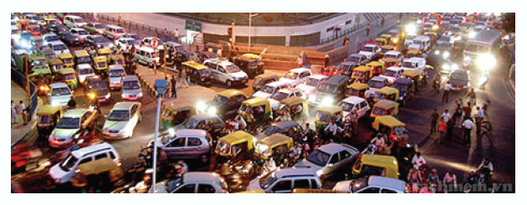
Ex 1: Look at the picture. Can you see anything that is dangerous?

Slide 23
Thursday, January 27th, 2022 Unit 7: Traffic Period 59- Lesson 5: Skills 1 ( p.12)
I. New words:
pedestrian (n) /pəˈdestriən/ : người đi bộ
zebra crossing (n) /ˌziːbrə ˈkrɒsɪŋ/: vạch qua đường dành cho người đi bộ
speed limit (n) /ˈspiːd lɪmɪt/: giới hạn tốc độ
passenger (n) /ˈpæsɪndʒə(r)/ : hành khách
pavement (n) /ˈpeɪvmənt/ : vỉa hè
II. Reading
Ex 1: Look at the picture. Can you see anything dangerous?

Slide 24
Thursday, January 27th, 2022 Unit 7: Traffic Period 59- Lesson 5: Skills 1 ( p.12)
I. New words:
pedestrian (n) /pəˈdestriən/ : người đi bộ
zebra crossing (n) /ˌziːbrə ˈkrɒsɪŋ/: vạch qua đường dành cho người đi bộ
speed limit (n) /ˈspiːd lɪmɪt/: giới hạn tốc độ
passenger (n) /ˈpæsɪndʒə(r)/ : hành khách
pavement (n) /ˈpeɪvmənt/ : vỉa hè
II. Reading
Ex 1: Look at the picture. Can you see anything dangerous?
Ex 2: Matching
Ex 3: Read and answer

Slide 25
Ex 2: Now match the words to make common expressions
1. traffic
2. zebra
3. road
4. driving
5. speed
6. railway
7. train
8. means
a. limit
b. users
c. license
d. crossing
e. of transport
f. ticket
g. jam
h. station

Slide 26

Ex 3: Work in groups (break out 4 rooms) Answer the question:
When you are a road user, what you should NOT do?

Slide 27
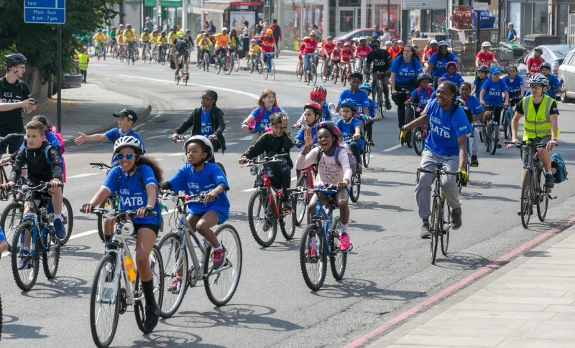
When you are a road user, what you should NOT do?
Eg: We shouldn’t wave our hand when riding a bike.

Slide 28
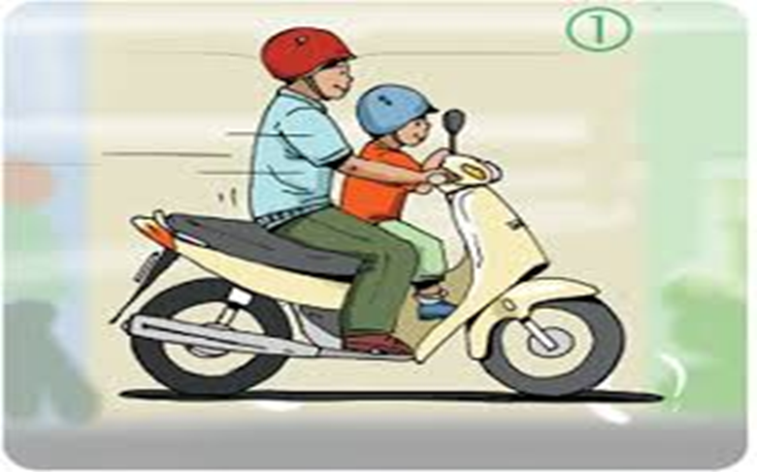
When you are a road user, what you should NOT do?
Eg: We shouldn’t sit in front of the driver when going by motorbike.

Slide 29
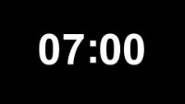
4. Read and answer the questions
1. Where should you cross the street?
2. What must one always do when he /she drive?
3. Should we drive after drinking alcohol?
4. What must you do before turning left or right while driving or
riding a motorbike?
5. Who should wear light-coloured clothes in the dark?
6. Should a cyclist or a motorist carry a passenger in front of him/her?
7. What must a motorist always do when they ride a motorbike?
8. What must a pedestrian do before he/she crosses the street?

Slide 30
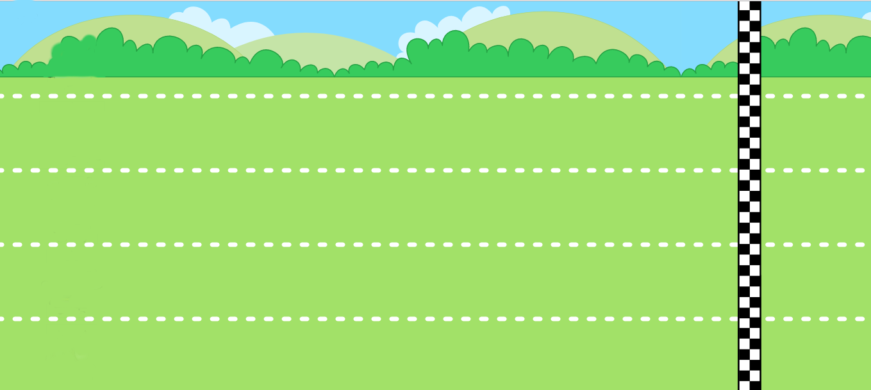

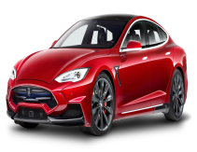
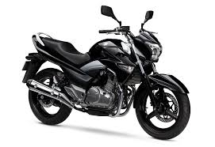
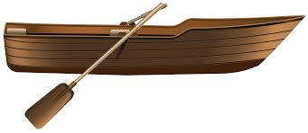
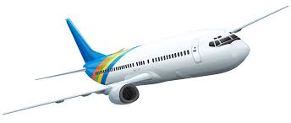
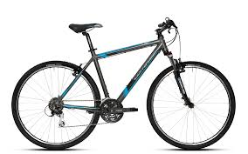
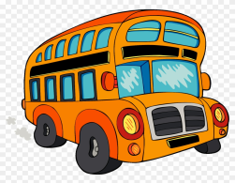
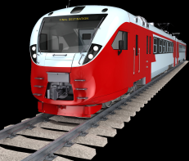
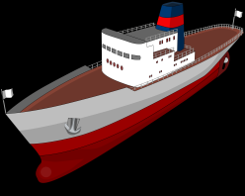

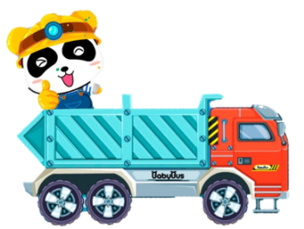
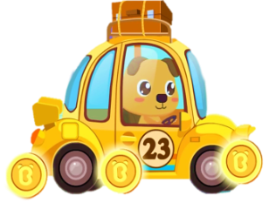
1
2
3
4
5
6
7
8
CONGRATULATION!
CONGRATULATION!
CONGRATULATION!
1
2

Slide 31
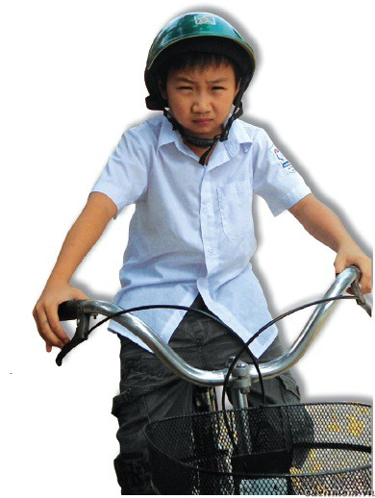

5. In pairs, ask and answer
1.Hoang is riding a bike, and he is wearing a helmet.
* Model sentences:
A: Do you think …………………….. safely or dangerously?
B: …………(Safely/ Dangerously)
A: Why?
B: Because …………………..
A: You’re right.

Slide 32
5. In pairs, ask and answer who is using the road SAFELY, and who is acting DANGEROUSLY. Give reasons. Write the dialogue into your notebook.
* Model sentences:
A: Do you think …………………….. safely or dangerously?
B: ………………….
A: Why?
B: Because ………………………………….
A: You’re right.

Slide 33
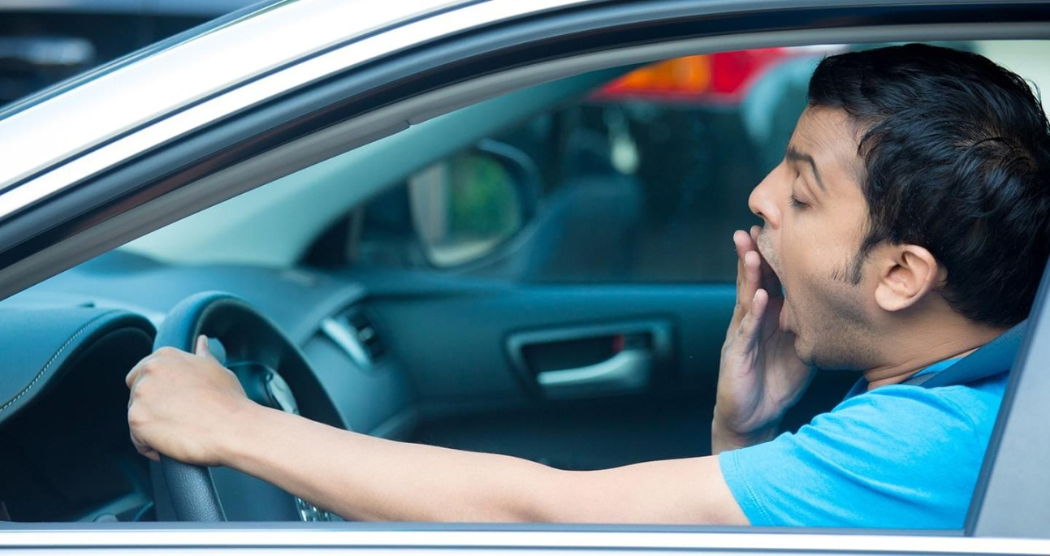
Eg: It’s dangerous because he is likely to have an accident.

Slide 34
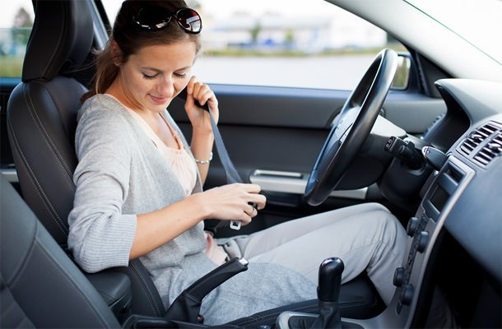
She is driving safely because the seatbelt can prevent her from being injured or killed in car accidents.

Slide 35
Remember
ROAD SAFETY IS HAPPINESS FOR EVERYBODY, FOR YOU AND FOR ME

Slide 36

Wrap up
Some new words about the topic: “ Traffic”
Eg: Pavement, zebra crossing, speed limit, …
- Practice reading about traffic safety on the road

Slide 37
Thursday, January 27th, 2022 Unit 7: Traffic Period 59- Lesson 5: Skills 1 ( p.12)
New words:
pedestrian (n) /pəˈdestriən/ : người đi bộ
zebra crossing (n) /ˌziːbrə ˈkrɒsɪŋ/: vạch qua đường dành cho người đi bộ
speed limit (n) /ˈspiːd lɪmɪt/: giới hạn tốc độ
passenger (n) /ˈpæsɪndʒə(r)/ : hành khách
pavement (n) /ˈpeɪvmənt/ : vỉa hè
II. Reading
Ex 1: Look at the picture. Can you see anything dangerous?
Ex 2: Matching
Ex 3: Read and answer
III. Speaking: do at home
IV. Homework:
Write new words ( 2 lines/ 1 word)
Do ex D1,2 p. 8- workbook
Prepare Unit 7: Skills 2

Slide 38
THANKS FOR YOUR ATTENTION!
Goodbye!
See you again!

