Slide 1
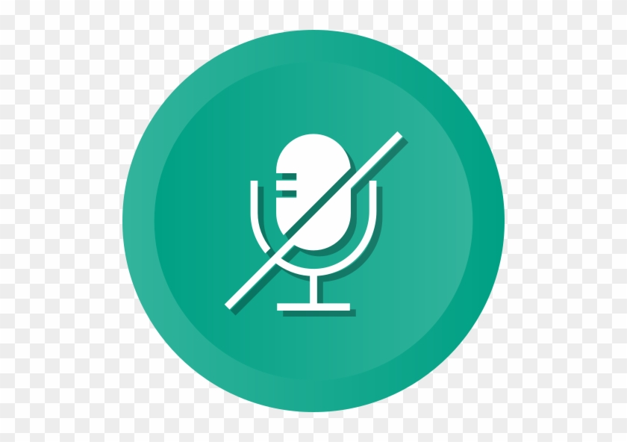
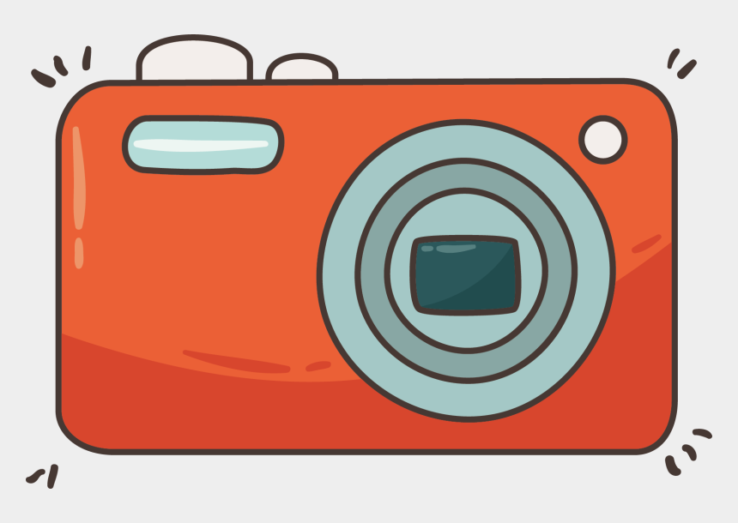

Good afternoon!
WELCOME TO
8A1
Turn off your microphone
Turn on your camera
Raise your hand

Slide 2
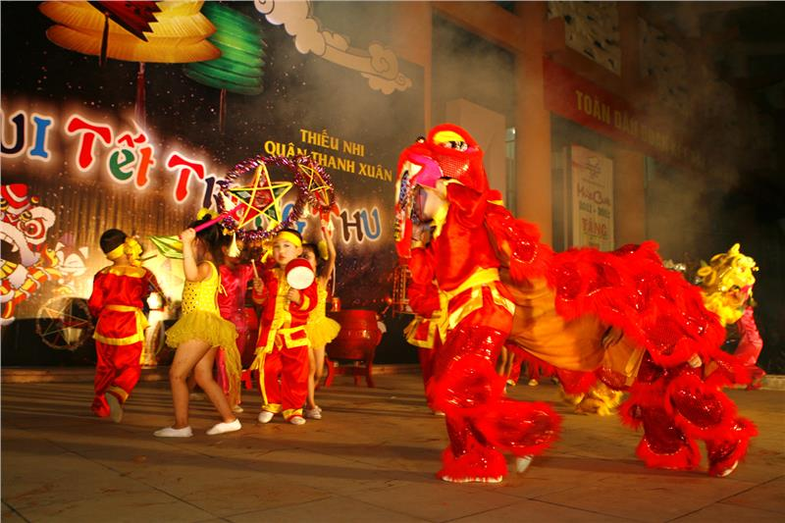
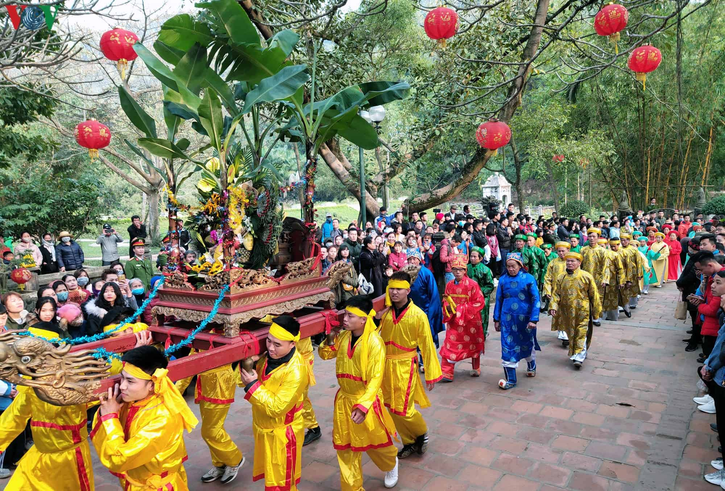
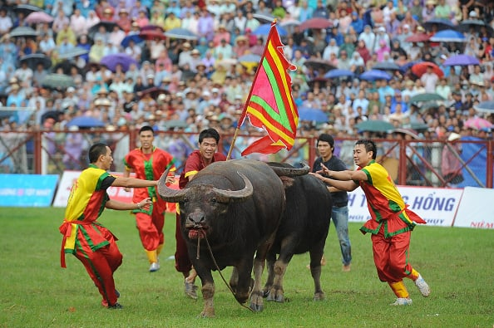
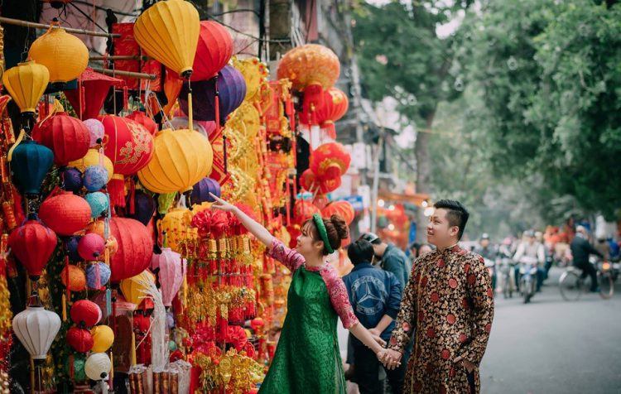
Thursday, December 9th ,2021
Period 40-Unit 5: Festivals in Vietnam
Lesson 5: Skills 1

Slide 3
Objectives
- Vocabulary about Festivals in Vietnam
- Read about festivals in Viet Nam.
-Explain your decision about your favorite place to go.

Slide 4
Thursday, December 9th, 2021
Period 40-Unit 5: Festivals in Vietnam
Lesson 5: Skills 1
*Discussion

Slide 5
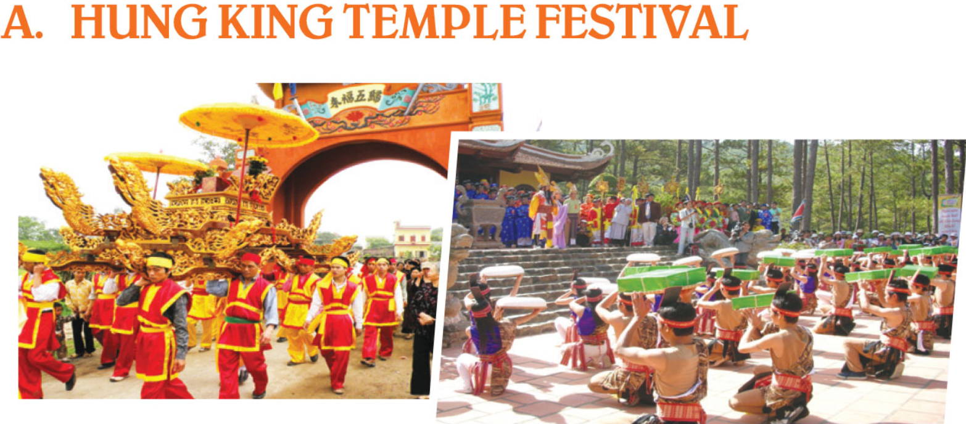
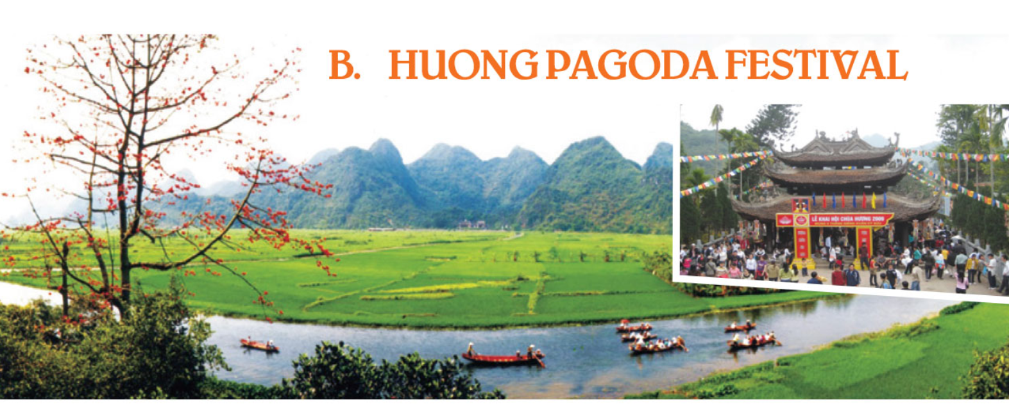

Group 1+2
Discussion!
2’
Group 3+4
1. What are people doing in the picture?
2. Who do they worship at the festival?

Slide 6
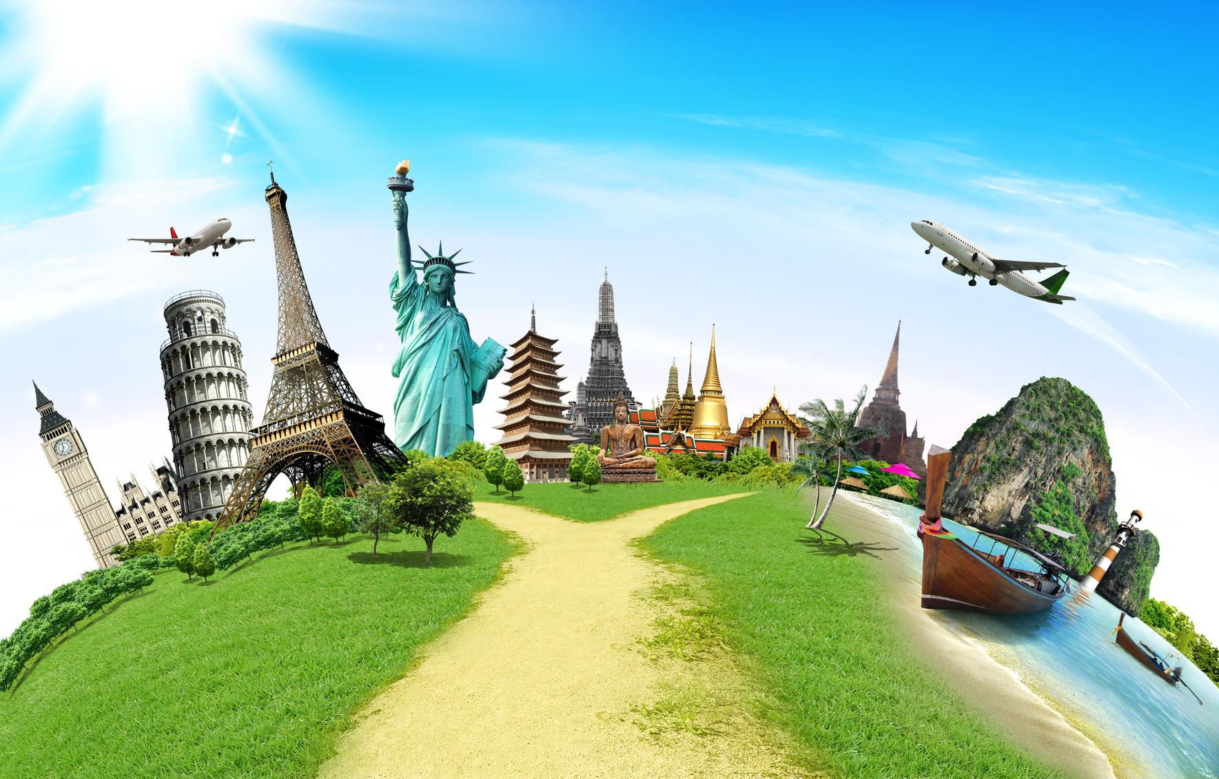
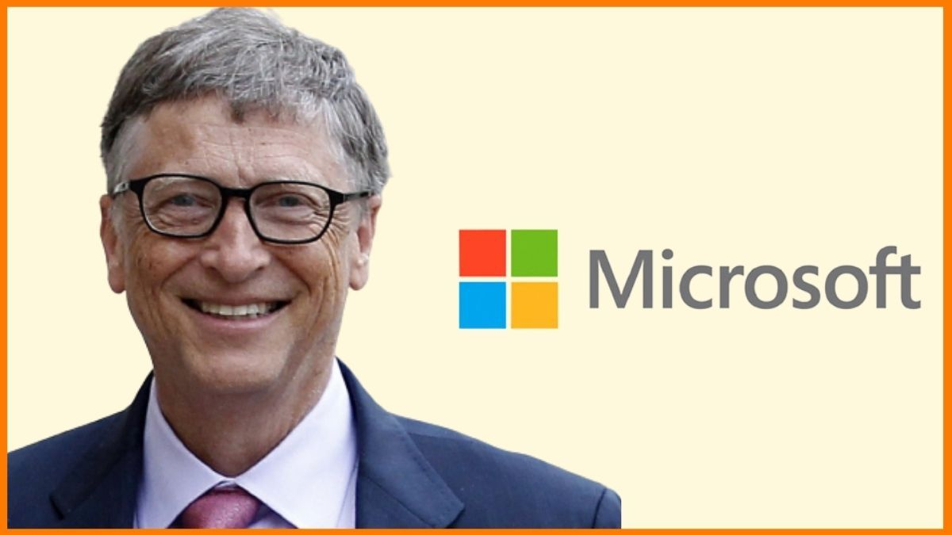
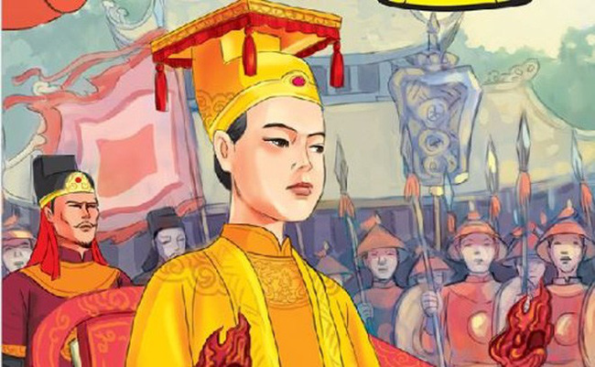
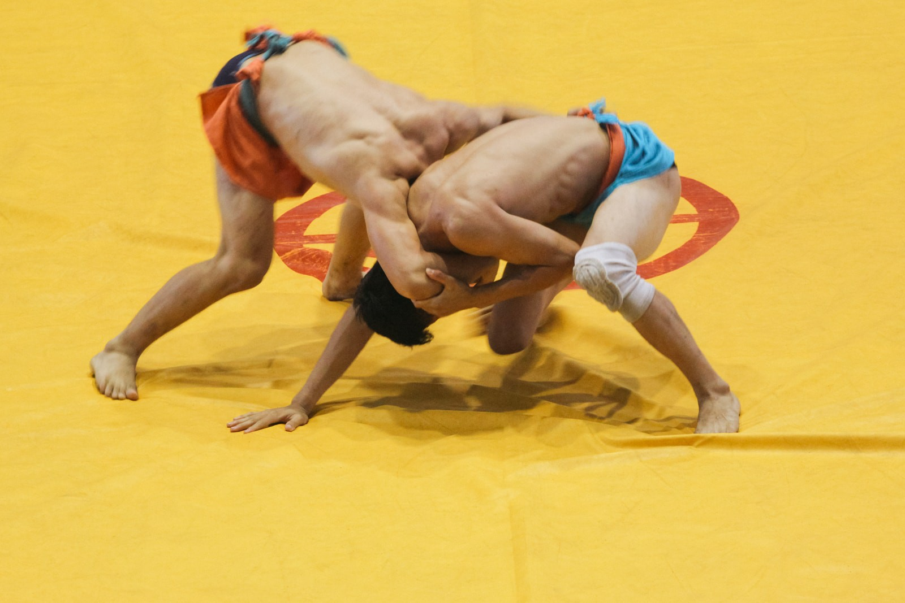
Thursday, December 9th, 2021
Period 40-Unit 5: Festivals in Vietnam
Lesson 5: Skills 1
*Discussion
New words
-take place /teik/ /pleis/ (v) : diễn ra
-overseas /¸ouvə´si:/ (n) :
nước ngoài.
-founder /ˈfaʊndər/ (n) :
người sáng lập
-emperor /´empərə/ (n):
vua
-wrestling /´resliη/ (n) :
đấu vật

Slide 7
Thursday, December 9th, 2021
Period 40-Unit 5: Festivals in Vietnam
Lesson 5: Skills 1
*Discussion
New words
-take place /teik/ /pleis/ (v) : diễn ra
-overseas /¸ouvə´si:/ (n) :
nước ngoài.
-founder /ˈfaʊndər/ (n) :
người sáng lập
-emperor /´empərə/ (n):
vua
-wrestling /´resliη/ (n) :
đấu vật
Reading
1. Read and check your ideas

Slide 8
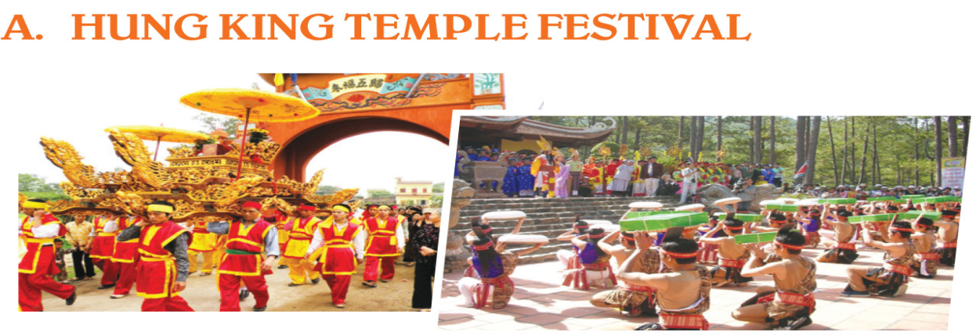
1. Read and check your ideas
A. The Hung King Temple Festival takes place from the 8th to the 11th day of the third lunar month in Phu Tho. This festival is held to worship the Hung Kings who are the founders and also the first emperors of the nation. The festival features a procession from the foot of the Nghia Linh mountain to the High Temple on top of the mountain. Here, there is a ceremony of offering incense and specialties such as Chung cakes, day cakes and five-fruit trays to the Kings. Moreover, there are also many joyful activities including bamboo swings, lion dances, wrestling
and Xoan singing performances.

Slide 9
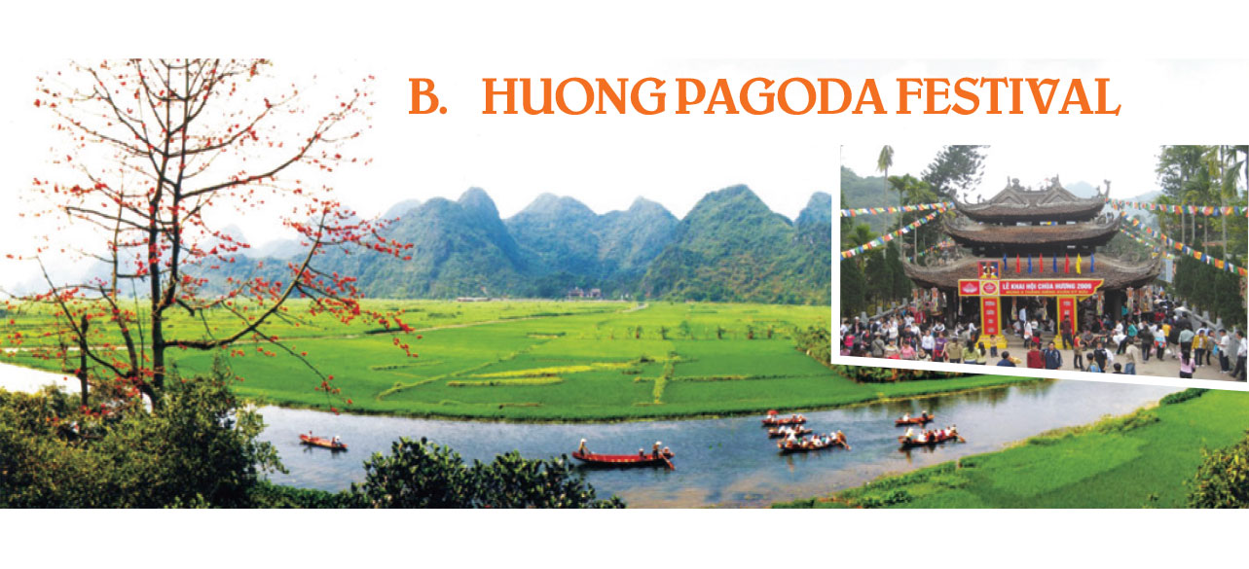
1. Read and check your ideas
B. This Buddhist Festival is held annually and lasts for three months from the first to the third lunar month. During the festival, visitors come from all over the country and from overseas to join the procession and make offerings of incense, flowers, fruit and candles to worship Buddha at the pagoda. In addition to the ceremonies, people enjoy activities at this festival such as hiking in the mountains, exploring caves and taking photos of the beautiful scenery.

Slide 10
Thursday, December 9th, 2021
Period 40-Unit 5: Festivals in Vietnam
Lesson 5: Skills 1
*Discussion
New words
-take place /teik/ /pleis/ (v) : diễn ra
-overseas /¸ouvə´si:/ (n) :
nước ngoài.
-founder /ˈfaʊndər/ (n) :
người sáng lập
-emperor /´empərə/ (n):
vua
-wrestling /´resliη/ (n) :
đấu vật
Reading
Read and check your ideas
Hung Temple Festival worships
Huong Festival worships
Hung Kings
Buddha

Slide 11
Thursday, December 9th, 2021
Period 40-Unit 5: Festivals in Vietnam
Lesson 5: Skills 1
*Discussion
New words
Find words/phrases in the passages
that have similar meaning to these words
or phrases
-take place /teik/ /pleis/ (v) : diễn ra
-overseas /¸ouvə´si:/ (n) :
nước ngoài.
-founder /ˈfaʊndər/ (n) :
người sáng lập
-emperor /´empərə/ (n):
vua
-wrestling /´resliη/ (n) :
đấu vật
Reading
Read and check your ideas
Hung Temple Festival worships Hung Kings
Huong Festival worships Buddha

Slide 12
Find words/phrases in the passages that have similar meaning to
these words or phrases
1. kings
2. includes as an important part of something
3. interesting, full of fun
4. from abroad
5. going for a long walk
6. natural surroundings
emperors
features
joyful
from overseas
hiking
scenery

Slide 13
Thursday, December 9th, 2021
Period 40-Unit 5: Festivals in Vietnam
Lesson 5: Skills 1
*Discussion
New words
Find words/phrases in the passages
that have similar meaning to these words
or phrases
-take place /teik/ /pleis/ (v) : diễn ra
1. Kings = emperors
-overseas /¸ouvə´si:/ (n) :
nước ngoài.
2. includes as an important part of something
= features
-founder /ˈfaʊndər/ (n) :
người sáng lập
-emperor /´empərə/ (n):
vua
3. interesting, full of fun= joyful
-wrestling /´resliη/ (n) :
4. from abroad = overseas
đấu vật
Reading
Read and check your ideas
Hung Temple Festival worships Hung Kings
Huong Festival worships Buddha
5. going for a long walk = hiking
6. natural surroundings = scenery

Slide 14
Thursday, December 9th, 2021
Period 40-Unit 5: Festivals in Vietnam
Lesson 5: Skills 1
*Discussion
New words
Find words/phrases in the passages
that have similar meaning to these words
or phrases
-take place /teik/ /pleis/ (v) : diễn ra
1. Kings = emperors
-overseas /¸ouvə´si:/ (n) :
nước ngoài.
2. includes as an important part of something
= features
-founder /ˈfaʊndər/ (n) :
người sáng lập
-emperor /´empərə/ (n):
vua
3. interesting, full of fun= joyful
-wrestling /´resliη/ (n) :
4. from abroad = overseas
đấu vật
Reading
Read and check your ideas
Hung Temple Festival worships Hung Kings
Huong Festival worships Buddha
5. going for a long walk = hiking
6. natural surroundings = scenery
3. Read again and answer the questions

Slide 15
3. Read again and answer the questions
When does the Hung King Temple Festival take place?
→
What is included in the offerings to the Hung Kings?
→
Why is it joyful to go to the Hung King Temple Festival?
→
What do people do to worship Buddha at the Huong Pagoda Festival?
→
Which of the activities at the Huong Pagoda Festival do you like most?
→
The Hung King Temple festival takes place from the 8th to the 11th day of
the third lunar month .

Slide 16
A. The Hung King Temple Festival takes place from the 8th to the 11th day of the third lunar month in Phu Tho. This festival is held to worship the Hung Kings who are the founders and also the first emperors of the nation. The festival features a procession from the foot of the Nghia Linh mountain to the High Temple on top of the mountain. Here, there is a ceremony of offering incense and specialties such as Chung cakes, day cakes and five-fruit trays to the Kings. Moreover, there are also many joyful activities including bamboo swings, lion dances, wrestling
and Xoan singing performances.

Slide 17
3. Read again and answer the questions
When does the Hung King Temple Festival take place?
→
What is included in the offerings to the Hung Kings?
→
Why is it joyful to go to the Hung King Temple Festival?
→
What do people do to worship Buddha at the Huong Pagoda Festival?
→
Which of the activities at the Huong Pagoda Festival do you like most?
→
The Hung King Temple festival takes place from the 8th to the 11th day of
the third lunar month .
Incense, specialties such as Chung cakes, day cakes and five-fruit trays.

Slide 18
A. The Hung King Temple Festival takes place from the 8th to the 11th day of the third lunar month in Phu Tho. This festival is held to worship the Hung Kings who are the founders and also the first emperors of the nation. The festival features a procession from the foot of the Nghia Linh mountain to the High Temple on top of the mountain. Here, there is a ceremony of offering incense and specialties such as Chung cakes, day cakes and five-fruit trays to the Kings. Moreover, there are also many joyful activities including bamboo swings, lion dances, wrestling
and Xoan singing performances.

Slide 19
3. Read again and answer the questions
When does the Hung King Temple Festival take place?
→
What is included in the offerings to the Hung Kings?
→
Why is it joyful to go to the Hung King Temple Festival?
→
What do people do to worship Buddha at the Huong Pagoda Festival?
→
Which of the activities at the Huong Pagoda Festival do you like most?
→
The Hung King Temple festival takes place from the 8th to the 11th day of
the third lunar month .
Incense, specialties such as Chung cakes, day cakes and five-fruit trays.
Because there are many joyful activities including bamboo swings, lion dances,
wrestling and Xoan singing performances

Slide 20
A. The Hung King Temple Festival takes place from the 8th to the 11th day of the third lunar month in Phu Tho. This festival is held to worship the Hung Kings who are the founders and also the first emperors of the nation. The festival features a procession from the foot of the Nghia Linh mountain to the High Temple on top of the mountain. Here, there is a ceremony of offering incense and specialties such as Chung cakes, day cakes and five-fruit trays to the Kings. Moreover, there are also many joyful activities including bamboo swings, lion dances, wrestling
and Xoan singing performances.

Slide 21
3. Read again and answer the questions
When does the Hung King Temple Festival take place?
→
What is included in the offerings to the Hung Kings?
→
Why is it joyful to go to the Hung King Temple Festival?
→
What do people do to worship Buddha at the Huong Pagoda Festival?
→
Which of the activities at the Huong Pagoda Festival do you like most?
→
The Hung King Temple festival takes place from the 8th to the 11th day of
the third lunar month .
Incense, specialties such as Chung cakes, day cakes and five-fruit trays.
Because there are many joyful activities including bamboo swings, lion dances,
wrestling and Xoan singing performances
People join the procession and make offerings of incense, flowers, fruit and candles

Slide 22
B. This Buddhist Festival is held annually and lasts for three months from the first to the third lunar month. During the festival, visitors come from all over the country and from overseas to join the procession and make offerings of incense, flowers, fruit and candles to worship Buddha at the pagoda. In addition to the ceremonies, people enjoy activities at this festival such as hiking in the mountains, exploring caves and taking photos of the beautiful scenery.

Slide 23
3. Read again and answer the questions
When does the Hung King Temple Festival take place?
→
What is included in the offerings to the Hung Kings?
→
Why is it joyful to go to the Hung King Temple Festival?
→
What do people do to worship Buddha at the Huong Pagoda Festival?
→
Which of the activities at the Huong Pagoda Festival do you like most?
→
The Hung King Temple festival takes place from the 8th to the 11th day of
the third lunar month .
Incense, specialties such as Chung cakes, day cakes and five-fruit trays.
Because there are many joyful activities including bamboo swings, lion dances,
wrestling and Xoan singing performances
People join the procession and make offerings of incense, flowers, fruit and candles

Slide 24
Thursday, December 9th, 2021
Period 40-Unit 5: Festivals in Vietnam
Lesson 5: Skills 1
*Discussion
New words
Find words/phrases in the passages
that have similar meaning to these words
or phrases
-take place /teik/ /pleis/ (v) : diễn ra
3. Read again and answer the questions
-overseas /¸ouvə´si:/ (n) :
nước ngoài.
III. Speaking – Guide to do at home
-founder /ˈfaʊndər/ (n) :
người sáng lập
-emperor /´empərə/ (n):
vua
-wrestling /´resliη/ (n) :
đấu vật
Reading
Read and check your ideas
Hung Temple Festival worships Hung Kings
Huong Festival worships Buddha

Slide 25
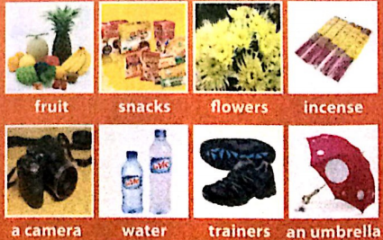
Speaking Guide
Which place do you prefer to go? Why ?
2. What things should you take with you ? Why?

Slide 26
Speaking Guide
I prefer to go Huong Pagoda because I really want to travel along Yen Steam by boat.
I think I will take a bottle of water because we’ll need it when we’re climbing the mountain.
I prefer to go ____________________ because ________________________
I think I will take _____________because __________________________

Slide 27
Wrap up
-take place (v) :
diễn ra
-overseas (n) :
nước ngoài.
Hung Temple Festival worships _________
Huong Festival worships___________
Hung Kings
-founder (n) :
người sáng lập
Buddha
-emperor (n):
vua
-wrestling (n) :
đấu vật
I prefer to go ____________________ because ________________________
I think I will take _____________because __________________________

Slide 28
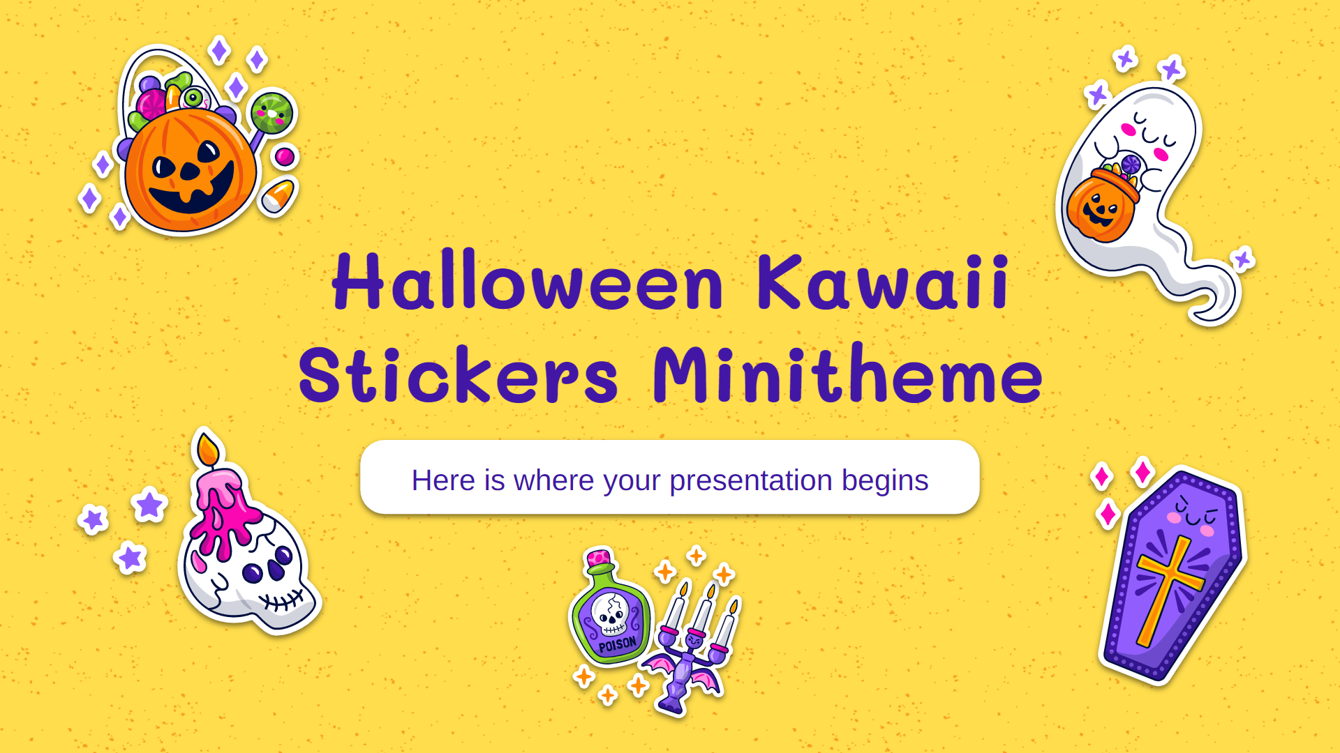
Homework
Learn by heart new words
Prepare Lesson 6: Skills 2
Make a recording of Speaking part

Slide 29
Thanks for your attention!

