Slide 1
Unit 4
When’s your birthday?
Lesson 1

Slide 2
Vocabulary

Slide 3
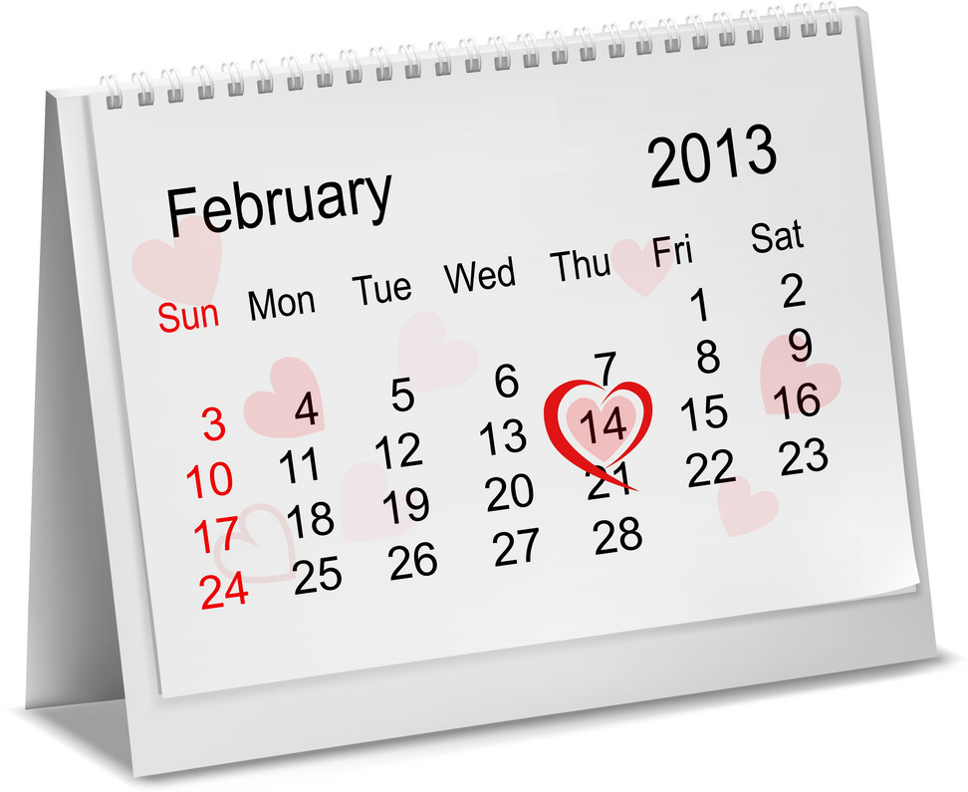
MsPham-9036082789
Calendar
Month
Year
Day
Week
Date

Slide 4
Dates of the month
first
second
third
fourth
1st
2nd
3rd
4th
fifth
sixth
seventh
5th
6th
7th

Slide 5
Dates of the month
eighth
nineth
tenth
8th
9th
10th
eleventh
twelveth
thirteenth
11th
12th
13th

Slide 6
Dates of the month
fourteenth
fifteenth
sixteenth
14th
15th
16th
seventeenth
eighteenth
nineteenth
17th
18th
19th

Slide 7
Dates of the month
twentieth
twenty-first
twenty-second
20th
21th
22th
twenty-third
twenty-fourth
twenty-fifth
23th
24th
25th

Slide 8
Dates of the month
twenty-sixth
twenty-seventh
twenty-eighth
26th
27th
28th
twenty-nineth
thirtieth
thirty-first
29th
30th
31st

Slide 9

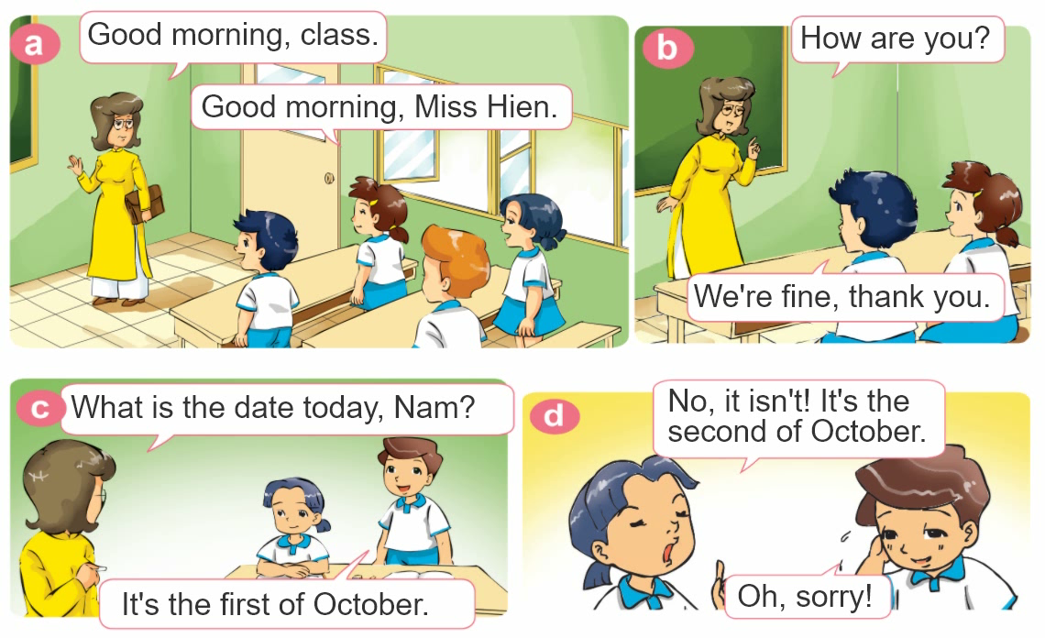
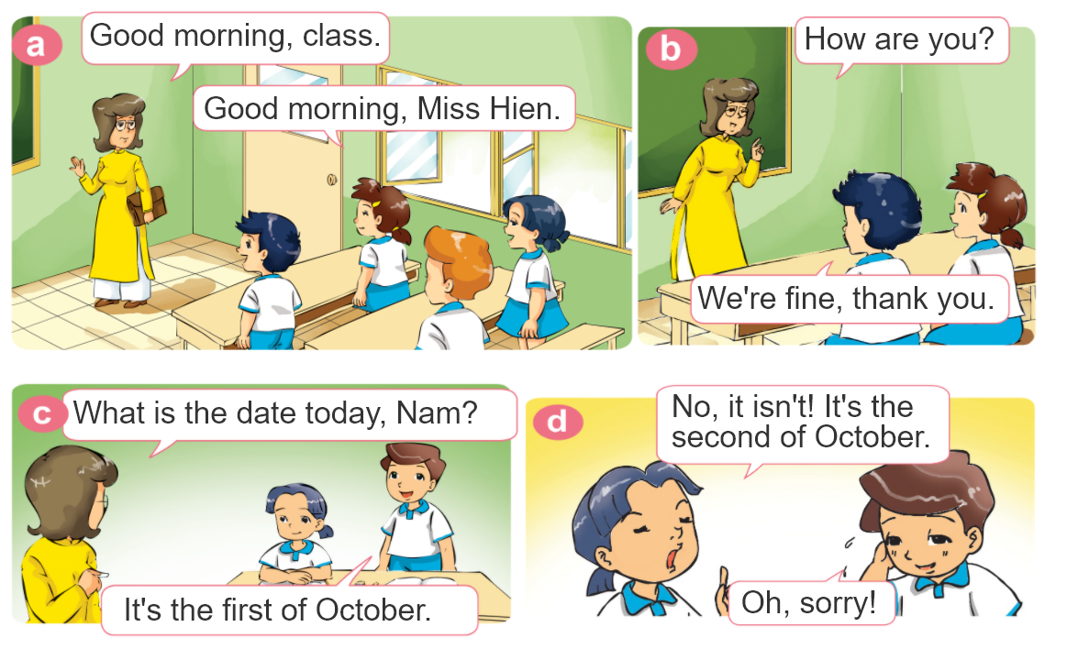
1. Look, listen and repeat.

Slide 10




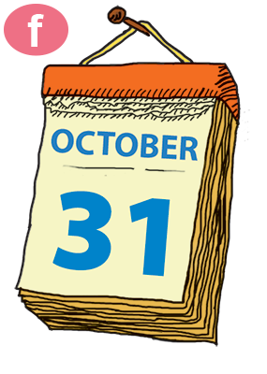
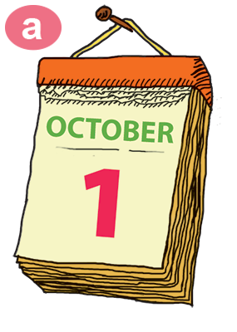
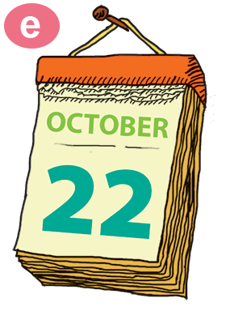
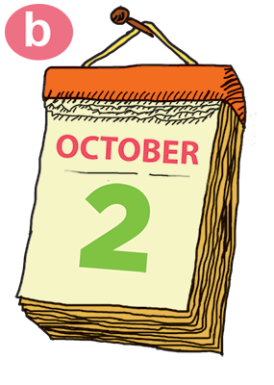
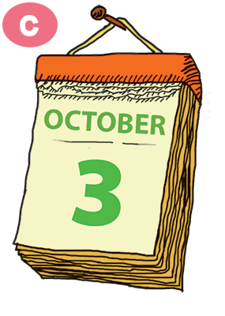
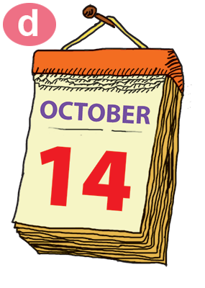
2. Point and say.
What is the date today?
It’s the ____ of _____.
thirty-first
first
twenty-second
second
third
fourteenth

Slide 11
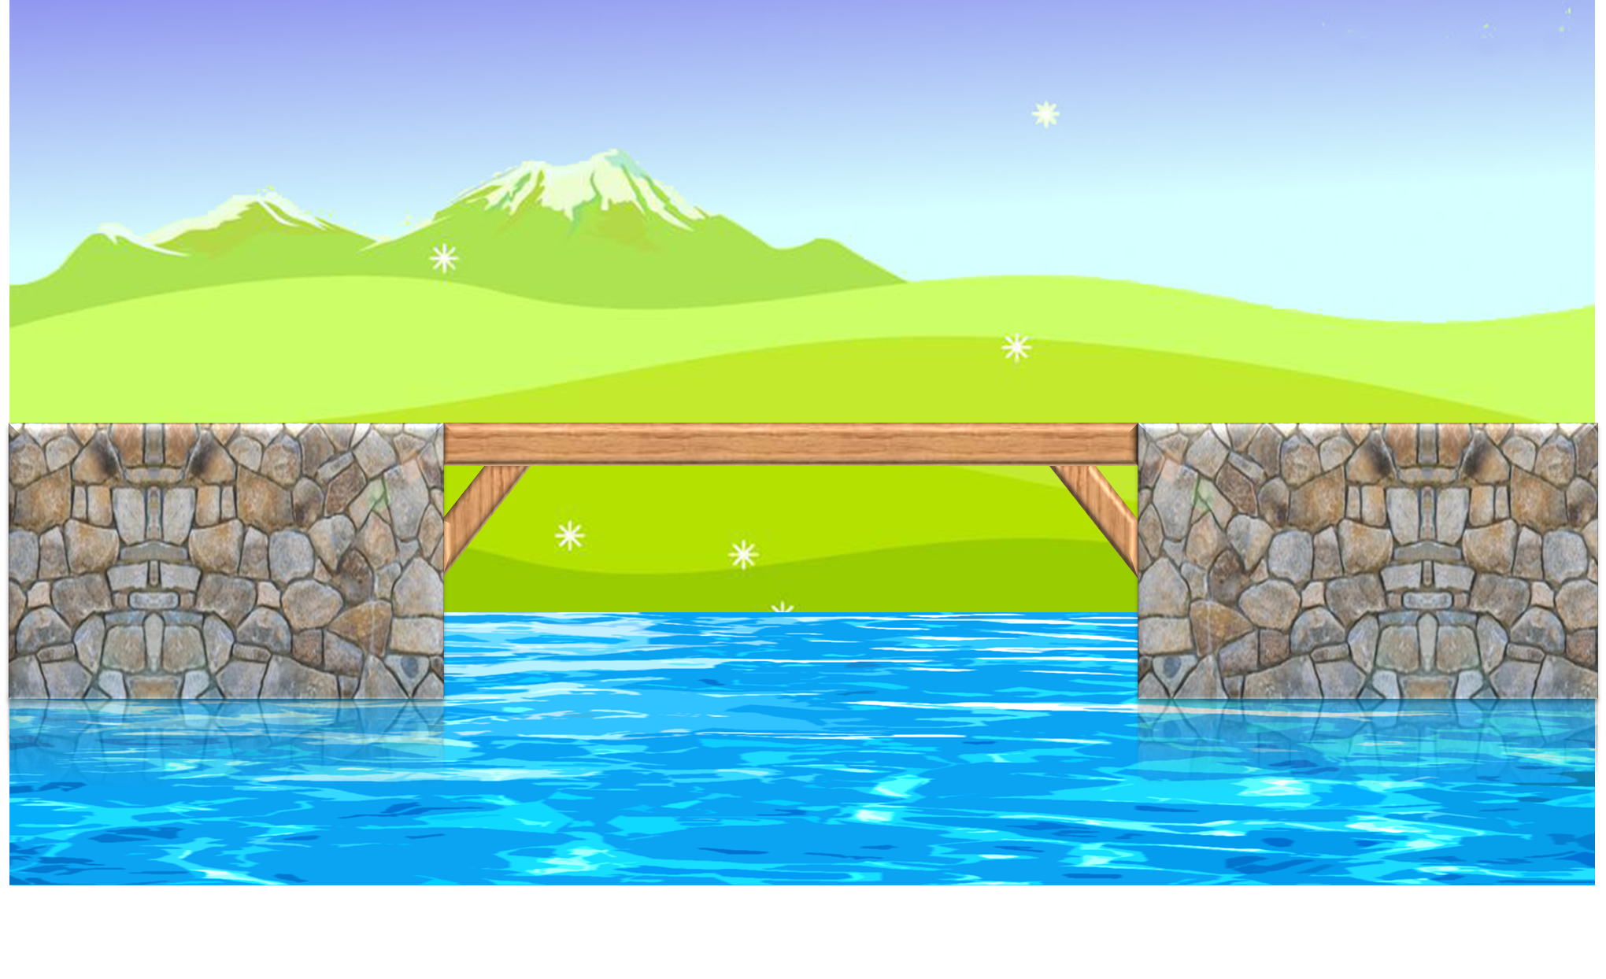
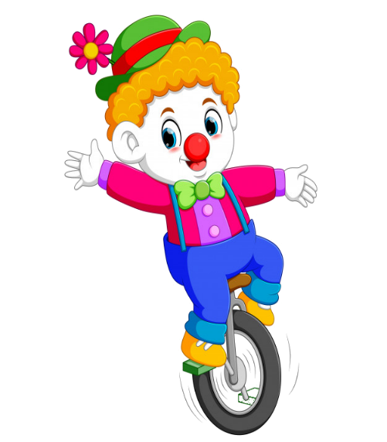
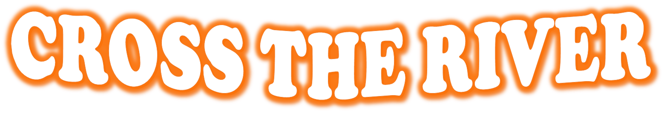
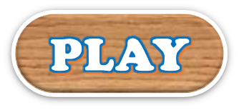

PLAY

Slide 12
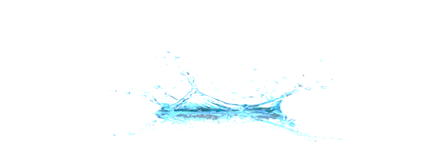


What is the date today?
It’s the second of October.
It’s the seconth of October.
It’s the twoth of October.
It’s second of October.

Slide 13
What is the date today?
It’s the twenty-two of October.
It’s the twentieth-one of October.
It’s the two-twoth of October.
It’s the twenty-second of October.

Slide 14
What is the date today?
It’s the ten-fourth of October.
It’s the fourteenth of October.
It’s the fourtieth of October.
It’s the fourteen of October.

Slide 15
What is the date today?
It’s the thirty-first of October.
It’s the thirty-one of October.
It’s the thirteen-first of October.
It’s the threety-one of October.

Slide 16
What is the date today?
It’s the oneth of October.
It’s the second of October.
It’s the third of October.
It’s the first of October.

Slide 17
What is the date today?
It’s the thirth of October.
It’s the threeth of October.
It’s the third of October.
It’s third of October.

Slide 18
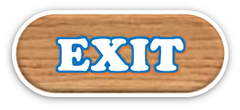
End

Slide 19

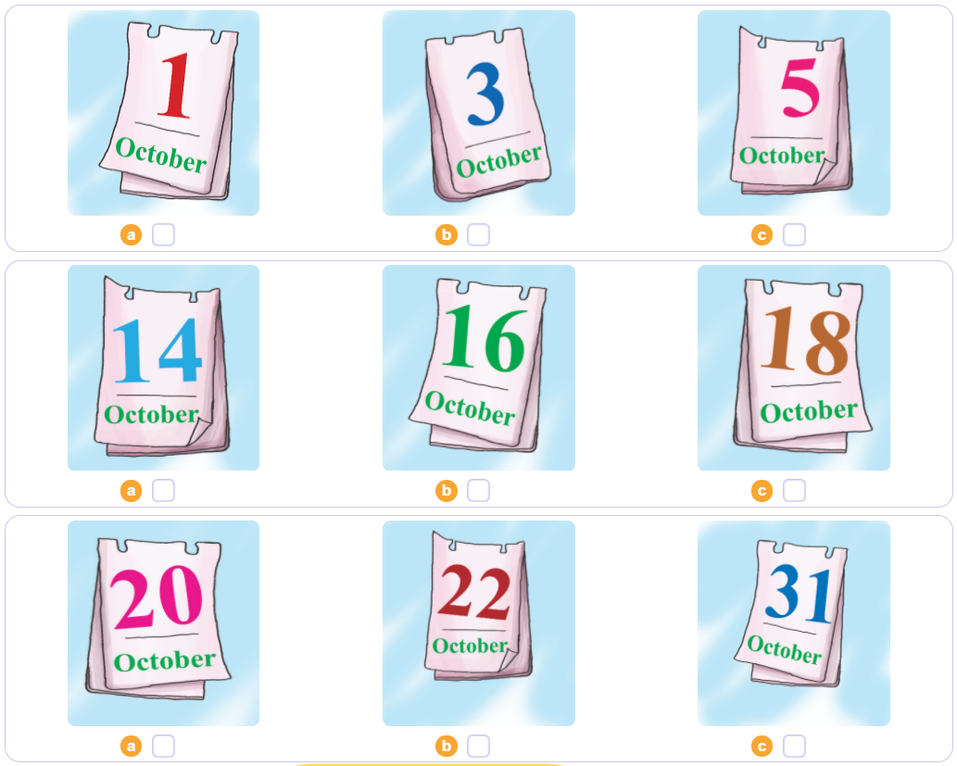

3. Listen and tick.
1
2
3

Slide 20

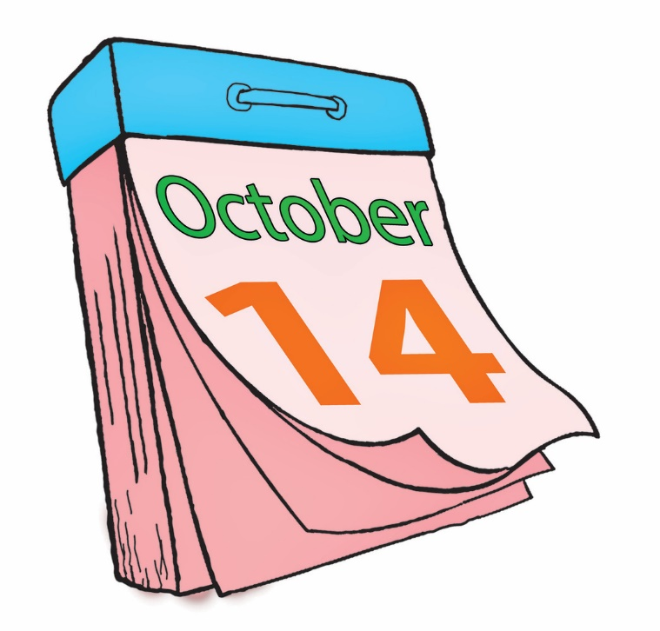
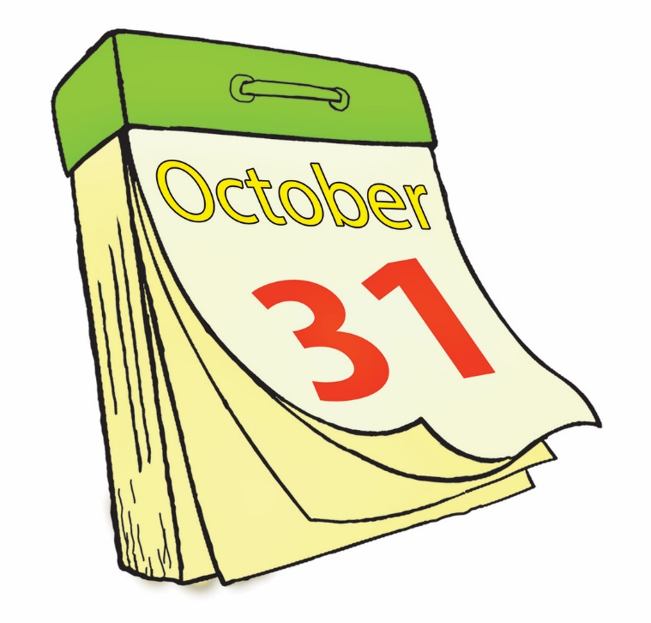
4. Look and write.
the fourteenth of October.
2. It's___________
_______________.
3. It's___________
_______________.
1. It's___________
_______________.
the thirty-first
of October.
the twelveth
of October.

Slide 21
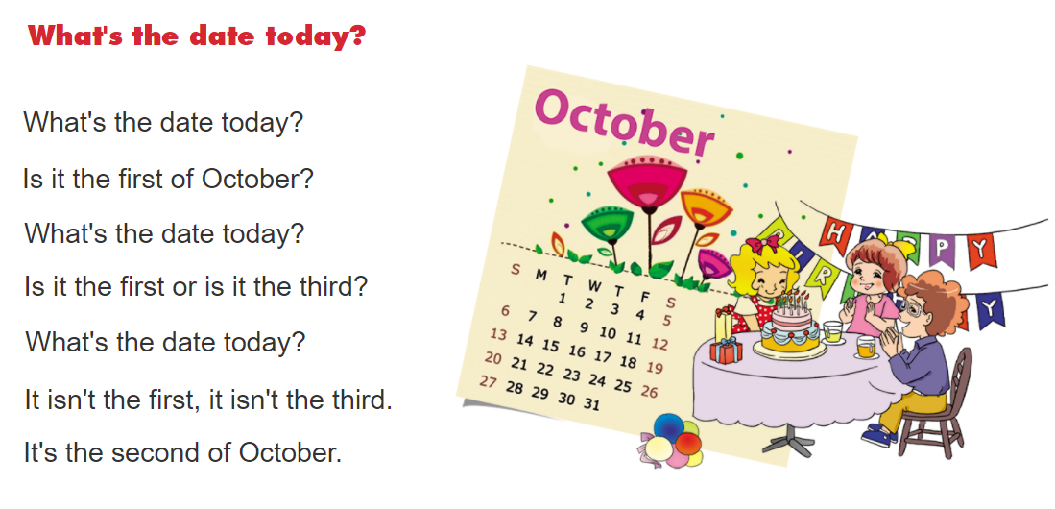
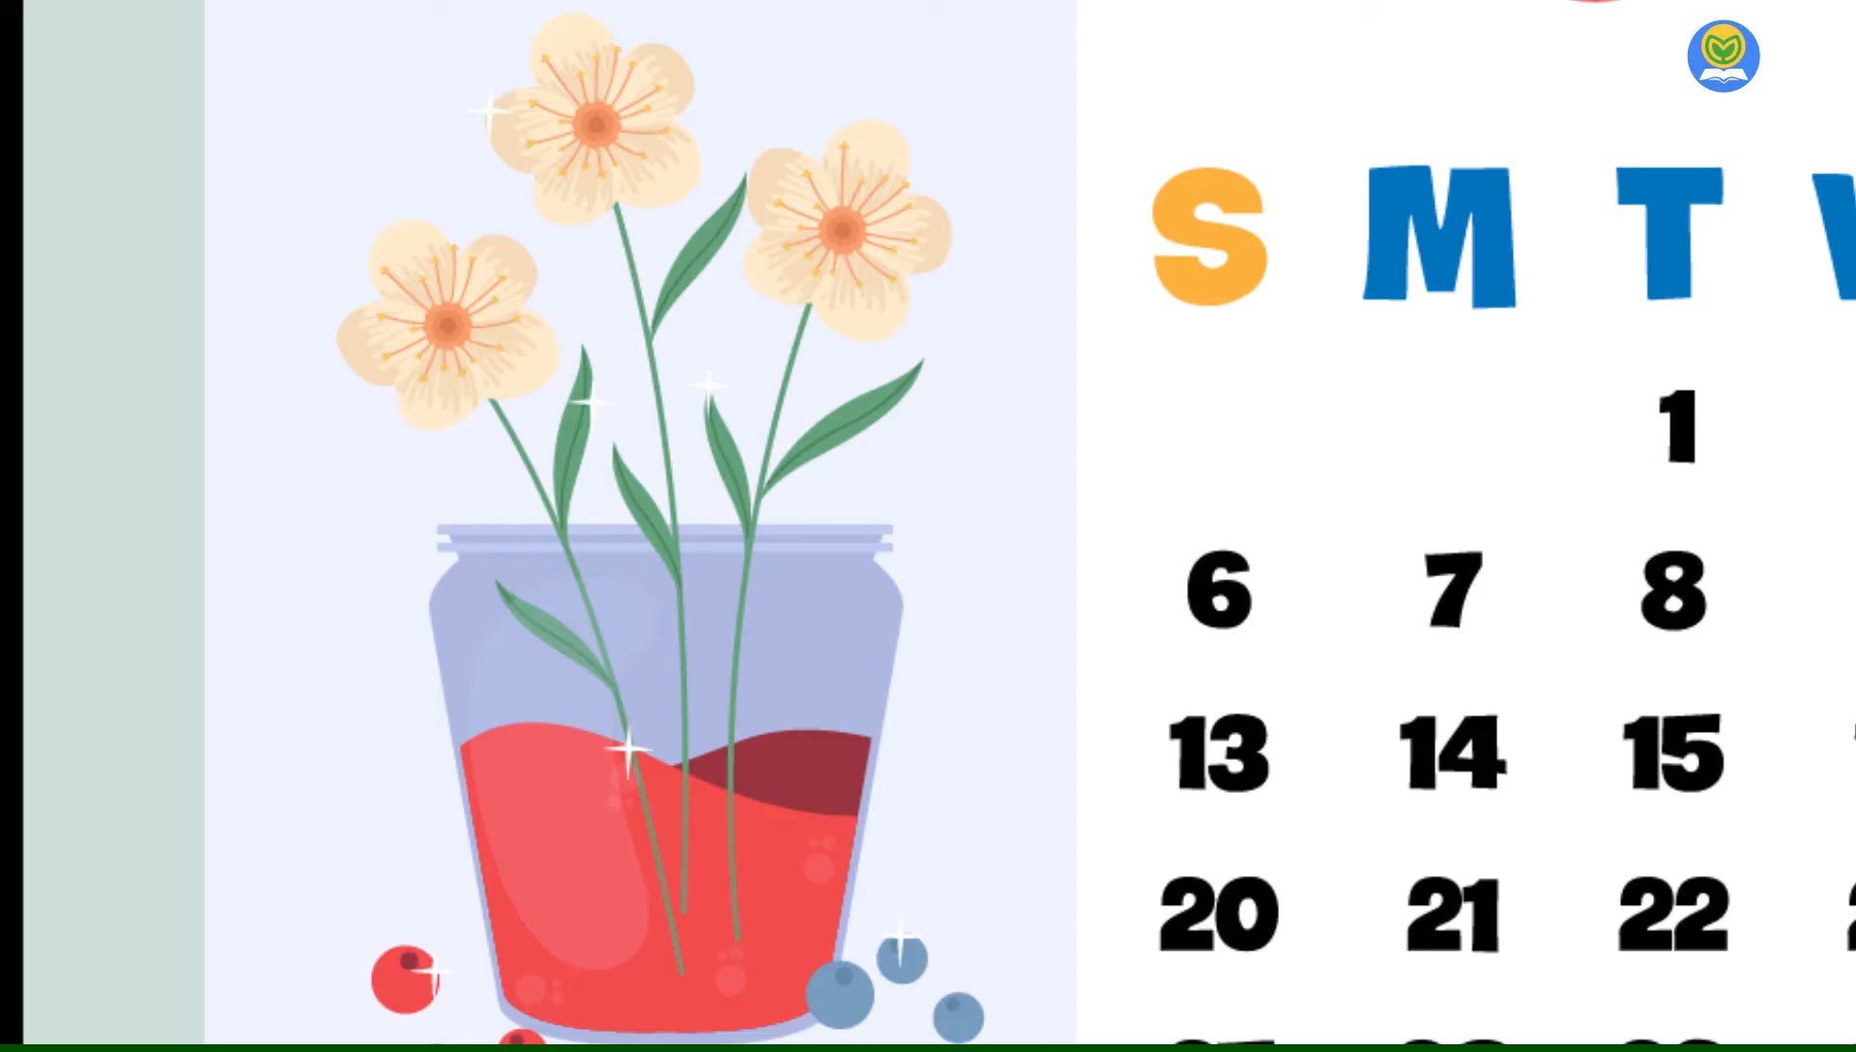
5. Let’s sing

