Slide 1

Unit 1: MY FRIENDS
Lesson 4.3
Page 21

Slide 2

WARM UP

Slide 3

Activity 1
TEACHER SAYS
Notes:
Kết hợp các hành động “sit down”, “stand up”, “touch your nose”, “touch your shoulders”, …
Kết hợp “Traffic lights” – green light/go fast, yellow light/go slow, red light/stop
Stand-up
Sit down
Touch your nose
Touch your shoulders
Walk in circle
Touch your friends’ knee
Dance
Jump
Hop
Tip-toe
Green light➔ ss run fast
Yellow light => ss walk slowly
Red light => ss stop walking

Slide 4



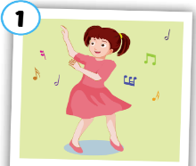

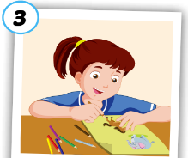
Click on numbers to open the pics and words
Activity 2
1
2
3
4
5
6
7
Hi
8
Good
Great
9
10
12
Dancing
11
Drawing
Singing
Click on ”No” icon to hide pics and words.
Notes:
Memory game.
Divide class into 3 teams. Tic-tac-toe to choose 2 numbers. Get points if ss can choose correct picture with word

Slide 5

It’s time to learn …

Slide 6
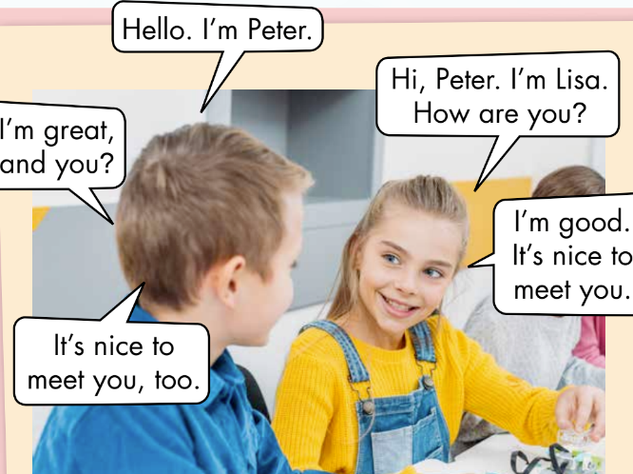
Activity 1
Look, read and guess.
1. The boy is Lisa.
True/ False
2. The girl is Peter.
True/ False
3. The girl says,
”Thank you.”
True/ False
4. The boy says,
“I’m good”
True/ False
Notes:
Set context (analyze the picture)
Show sentence by sentence, ask ss to make a guess

Slide 7
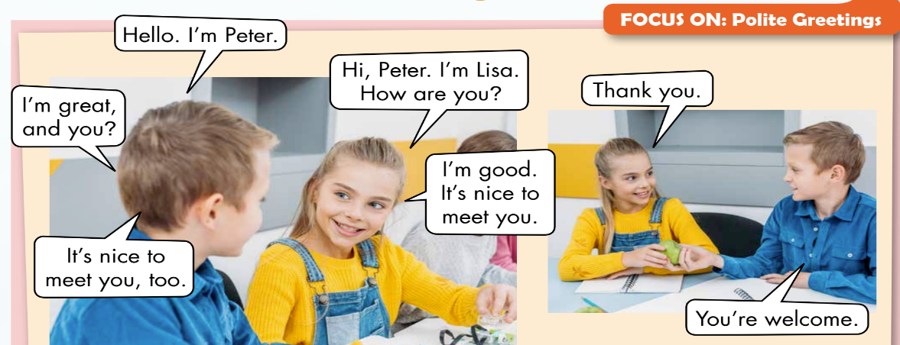
Click on each number to show the sentence.
Activity 2
1
2
3
4
5
6
7
1. The boy is Lisa.
True/ False
3. The girl says, ”Thank you.”
True/ False
2. The girl is Peter.
True/ False
4. The boy says, “I’m good”
True/ False
Notes:
- Ask ss to guess who will say 1st, what will they say?

Slide 8

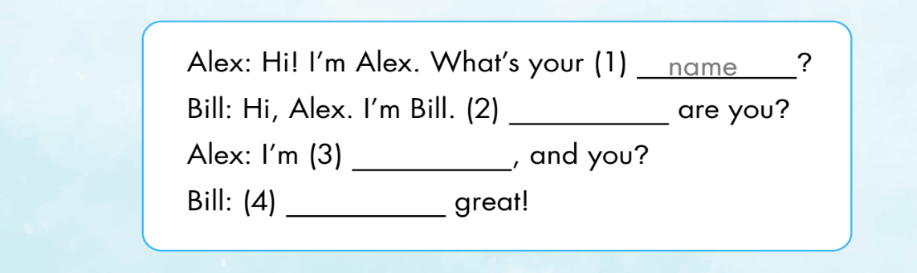
Extra activity
WB P. 15
How
good
I’m

Slide 9

Production

Slide 10
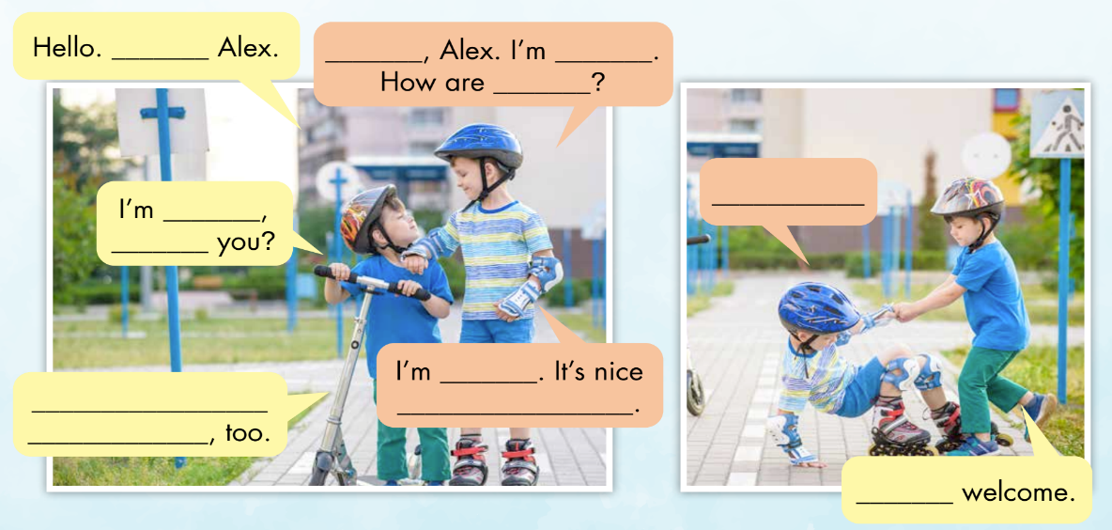
Activity 1
Look and read. Then write the correct words
1
I’m
2
Hi
3
John
4
you
10
Thank you.
5
fine
6
and
7
great
9
It’s nice to
meet you
8
you
11
You’re
Notes:
In groups, ask ss to write the correct answers to complete the “Polite greetings”
Show answers and check. Accept suitable answers

Slide 11
Activity 2
Write and draw your own story.
Hello. I’m …
It’s nice to meet you, too.
Hi. I’m …
Where are you from?
A few minutes later
I’m from …, and you?
Thank you.
I’m from …
How are you?
You’re welcome.
I’m …, and you?
I’m …. It’s nice to meet you.
Notes:
Ask ss to write and draw their own story in groups based on the given outline.
Encourage ss to be creative

Slide 12

Speaking

Slide 13
Gallery walk
Notes:
After finishing the story, ask ss to do the gallery walk.
Ask and take note about their friends’ story
Helps ss when necessary

Slide 14

CONSOLIDATION

Slide 15
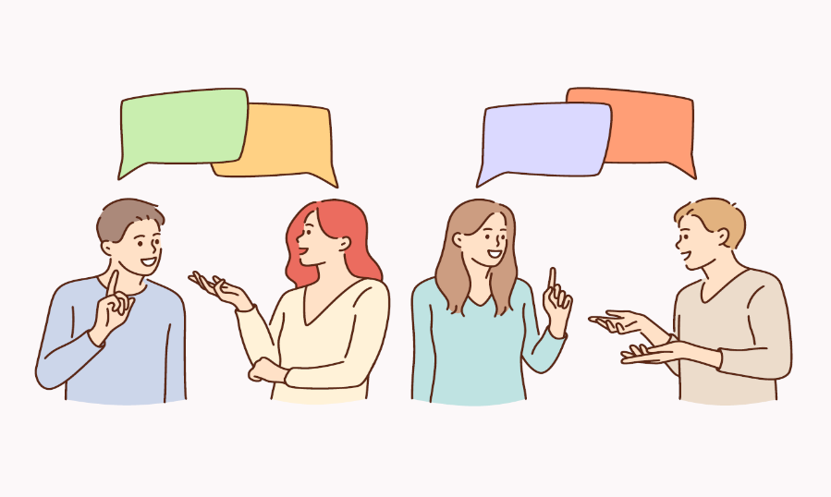
Role-play. Act out the story
Notes:
Give time for ss to practice
Each group comes to in front of the class. Act out their story

Slide 16
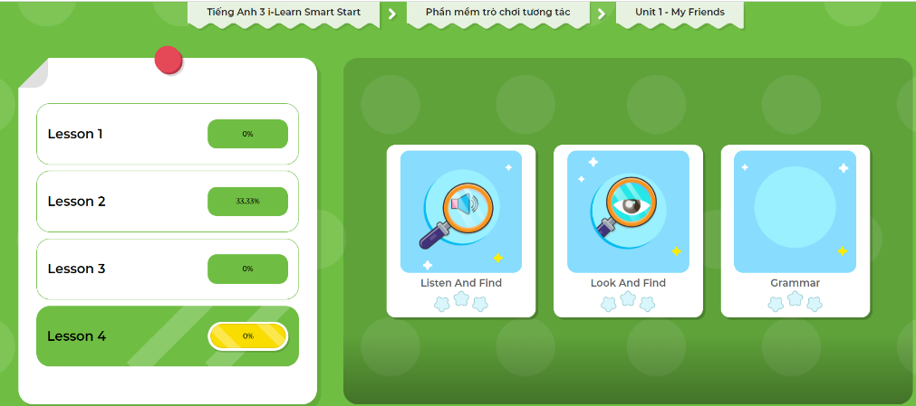
Extra Practice
DHA App
LET’S PLAY!
Click on the picture below

