Slide 1

Unit 1: My Friends
Lesson 2.1
Page 16

Slide 2

WARM UP

Slide 3






Memory Cards!
A
B
C
D
E
F
Japan
India
The UK
1
2
3
4
5
6
G
H
I
J
K
L
Italy
Alpha
The USA
7
8
9
10
11
12
Notes:
Instruction:
There are 6 pictures with 6 names of them.
Students have to choose 2 numbers to open. If the picture and the name match, they get1 point.
If the picture and the name don’t match, close the picture and let them choose again.
Click on the big square to open.
Click on the smaller square with numbers to close.

Slide 4

It’s time to learn …

Slide 5

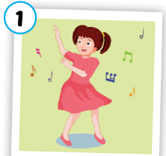
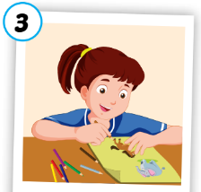
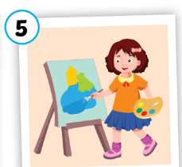
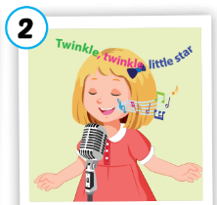
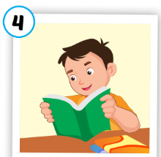
A
1. Listen, point and repeat.
dancing
drawing
painting
/dænsɪŋ/
nhảy, nhảy múa
singing
/drɑːɪŋ/
vẽ
reading
/sɪŋɪŋ/
hát, ca hát
/riːdɪŋ/
đọc
/peɪntɪŋ/
vẽ bằng cọ
Notes:
Click numbers to show pictures
Click the words to listen
Click to show meanings

Slide 6

Activity 1
Slow Motion

singing
Notes:
Click to open the picture under the cover slowly.
Click the star to show answer.

Slide 7

Activity 1
Slow Motion

painting
Notes:
Click to open the picture under the cover slowly.

Slide 8

Activity 1
Slow Motion

dancing
Notes:
Click to open the picture under the cover slowly.

Slide 9

Activity 1
Slow Motion

drawing
Notes:
Click to open the picture under the cover slowly.

Slide 10

Activity 1
Slow Motion

reading
Notes:
Click to open the picture under the cover slowly.

Slide 11
Activity 2
Say the right pictures.
dancing
singing
reading
painting
singing
drawing
reading
dancing
singing
STOP
Notes:
Click to show the new words.
Students say the numbers of the pictures.

Slide 12


Activity 3
Listen and Choose the right answer.
singing
dancing
drawing
a
b
c
Notes:
Click the head phones to listen.
Click anywhere to eliminate the wrong answers.

Slide 13

Activity 3
Listen and Choose the right answer.
painting
drawing
singing
a
b
c
Notes:
Click the head phones to listen.
Click anywhere to eliminate the wrong answers.

Slide 14

Activity 3
Listen and Choose the right answer.
drawing
painting
dancing
a
b
c
Notes:
Click the head phones to listen.
Click anywhere to eliminate the wrong answers.

Slide 15

Activity 3
Listen and Choose the right answer.
singing
reading
dancing
a
b
c
Notes:
Click the head phones to listen.
Click anywhere to eliminate the wrong answers.

Slide 16

Activity 3
Listen and Choose the right answer.
painting
reading
drawing
a
b
c
Notes:
Click the head phones to listen.
Click anywhere to eliminate the wrong answers.

Slide 17

STRUCTURE

Slide 18

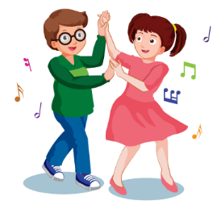

B
1. Listen and practice.
Do your friends like dancing?
A
Yes, they do.✓
B
No, they don’t. ✗
Notes:
Click the picture to listen.
For the boy, click 2 times to listen to both answers.
Click the heart to show the illustration

Slide 19

Practice

Slide 20
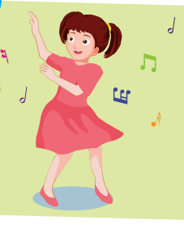
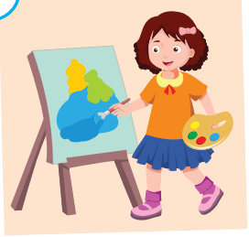

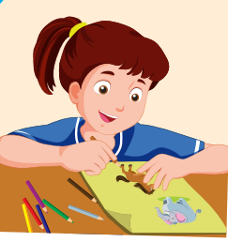

Activity 1
Look and fill in the blank. Then ask and answer.
Yes, they do.✓
B
Do your friends like ………………..?
No, they don’t. ✗
A
1
2
3
4
5
Notes:
Click the hearts to show the pictures.
Click the pictures to let it disappear

Slide 21
















Activity 2
Let’s open the gifts!
☑
☒
☑
☑
1
2
5
7
☒
☒
☒
☑
3
4
6
8
Notes:
Instructions:
Students choose 1 gift and 1 face.
The picture behind the gift is used to make question. “Do you friends like…? The tick and cross is used to answer.” Yes, they do./ No, they don’t.
Click the numbers to open the gifts. Click the face to show the ticks and crosses

Slide 22
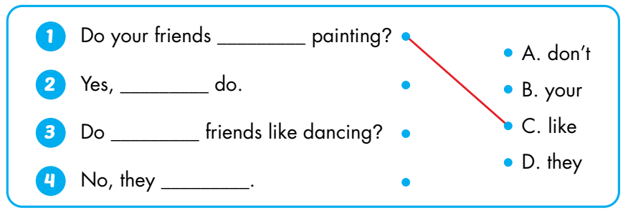
B
2. Look and match.
like
they
your
don’t

Slide 23
WORKBOOK
Page 13

Slide 24
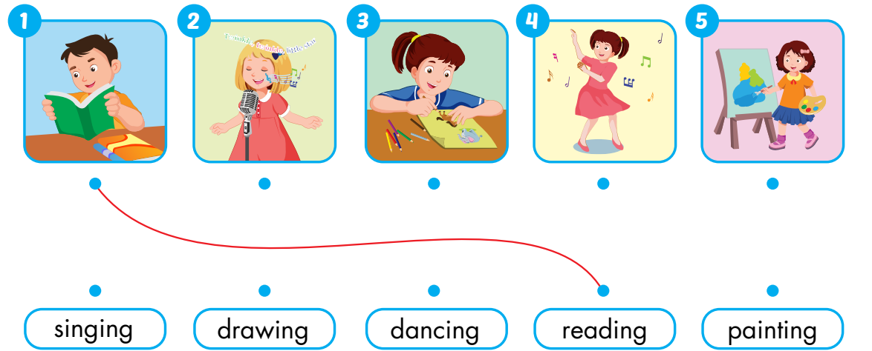
Extra Activity
WB 12
A
Draw lines.

Slide 25
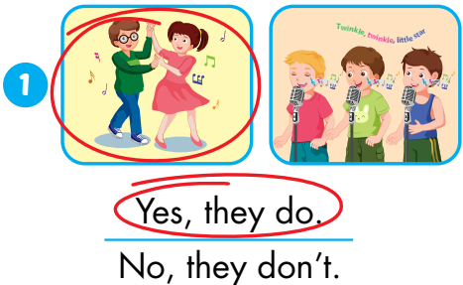
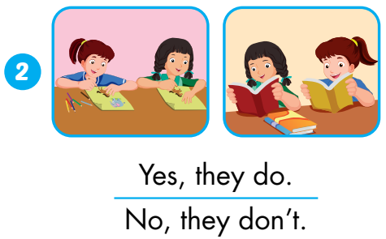
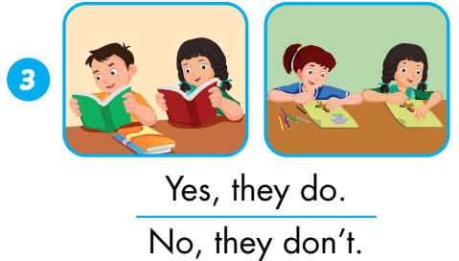
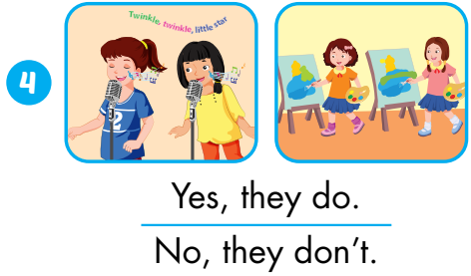
Extra Activity
WB p. 13
C
Listen and circle.
Notes:
Click on the pictures to listen.
Click anywhere to show answers.

