Slide 1

Unit 1: My friends
Lesson 2.1
Page 13

Slide 2

WARM UP
Notes:
UPPP (put hand on head)
Students sit in their chairs (if too many) or make a round (<20)
In turn count 1-2-UP-4-5-UP-7-8-UP-10-11-UP... (say UP instead of numbers 3,6,9,12,... which can divide 3)
Change the rule by saying UP instead of number which can DIVIDE 2;5;...
1-UP-3-UP-5-UP-7-UP...
1-2-3-4-UP-6-7-8-9-UP-11-12-13-14-UP...
(Students making mistake will be out of the round, the last one is the winner)

Slide 3


Slide 4

It’s time to learn …

Slide 5








the USA
the UK
Italy
India
Japan
Alpha
/ðə ˌjuː es ˈeɪ/
nước Mỹ,
Hoa Kỳ
/ðə ˌjuː ˈkeɪ/
Vương quốc Anh
/ˈɪtəli/
nước Ý
/ˈɪndiə/
nước Ấn Độ
/dʒəˈpæn/
Nước Nhật
/ˈælfə/
Hành tinh Alpha

Slide 6

Practice 1

Slide 7






SLAP THE BOARD
Japan
The USA
The UK
Alpha
Italy
India
Notes:
Divide students into 2-3 groups. Make lines.
Teacher show picture one by one. One students of each team quickly SLAP THE BOARD and SAY ALOUD THE ANSWER at the same time.
The fastest and most correctly is the winner.
(there are 6 rounds)

Slide 8
Practice 2

Slide 9


Listen and match.
a
b
c
d
e
f
Notes:
Show listening option one by one.
Then show pictures and ask students to guess the answer.
Click on the STARS A/B/C/... To hear the sound.
Click on the background to reveal the line answers.

Slide 10

Structure
Where are you from?
I’m from ...

Slide 11








Notes:
Click on each sentence to hear the sound.
Click on the headphone CD1 19 to hear the entire audio.

Slide 12








Where are you from?
I’m from ...
Notes:
Divide students into 2 teams. Tiktoktoe to find the winner, the loser asks, the winner answers.
The winner SPIN THE WHEEL to get points. (click on the arrow to move to the wheel)
(there are 12 rounds)
Click on the wheel to go to WHEEL SLIDE

Slide 13

Where is he from?
He’s from ...
Notes:
Divide students into 2 teams. Tiktoktoe to find the winner, the loser asks, the winner answers.
The winner SPIN THE WHEEL to get points. (click on the arrow to move to the wheel)
(there are 12 rounds)
Click on the wheel to go to WHEEL SLIDE

Slide 14

WHEEL OF POINT
֎
Where is she from?
She’s from ...
Notes:
Divide students into 2 teams. Tiktoktoe to find the winner, the loser asks, the winner answers.
The winner SPIN THE WHEEL to get points. (click on the arrow to move to the wheel)
(there are 12 rounds)
Click on the wheel to go to WHEEL SLIDE

Slide 15

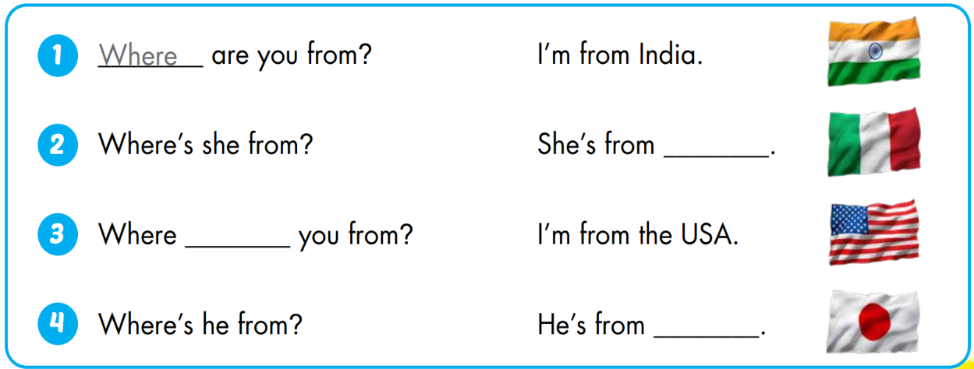
Italy
are
Japan

Slide 16

WORKBOOK
Page 10

Slide 17
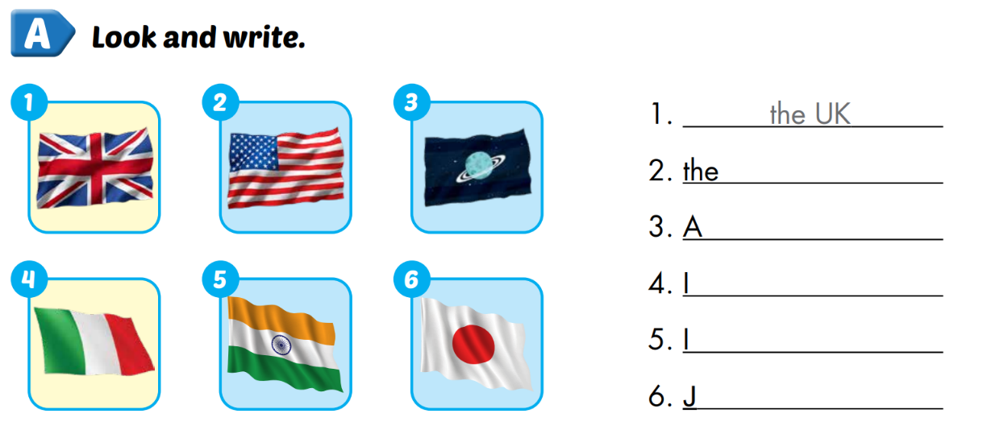
WORKBOOK P.10
USA
lpha
taly
ndia
apan

Slide 18
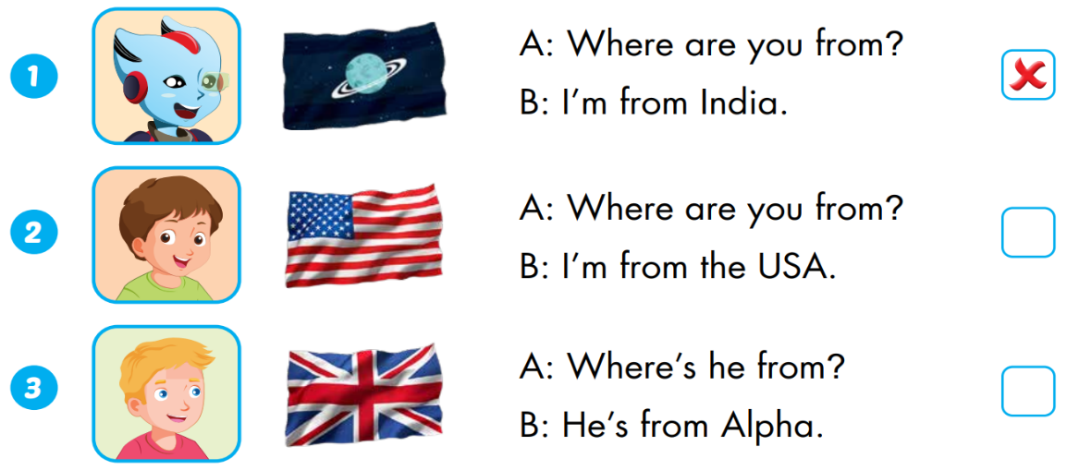


Extra 1 – WB P.10
Alpha
the UK

Slide 19
Tuesday, September 20th 2022
Unit 1: My friends
Lesson 2 (page 13)
1. A: Where are you from?
B: I’m from Viet Nam.
2. A: Where’s she from?
B: She’s from Japan.
Where …from? : … từ đâu đến?
the USA: nước Mĩ
the UK: vương quốc Anh
Italy: nước Ý
India: Ấn Độ
Japan: nước Nhật
Alpha: hành tinh AlPha

Slide 20
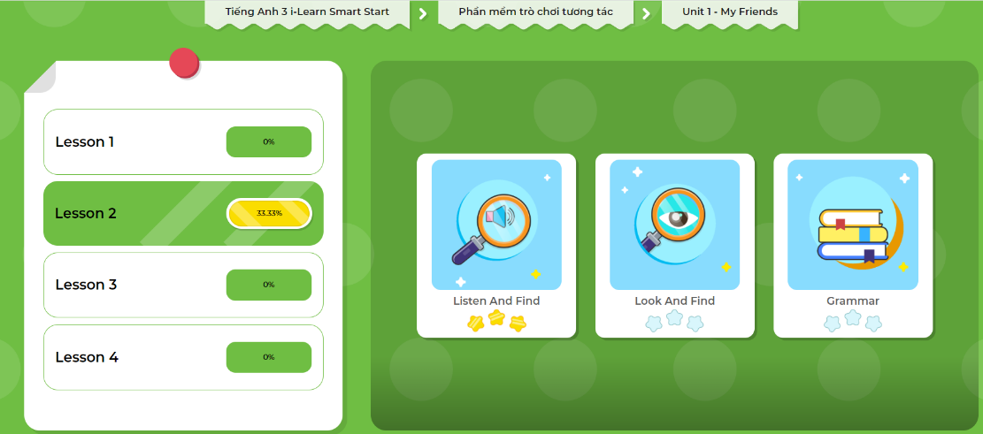
Extra-Act2. DHA app.
Click here to play the games

