Slide 1

Unit 1: My friends
Lesson 1.3
Page 12

Slide 2

WARM UP

Slide 3

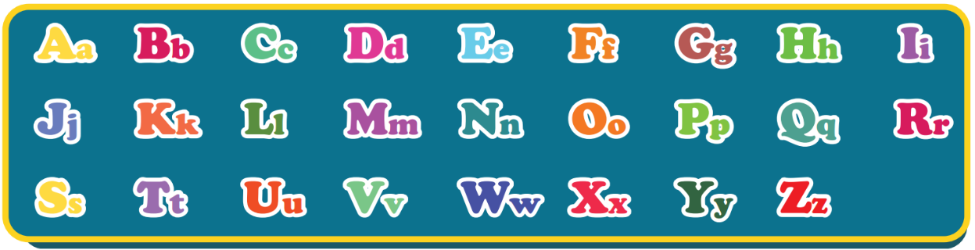
The Alphabet Song
Notes:
Click on the picture to listen to the Alphabet song.
For the first time, the arrow icon automatically appears in group of two-three letters along with the music.
For the second time, guider has to point every single letter for students.

Slide 4

It’s time to learn …

Slide 5


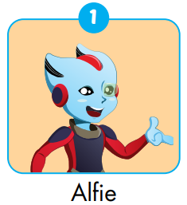
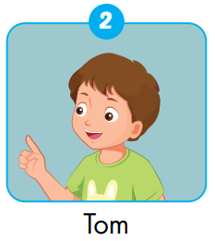
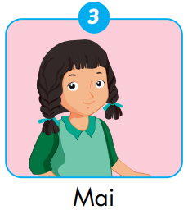
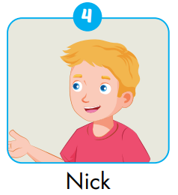
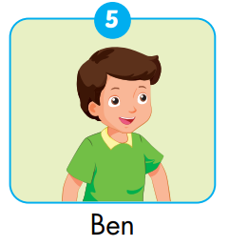
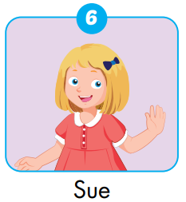
Notes:
Invite students to play roles.

Slide 6

How do you spell…?

Slide 7

How do you spell …?
_ _ _ _ _
LUCY
WELLDONE!
HARRY
MAI
CODY
Ready? Go!
TOM
NAM
BEN
NICK
SUE
Notes:
divide students into 4 teams.
One S from each team comes to the front, face the class
Show a name on the board, call a S to spell the name,
the four SS at the front write the name, who write correctly get one point, one more point for the fastest
-

Slide 8

WORKBOOK page 9

Slide 9

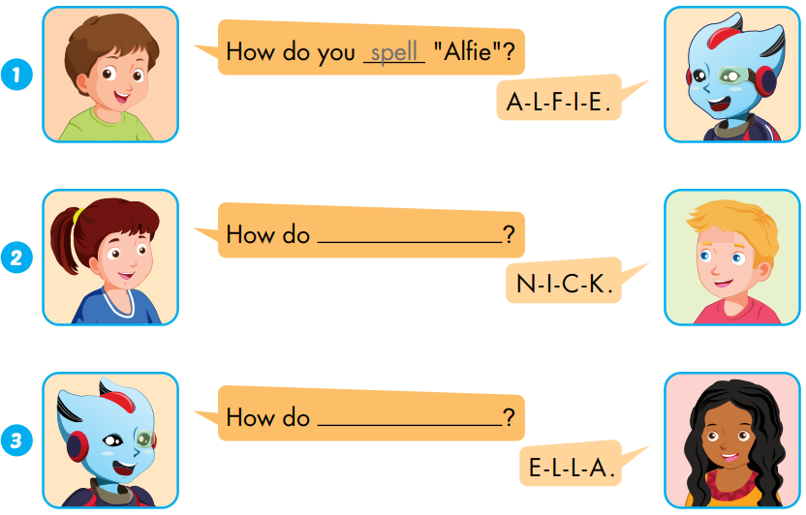
...
spell
Workbook P.9
...
spell “Nick”
spell “Ella”
...

Slide 10
Thursday, September 15th 2022
Unit 1: My friends
Lesson 1.3 (page 11)
My friend’s name is Alfie.
It’s A-L-F-I-E.

Slide 11
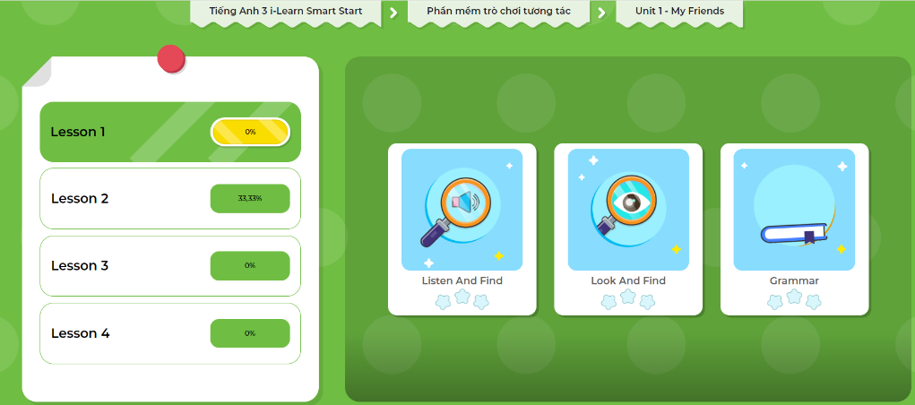
Extra-Act2. DHA app.
Click here to play the games

Slide 12

3
2
0
1
SPIN
1
0
2
3
Notes:
Click spin the spin the wheel.
Click the wheel to stop.
Click return SYMBOL to comeback to game.

