Slide 1
Unit 7
What do you
like doing?
Lesson 3

Slide 2
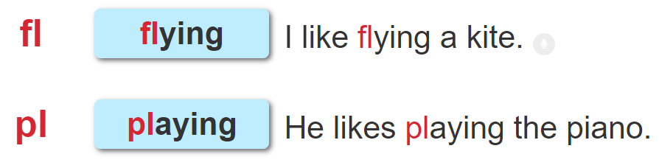

1. Listen and repeat.

Slide 3
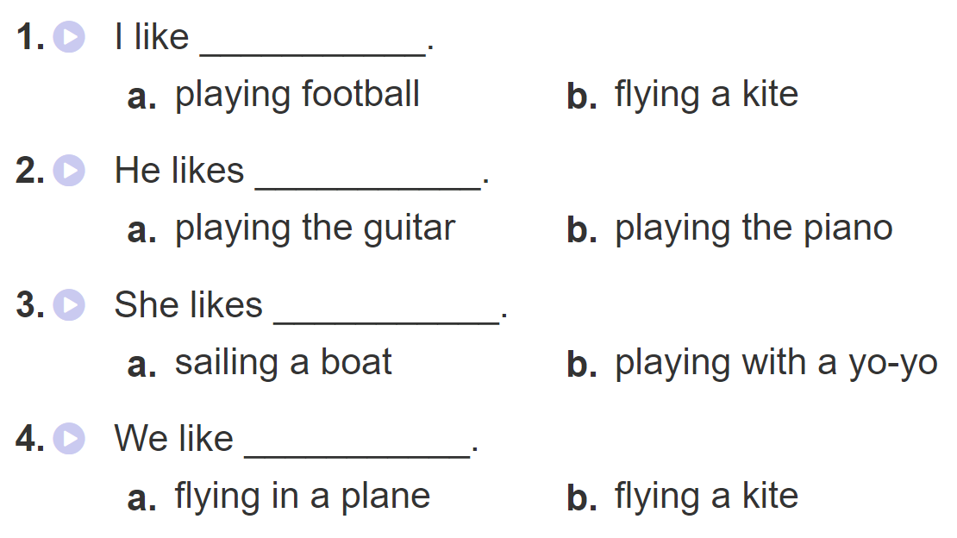
2. Listen and circle. Then say aloud

Slide 4
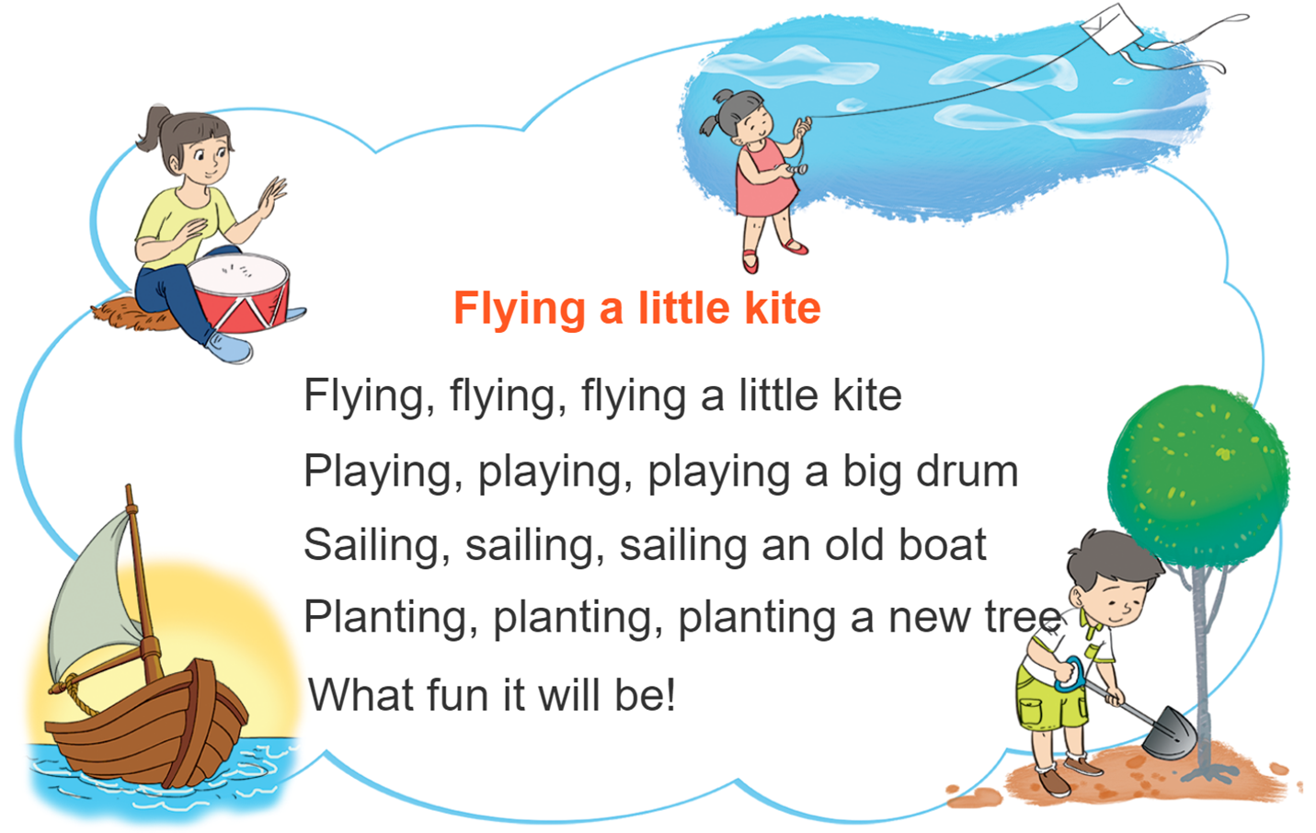
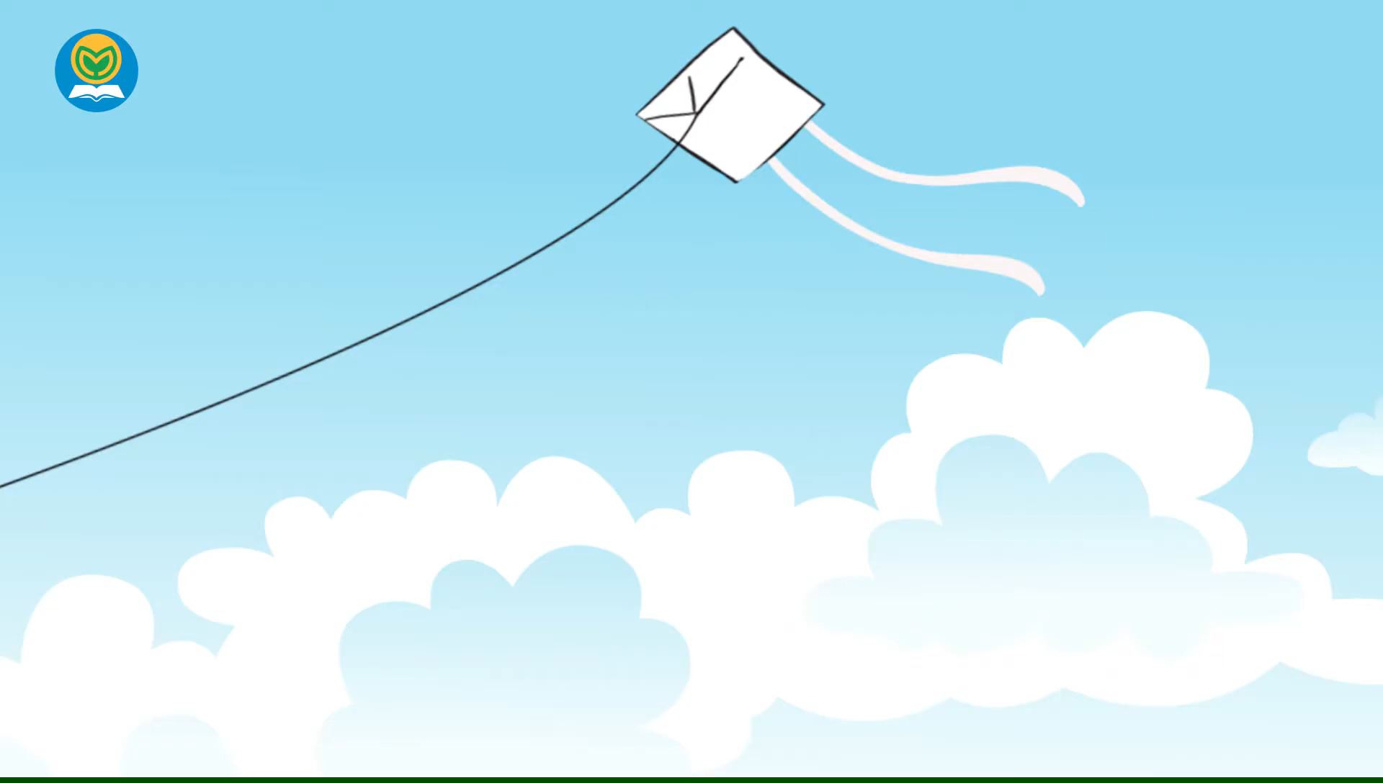


3. Let’s chant

Slide 5
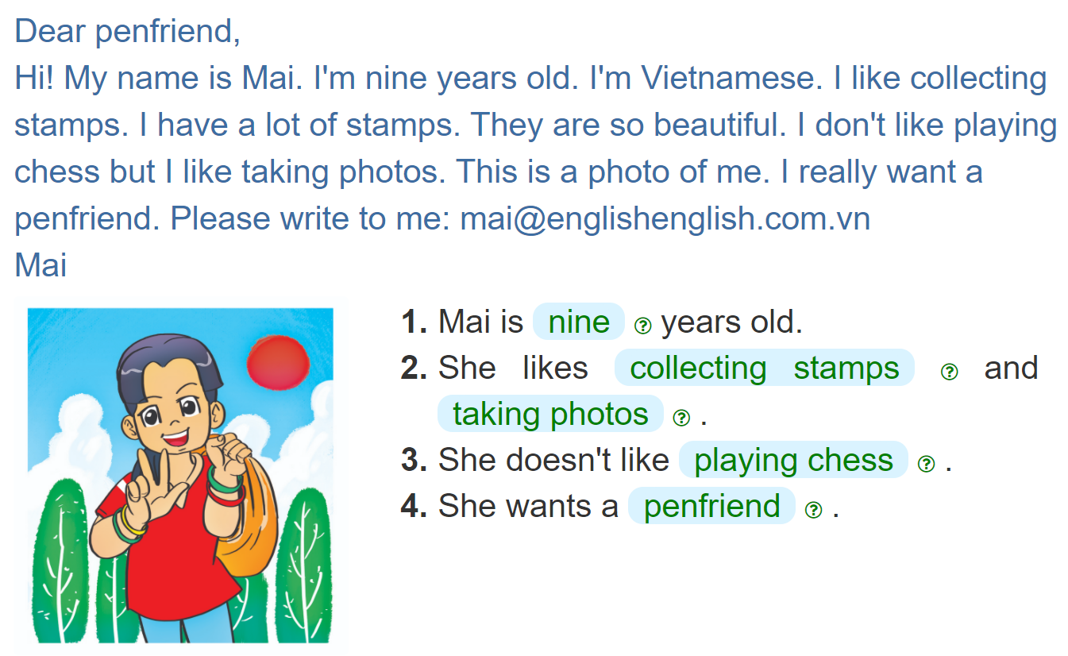
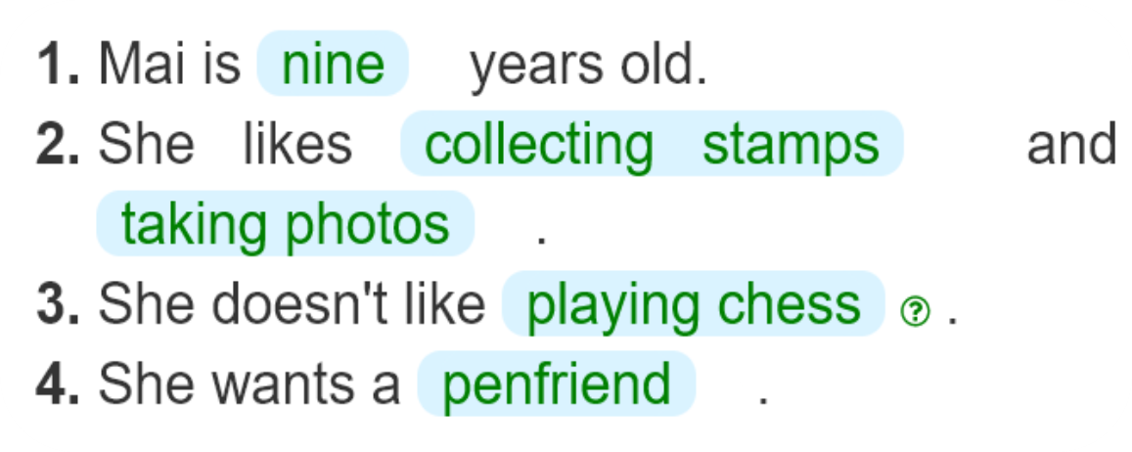

4. Read and complete

Slide 6
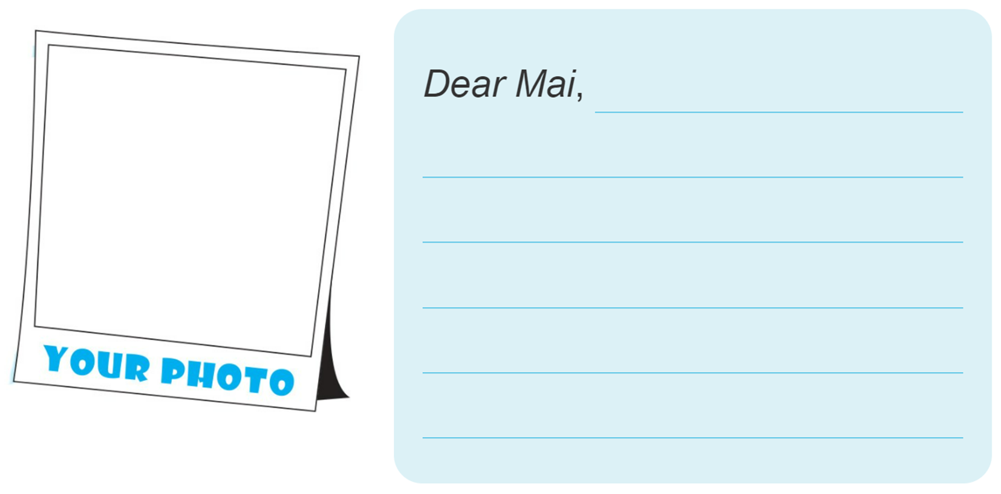
5. Add your photo and write a reply email to Mai.

Slide 7
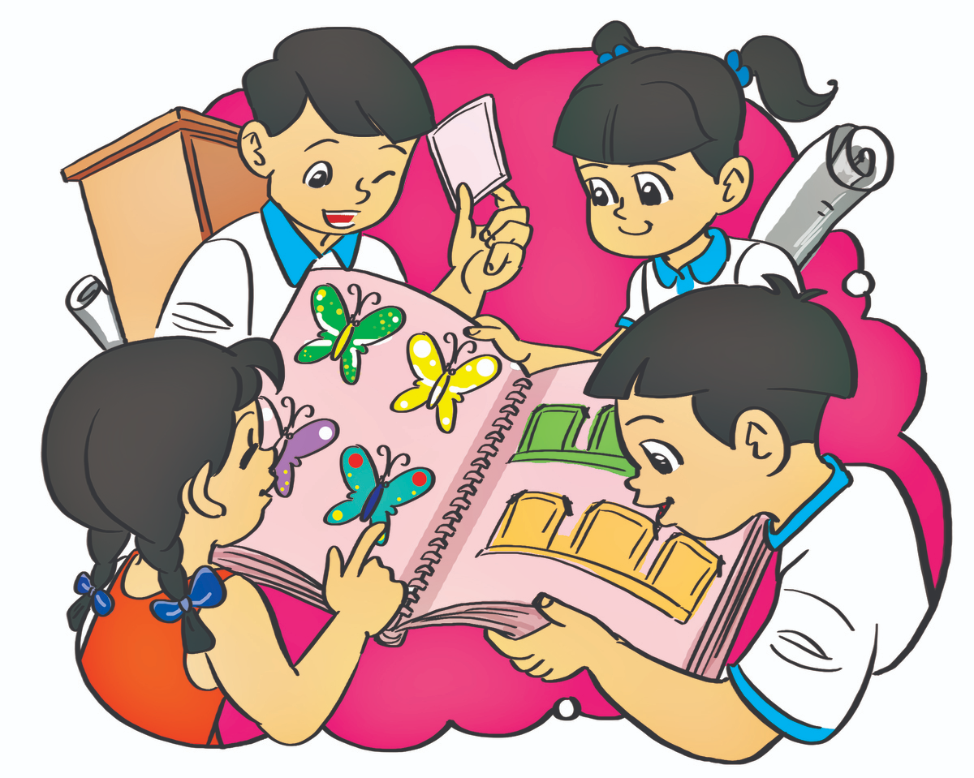
6. Project
Collect things that you like (e.g. stickers, stamps, candy wrappers) and show them to your classmates.

Slide 8




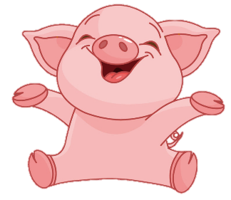
BOMSTAR
PLAY
Notes:
Ms Huyền Phạm - 0936.082.789 – YOUTUBE: MsPham. Facebook: Powerpoint thật dễ

Slide 9










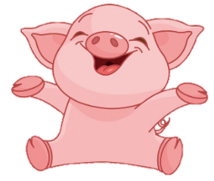

10
10
10
20
20
10
20
20

Slide 10

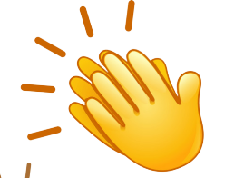
Thêm
1 lượt
Back

Slide 11
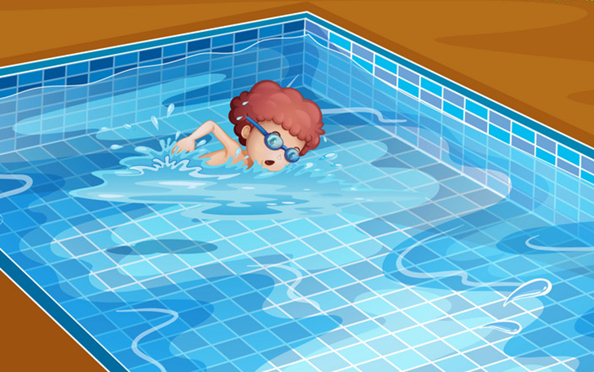


What's your hobby?
Back
I like swimming.
I like swim.
I like go swimming.

Slide 12
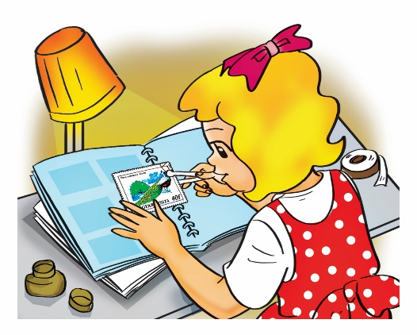
What's your hobby?
Back
I like collect stamps.
I like collecting stamps.
I like to
collecting stamps.

Slide 13
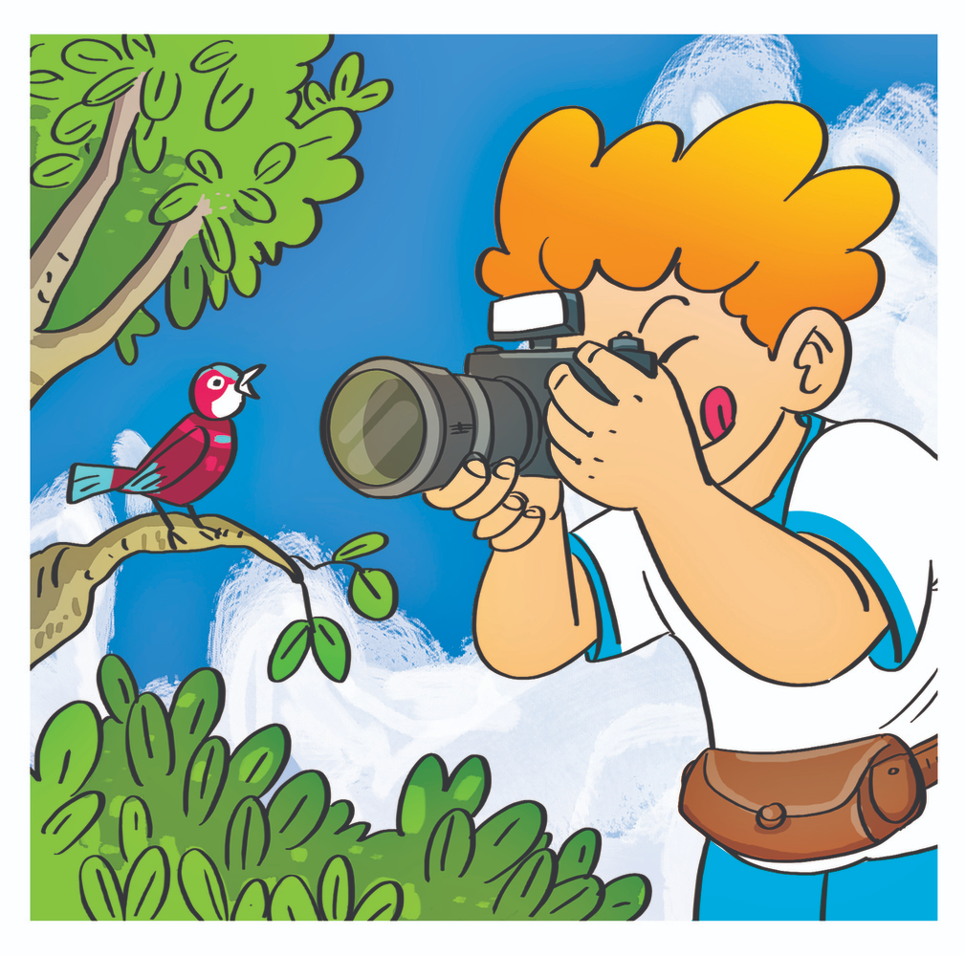
What do you
like doing?
Back
I like photos.
I taking photos.
I like taking photos.

Slide 14
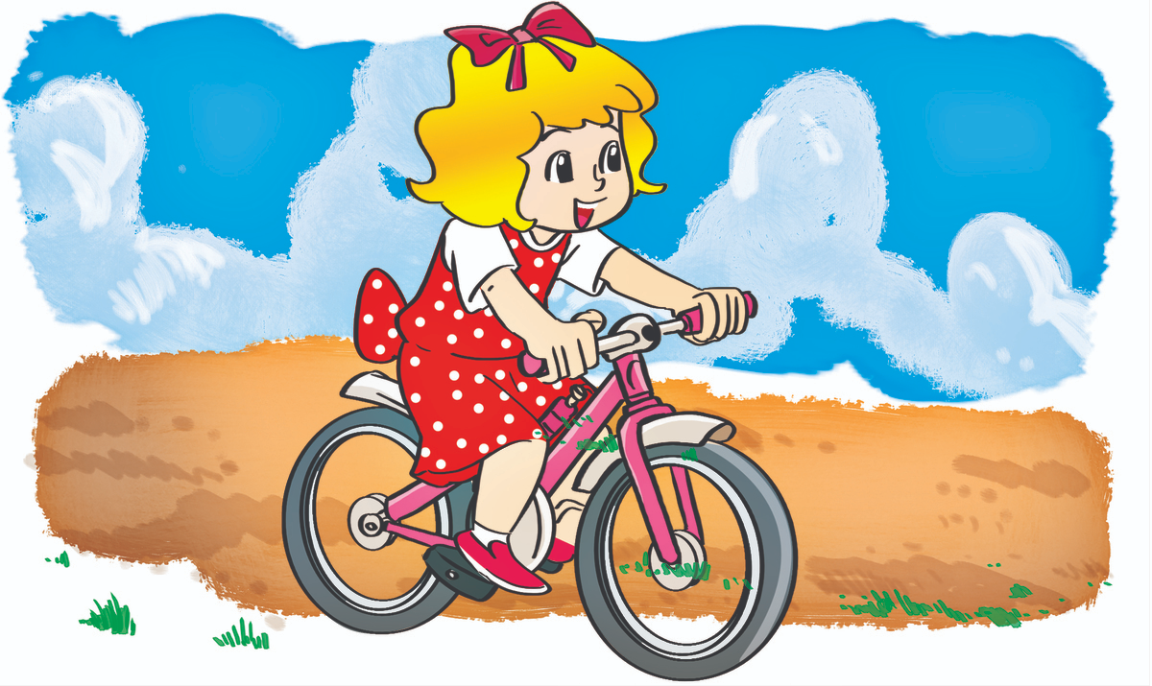
What do you
like doing?
Back
I riding
a bike.
I like riding
a bike.
I like ride
a bike.

Slide 15
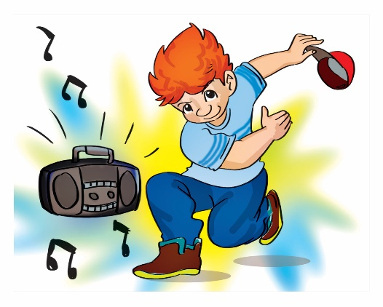
I like dancing.
Back
What do you
like doing?
What do you
like hobby?
What are you
hobby?

Slide 16
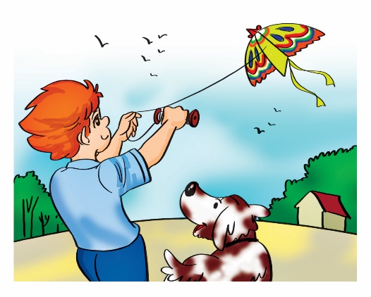
I like flying a kite.
Back
What is your
like doing?
What is your hobby?
What do your hobby?

