Slide 1
Unit 7
What do you
like doing?
Lesson 2

Slide 2
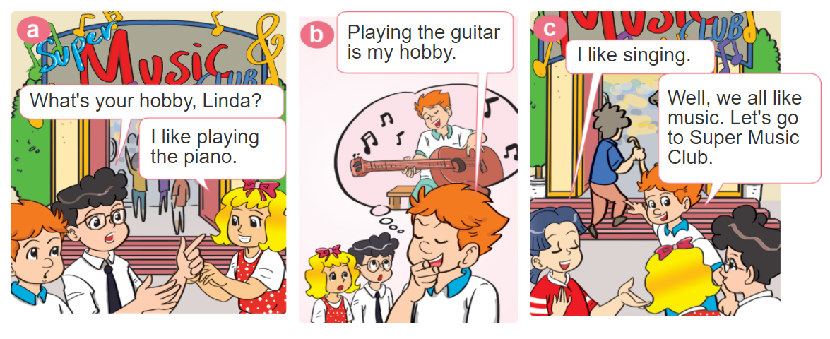

1. Look, listen and repeat.

Slide 3


Structures:
Hỏi và trả lời sở thích của bạn là gì:
What's your hobby?
(Sở thích của bạn là gì?)
I like ______.
V-ing
(Tớ thích___.)

Slide 4
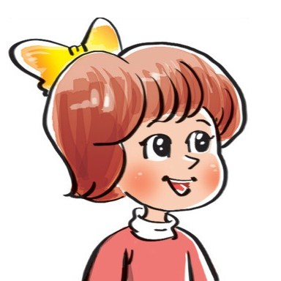
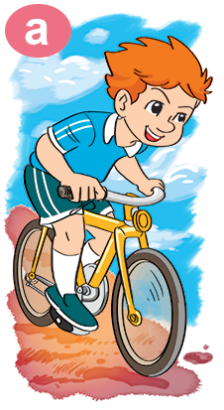
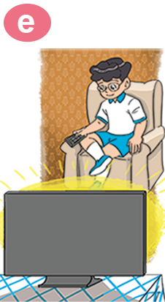
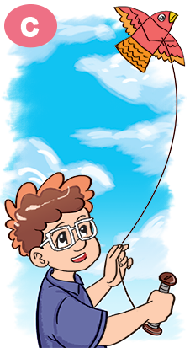
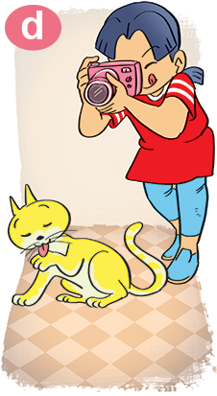

2. Point and say
What's your hobby?
I like ___________.
riding
a bike
watching TV
taking
photos
playing
badminton
flying a kite

Slide 5

3. Let’s talk
What do you
like doing?
I like _________.
What's your hobby?
I like _________.

Slide 6

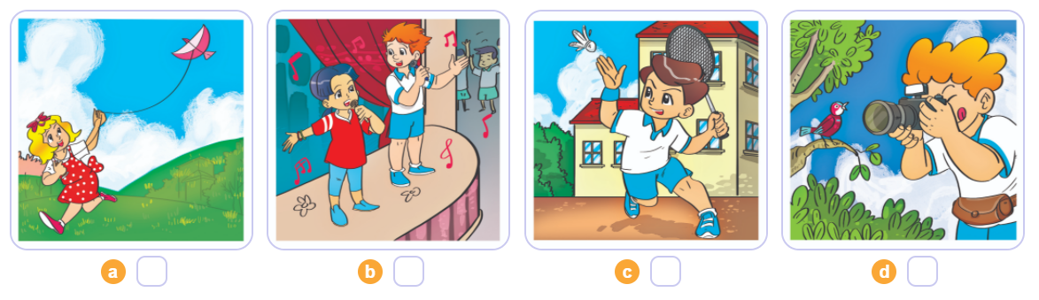
4. Listen and number
2
4
1
3

Slide 7
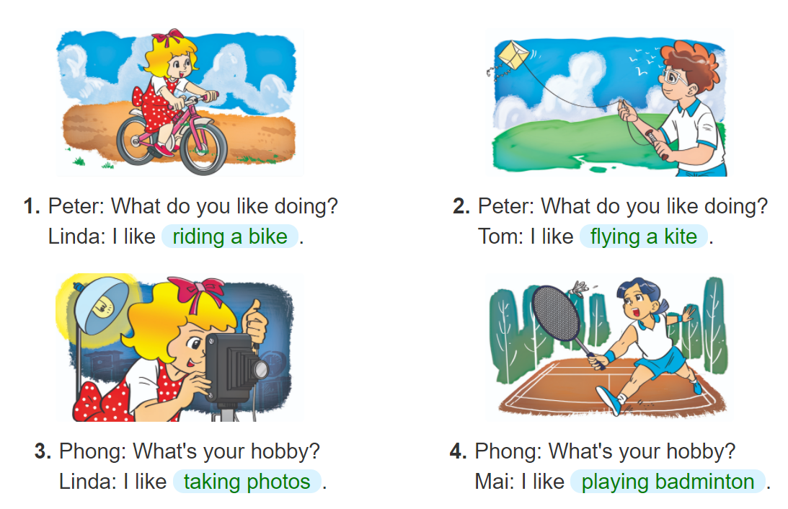

5. Look and write

Slide 8
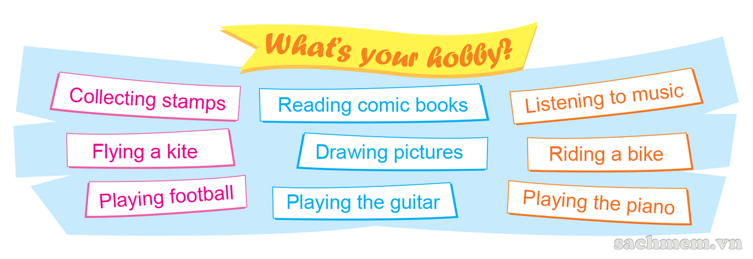
6. Let’s play

Slide 9







Notes:
Ms Huyền Phạm - 0936.082.789 – YOUTUBE: MsPham. Facebook: Dạy và học cùng công nghệ.

Slide 10




What ____ your hobby?
I like watching TV.
are
is
+5
-1
-1
-1
do
does
Notes:
Ms Huyền Phạm - 0936.082.789 – YOUTUBE: MsPham. Facebook: Dạy và học cùng công nghệ.

Slide 11
What is your hobby?
I like flying kites.
I like watching TV.
+5
-1
-1
-1
I like swimming.
I like riding a bike.
Notes:
Ms Huyền Phạm - 0936.082.789 – YOUTUBE: MsPham. Facebook: Dạy và học cùng công nghệ.

Slide 12
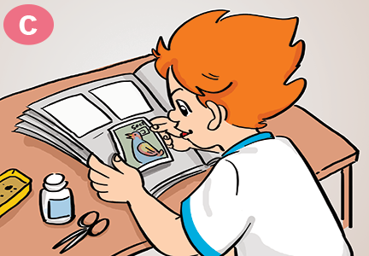

Câu hỏi 2
What is your hobby?
I like riding the bike.
I like dancing.
+5
-1
-1
-1
I like collecting stamps.
I like cooking.
Notes:
Ms Huyền Phạm - 0936.082.789 – YOUTUBE: MsPham. Facebook: Dạy và học cùng công nghệ.

Slide 13
What is your hobby?
I like collecting stamps.
I like playing with cats.
+5
-1
-1
-1
I like taking photos.
I like eating.
Notes:
Ms Huyền Phạm - 0936.082.789 – YOUTUBE: MsPham. Facebook: Dạy và học cùng công nghệ.

Slide 14
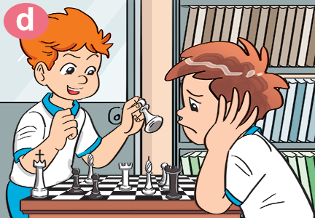
What is your hobby?
I like playing
badminton.
I like playing
Chess.
+5
-1
-1
-1
I like taking
photos.
I like watching TV.
Notes:
Ms Huyền Phạm - 0936.082.789 – YOUTUBE: MsPham. Facebook: Dạy và học cùng công nghệ.

Slide 15
I like flying a kite.
What is your hobby?
What are you hobby?
+5
-1
-1
-1
What your hobby?
What do you hobby?
Notes:
Ms Huyền Phạm - 0936.082.789 – YOUTUBE: MsPham. Facebook: Dạy và học cùng công nghệ.

Slide 16
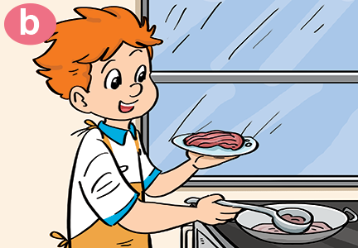
Câu hỏi 1
What is your_____?
I like cooking.
hobby
cooking
+5
-1
-1
-1
like
do
Notes:
Ms Huyền Phạm - 0936.082.789 – YOUTUBE: MsPham. Facebook: Dạy và học cùng công nghệ.

Slide 17
What is your hobby?
I ____ playing badminton.
do
am
+5
-1
-1
-1
hobby
like
I like riding
a bike.
I like watching TV.
I like taking
photos.
I like playing
badminton.
I like flying a kite.
Notes:
Ms Huyền Phạm - 0936.082.789 – YOUTUBE: MsPham. Facebook: Dạy và học cùng công nghệ.

Slide 18
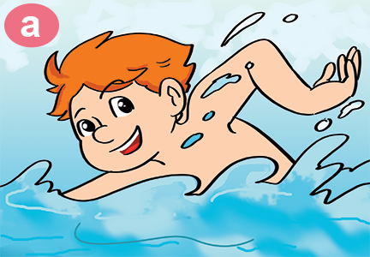
Câu hỏi 4
What is your hobby?
I like ________.
swim
go swimming
+5
-1
-1
-1
going swim
swimming
Notes:
Ms Huyền Phạm - 0936.082.789 – YOUTUBE: MsPham. Facebook: Dạy và học cùng công nghệ.

Slide 19



Great job!
Exit
8
13
Notes:
Ms Huyền Phạm - 0936.082.789 – YOUTUBE: MsPham. Facebook: Dạy và học cùng công nghệ.

