Slide 1
Unit 6
Where’s
your school?
Lesson 2

Slide 2
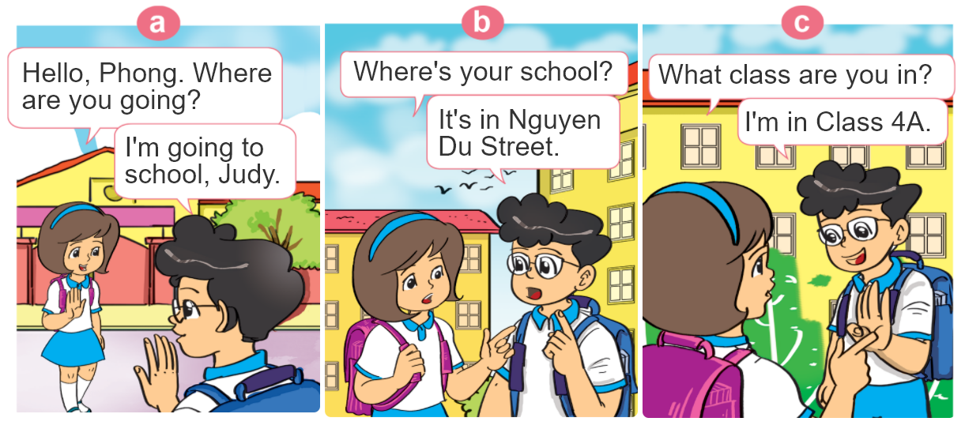

1. Look, listen and repeat.

Slide 3


B. Structures:
Hỏi và trả lời TÊN LỚP của bạn là gì:
What class are you in?
I’m in Class _______.
+Tên lớp
(Bạn học lớp nào?)
(Tớ học lớp ______.)
Hỏi và trả lời TÊN LỚP của cô ấy anh ấy là gì:
What class is she/he in?
(Cô ấy/anh ấy học lớp nào?)
She/He’s in Class ______.
+Tên lớp
(Cô ấy/anh ấy học lớp ______.)

Slide 4

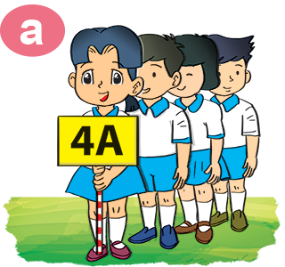

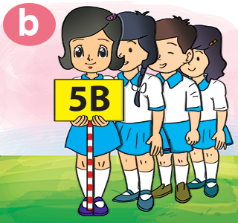
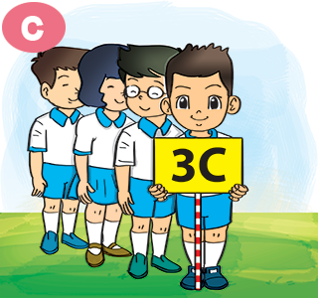
2. Point and say
What class is she/he in?
She/He’s in Class ____.

Slide 5
3. Let’s talk
____ Primary School.
What's the name of your school?
It’s in ________.
Where is it?
What class are you in?
I am in Class ____.

Slide 6
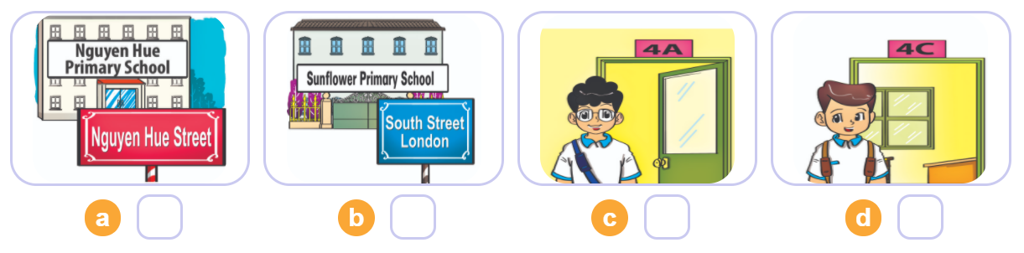

4. Listen and number
3
1
4
2
1
2
3
4

Slide 7
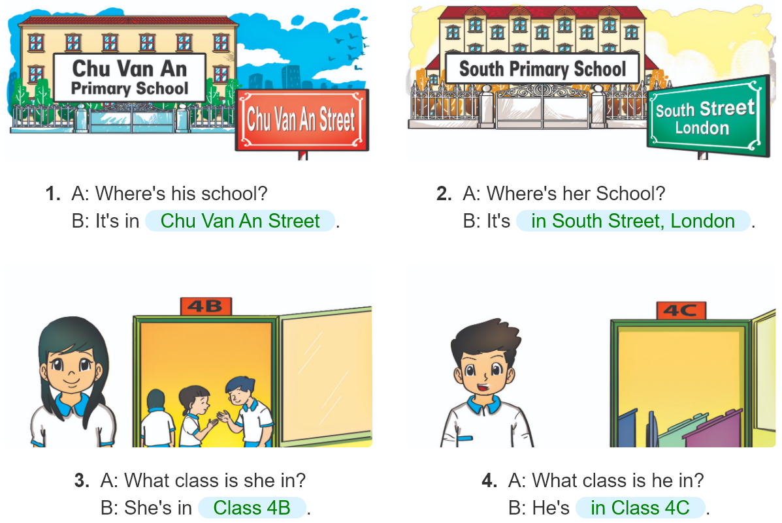
5. Look and write.
_______________
_______________
________.
________.

Slide 8
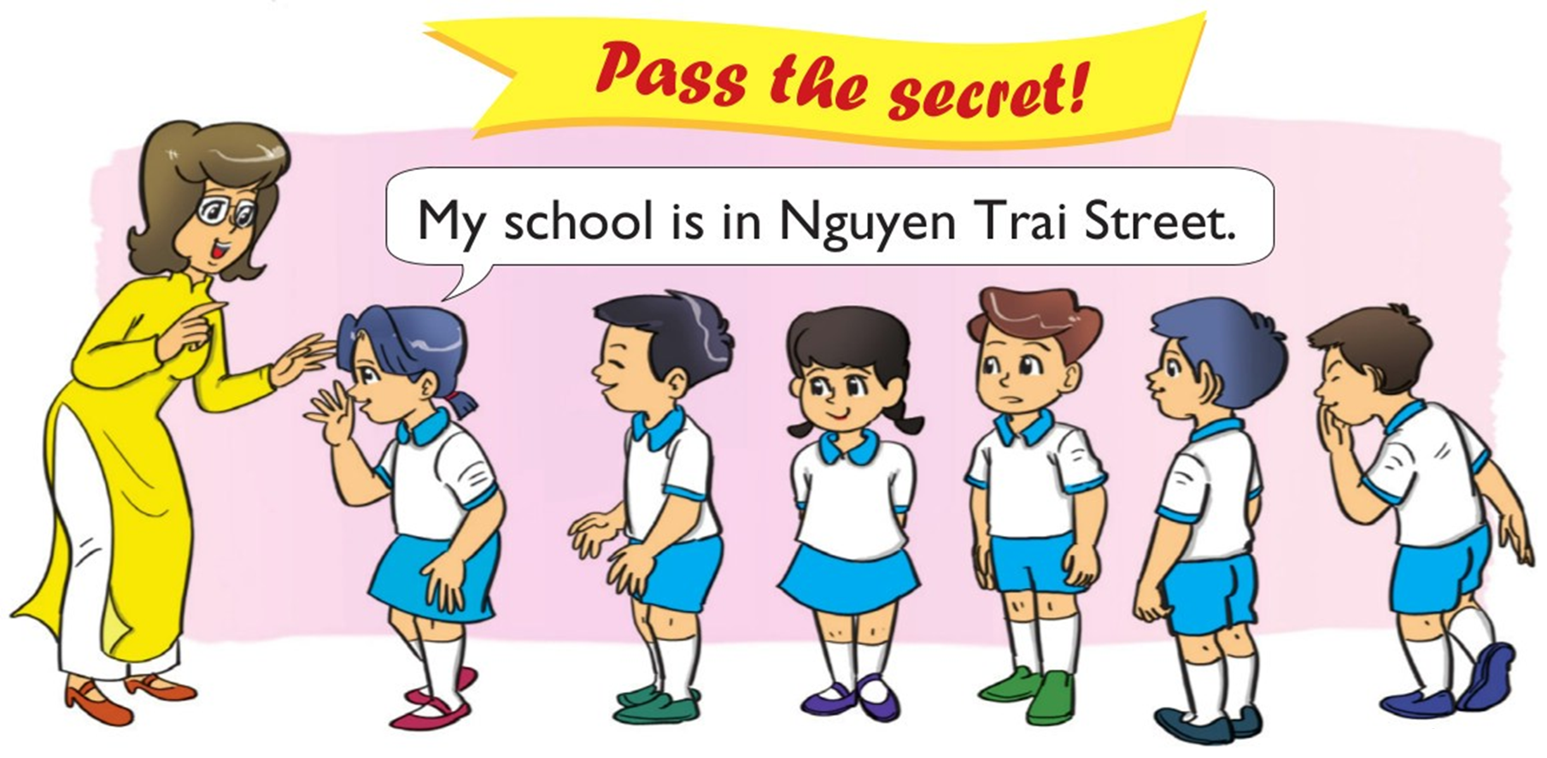
6. Let’s play

Slide 9
Monday, November 7th 2022
Unit 6: Lesson 2 (page 42-43)
1. A: What class are you in?
B: I’m in Class 4A1.
2. A: What class is he / she in?
B: He’s / She’s in Class 4A2.

Slide 10








Slide 11




He’s in Class 5B.
I’m in Class 5B.
What class are you in?
She’s in Class 5B.

Slide 12
He’s in Class 4D.
I’m in Class 4D.
What class is he in?
She’s in Class 4D.

Slide 13
She’s in Class 2E.
He’s in Class 2E.
What class is she in?
I’m in Class 2E.

Slide 14
He’s in Class 3A.
I’m in Class 3A.
What class are you in?
She’s in Class 3A.

Slide 15
He’s in Class 1C.
She’s in Class 1C.
What class are you in?
I’m in Class 1C.

Slide 16
I’m in Class 4A.
She’s in Class 4A.
What class is he in?
He’s in Class 4A.

Slide 17
I’m in Class 5A.
He’s in Class 5A.
What class is she in?
She’s in Class 5A.

Slide 18
He’s in Class 3B.
She’s in Class 3B.
What class is he in?
I’m in Class 3B.

Slide 19
I’m in Class 2H.
She’s in Class 2H.
What class are you in?
He’s in Class 2H.

Slide 20
Time’s up!

