Slide 1

Unit 3: School
Lesson 1.2
Page 39
Notes:
By the end of this lesson, students will be able to pronounce the sounds /eɪ/, /ɪə/ and ask and answer who owns different school supplies.

Slide 2

WARM UP

Slide 3

It’s time to learn …

Slide 4

Phonics
/eɪ/ and /ɪə/

Slide 5


eraser
here
/eɪ/
/ɪə/
Click on each word to hear the sound

Slide 6


Slide 7

Let’s play!
Let’s Dance Game

Slide 8
How To Play
Students must take turns reading the words in order.
Each time a student can choose to say the words in 1 square, 2 squares or a maximum of 3 squares.
The student who says the last word must dance!

Slide 9

pen
pencil
eraser
ruler
pencil case
book
bag
note-book
friends
mother
books
bags
DANCE!!
father
pencils
brother
rulers
pens
sister
uncle
note-books
pencil cases
school
here
friend
aunt
eraser
ruler
pencils
cousin
erasers

Slide 10
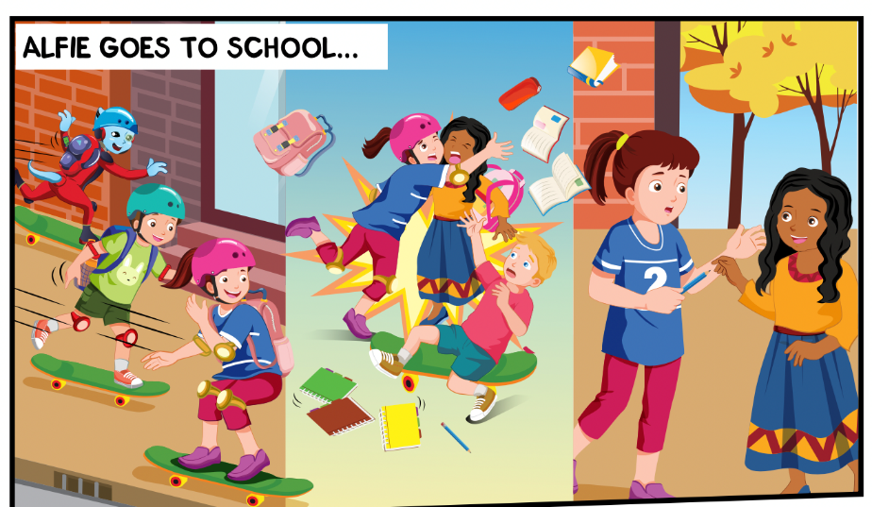
What things can you see?
Where are they?
Who can you see?

Slide 11
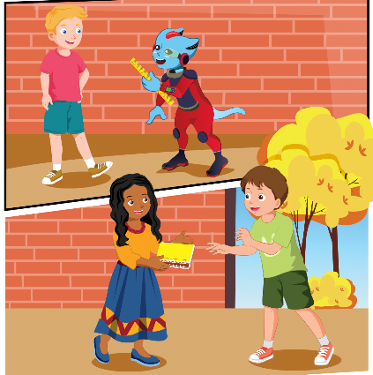

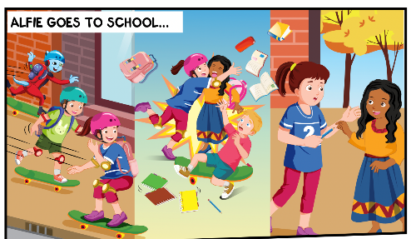
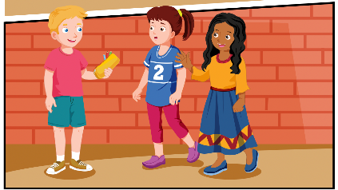
While-Listening
2.
3.
1.
4.
Click on the icon to hear the sound

Slide 12

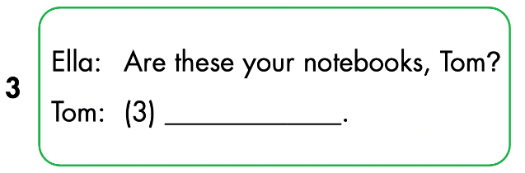
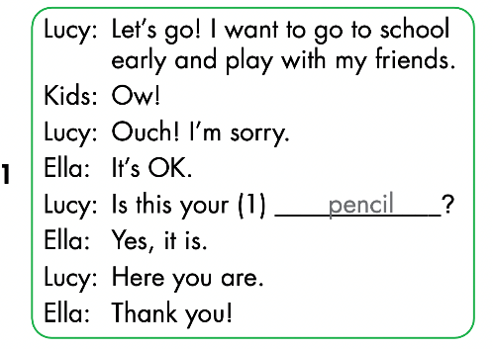
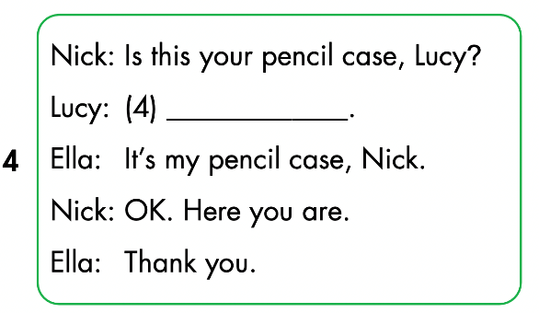
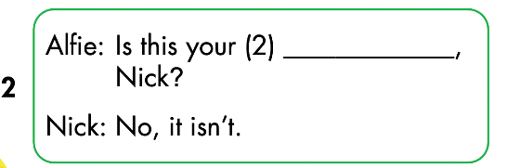
Click on the icon to hear the sound
Yes, they are
No, it isn’t
ruler

Slide 13

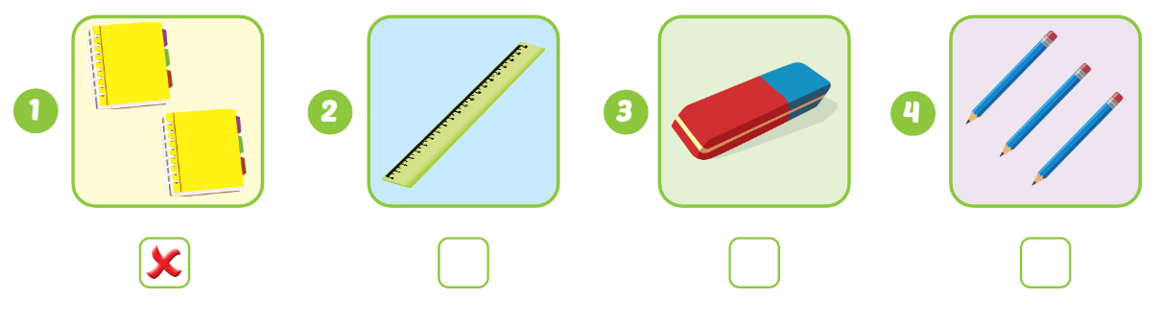


WB p. 29
Click on the icon to hear the sound

Slide 14

Let’s draw!
Work in pairs
Draw your favorite school thing
Tell your friend about your picture
Notes:
134722862

