Slide 1
Unit 5
CAN YOU SWIM?
Lesson 3

Slide 2
Phonics

Slide 3
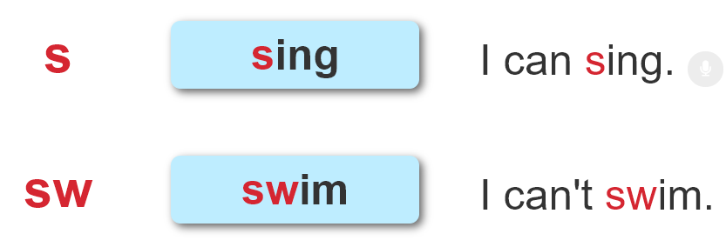

1. Listen and repeat.

Slide 4
2. Listen and number. Then say aloud.
1
2
3
4
Can you sing?
Can you swim?
4
1
Can you sit
on the chair?
Can you swing?
2
3

Slide 5
Practise

Slide 6
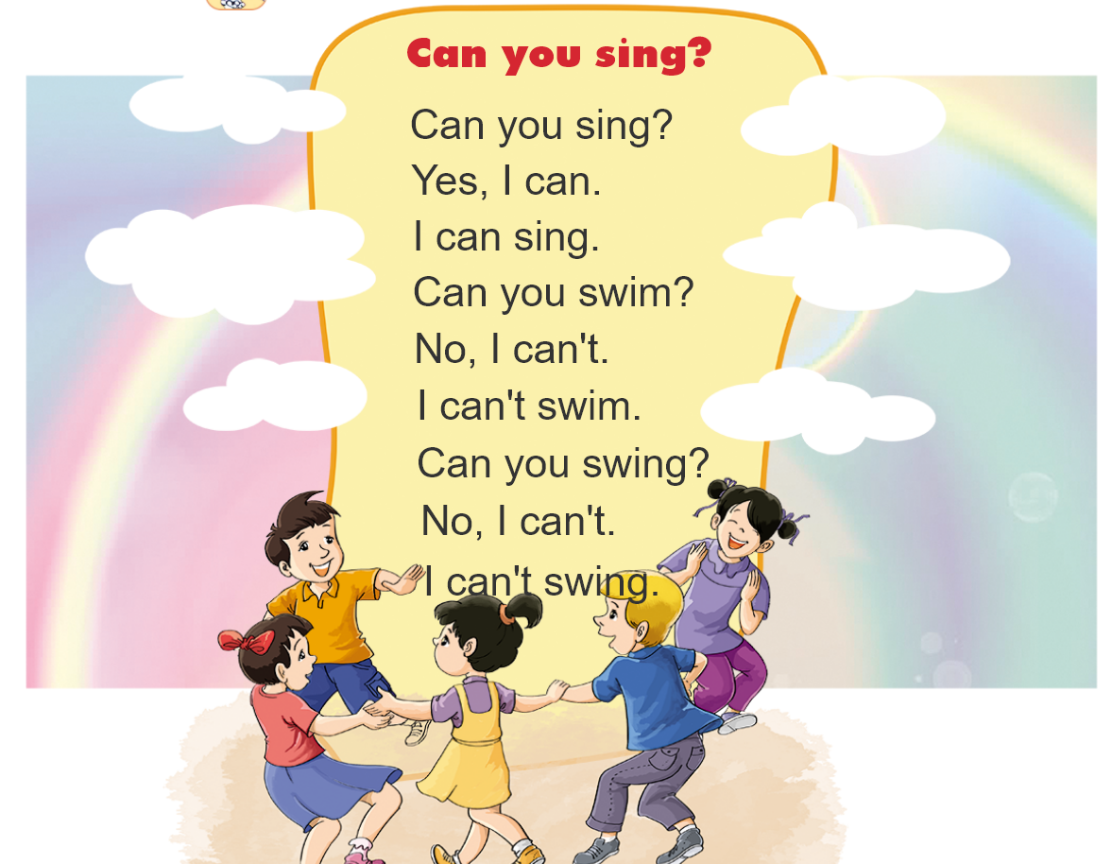


3. Let's chant

Slide 7
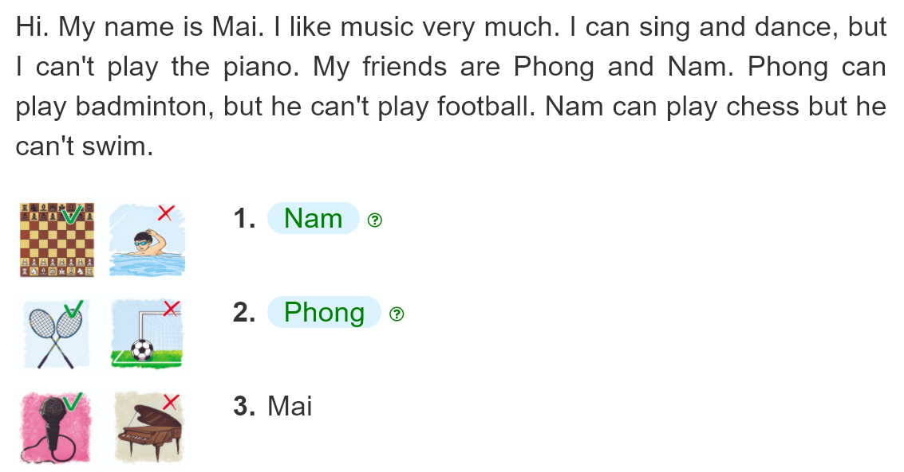
4. Read and match
__________.
__________.
__________.

Slide 8
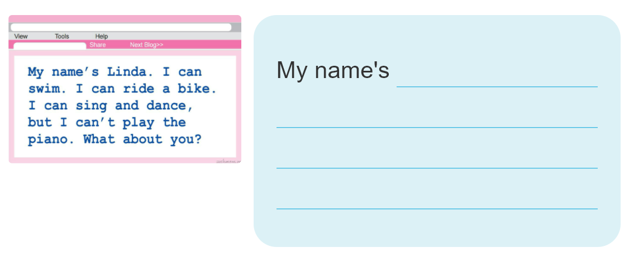
5. Write about you

Slide 9
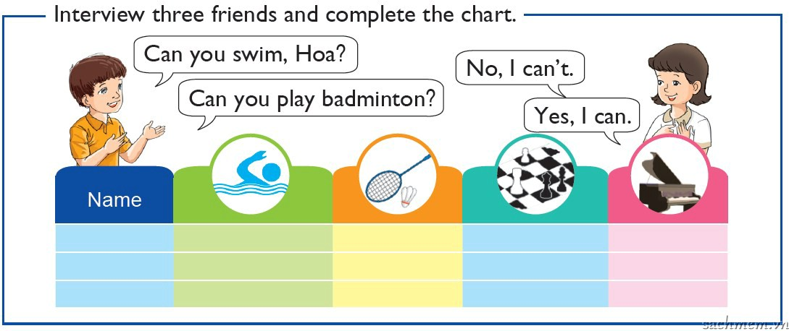
6. Project

Slide 10


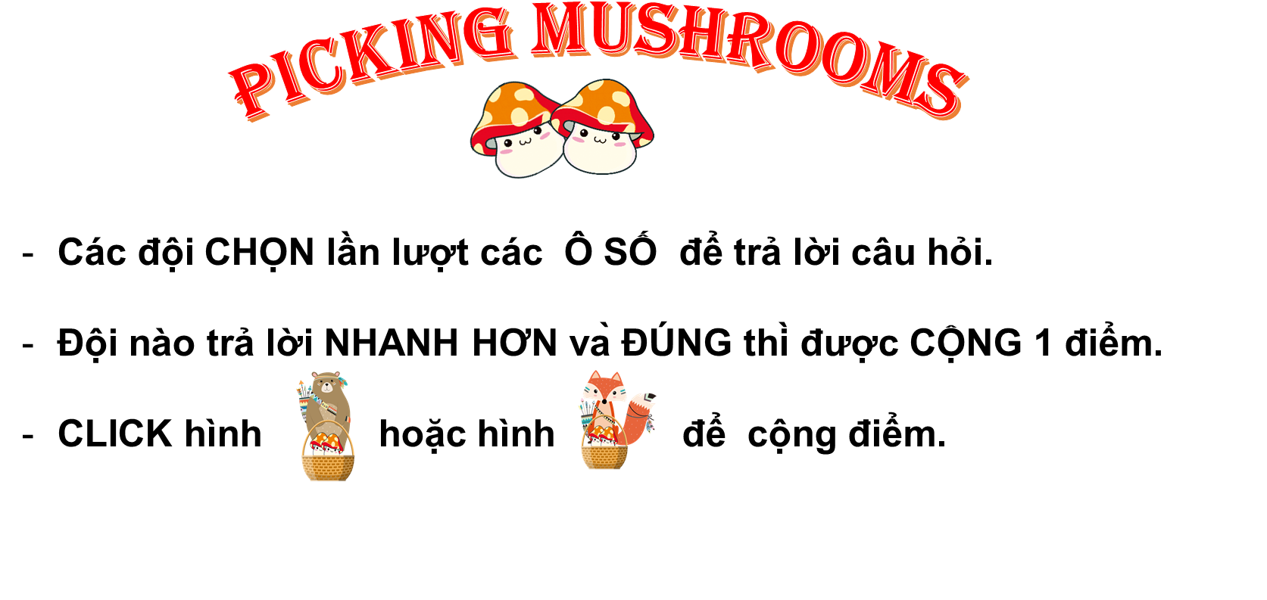







PICKING MUSHROOMS
1
2
3
Các đội CHỌN lần lượt các Ô SỐ để trả lời câu hỏi.
Đội nào trả lời NHANH HƠN và ĐÚNG thì được CỘNG 1 điểm.
CLICK hình hoặc hình để cộng điểm.
4
5
6
7
8
9
10

Slide 11

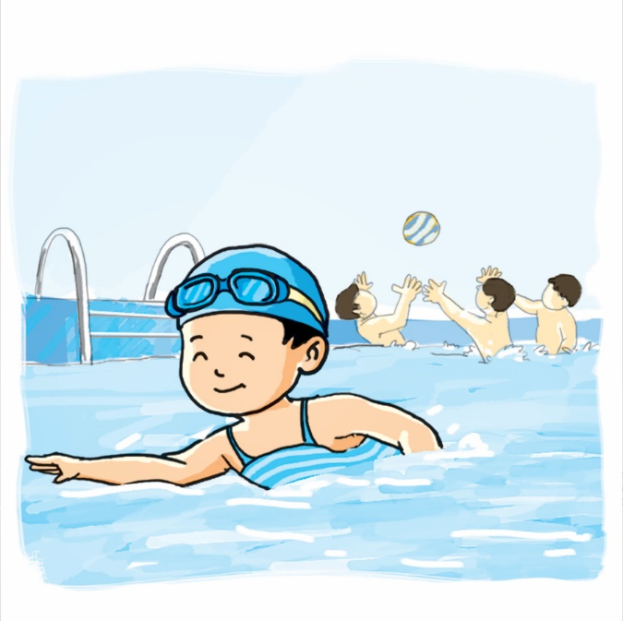






Time’s up
1
2
3
4
5
6
7
8
9
10
What can he do?
Back
A. He can swim
B. Yes, he can.
C. No, he can’t.
A.

Slide 12
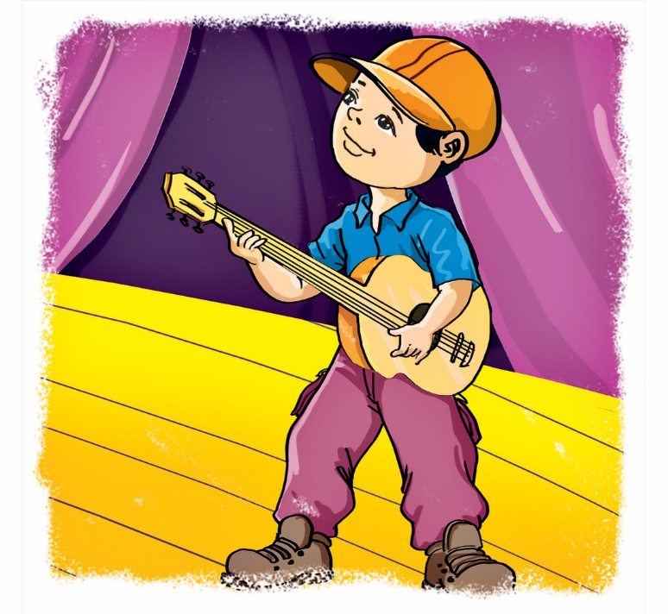
Time’s up
1
2
3
4
5
6
7
8
9
10
What can you do?
Back
A. I play the guitar.
B. I can play the guitar.
C. I can play guitar.
A.

Slide 13
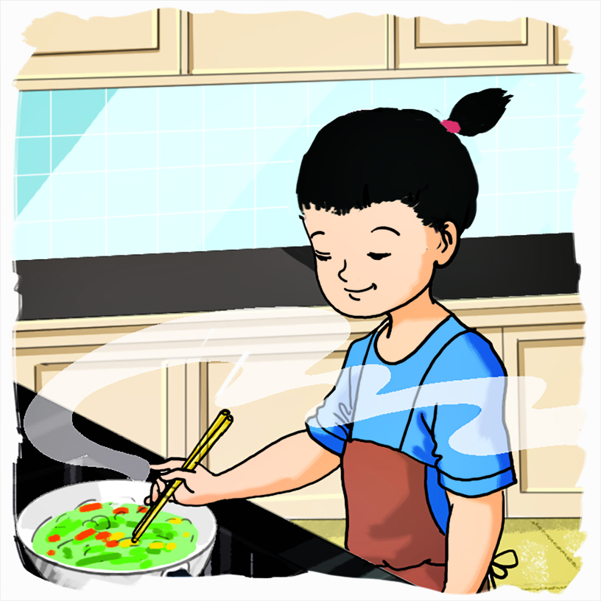
Time’s up
1
2
3
4
5
6
7
8
9
10
What can she do?
Back
A. I can cook.
B. She can cooks.
C. She can cook.
A.

Slide 14
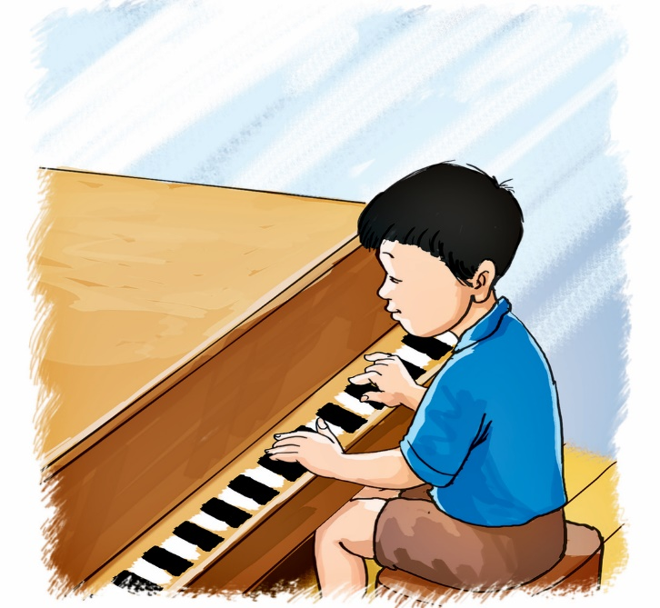
Time’s up
1
2
3
4
5
6
7
8
9
10
Can he play the piano?
Back
A. Yes, he is.
B. Yes, he can’t.
C. Yes, he can.
A.

Slide 15
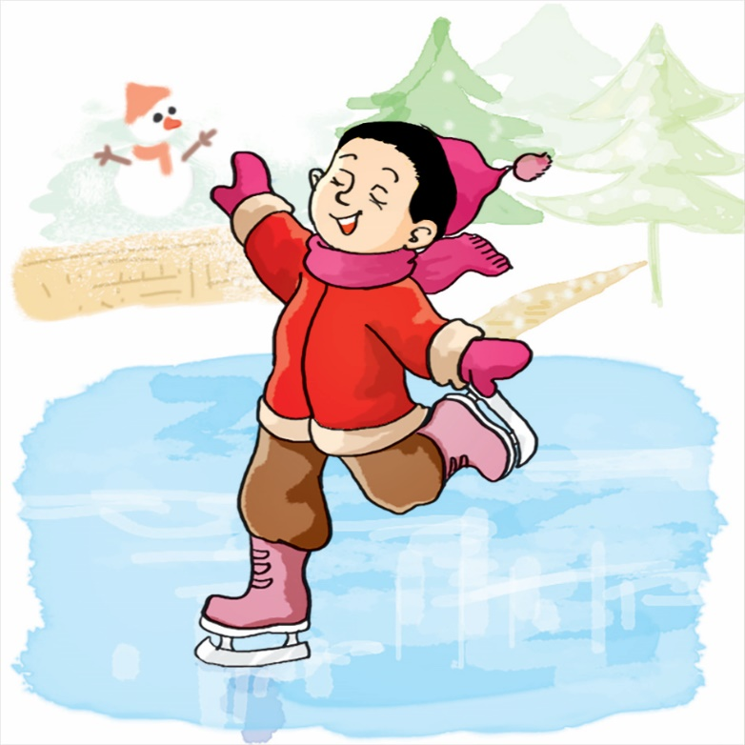
Time’s up
1
2
3
4
5
6
7
8
9
10
Can you skate?
Back
A. Yes, I can’t.
B. No, I can’t.
C. Yes, I am.
A.

Slide 16
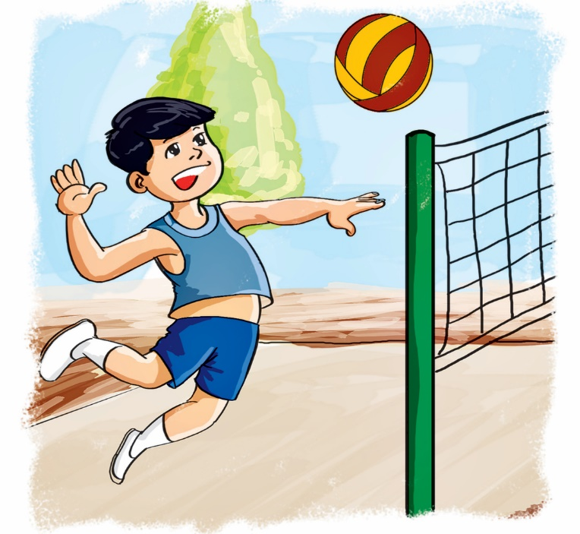
Time’s up
1
2
3
4
5
6
7
8
9
10
_______ play volleyball?
Back
A. He can
B. Can he
C. What can
A.

Slide 17
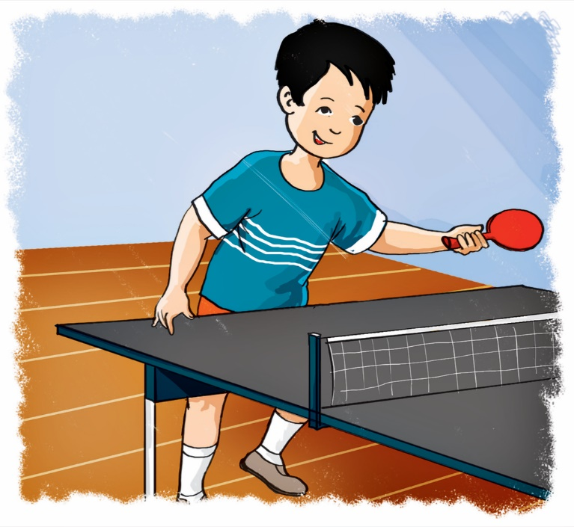
Time’s up
1
2
3
4
5
6
7
8
9
10
_______ you do?
Yes, I can.
Back
A. Do
B. Can
C. What can
A.

Slide 18
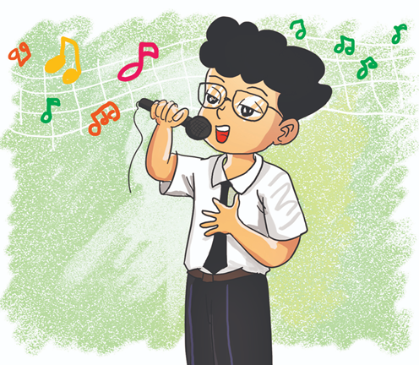
Time’s up
1
2
3
4
5
6
7
8
9
10
Can you sing?
____, I can’t.
Back
A. Yes
B. No
C. And
A.

Slide 19
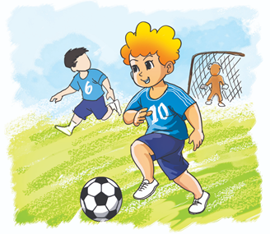
Time’s up
1
2
3
4
5
6
7
8
9
10
Can ____ play football?
Yes, they can.
Back
A. you
B. they
C. he
A.

Slide 20
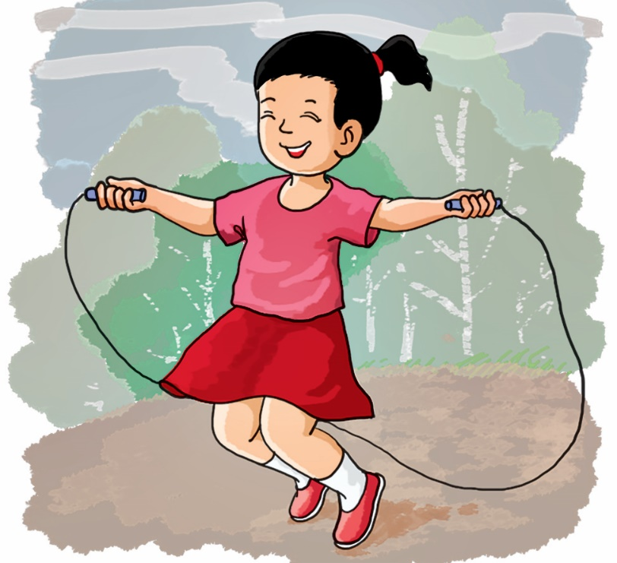
Time’s up
1
2
3
4
5
6
7
8
9
10
Can she skip?
Back
A. Yes, she is.
B. Yes, she do.
C. Yes, she can.
A.

