Slide 1
Unit 4
When’s your birthday?
Lesson 3

Slide 2








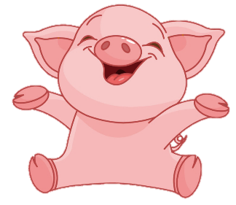
Luật chơi:
Các đội lần lượt chọn các số từ 1-10.
Trả lời đúng được cộng, trả lời sai bị trừ số điểm đã mở.
Ngôi sao xanh được +200 điểm khi trả lời đúng, trả lời sai không bị trừ điểm
Ngôi sao đen bị -200 điểm khi trả lời sai, trả lời đúng không bị trừ điểm.
Lucky number
PLAY
Notes:
Ms Huyền Phạm - 0936.082.789 – YOUTUBE: MsPham. Facebook: Dạy và học cùng công nghệ.

Slide 3


2
100
200
4
1
100
-200
3
100
7
5
6
+200
200
8
100
100
9
10
200
Notes:
Ms Huyền Phạm - 0936.082.789 – YOUTUBE: MsPham. Facebook: Dạy và học cùng công nghệ.

Slide 4




What is the date today?
It’s the nineteenth of
Back
9th /8
19th /8
8th /8
Notes:
Ms Huyền Phạm - 0936.082.789 – YOUTUBE: MsPham. Facebook: Dạy và học cùng công nghệ.

Slide 5

What is the date today?
It’s the twentieth of
Back
20th /11
12th /11
11th /12
Notes:
Ms Huyền Phạm - 0936.082.789 – YOUTUBE: MsPham. Facebook: Dạy và học cùng công nghệ.

Slide 6

What is the date today?
It’s the fourteenth of
Back
4th /2
2nd /4
14th /2
Notes:
Ms Huyền Phạm - 0936.082.789 – YOUTUBE: MsPham. Facebook: Dạy và học cùng công nghệ.

Slide 7

What is the date today?
It’s the first of
Back
1st /3
1st /4
1st /5
Notes:
Ms Huyền Phạm - 0936.082.789 – YOUTUBE: MsPham. Facebook: Dạy và học cùng công nghệ.

Slide 8

What is the date today?
It’s the thirty-first of
Back
30th /10
31st /10
32nd /10
Notes:
Ms Huyền Phạm - 0936.082.789 – YOUTUBE: MsPham. Facebook: Dạy và học cùng công nghệ.

Slide 9

What is your birthday?
It’s on the twenty-fifth of
Back
20th /1
25th /1
25th /2
Notes:
Ms Huyền Phạm - 0936.082.789 – YOUTUBE: MsPham. Facebook: Dạy và học cùng công nghệ.

Slide 10

What is your birthday?
It’s on the twelveth of
Back
12th /6
12nd /6
12th /7
Notes:
Ms Huyền Phạm - 0936.082.789 – YOUTUBE: MsPham. Facebook: Dạy và học cùng công nghệ.

Slide 11

What is your birthday?
It’s on the third of
Back
3rd /4
13rd /4
30rd /4
Notes:
Ms Huyền Phạm - 0936.082.789 – YOUTUBE: MsPham. Facebook: Dạy và học cùng công nghệ.

Slide 12

What is your birthday?
It’s on the second of
Back
2st /9
2nd /9
3rd /9
Notes:
Ms Huyền Phạm - 0936.082.789 – YOUTUBE: MsPham. Facebook: Dạy và học cùng công nghệ.

Slide 13

What is your birthday?
It’s on the thirteenth of
Back
12nd /12
13th/12
13rd /12
Notes:
Ms Huyền Phạm - 0936.082.789 – YOUTUBE: MsPham. Facebook: Dạy và học cùng công nghệ.

Slide 14
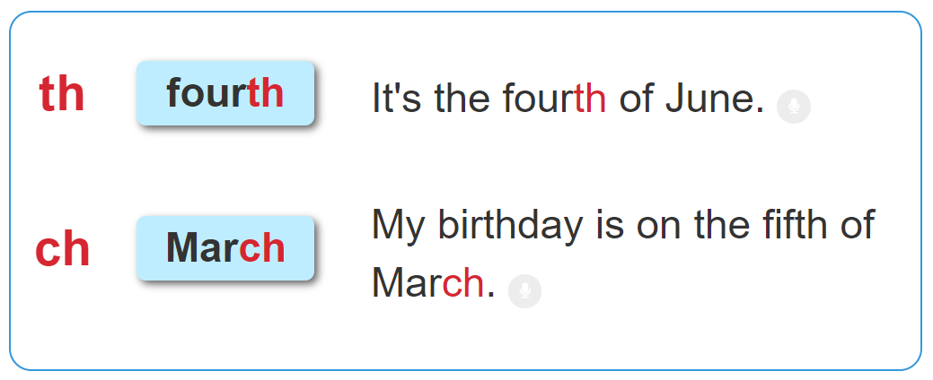

1. Listen and repeat.

Slide 15
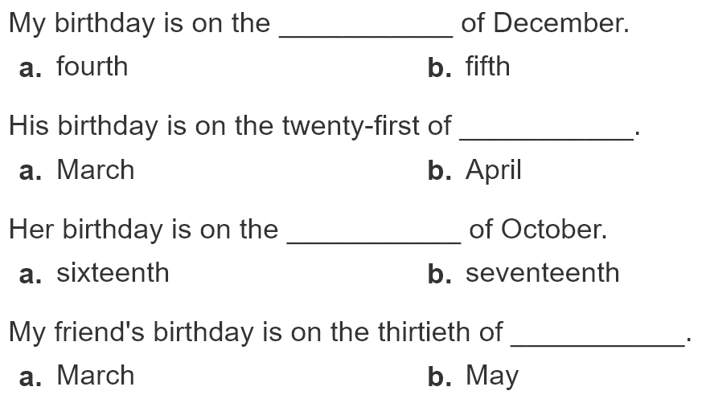
2. Listen and circle. Then say aloud.
1
2
3
4

Slide 16
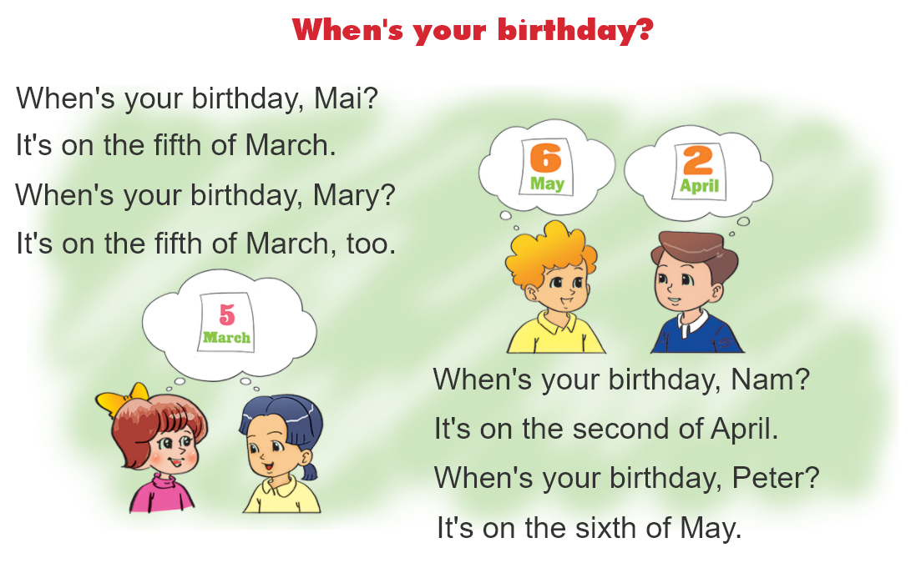
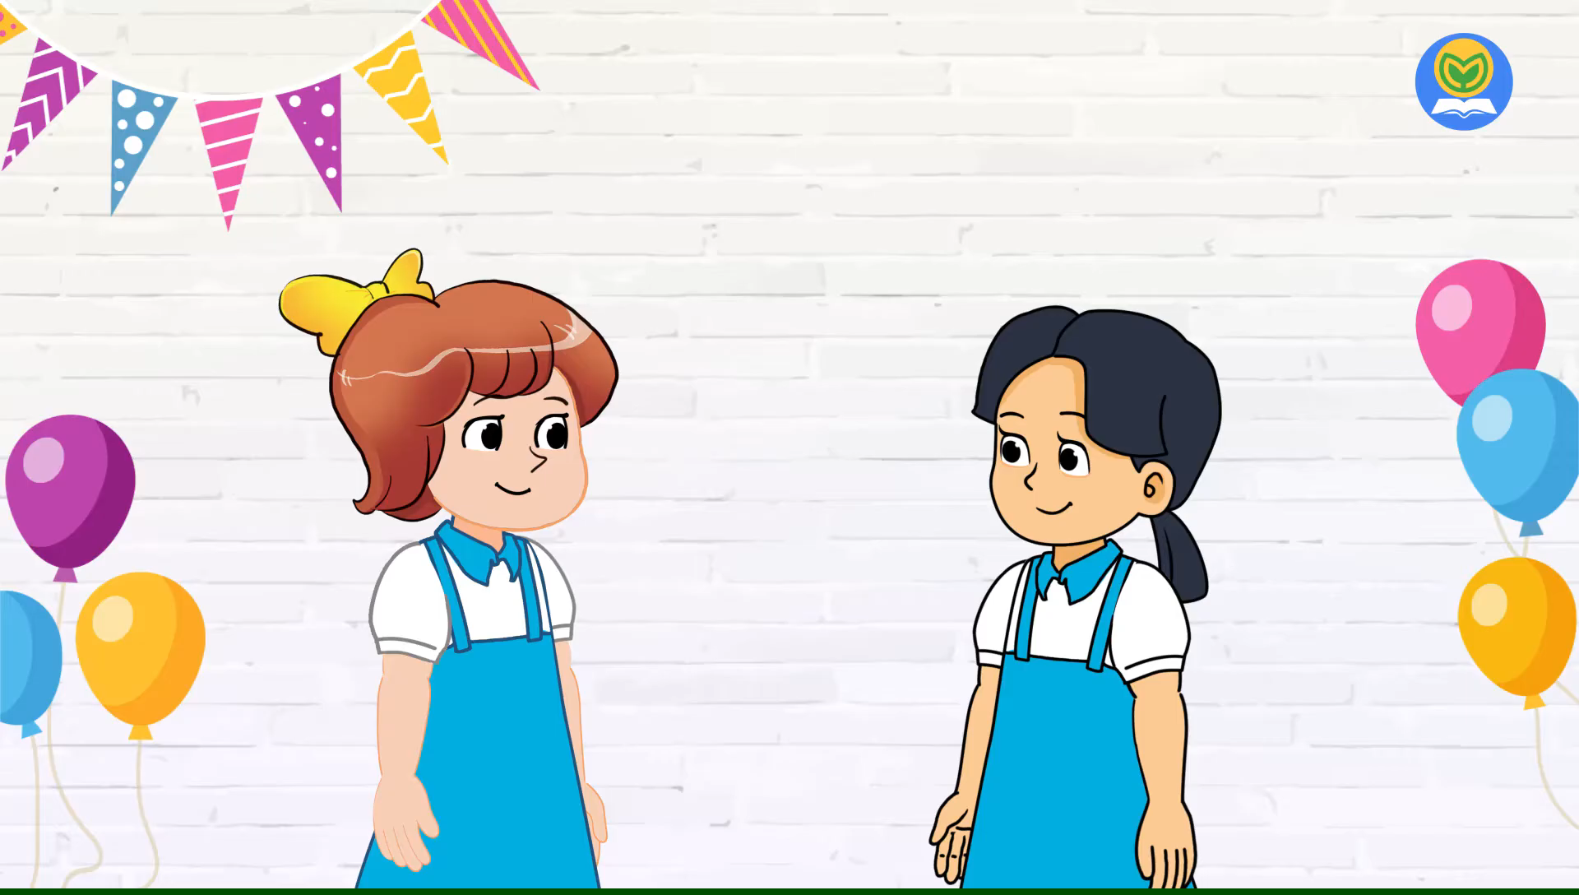
3. Let's chant.

Slide 17
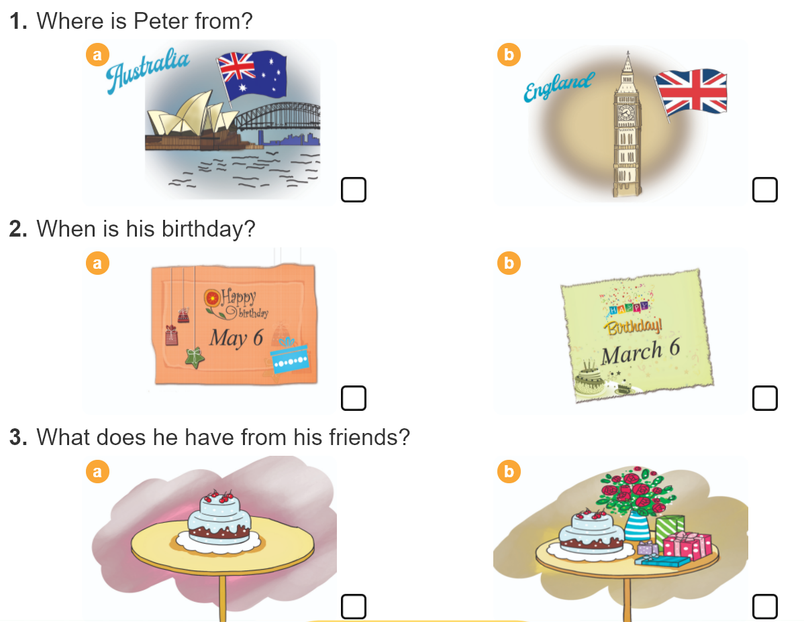

4. Read and tick.
Dear penfriend,
My name's Peter. I'm from London, England. Today is Sunday, the sixth of May. It's my birthday. I'm happy. I have many birthday presents from my friends. What about you? When's your birthday?
Write to me soon,
Peter

Slide 18

5. Write an invitation card
Please come to my birthday party.
To:
Date:
Time:
Address:
From:

