Slide 1

Unit 2
Review and Practice
Page 36
Notes:
By the end of this lesson, students will be able to review introducing family members, asking who someone is, and following simple instructions.
Vocabulary:
friend, cousin, uncle, grandfather, aunt, homework, clean, wake up
Structures:
Who’s he/she?/ This is my…/ What’s his/her name?/ Clean your room.

Slide 2

WARM UP

Slide 3






Memory Game
1
2
3
4
5
6
A
B
C
sister
cousin
uncle
D
E
F
grandmother
grandfather
aunt

Slide 4

It’s time to learn …

Slide 5

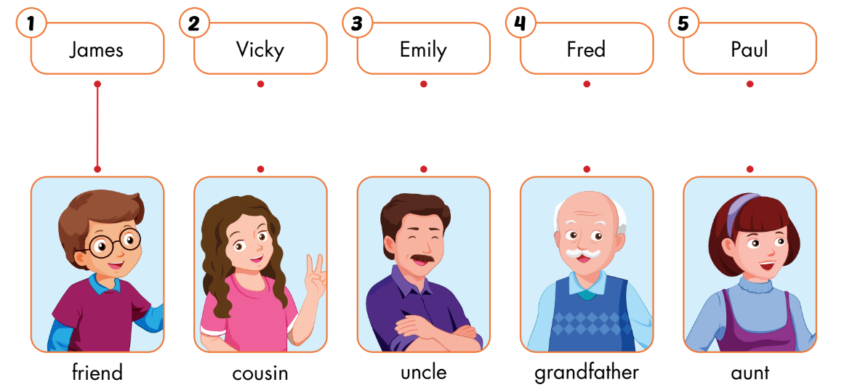
A
Listen and draw lines. (CD1 Track 57)
Keys

Slide 6

Reading

Slide 7

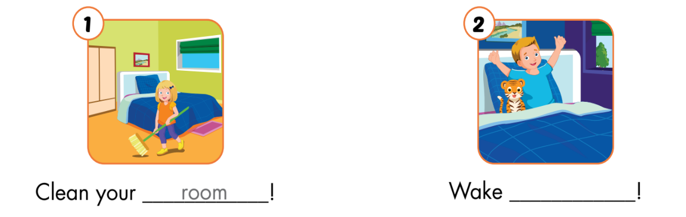
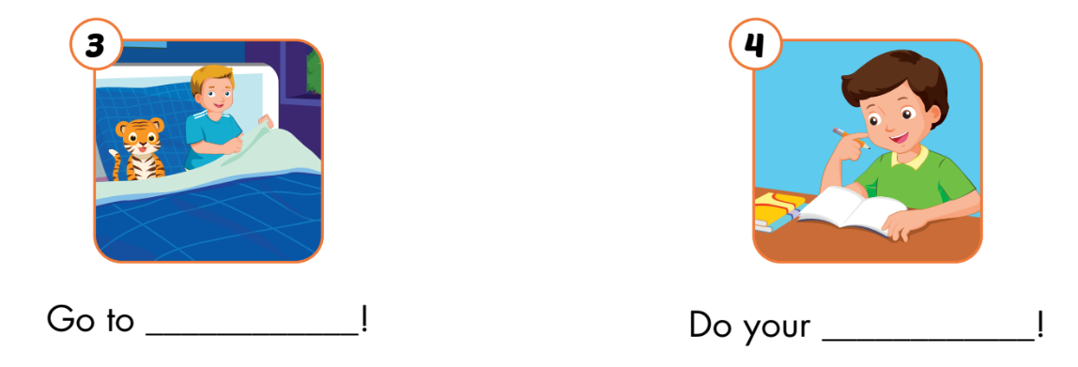
B
Read the sentences. Choose a word from the box. Fill in the blanks.
up
bed
homework

Slide 8

Workbook
Page 26

Slide 9
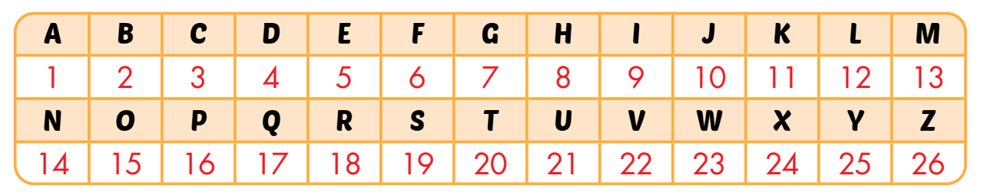
A
Look at the table and pictures. Look at the numbers. Write the words and draw lines.

Slide 10
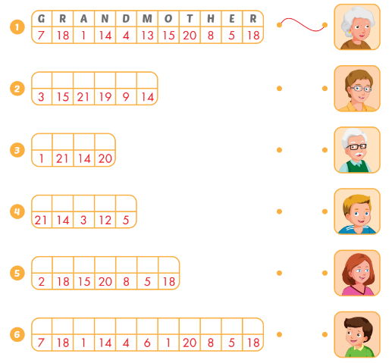
A
Look at the table and pictures. Look at the numbers. Write the words and draw lines.
c
o
u
s
i
n
a
u
n
t
u
n
c
l
e
b
r
o
t
h
e
r
g
r
a
n
d
f
a
t
h
e
r

Slide 11

Consolidation

Slide 12



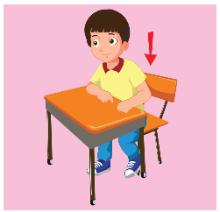
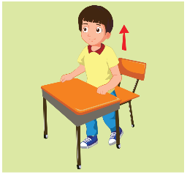



What’s missing?
1
2
3
4
5
6
7
8

Slide 13








What’s missing?
1
2
3
4
5
6
7
8

