Slide 1

Unit 2: Family
Lesson 2.2
Page 28

Slide 2

WARM UP

Slide 3
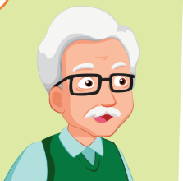
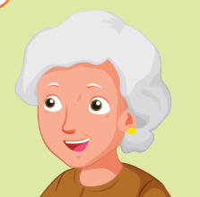
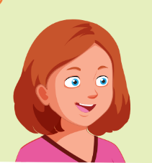
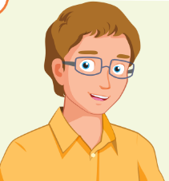

FAMILY TREE

Slide 4

Phonics
/ð / sound

Slide 5



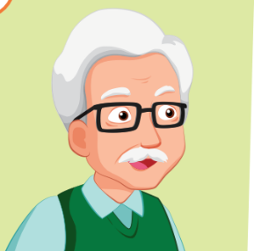
Click on the icon to hear the sound
grandmother
grandfather
/ð /
/ð /

Slide 6

Listen and point
Listen and clap
Listen and chant

Slide 7
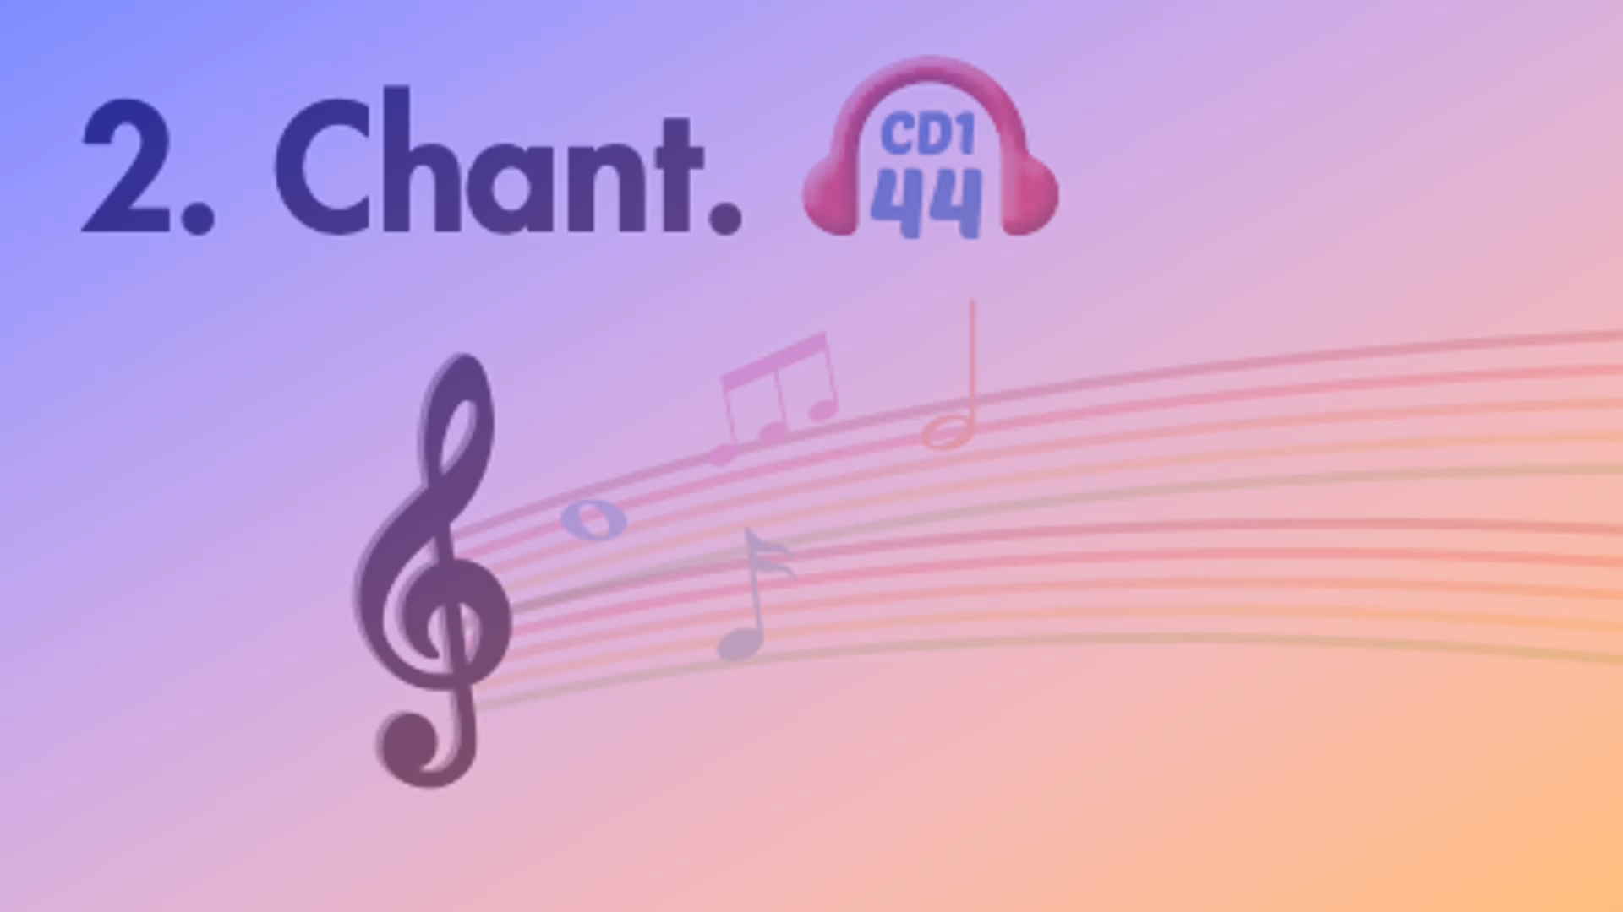

Slide 8

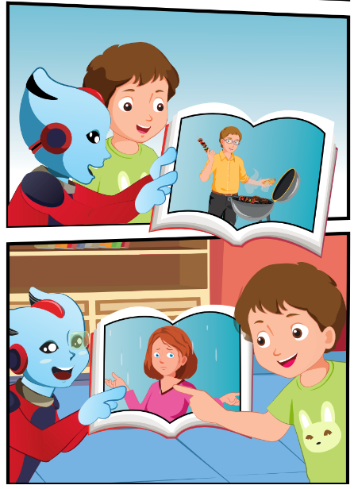
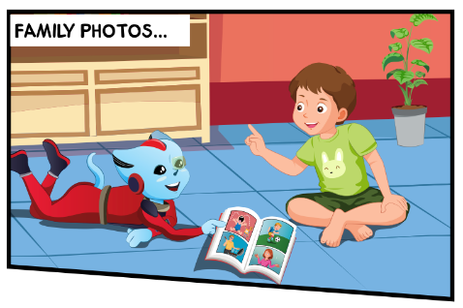
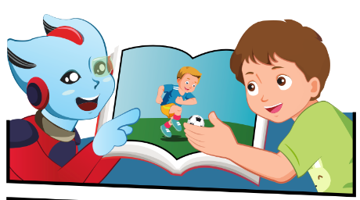
Who can you see?
Who are the people in the photos?
What photos do they look at?
3.
1.
4.
2.

Slide 9

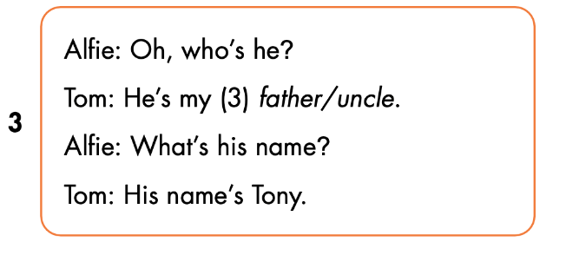
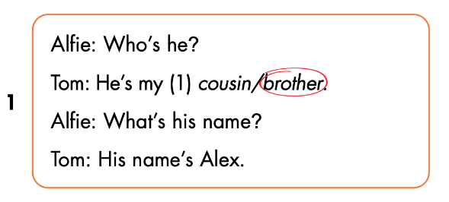
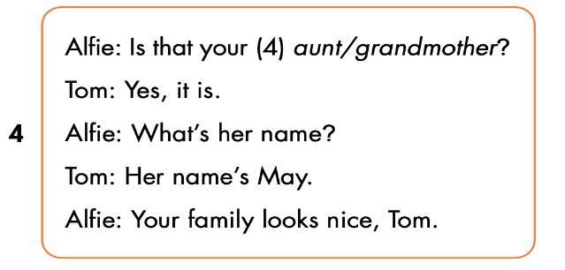
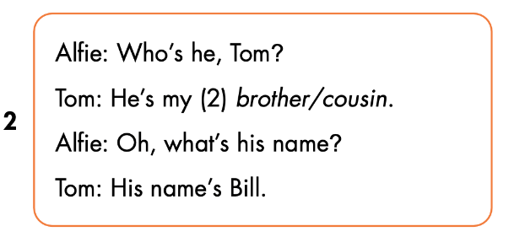

Slide 10


Slide 11

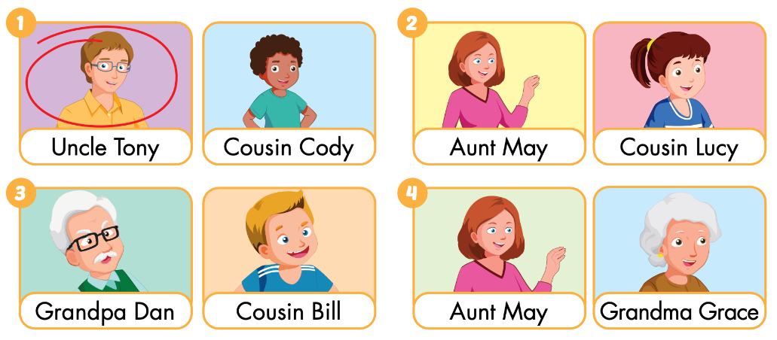
WB p.21
Click on the icon to hear the sound

Slide 12

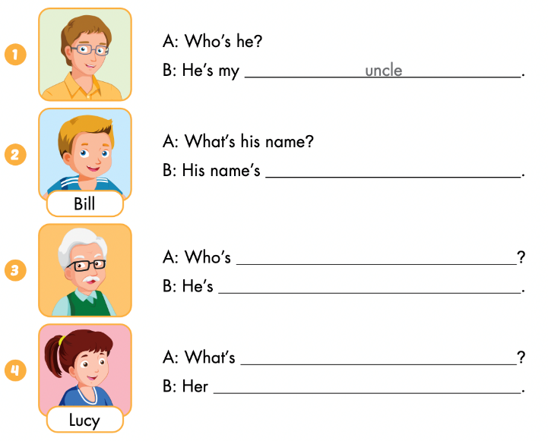
Bill
he
my grandfather
her name
name is Lucy

Slide 13
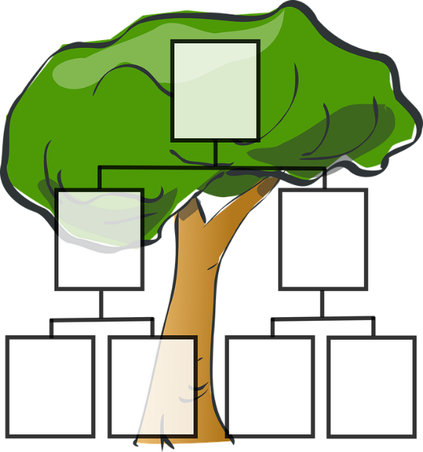
Let’s draw.
Draw your family tree
Work in pairs
Tell your partner about your family

