Slide 1

Unit 2: Family
Lesson 1.2
Page 25
Notes:
Phonics: /ʌ/
Structure: This is my (father).
Hello, I’m Alfie.
Hello Alfie.

Slide 2




WARM UP
2
3
1
4
This is my …

Slide 3

It’s time to learn …

Slide 4

Phonics
/ʌ/ sound

Slide 5
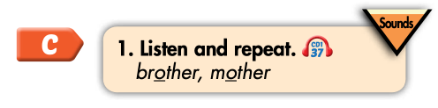



brother
mother
/ʌ/
/ʌ/
Click on the word to hear the sound

Slide 6
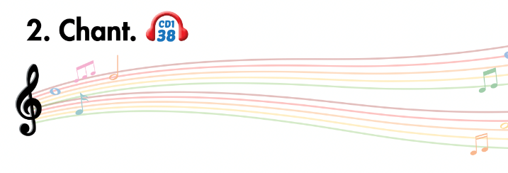
Listen and point
Listen and clap
Listen and chant

Slide 7
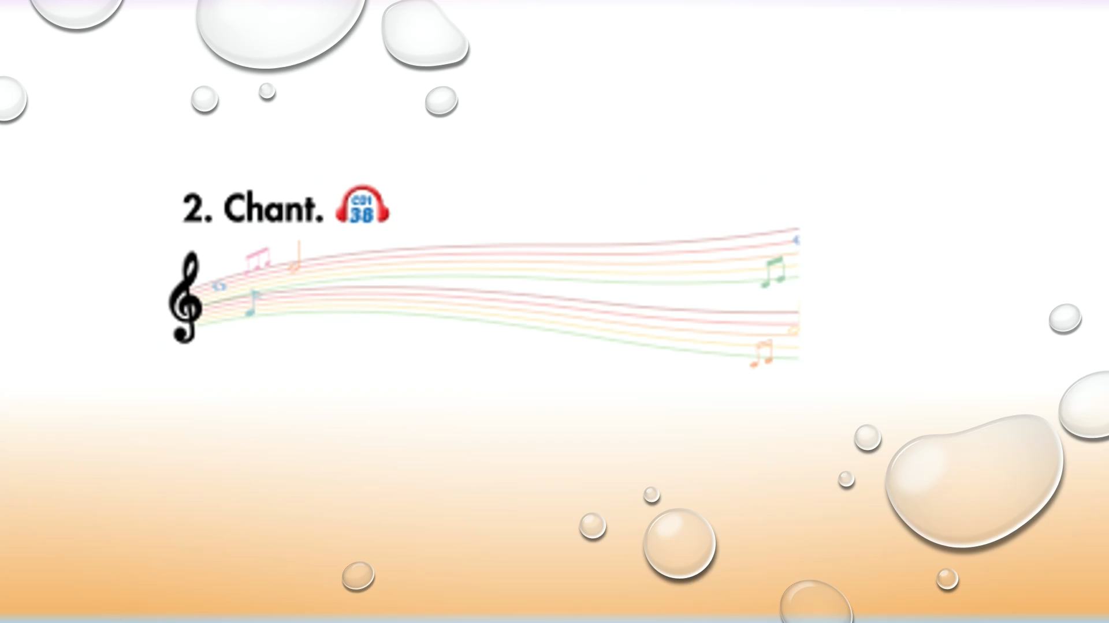

Slide 8
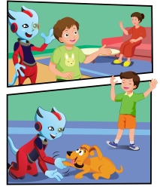
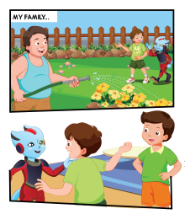
Does Alfie know Tom’s family?
Who can you see?
Where are they?
3.
1.
4.
2.

Slide 9

3.
Does Alfie know Tom’s family?
Who can you see?
Where are they?
1.
4.
2.

Slide 10

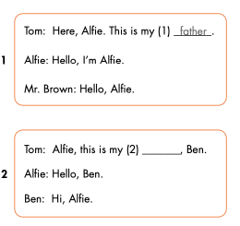
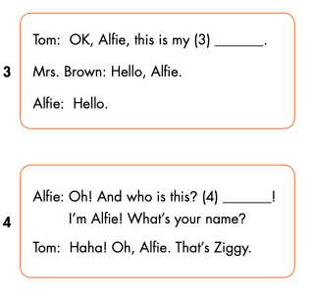
mother
brother
Hello

Slide 11

Speaking

Slide 12

mother
brother
Hello

Slide 13

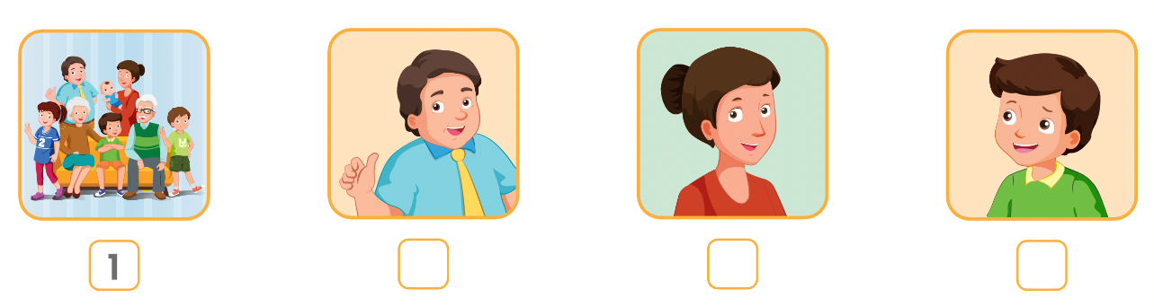
WORKBOOK
page 19
4
2
3
Click on the icon to hear the sound

Slide 14

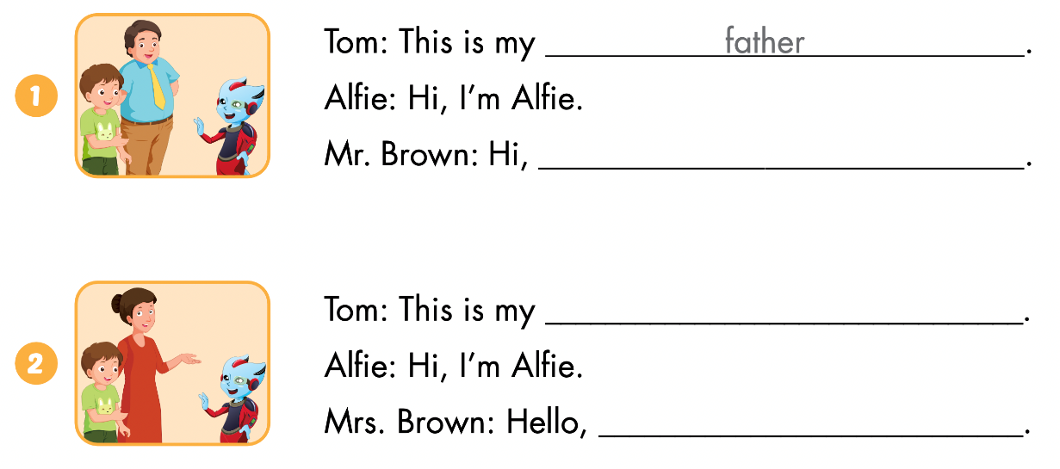
Alfie
mother
Alfie

Slide 15
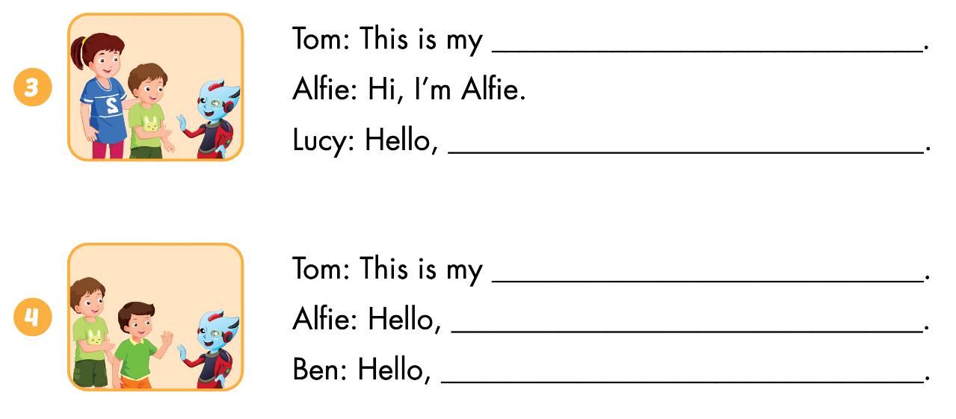
sister
Alfie
brother
I’m Alfie.
Alfie

Slide 16

Let’s draw.
Draw your family
Work in pairs
Tell your partner about your family

