Slide 1

Unit 2: Family
Lesson 1.1
Page 24
Notes:
Vocabulary: Father, mother, brother, sister
Structure: This is my father. / Hello, I’m Alfie. / Hello, Alfie
Aim: Students will be able to introduce family members.

Slide 2

WARM UP

Slide 3


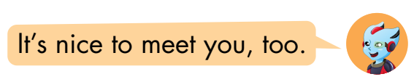

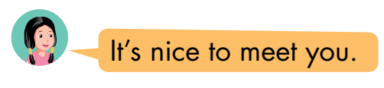


Look and read. Then listen and match.
1
a
2
b
3
c
Click here to listen
1
2
3
Click on squares 1,2,3 to show answers.
Notes:
click on square 1,2,3 to show answer. Let students practice in big groups then call some to stand up and practice together.

Slide 4

It’s time to learn …

Slide 5

New words

Slide 6


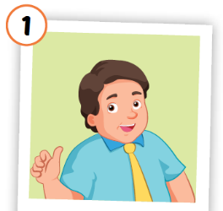
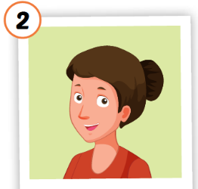
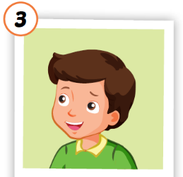
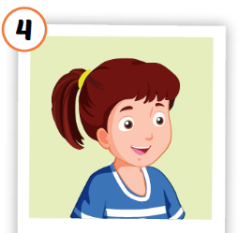
Click each English word to hear the sound.



father
mother
brother
sister





Notes:
Click vào từ tiếng Anh để nghe phát âm của từ
Khai thác nghĩa bằng tranh, cuối cùng mới giải thích phiên âm và nghĩa bằng tiếng Việt

Slide 7











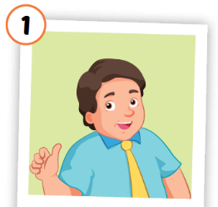

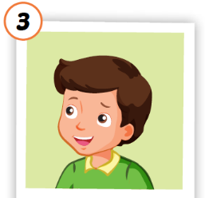
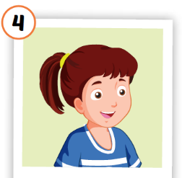
Activity 1
Look and read. Then listen and point to the right picture .
a
b
c
d
e
f
g
h
i
j
k
father
mother
brother
sister
Click on the animals to play audios.
Notes:
Click vào các con vật a-không để nghe âm thanh
HS có thể chọn bất kì con vật nào để nghe âm thanh của từ vựng

Slide 8




Activity 2
Look at the pictures and say the right number
2
3
1
4
father
mother
brother
sister
brother
mother
father
mother
sister
brother
father
sister
mother
brother
STOP
Notes:
GV ấn enter để chạy hiệu ứng, HS nói to số tranh có chứa từ tương ứng

Slide 9

Structures

Slide 10

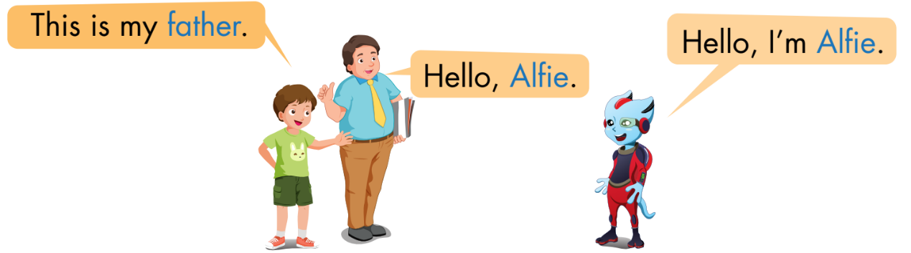
1
2
3
Tom
Sam
Alfie
Notes:
Giơi thiệu nhân vật
Click vào số để nghe nội dung.
Click vào bóng nói để xuất hiện chữ

Slide 11

Giới thiệu 1 ai đó:
This is my ……..

Slide 12
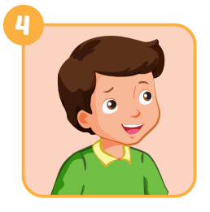

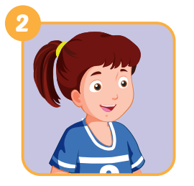


Activity 1
Help Tom introducing his family members
This is my ……..
Look at the pictures and complete what Tom’s saying.
Notes:
Devide sts into teams, explain the game and show the pictures one by one. Who knows the answer says " BINGO" will get the chance to answer.

Slide 13
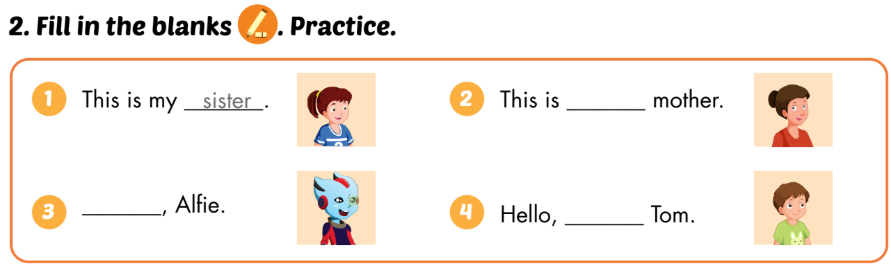
Activity 2
SB p.24
my
Hello
I’m

Slide 14





WORKBOOK
page 18
i
s
t
e
r
a
t
h
e
r
r
o
t
h
e
r
Notes:
GV giới thiệu tranh, HS điền từ còn thiếu
Step 1: open the pictures one by one and let student say what it is.
Step 2: Show the first answer ans an example. Then give sts sometimes to finish their answer
Step 3: ask for a volunteer, then let him/her say the answer. Ask the person to spell the word (if he/she can)

Slide 15

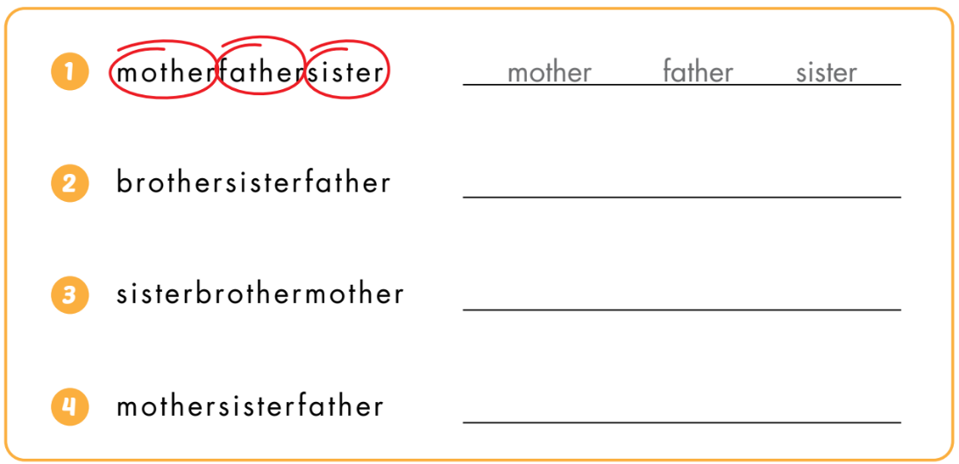
brother
sister
father
sister
brother
mother
mother
sister
father
Notes:
Câu 1 là ví dụ. HS khoanh đáp án trước rồi viết từ vào chỗ trống sau

Slide 16
Consolidation

Slide 17
Draw your family members on A4 paper and introduce them to your classmates.
1
2
3
4
This is my ……..
Hello, …..
Hello, I’m …….
1
3
2

Slide 18
Monday, October 10th 2022
Unit 1: Family
Lesson 1.1 (page 24)
A: This is my father.
B: Hello, I’m Alfie.
C: Hello, Alfie. Nice to meet you.
This is… Đây là …
father: bố
mother: mẹ
brother: anh, em trai
sister: chị, em gái

Slide 19
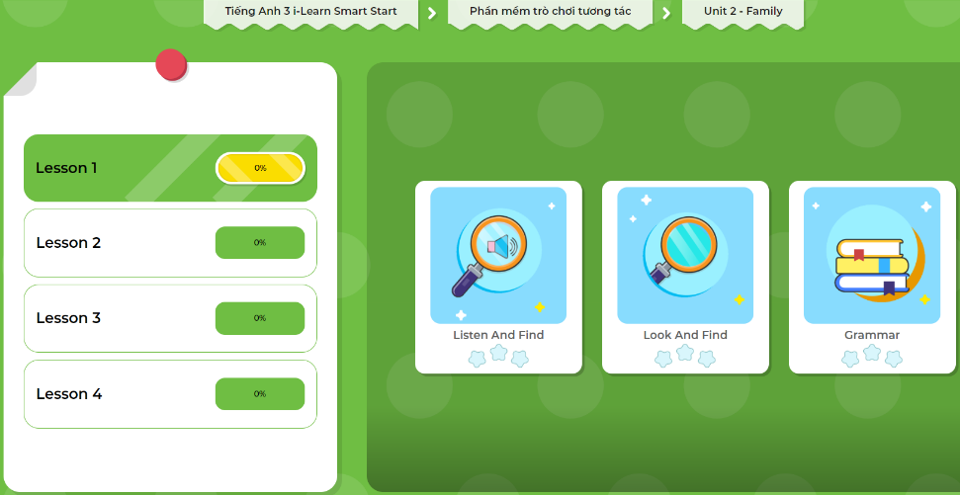
Extra Practice
DHA App
LET’S PLAY!
Click on the picture below

