Slide 1

WELCOME TO CLASS 4A
Ai Mo A PRIMARY SCHOOL
Teacher : Hoang Thi Hong

Slide 2


Warm - up

Slide 3



Let's play
Who's a millionaire?

Slide 4


Let’s go to the ……
I want to buy some food and drink .
A. zoo
B. school
C. supermarket
D. bookshop
C. supermarket

Slide 5
10,30,50,….,90
20,…,60,80,100
A. eighty/forty
B. seventy/forty
B. seventy/forty
C. seventy/fifty
D. twenty/thirty

Slide 6
Let’s go to the ……
I want to buy some books.
A. cinema
B. post office
C. bookshop
C. bookshop
D. library

Slide 7

You are a millionaire.
L
F

Slide 8
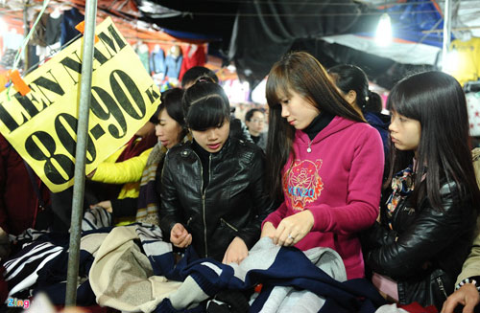
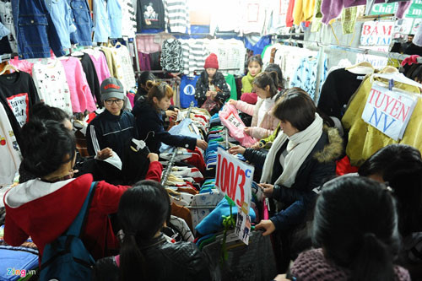
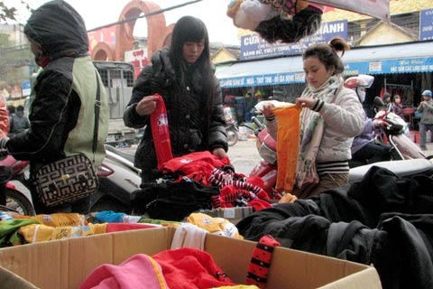
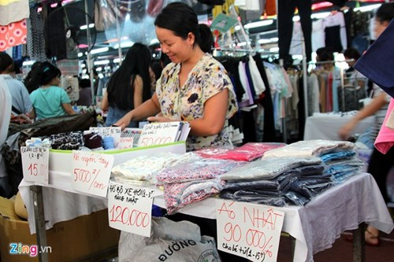
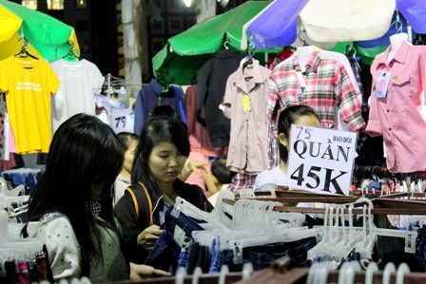
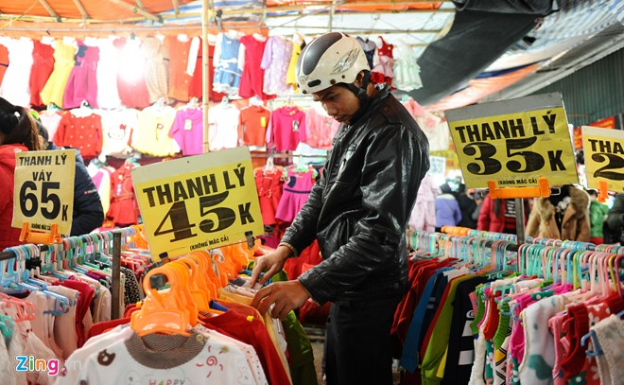
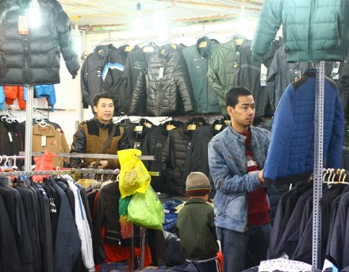


Slide 9
1. Look, listen and repeat.

Slide 10
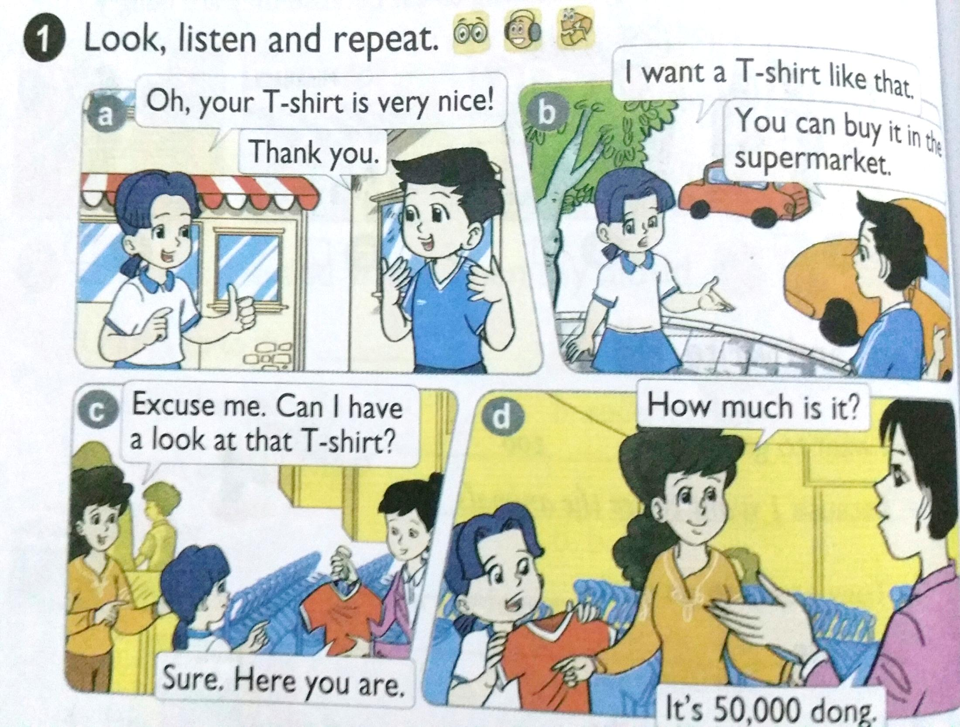

Slide 11
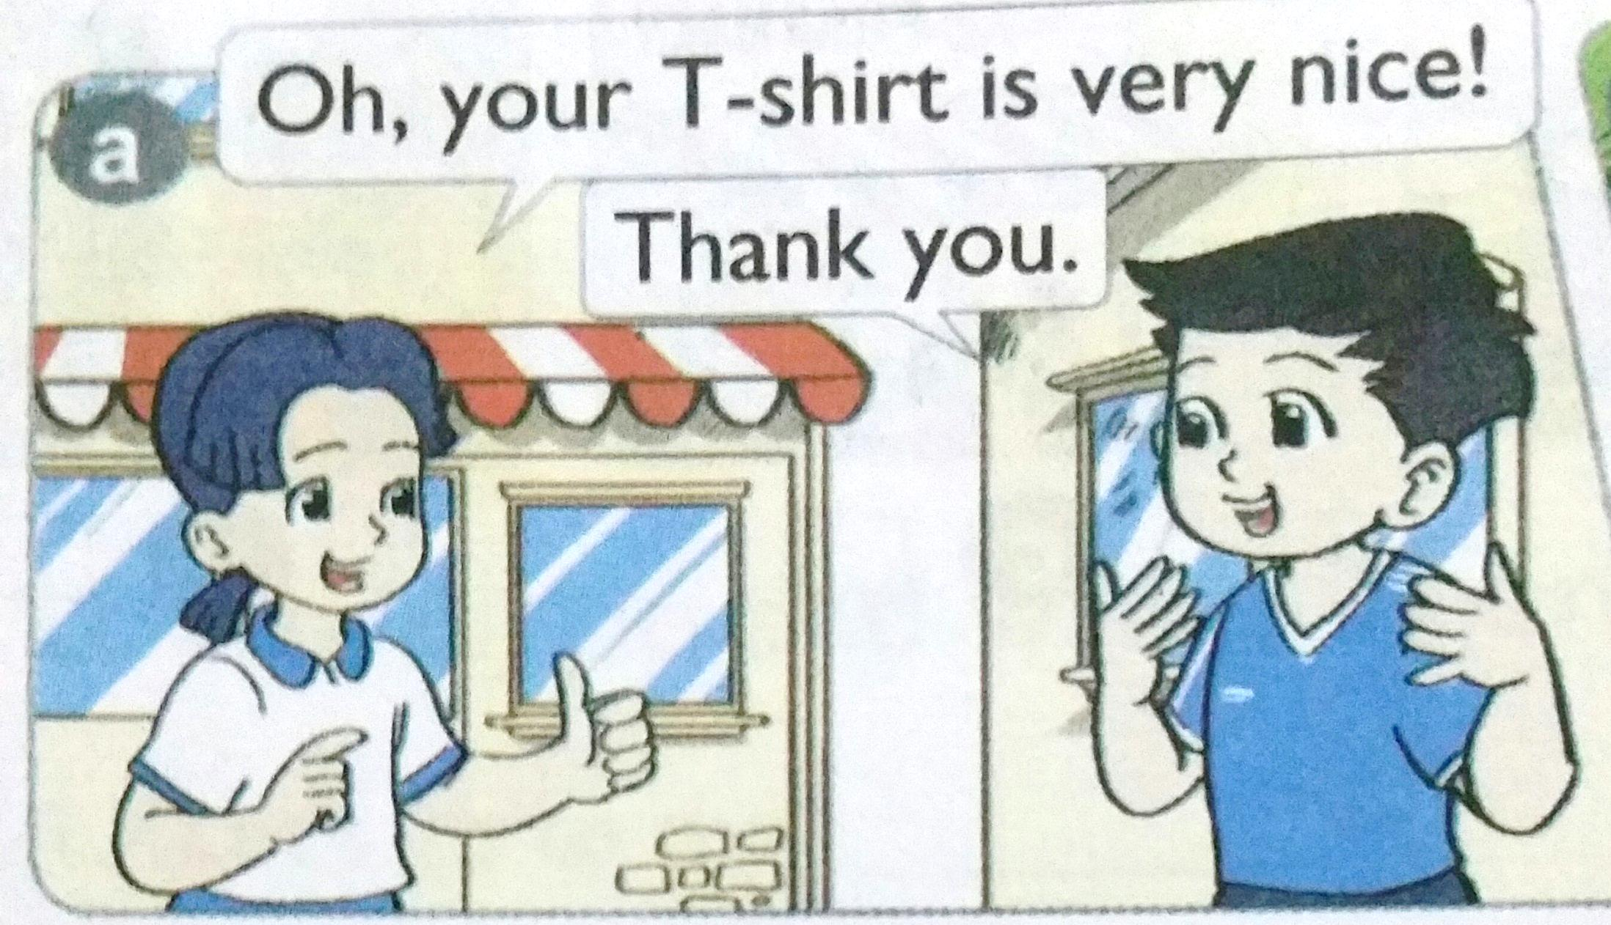

Slide 12
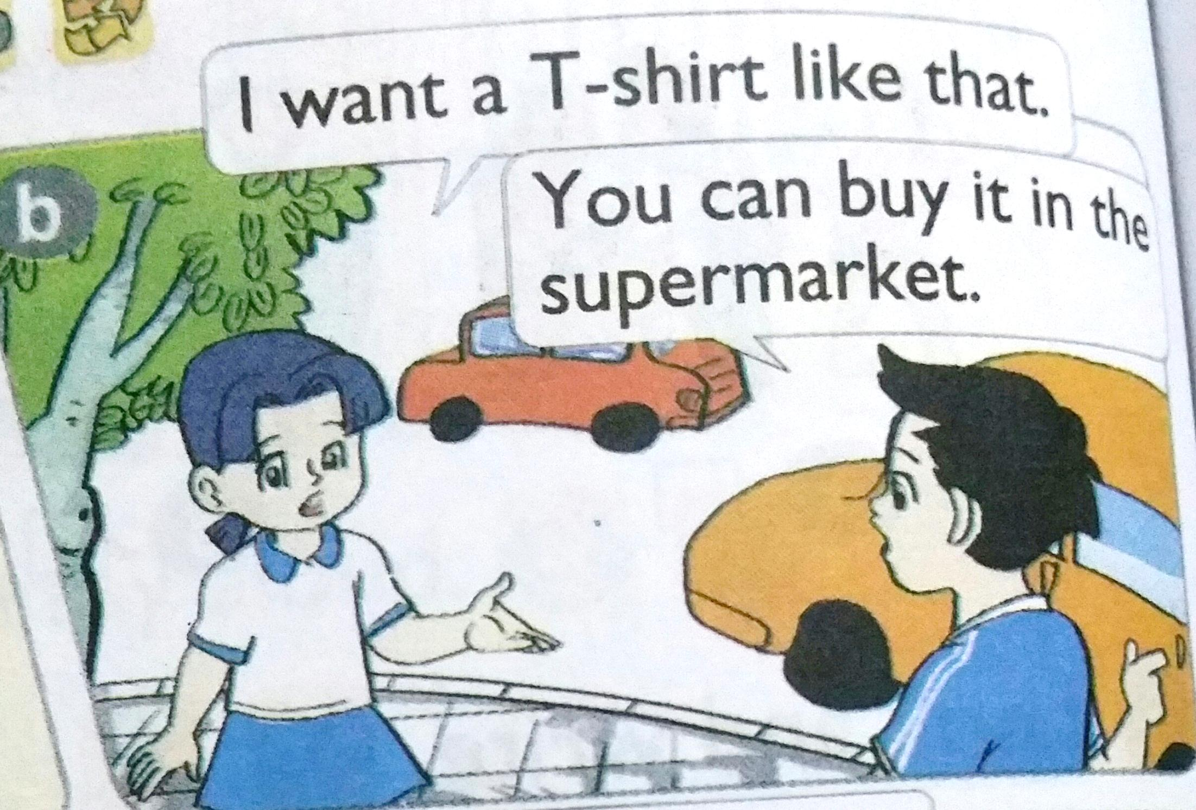

Slide 13
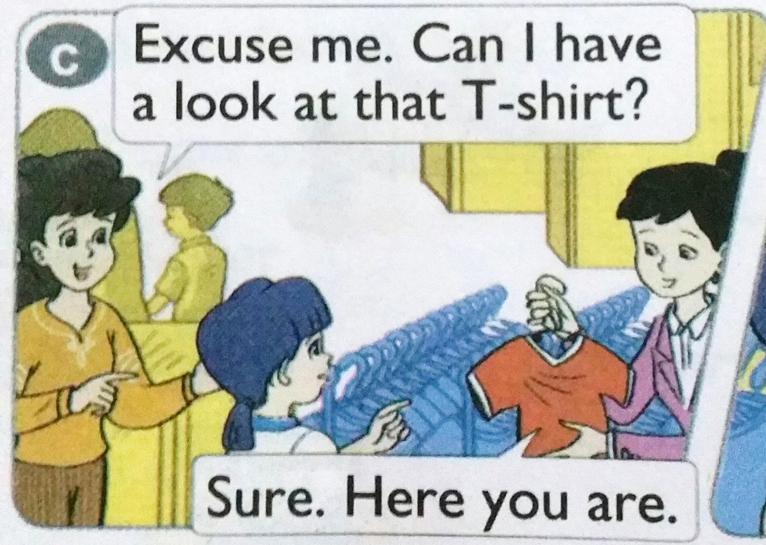

Slide 14
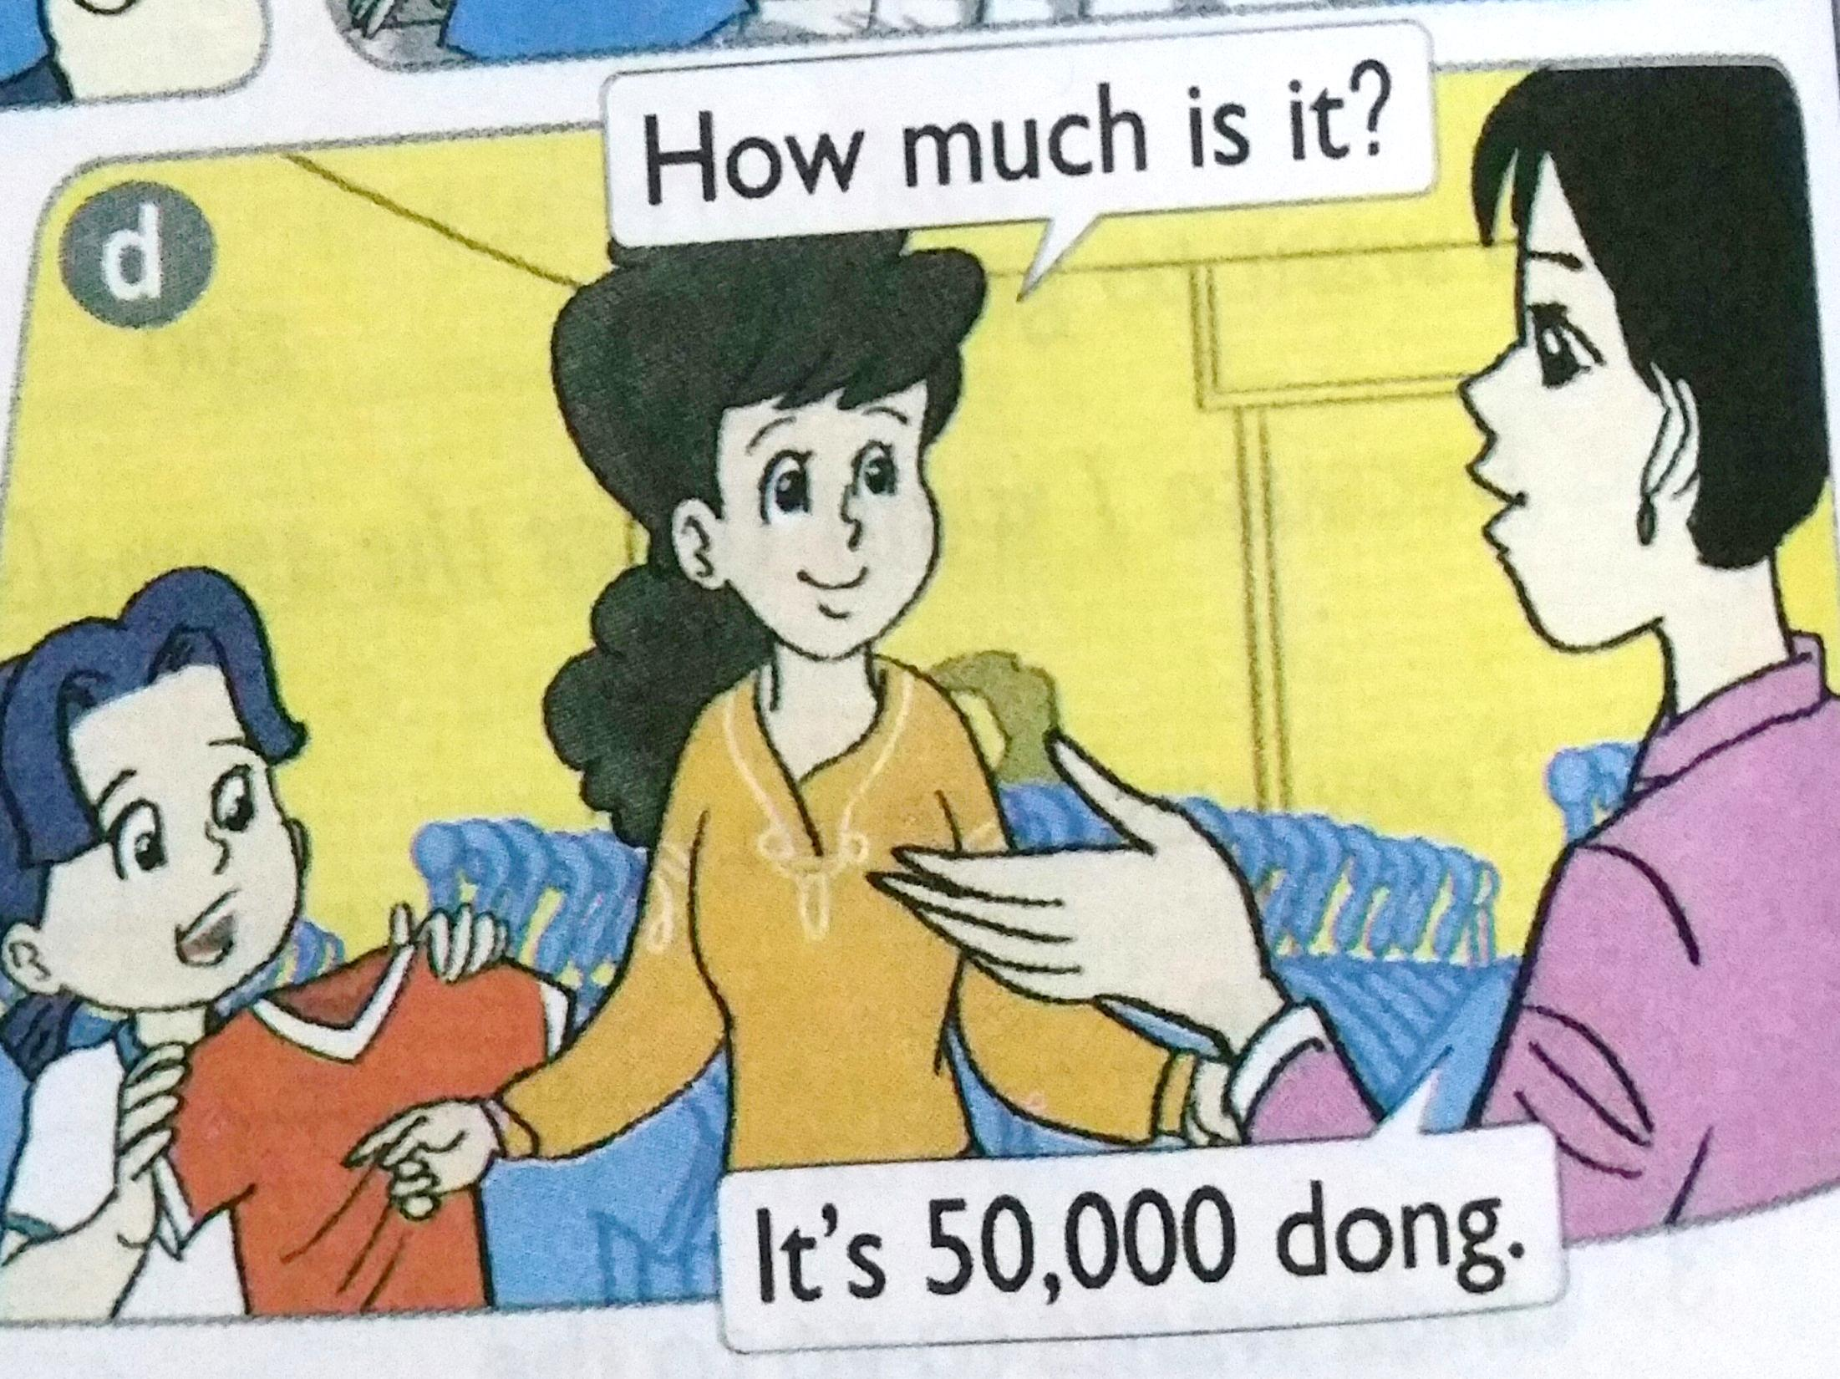

Slide 15
1. Look, listen and repeat.
2. Point and say.

Slide 17
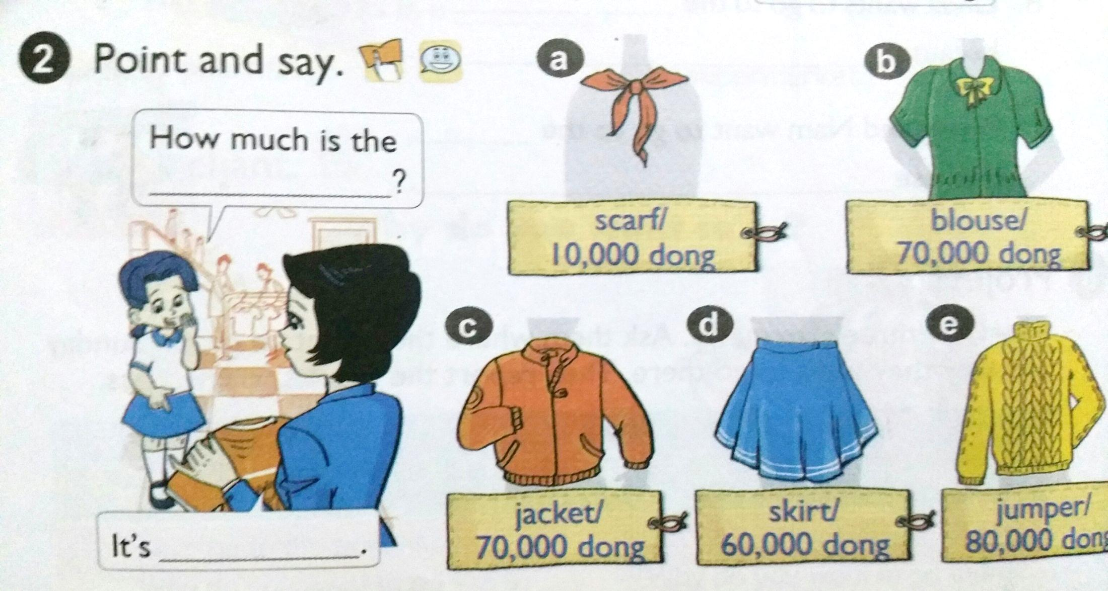

Slide 18

Role play

Slide 19
At home:
1, Learn by heart all the new words.
2, Prepare the next lesson ( lesson 2).

Slide 20







