Slide 1


Welcome to our class
Ai Mo A Primary School
Teacher: Hoàng Thị Hồng
English 3
31/3/2021
Võ Thị Thoa

Slide 2




Play game
1. Are there any posters in the room?
A. Yes, they are.
B. Yes, there are.
B. Yes, there are.
C. Yes, it is.
D. Yes, he is.

Slide 3
Play game
2. How many _____ are there?
A. map
B. fan
C. windows
C. windows
D. picture

Slide 4
Play game
3. How many classrooms are there?
A. There is eight.
B. These are eight
C. This is eight.
D. There are eight.
D. There are eight.

Slide 5


UNIT 15: DO YOU HAVE ANY TOYS?
Lesson 1

Slide 6
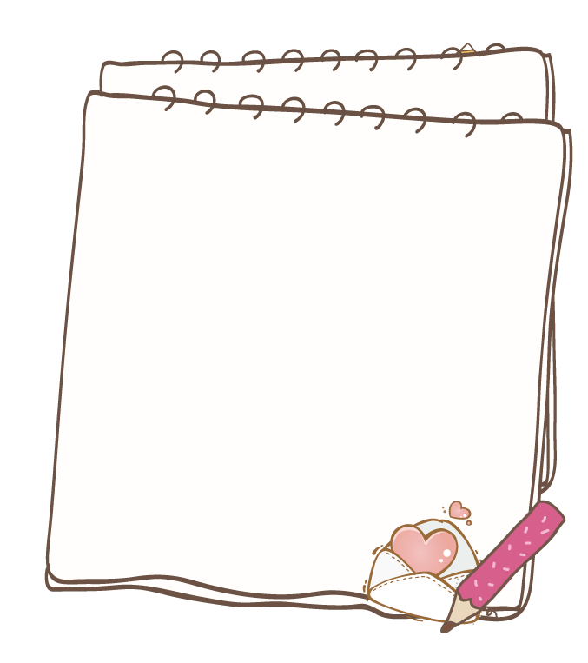
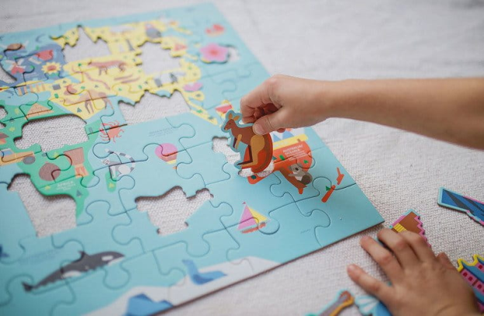
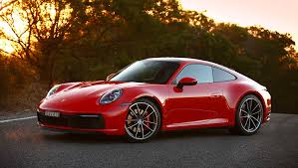
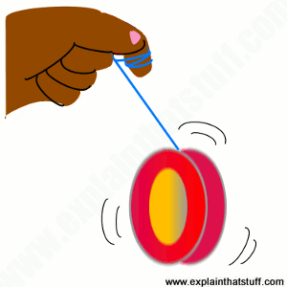
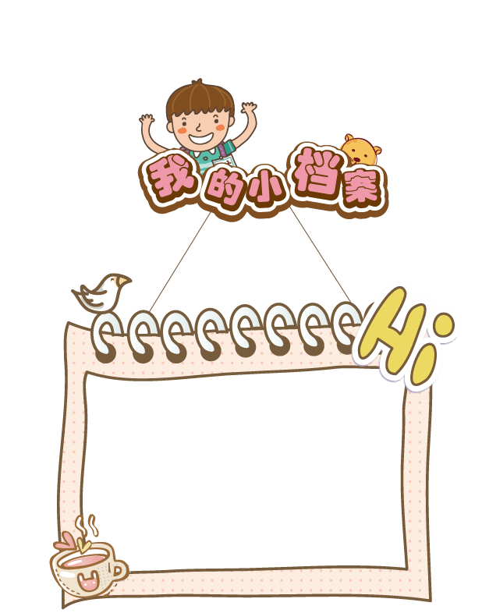
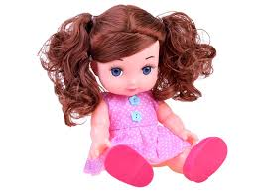
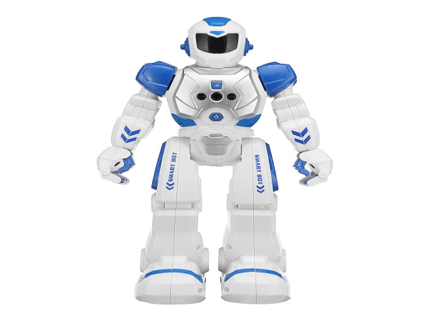
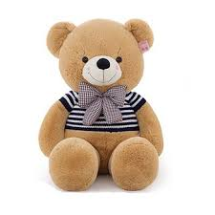
Puzzle: xếp hình
Car: xe ô tô
Yo- yo:
Doll: búp bê
Robot: Rô bốt
Teddy bear: gấu bông
Vocabulary

Slide 7
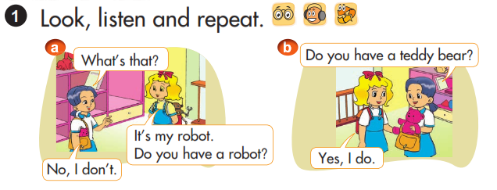
UNIT 15: DO YOU HAVE ANY TOYS?
Lesson 1
a
b
Do you have a teddy bear?
What’s that?
It’s my robot.
Do you have a robot?
Yes, I do.
No, I don’t.
Do you have _____? (Bạn có _____ phải không?)
Yes, I do. ( Phải, tôi có.)
No, I don’t. (Không, tôi không có.)

Slide 8
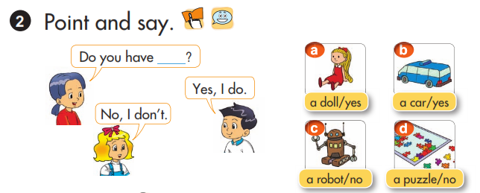
UNIT 15: DO YOU HAVE ANY TOYS?
Lesson 1
EX: Picture a: Do you have a doll? => Yes, I do.
Picture c: Do you have a robot? => No, I don’t.

Slide 9
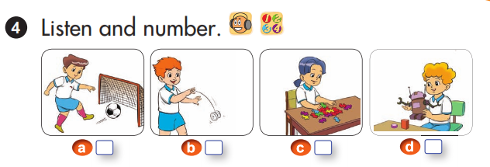
UNIT 15: DO YOU HAVE ANY TOYS?
Lesson 1
3
4
1
2

Slide 10
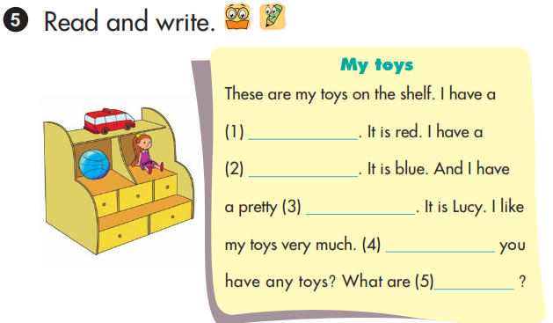
UNIT 15: DO YOU HAVE ANY TOYS?
Lesson 1
car
ball
teddy bear
Do
they

Slide 11
Summary

Slide 12
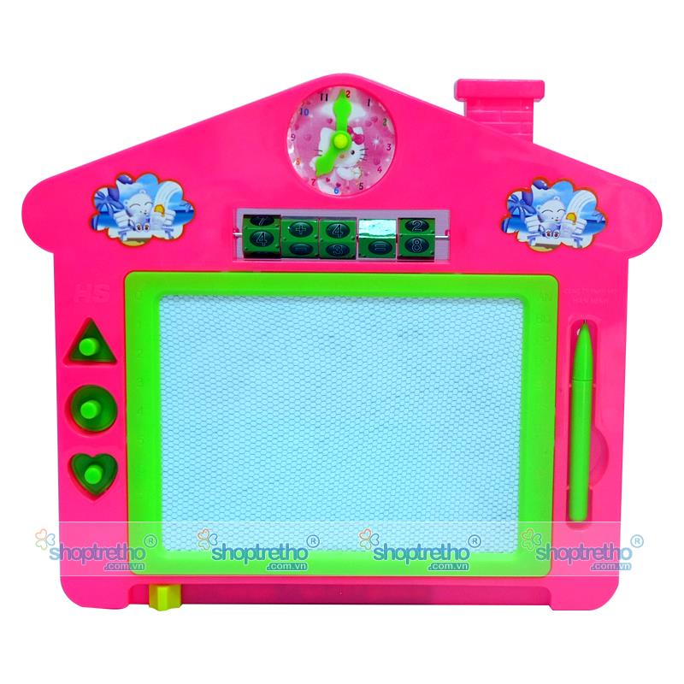

HOMELINK
Learn by heart the model sentences.
Write about your toys.
Prepare for new lesson.

Slide 13




The bye bye song
The bye bye song
Bye, bye.
See you tomorrow.
Bye, bye.
See you tomorrow.
Bye, bye.
See you tomorrow.
Bye, bye. Bye, bye.
Notes:
13

