Slide 1
Unit 18
What will the weather
be like tomorrow?
Lesson 2

Slide 2
Vocabulary

Slide 3
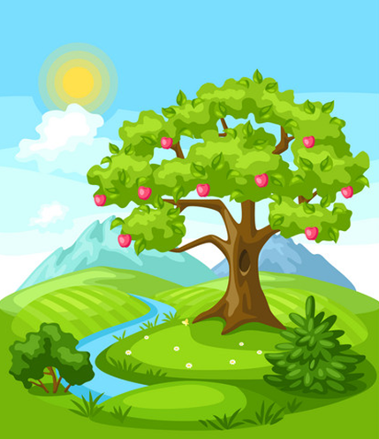

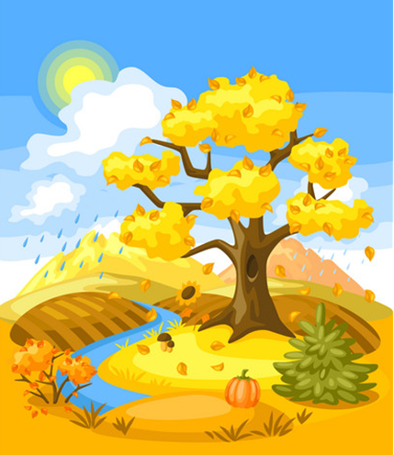
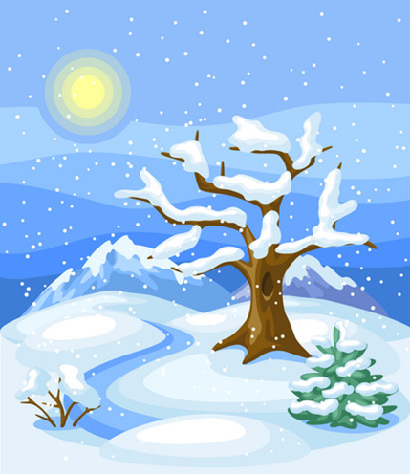
Vocabulary
Summer
Spring
/ˈsʌmər/
/sprɪŋ/
Season
/ˈsiːzn/
Autumn
Winter
/ˈwɪntər/
/ˈɔːtəm/

Slide 4
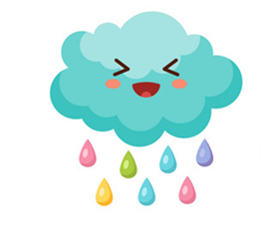
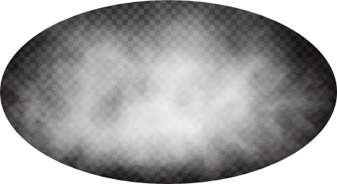
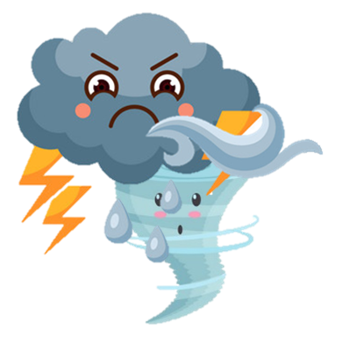



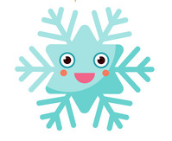

Vocabulary
Rain
Wind
Cloud
Snow
Fog
Storm
Flower
Plant
/ˈflaʊər/
/plænt/

Slide 5
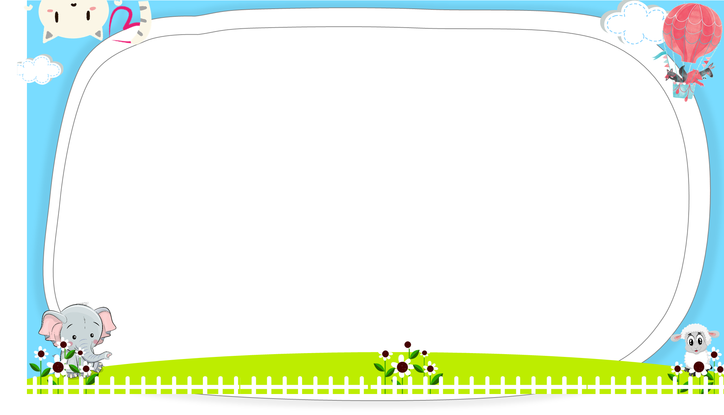
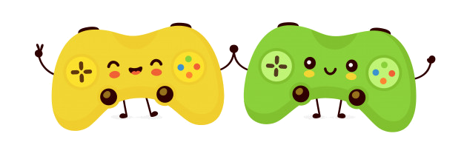



AND
GAME
PLAY

Slide 6



please
Thank you
Next

Slide 7
please
Thank you
Next

Slide 8
please
Thank you
Next

Slide 9
please
Thank you
Next

Slide 10
Four season
Four seasons
Next

Slide 11
sunny
storm
Next

Slide 12
cloud
rainbow
Next

Slide 13
tree
flower
Next

Slide 14
rain
sun
Next

Slide 15
snow
fog
Next

Slide 16
snow
rain
Next

Slide 17
wind
cloud
Next

Slide 18
Grammar

Slide 19

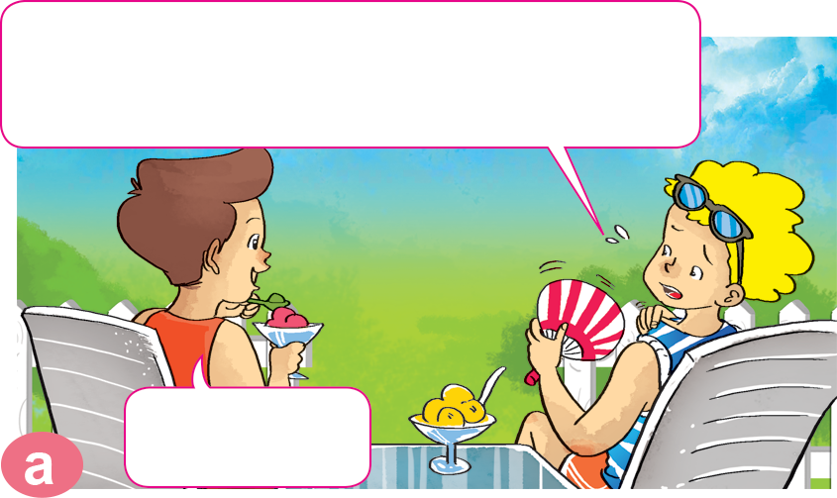
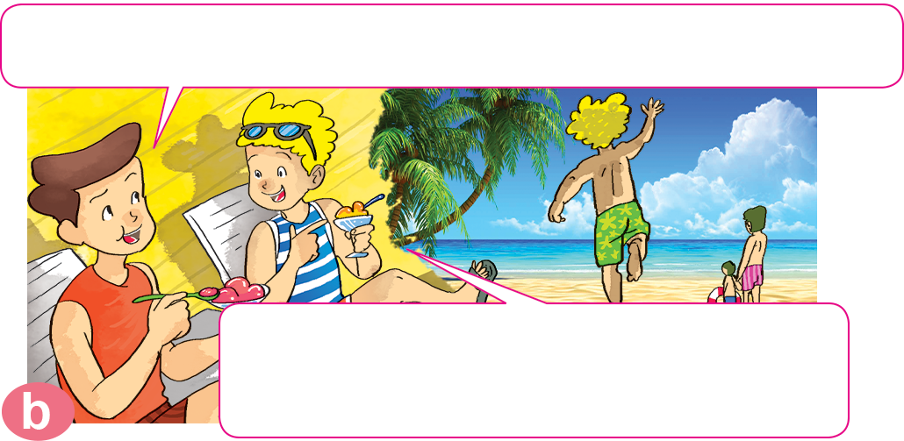
1. Look, listen and repeat.
It's so hot today! Is it always like this in summer, Nam?
It's usually hot in summer. And it rains a lot.
Really? I like summer here because I can swim in the sea.
Yes, it is.

Slide 20
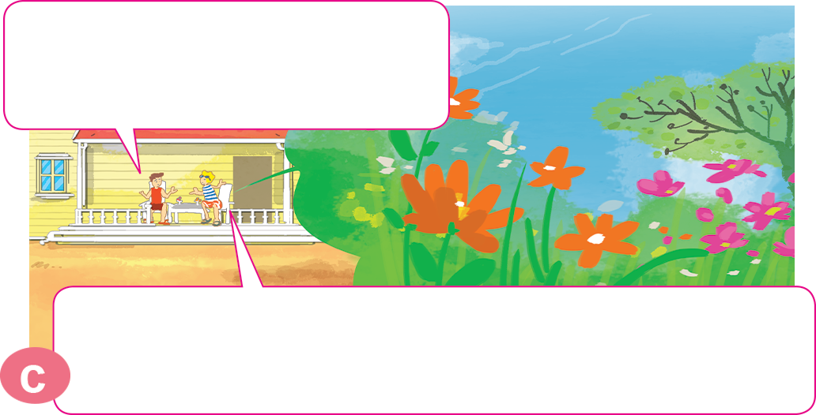
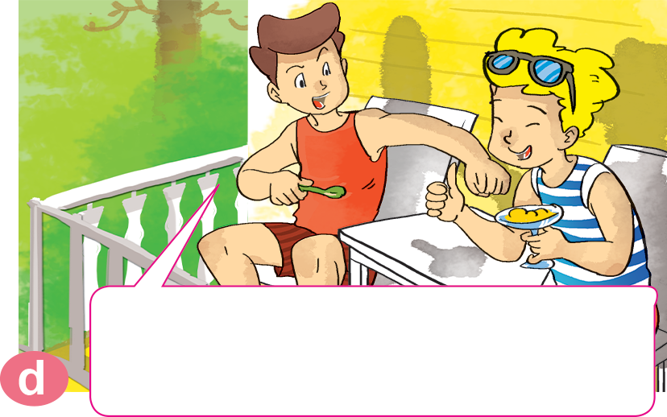
1. Look, listen and repeat.
What's summer like in your country, Peter?
It's cooler than here. But it's very green. There are lots of flowers and plants.
Really? I'd like to visit your country in summer.

Slide 21


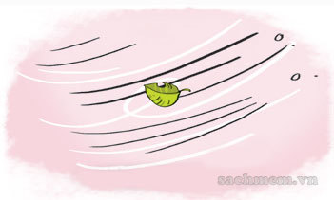
2. Point and say.
What's ___________ like in your country?
spring
It's usually ________.
_______________________.
cold
There is a lot of wind

Slide 22

2. Point and say.
What's ___________ like in your country?
summer
It's usually ________.
_________________________.
hot
There are a lot of flowers

Slide 23
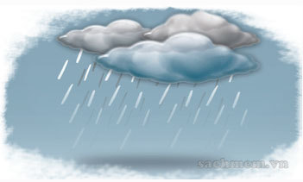
2. Point and say.
What's ___________ like in your country?
autunm
It's usually ________.
_________________________.
cool
There is a lot of rain

Slide 24
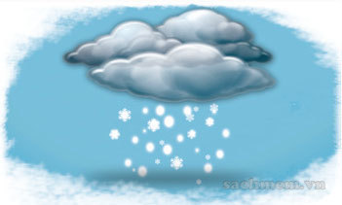
2. Point and say.
What's ___________ like in your country?
winter
It's _____________.
_________________________.
very cool
There is a lot of snows

Slide 25

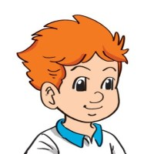
3. Let’s talk
Where do you live?
I live ___________.
How many seasons are there?
There are ______________.
What are they?
They're ______________.
What's your favourite season?
I like ______________.

Slide 26
4. Listen and write one word in each blank.
Name | Season | Weather
Tony | winter | cold, a lot of (1) ________
Akiko | (2) ______ | cold, a lot of (3) ________
Mai | summer | (4) ________, a lot of (5) _______
wind
snow
winter
hot
rain

Slide 27
5. Write about your favourite season and the weather.
1. What's your favourite season?
___________________________________________.
2. What's the weather like in your favourite season?
___________________________________________.
3. What's the weather like today?
___________________________________________.
4. What will the weather be like tomorrow?
___________________________________________.

Slide 28
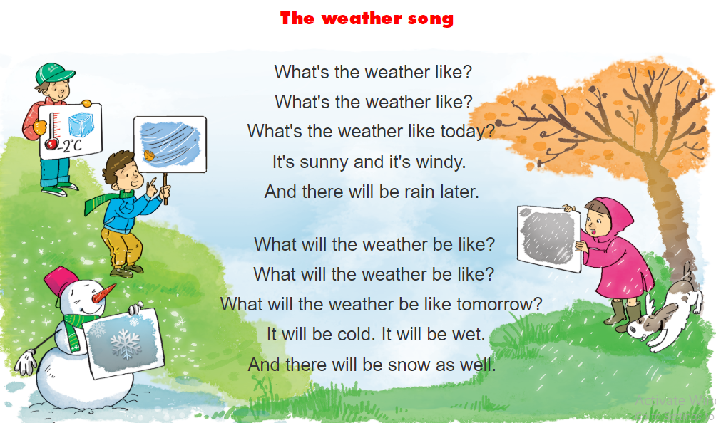


5. Let’s song

