Slide 1
Unit 18 – Lesson 2
What are you doing?

Slide 2
Vocabulary

Slide 3

singing
/ˈsɪŋɪŋ/

Slide 4
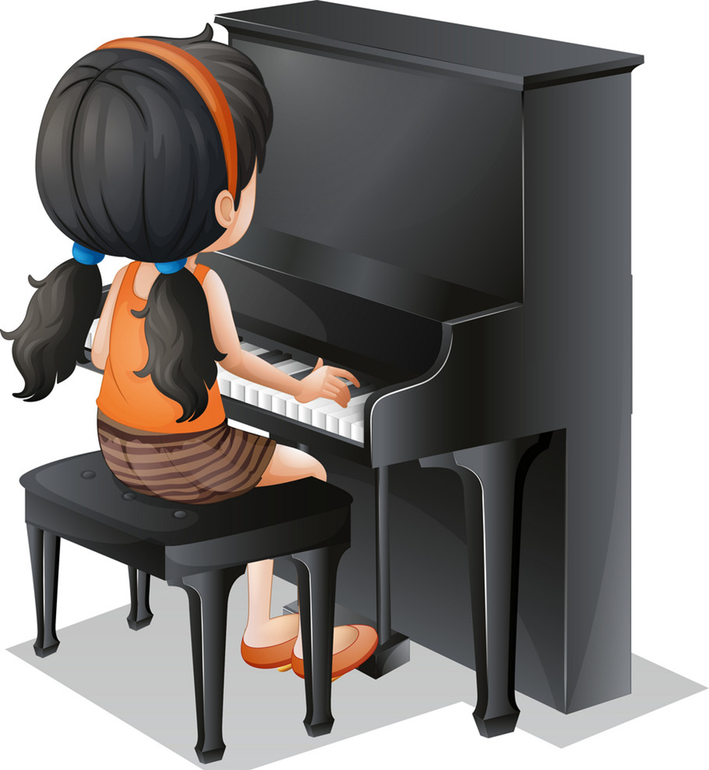
playing the piano
/ˈpleɪɪŋ ðə piˈænəʊ/

Slide 5

drawing
/ˈdrɔːɪŋ/

Slide 6

watching TV
/wɑːtʃ ˌtiː ˈviː/

Slide 7
Vocabulary
drawing
watching TV
singing
playing the piano

Slide 8


Tick or cross
Next
playing the piano
singing
watching TV
drawing

Slide 9
Match
singing
playing the piano
drawing
watching TV
Next

Slide 10
Grammar

Slide 11
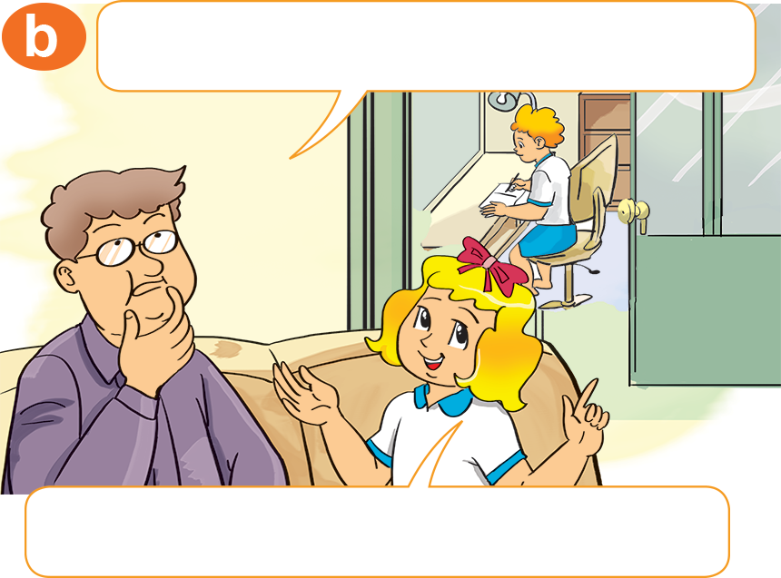
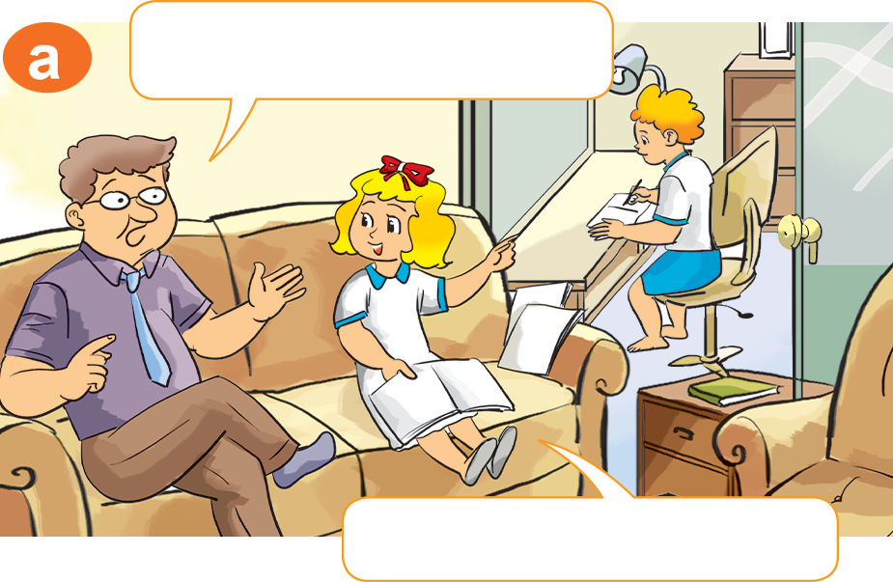

He’s in his room.
He’s doing his homework
1. Look, listen and repeat.
What's he doing there?
Where's Peter?
He's in his room.
He's doing his homework.

Slide 12
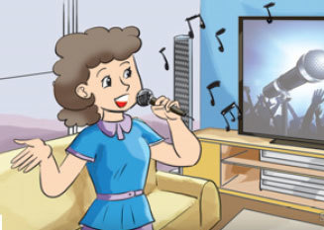
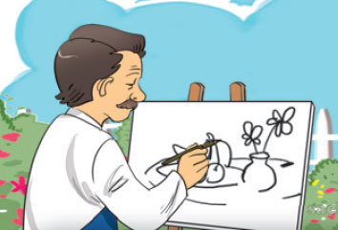
2. Point and say.
What's she doing?
What's he doing?
singing
drawing
She's _________.
He's _________.

Slide 13
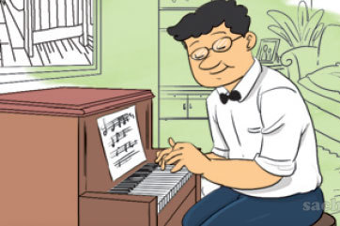
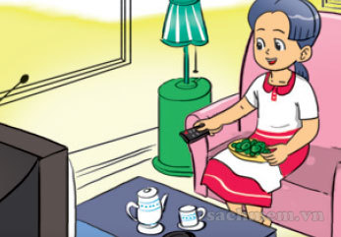
2. Point and say.
What's he doing?
What's she doing?
playing the piano
watching TV
He's _________________.
She's ____________.

Slide 14
Model sentence
What's she/ he doing?
She/He's _______.
drawing
watching TV
singing
playing the piano

Slide 15
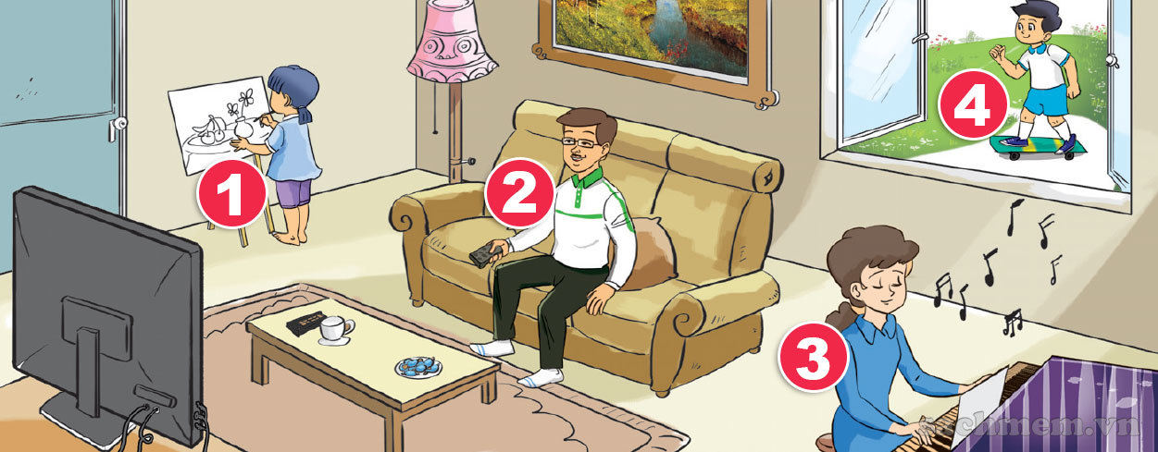

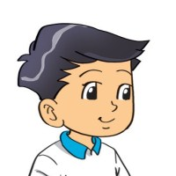
3. Let's talk.
4
What is he/she doing?
He/she _________.

Slide 16
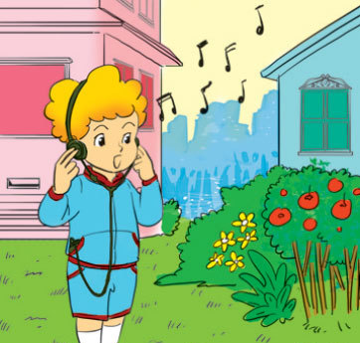
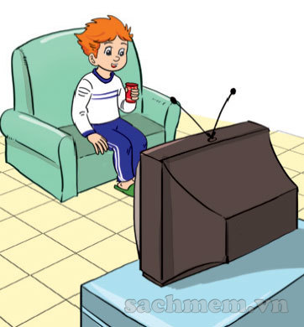
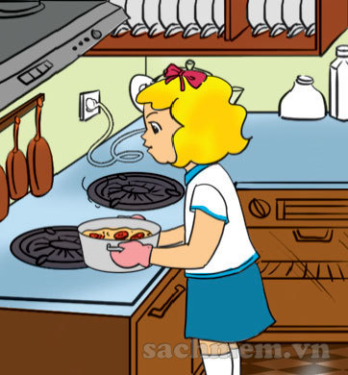
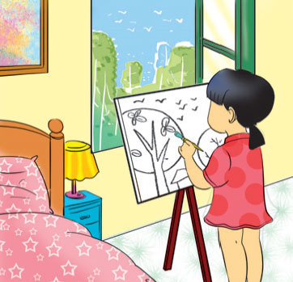
4. Listen and number.
a
b
c
d
3
1
4
2
1
2
3
4

Slide 17
5. Read and complete
1. What are you doing?
2. What's Mai doing?
3. What's Peter doing?
What are Tony and
Linda doing?
a. He's watching TV.
b. I'm playing the piano.
c. They're skating.
d. She's cooking.

Slide 18

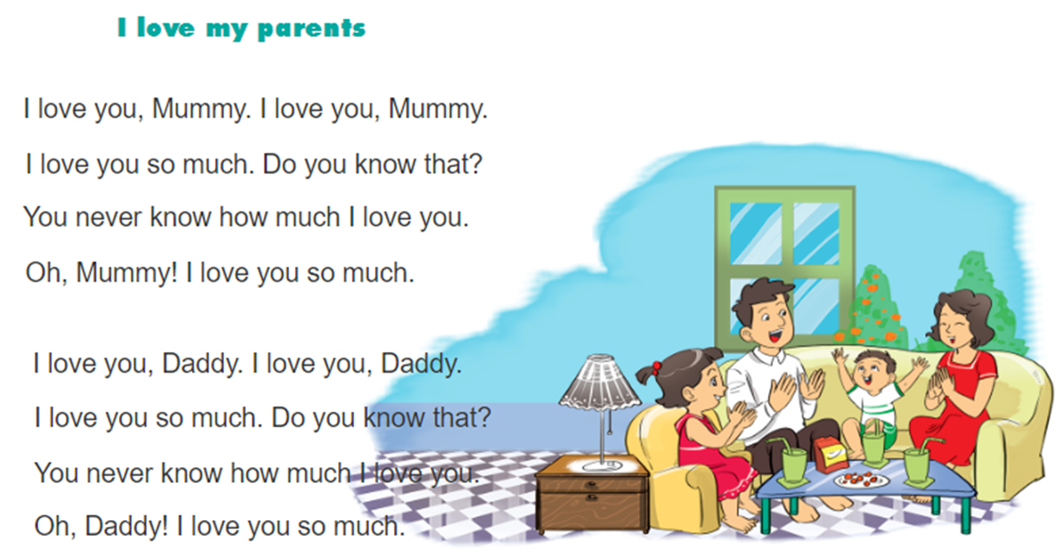
6. Let’s chan

