Slide 1
Unit 16
WHERE’S THE POST OFFICE?
Lesson 2

Slide 2
VOCABULARY

Slide 3
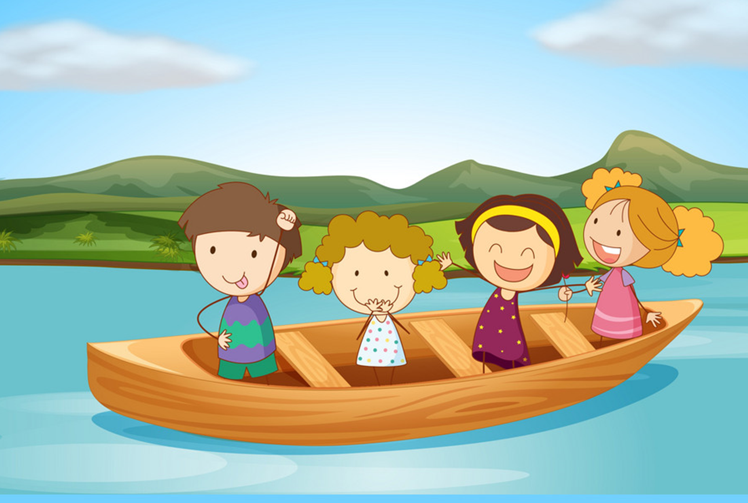
Vocabulary
take a boat
/teɪk ə bəʊt/

Slide 4

Vocabulary
take a coach
/teɪk ə kəʊtʃ/

Slide 5
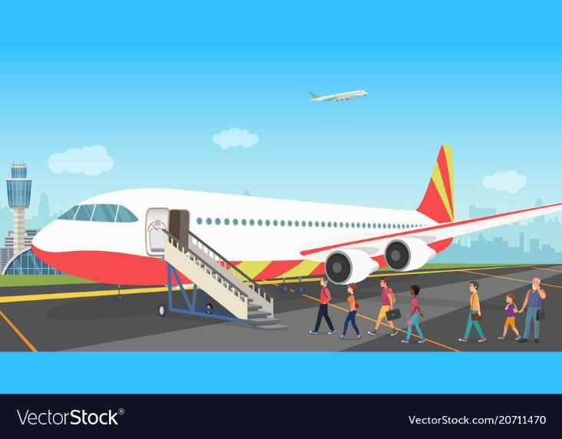
Vocabulary
go by plane
/ ɡəʊ baɪ pleɪn/

Slide 6

Vocabulary
on foot
/ ɒn fʊt /
walk
/wɔːk/

Slide 7
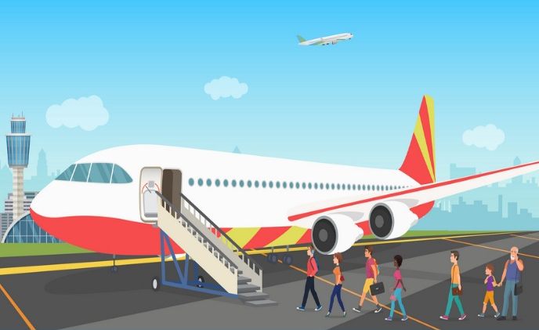
Vocabulary
1
2
3
take a boat
take a coach
on foot
4
5
go by plane
walk

Slide 8



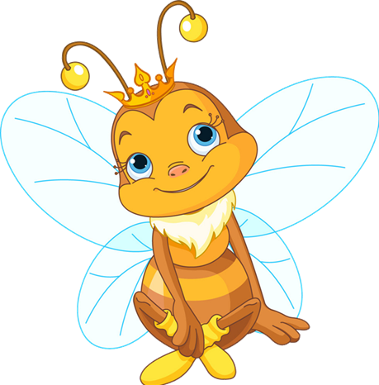
take a boat
take a boat
A
B
C

Slide 9
go by plane
go by plane
A
B
C

Slide 10
take a coach
take a coach
A
B
C

Slide 11
on foot
on foot
A
B
C

Slide 12
walk
walk
A
B
C

Slide 13
GRAMMAR

Slide 14
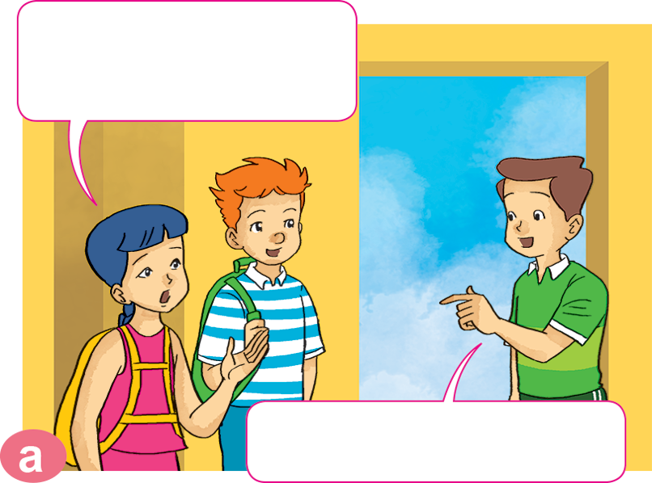
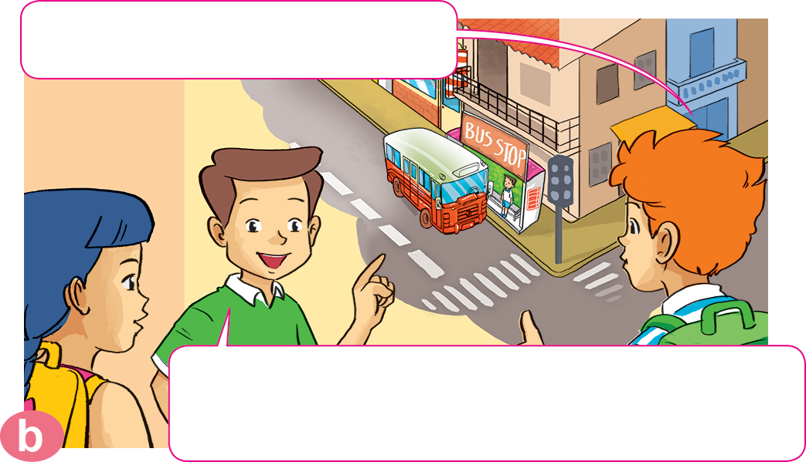

1. Look, listen and repeat.
How can we get to the zoo, Nam?
Where's the bus stop?
Go out of this building. Turn right. It's on the next corner.
You can take a bus.

Slide 15
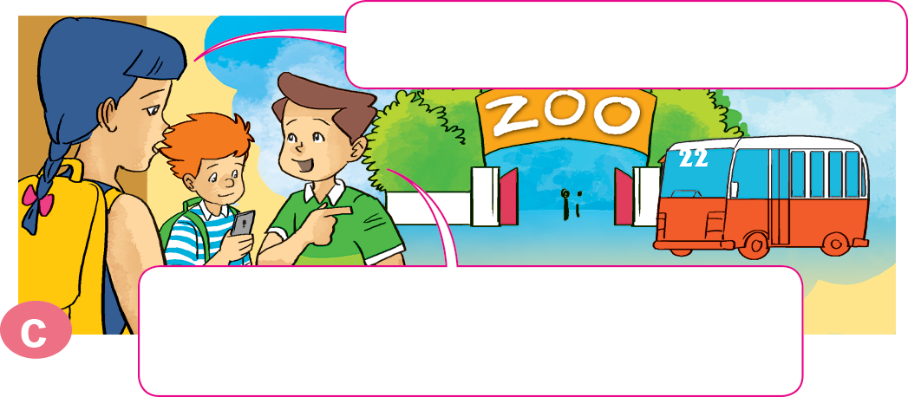
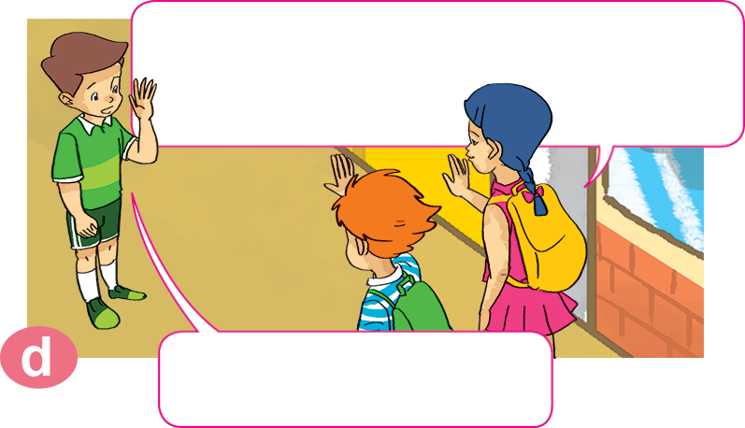
1. Look, listen and repeat.
What bus goes to the zoo?
It's very kind of you, Nam.
Thanks a lot.
You can take bus number 22. It stops right at the zoo entrance.
You're welcome.

Slide 16


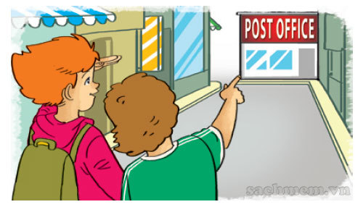
2. Point and say.
How can I get to _________________?
the post office
You can __________________.
walk for five minutes
Excuse me, where's the bus stop?
It's next to the stadium.

Slide 17
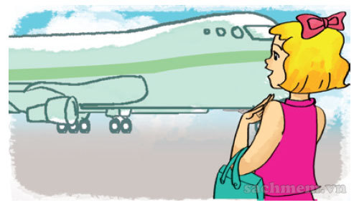
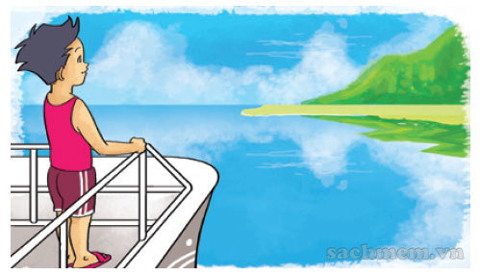
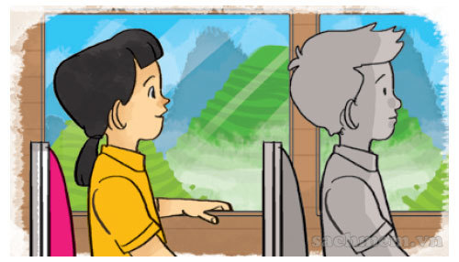
2. Point and say.
How can I get to _________________?
Phu Quoc Island
You can ______________.
take a boat
Excuse me, where's the bus stop?
It's next to the stadium.

Slide 18
2. Point and say.
How can I get to _________________?
Sa Pa
You can ______________.
take a coach
Excuse me, where's the bus stop?
It's next to the stadium.

Slide 19
2. Point and say.
How can I get to _________________?
Ho Chi Minh city
You can ______________.
go by plane
Excuse me, where's the bus stop?
It's next to the stadium.

Slide 20


3. Let’s talk.
the supermarket
How can I get to _____________________?
You can _______________________.

Slide 21
3. Let’s talk.
Ha Noi
How can I get to _____________________?
You can _______________________.

Slide 22
3. Let’s talk.
the cinema
How can I get to _____________________?
You can _______________________.

Slide 23
3. Let’s talk.
How can I get to _____________________?
Ho Chi Minh City
You can _______________________.

Slide 24
3. Let’s talk.
How can I get to _____________________?
the post office
You can _______________________.

Slide 25
3. Let’s talk.
Singapore
How can I get to _____________________?
You can _______________________.

Slide 26
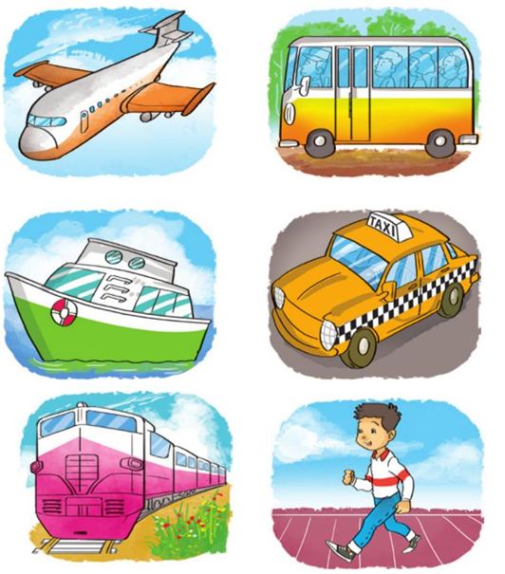
4. Listen and write one word in each box
4
3
How can they get there? | By
1. Akiko
2. Tony
3. Mai
4. Linda
boat
1
2
taxi
coach
plane

Slide 27
5. Read and complete. Then say aloud.
1
trip
Mai: We're going to have a school (1) _______ next weekend.
Akiko: Where are you going?
Mai: We're going to the (2) _______.
Akiko: Is it far from your school?
Mai: No, it isn't.
Akiko: How are you going to get there?
Mai: On (3) _______.
zoo
have
foot
how
welcome
trip
zoo
foot

Slide 28
5. Read and complete. Then say aloud.
2
zoo
have
foot
how
welcome
trip
Tony: I'll go to Ho Chi Minh City tomorrow.
Mai: (4) _______ are you going to get there?
Tony: By plane because I don't have much time.
Mai: (5) _______ a nice trip!
Tony: Thanks a lot, Mai.
Mai: You're (6) _______.
How
Have
welcome

