Slide 1
Unit 17 – Lesson 1
HOW MUCH IS THE T-SHIRT

Slide 2
VOCABULARY

Slide 3
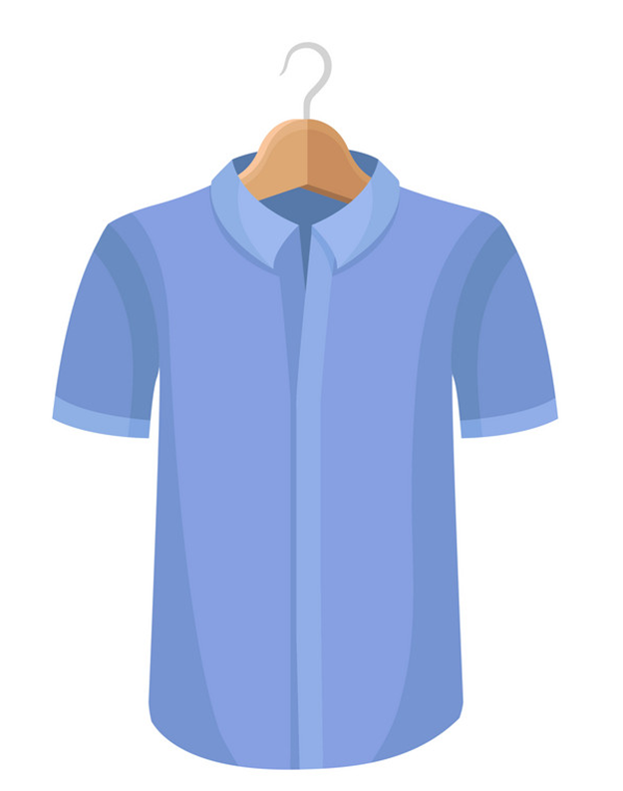
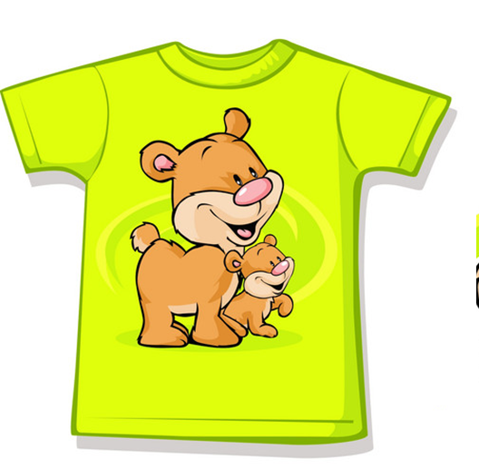
Vocabulary
shirt
T-shirt
/ʃɜːrt/
/ˈtiː ʃɜːrt/

Slide 4
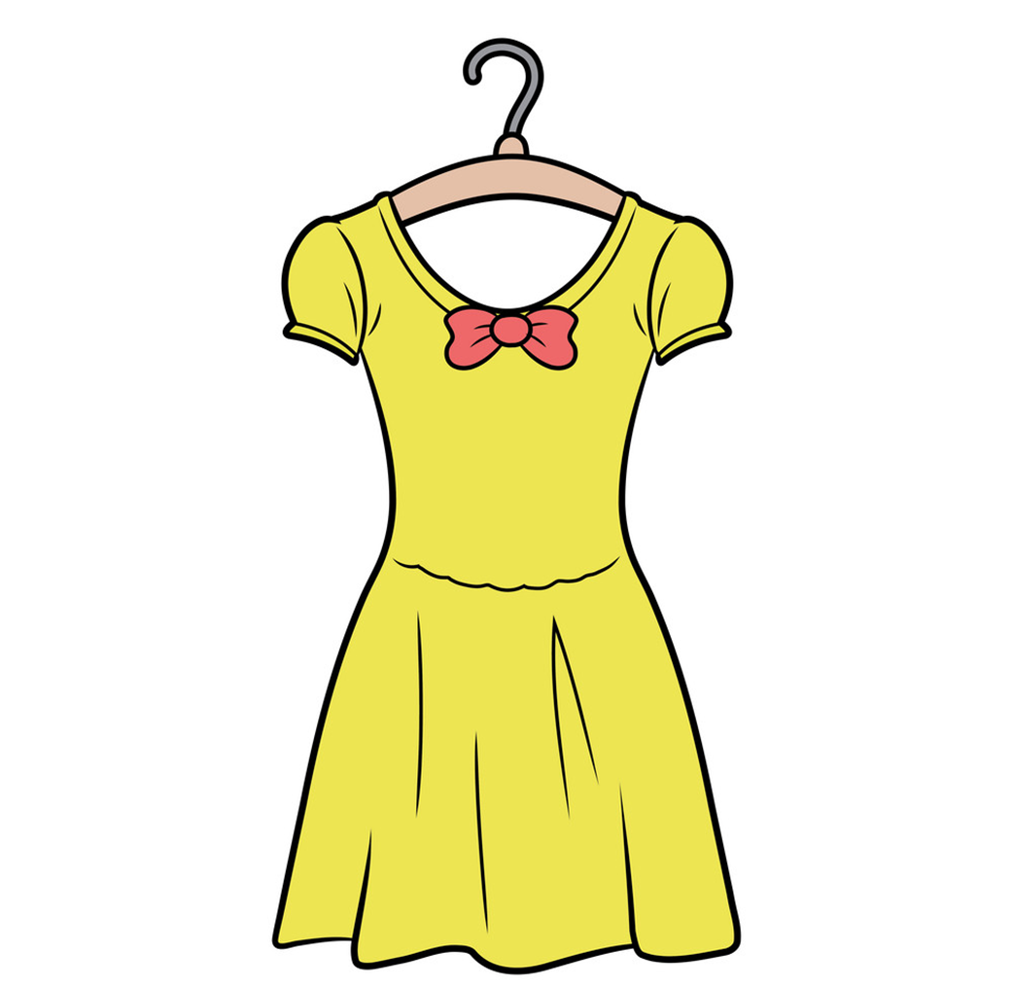

Vocabulary
skirt
dress
/skɜːrt/
/dres/

Slide 5
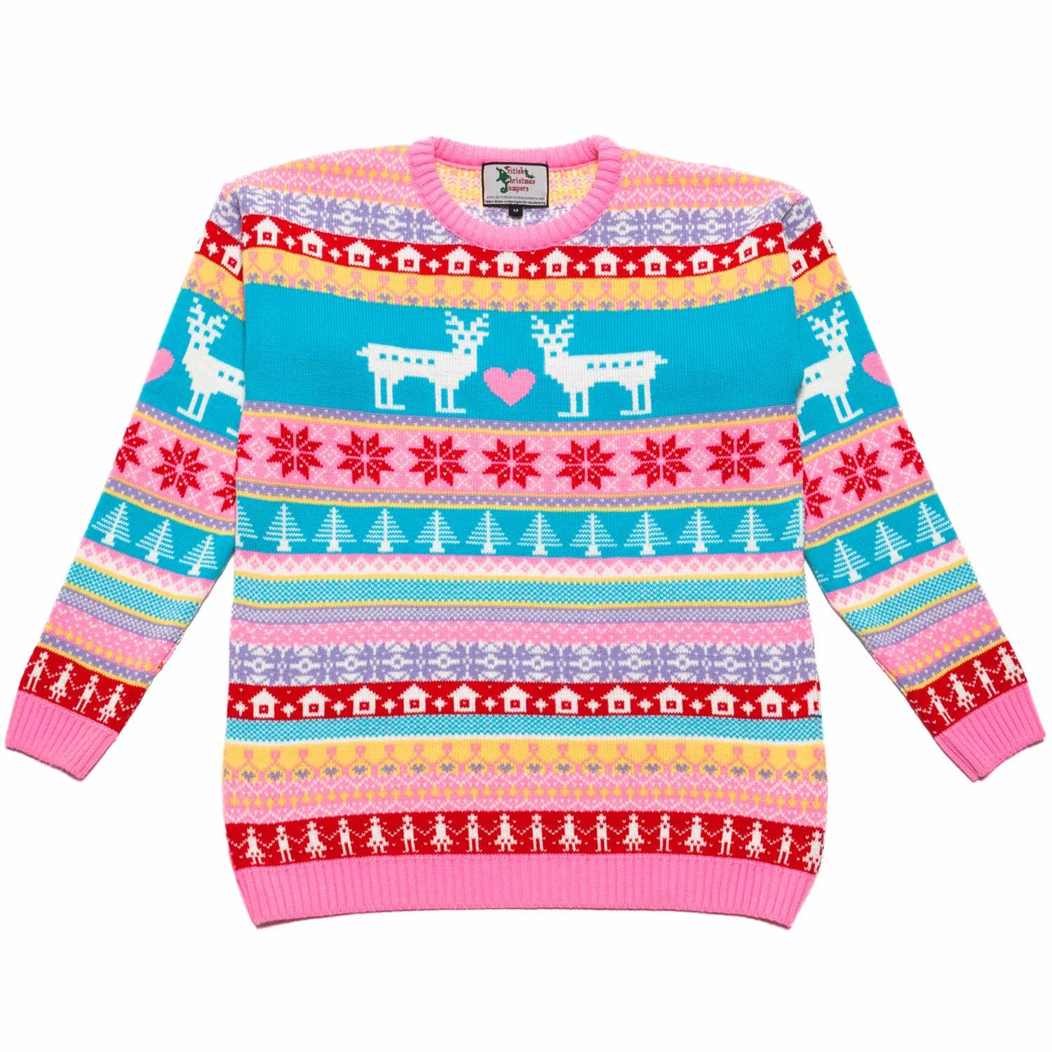
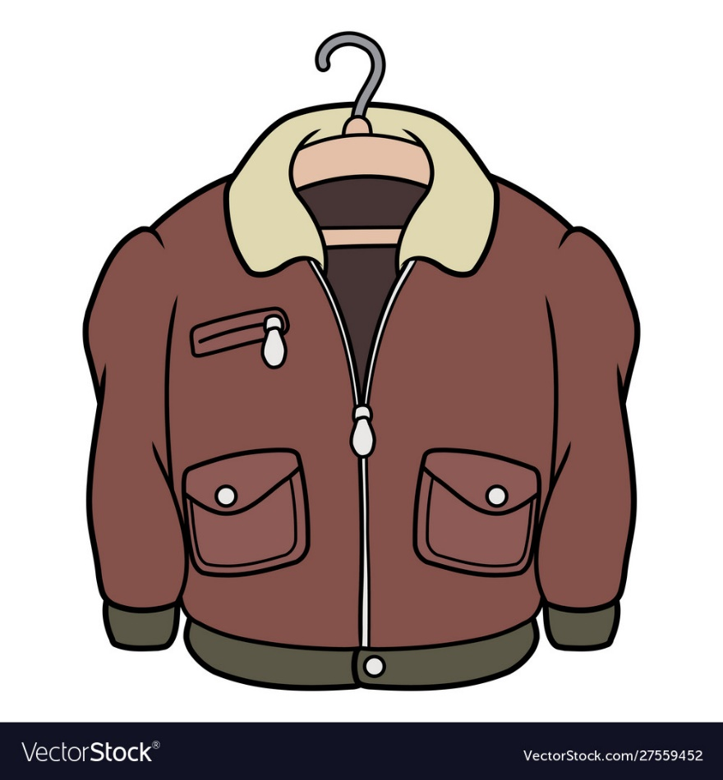
Vocabulary
jacket
jumper
/ˈdʒækɪt/
/ˈdʒʌmpər/

Slide 6
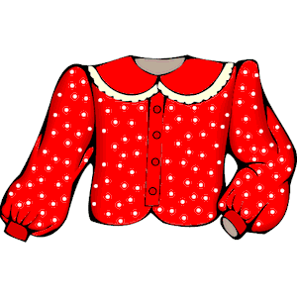

Vocabulary
blouse
scarf
/blaʊs/
/skɑːrf/

Slide 7
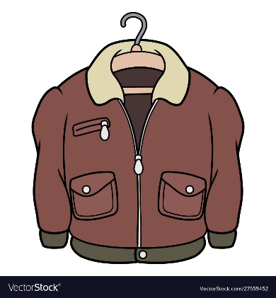
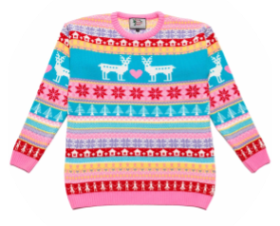
Vocabulary
blouse
scarf
jacket
T-shirt
shirt
skirt
dress
jumper

Slide 8

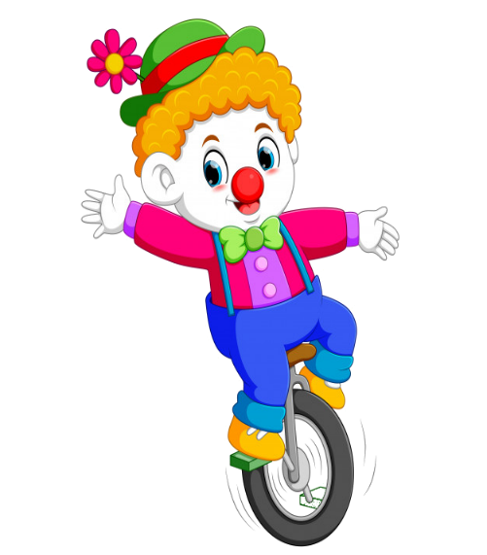



PLAY

Slide 9



blouse
jumper
supermaket
bookshop

Slide 10
jacket
dress
KA
KO

Slide 11
skirt
scarf
LA
LE

Slide 12
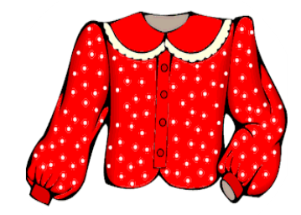
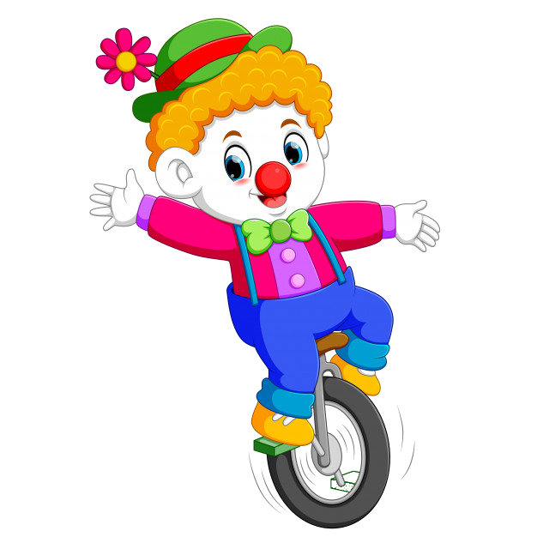
T-shirt
blouse
LE
LO

Slide 13
skirt
shirt
supermaket
bookshop

Slide 14
dress
T-shirt
KA
KO

Slide 15
dress
skirt
LA
LE

Slide 16
jumper
T-shirt
LE
LO

Slide 17

End

Slide 18
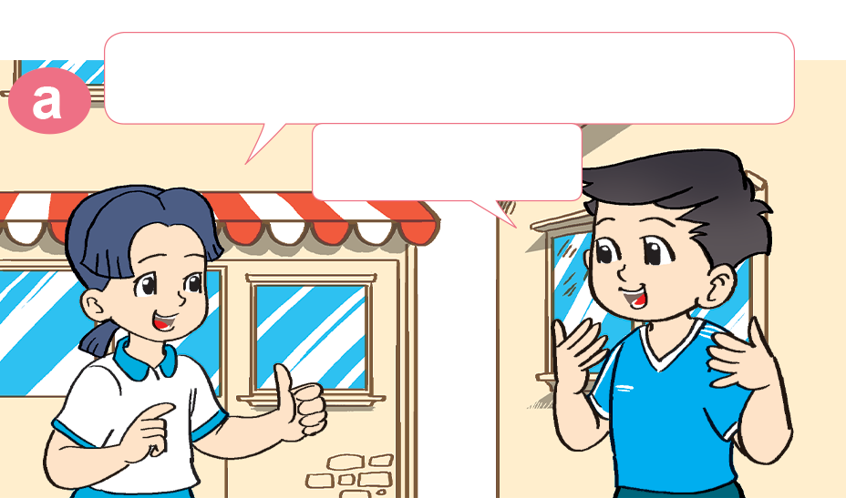
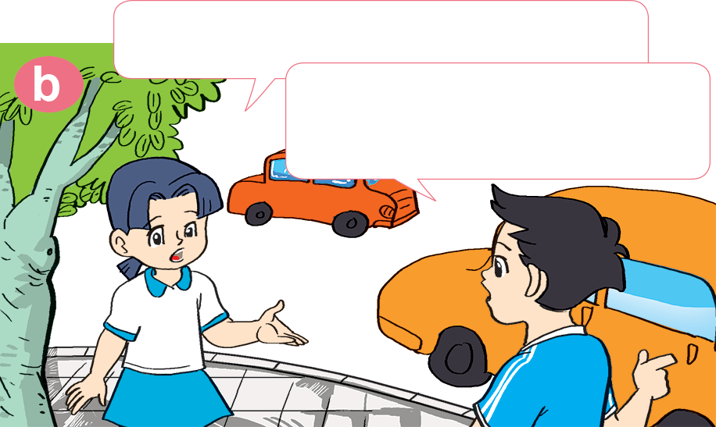

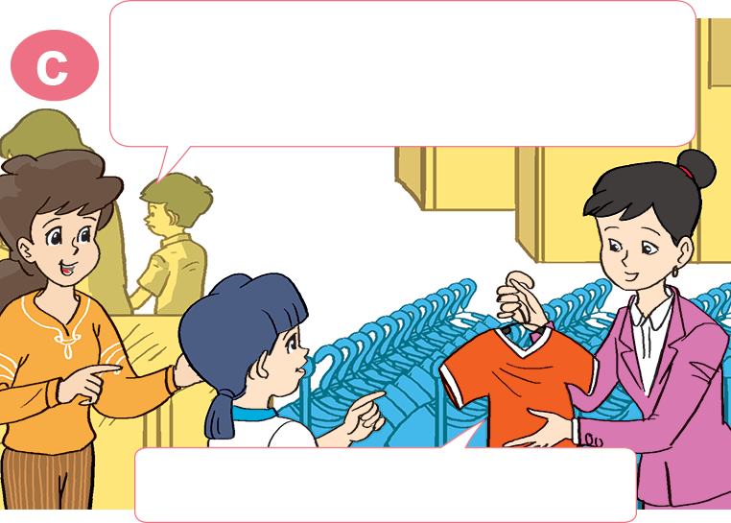
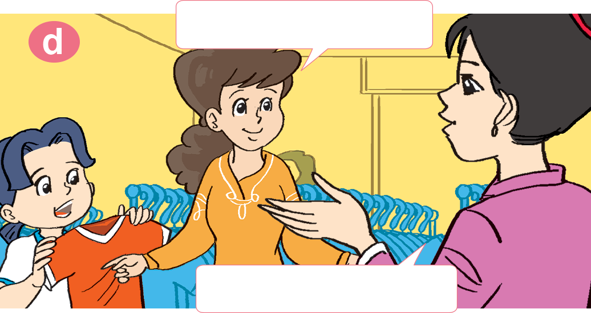
1. Look, listen and repeat
I want a T-shirt like that.
Oh, your T-shirt is very nice!
You can buy it in the supermarket.
Thank you.
Excuse me. Can I have a look at that T-shirt?
How much is it?
Sure. Here you are.
It's 50,000 dong.

Slide 19


2. Point and say
jumper
How much is the _________?
It's _____________________.
80.000 dong

Slide 20
2. Point and say
skirt
How much is the _________?
It's _____________________.
60.000 dong

Slide 21
2. Point and say
blouse
How much is the _________?
It's _____________________.
10.000 dong

Slide 22
2. Point and say
shirt
How much is the _________?
It's _____________________.
40.000 dong

Slide 23
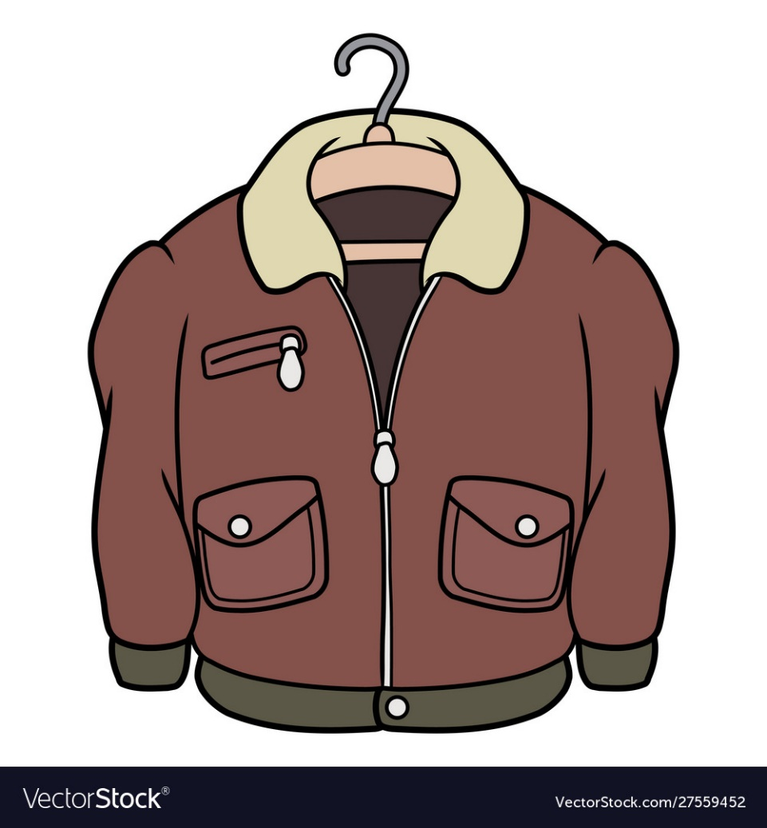
2. Point and say
jacket
How much is the _________?
It's _____________________.
90.000 dong

Slide 24
2. Point and say
blouse
How much is the _________?
It's _____________________.
70.000 dong

Slide 25

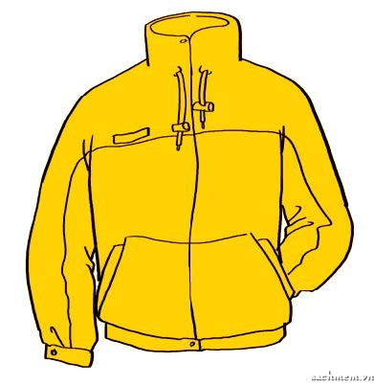
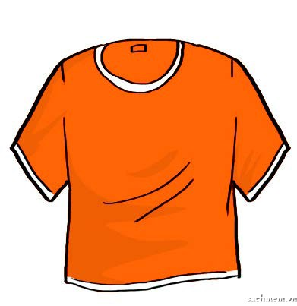
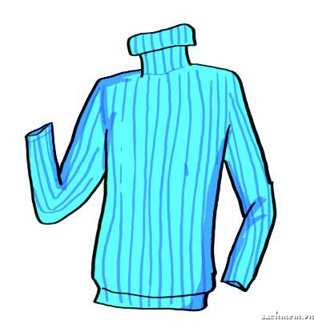

3. Listen and tick
1. 60,000 dong
2. 40,000 dong
3. 50,000 dong

Slide 26
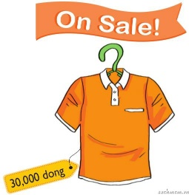
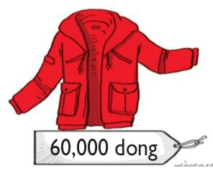
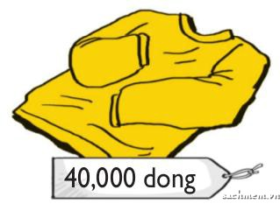
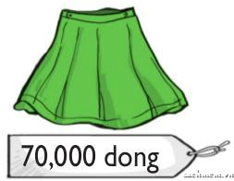
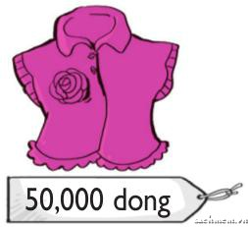
4. Look and write
orange T-shirt
thirty thousand dong
The _____________ is ___________________.
red jacket
The _____________ is ___________________.
sixty thousand dong
The ____________ is _________________.
yellow jumper
forty thousand dong
green skirt
seventy thousand dong
The ____________ is ____________________.
The ____________ is ____________________.
pink blouse
fifty thousand dong

Slide 27


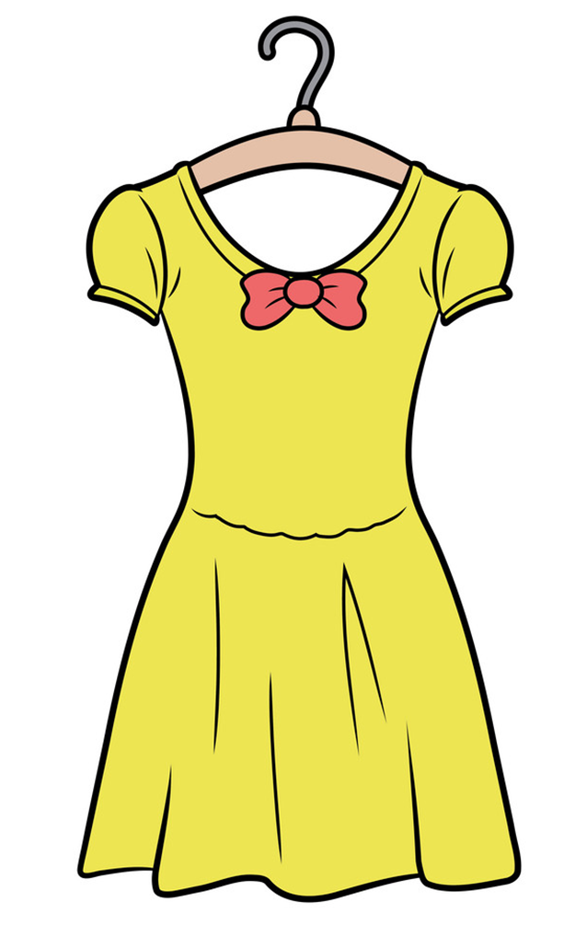
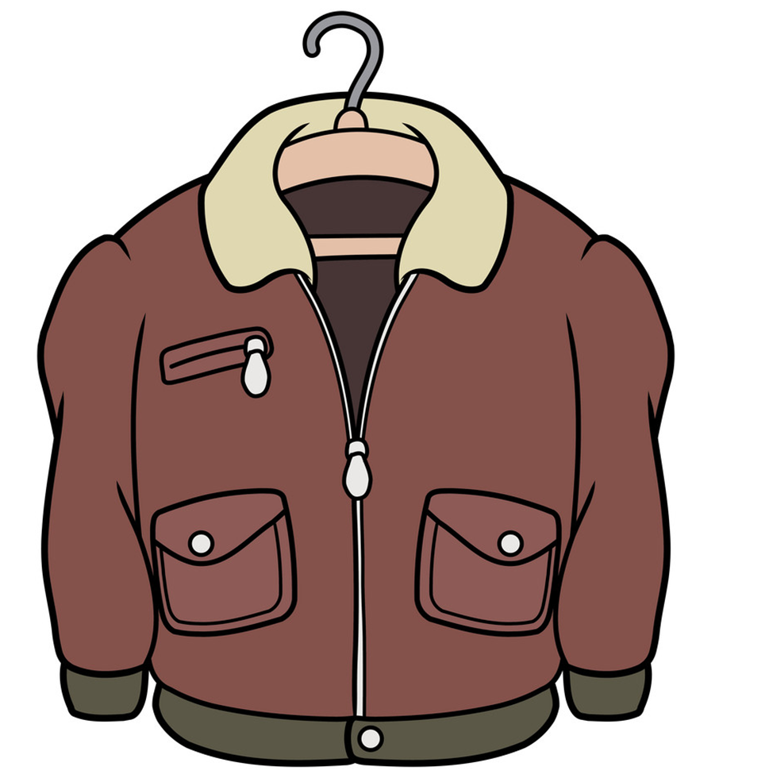
Unit 17
How much is the _______?
It’s ______________.
70.000 DONG
10.000 DONG
80.000 DONG
50.000 DONG
jumper
90.000 DONG
scarf
60.000 DONG
skirt
jacket
blouse
dress
Ms. Huyền Phạm

