Slide 1
Unit 16
LET'S GO TO
THE BOOKSHOP
Lesson 2

Slide 2
VOCABULARY

Slide 3

Vocabulary
Swimming pool
/ˈswɪmɪŋ puːl/

Slide 4
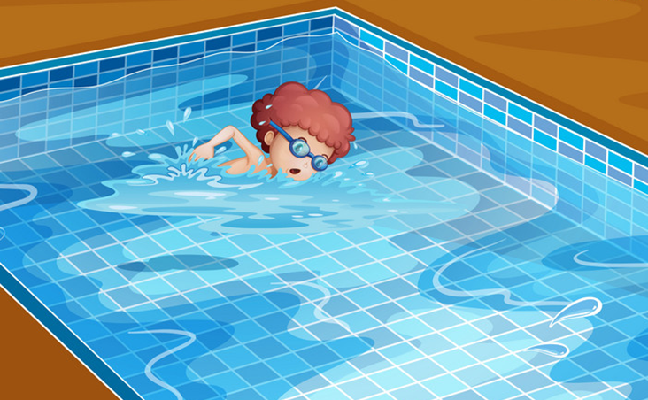
Vocabulary
swim
/swɪm/

Slide 5

Vocabulary
cinema
/ˈsɪnəmə/

Slide 6
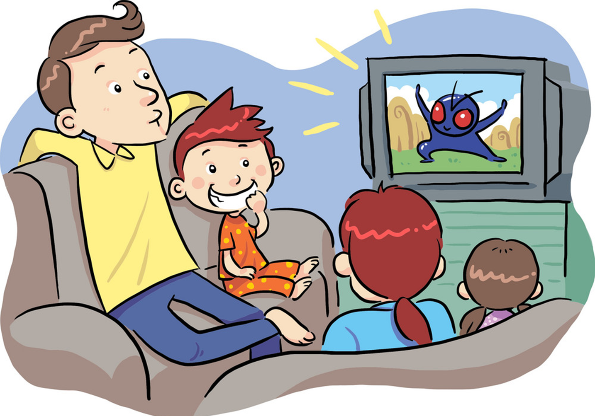
Vocabulary
see a film
/ siː ə fɪlm/

Slide 7
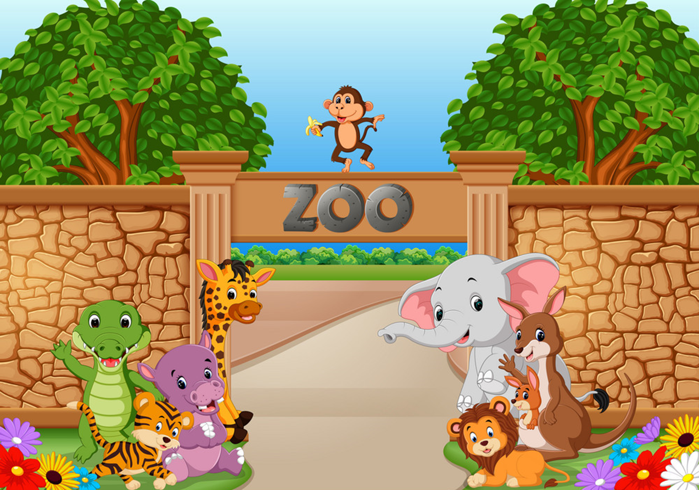
Vocabulary
zoo
/zuː/

Slide 8
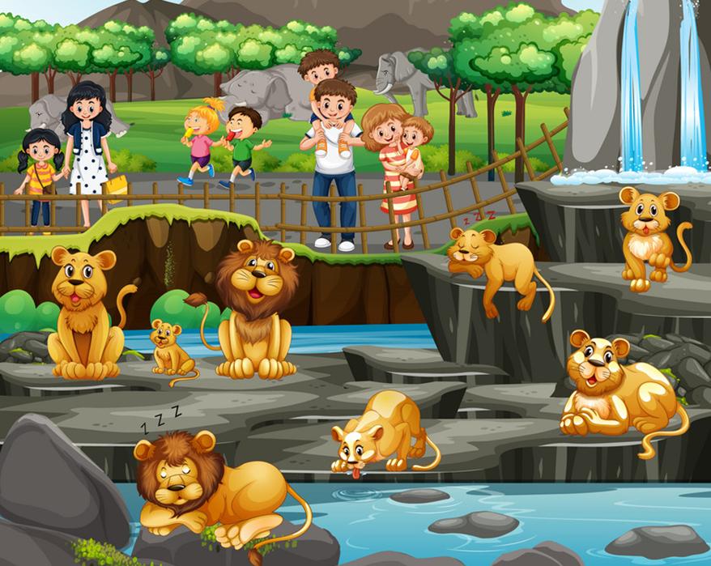
Vocabulary
see animals
/ siː ˈænɪmlz/

Slide 9
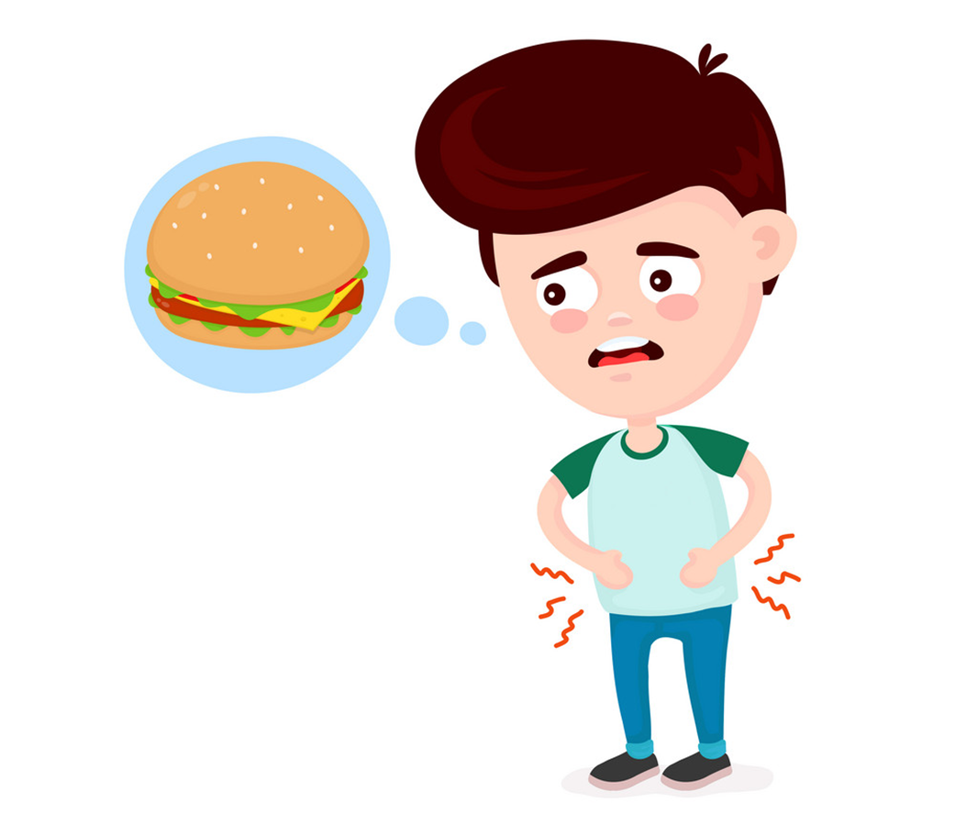
Vocabulary
hungry
/ˈhʌŋɡri/

Slide 10
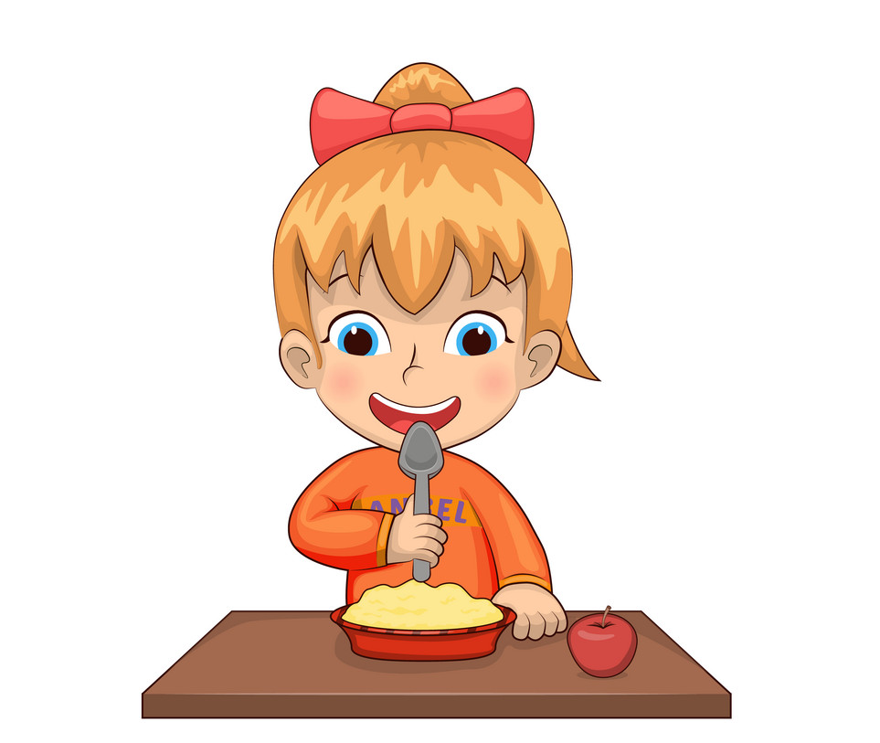
Vocabulary
eat
/iːt/

Slide 11

Vocabulary
1
2
3
4
swimming pool
swim
cinema
see a film
5
6
7
8
zoo
see animals
Medicine
Medicine

Slide 12
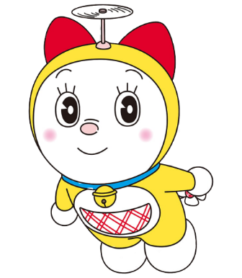



Find the correct picture
1
2
3
4
5
6
7
8
swimming pool

Slide 13
Find the correct picture
1
2
3
4
5
6
7
8
swim

Slide 14
Find the correct picture
1
2
3
4
5
6
7
8
cinema

Slide 15
Find the correct picture
1
2
3
4
5
6
7
8
zoo

Slide 16
Find the correct picture
1
2
3
4
5
6
7
8
see a film

Slide 17
Find the correct picture
1
2
3
4
5
6
7
8
see animals

Slide 18
Find the correct picture
1
2
3
4
5
6
7
8
eat

Slide 19

Find the correct picture
1
2
3
4
5
6
7
8
hungry

Slide 20
GRAMMAR

Slide 21

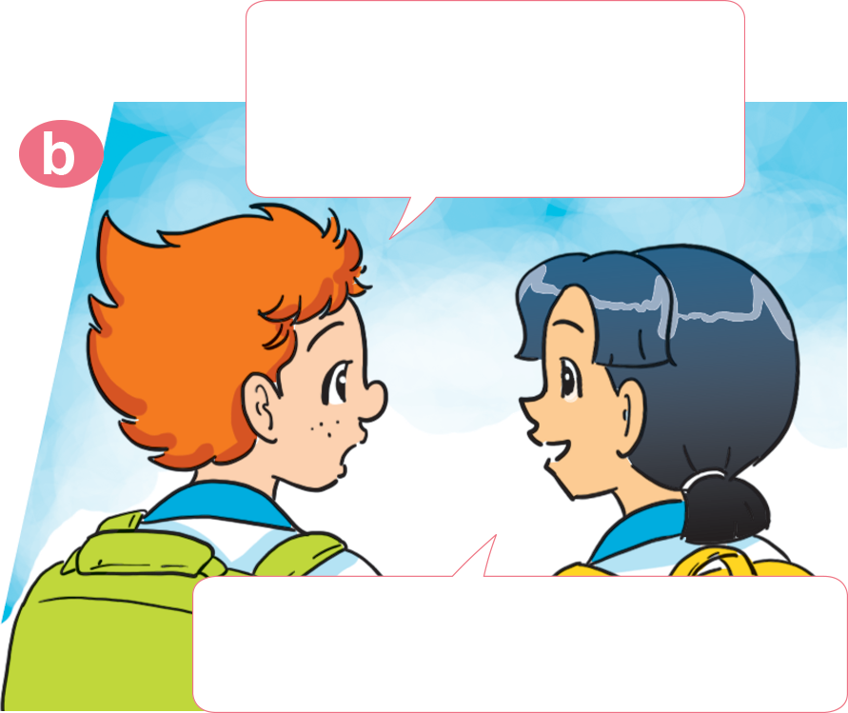
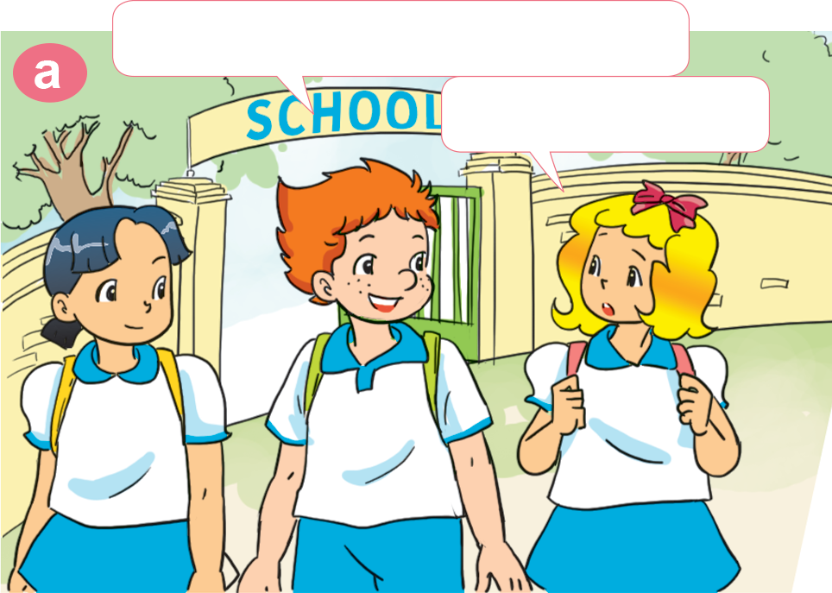
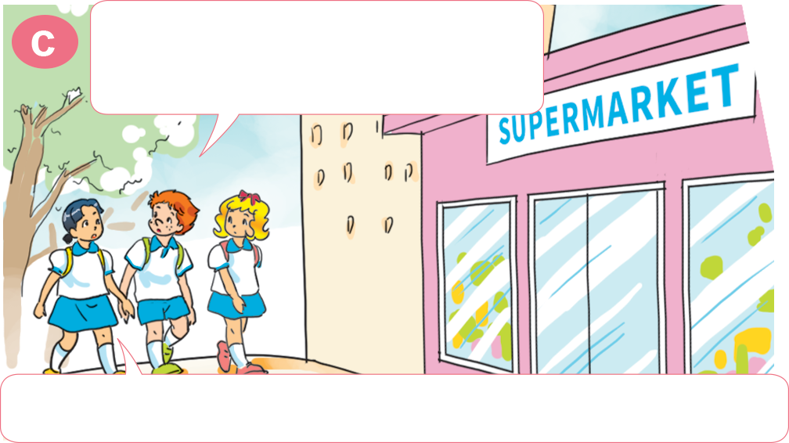
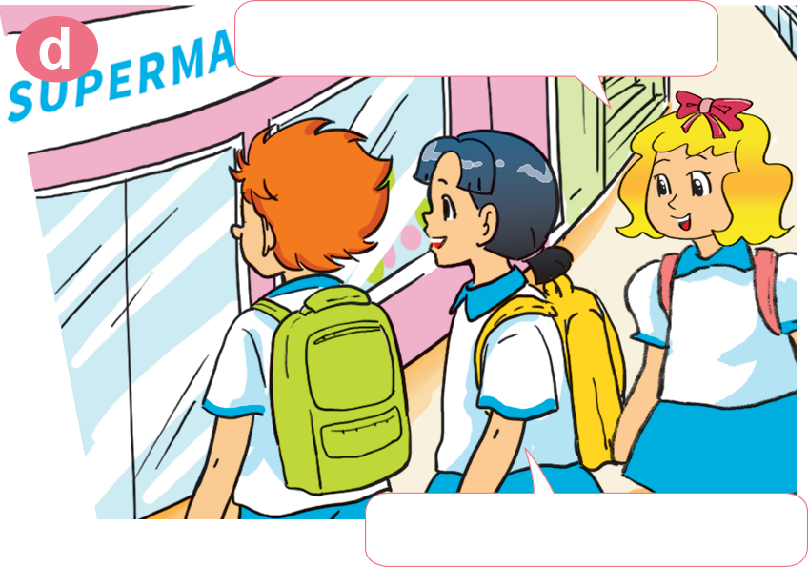
1. Look, listen and repeat.
How about you, Mai? Would you like to go to the zoo?
Let's go to the zoo, Linda.
Sorry. I can't.
Yes, I'd like to. Can we go to the supermarket first?
Why do you want to go to the supermarket?
Me too! I'm hungry!
Because I want to buy something to eat.
Let's go together.

Slide 22
2. Point and say
Why do you want to go to the ________?
Because _______________________.
zoo
I want to see the animals

Slide 23
2. Point and say
Why do you want to go to the _______________?
Because _____________________.
swimming pool
I want to swim

Slide 24
2. Point and say
Why do you want to go to the ________?
Because _______________________.
cinema
I want to see a film

Slide 25
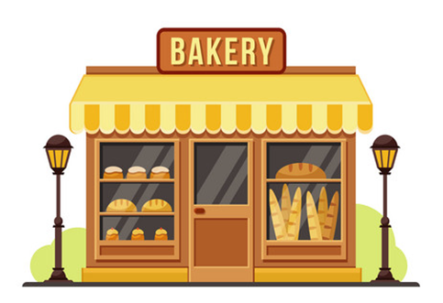
2. Point and say
Why do you want to go to the ________?
Because _______________________.
bakery
I want to buy some bread

Slide 26
3. Listen and circle.
1. Mai wants to go to the ______.
a. zoo b. sweet shop c. bookshop
2. Tony wants to go to the ______.
a. books b. pens c. rulers
3. Phong wants to buy some ______.
a. sweets b. chocolate c. bread
4. Tom wants to buy some ______.
a. sweets b. chocolate c. bread

Slide 27
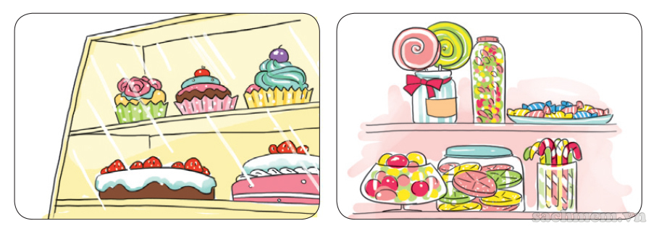
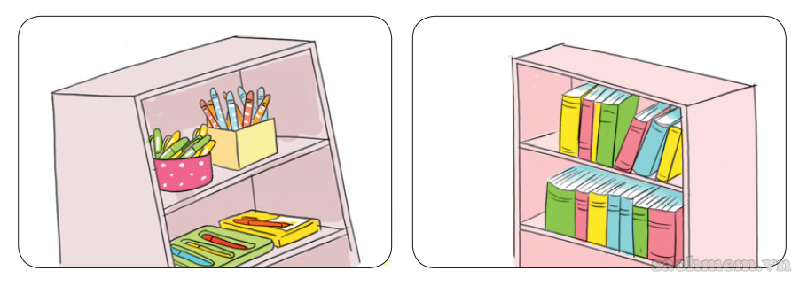
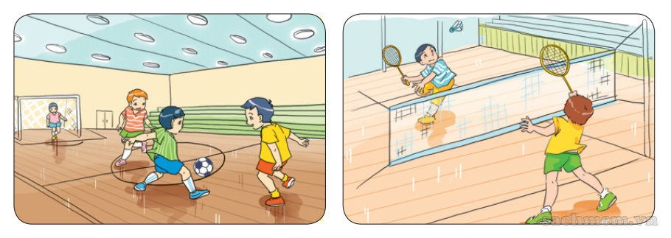
5. Look and write
A: Why does he want to go to the supermarket?
B: Because _____________________________
_____________________.
he wants to buy some cakes and
sweets
A: Why does she want to go to the bookshop? B: Because _____________________________
_______________________.
he wants to buy some pens and
books
A: Why do they want to go to the gym? B: Because _____________________________
____________________.
they want to play football and
badminton

