Slide 1
Unit 17
What toys do
you like?
Lesson 1

Slide 2
Vocbulary

Slide 3
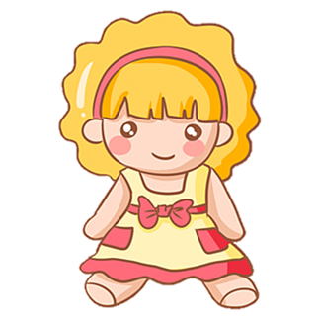
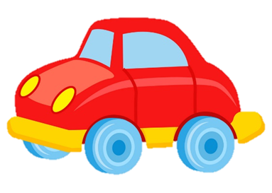


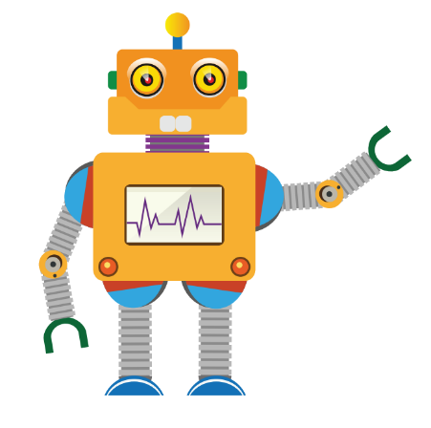
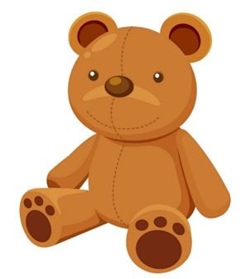
Vocabulary
a doll
a car
a yo-yo
a puzzle
a robot
a teddy bear

Slide 4

Vocabulary
dolls
cars
yo-yos
Puzzles
robots
teddy bears

Slide 5
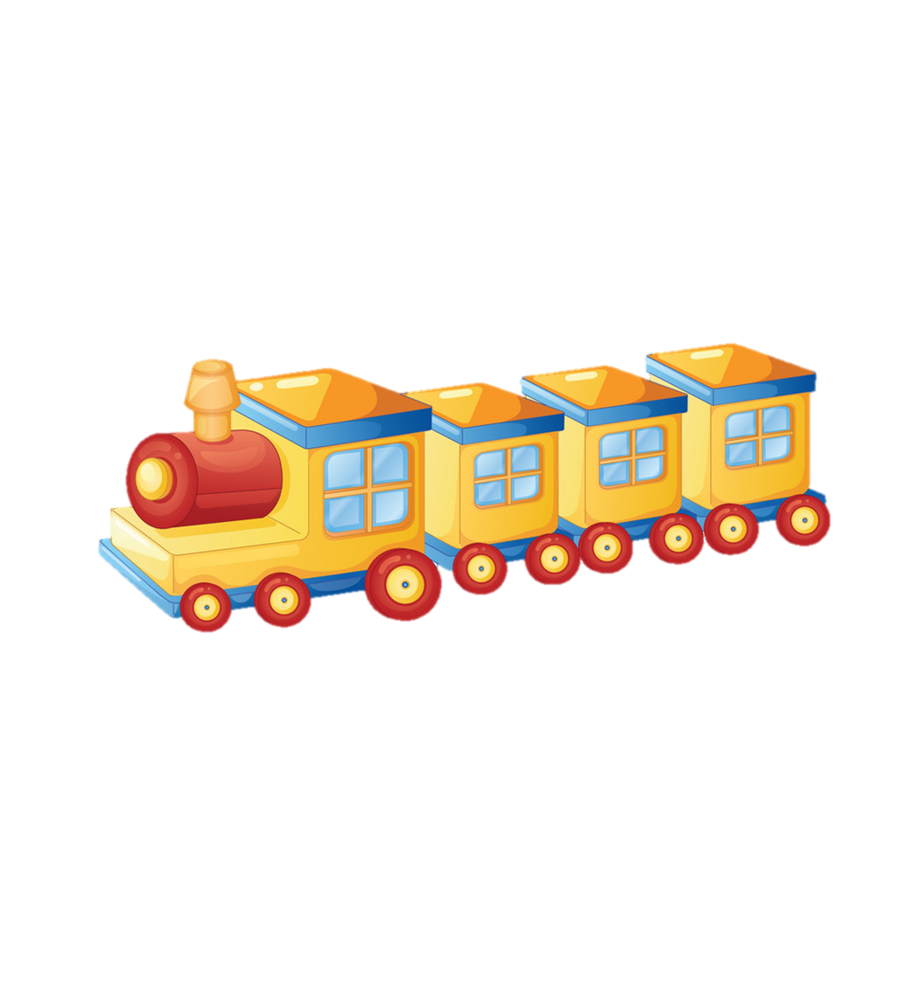
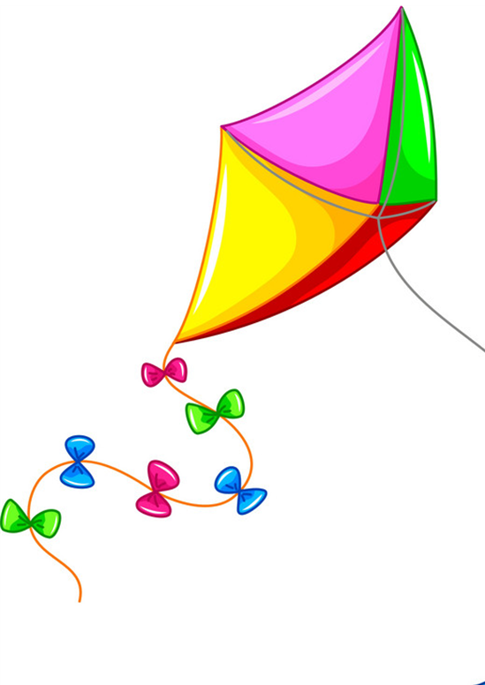
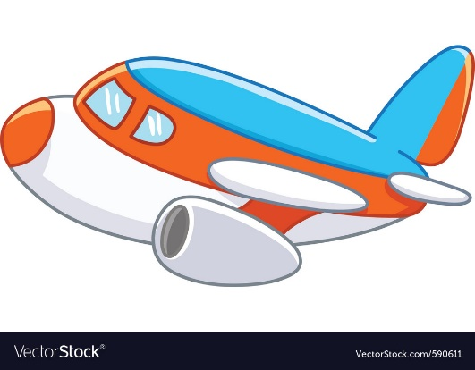
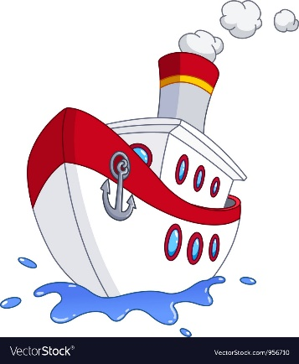
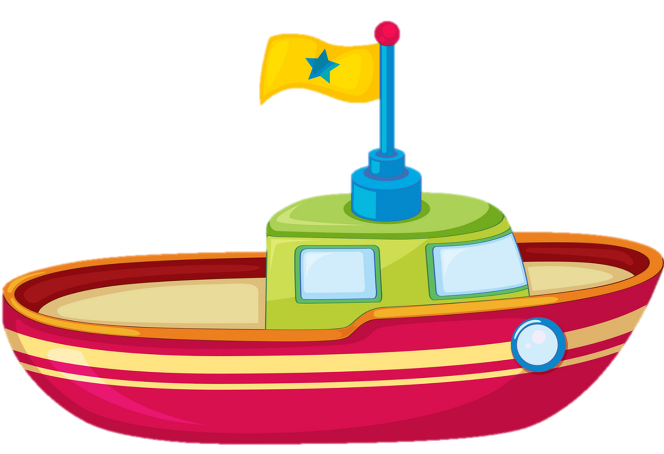
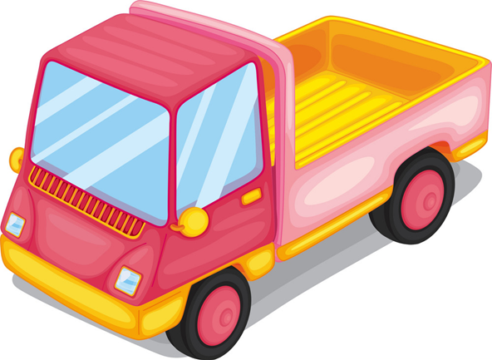
Vocabulary
a train
a kite
a plane
a ship
a truck
a boat

Slide 6



Vocabulary
trains
kites
planes
ships
trucks
boats

Slide 7
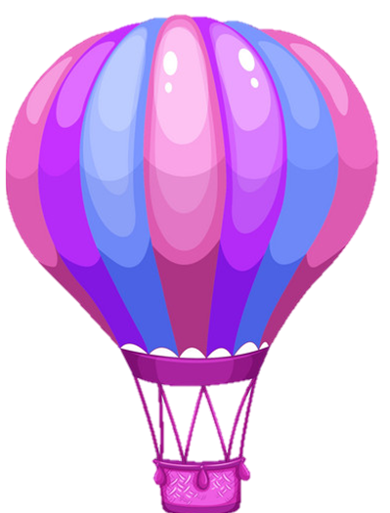
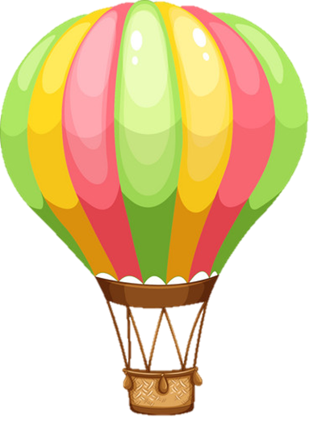


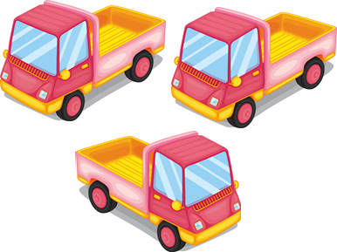

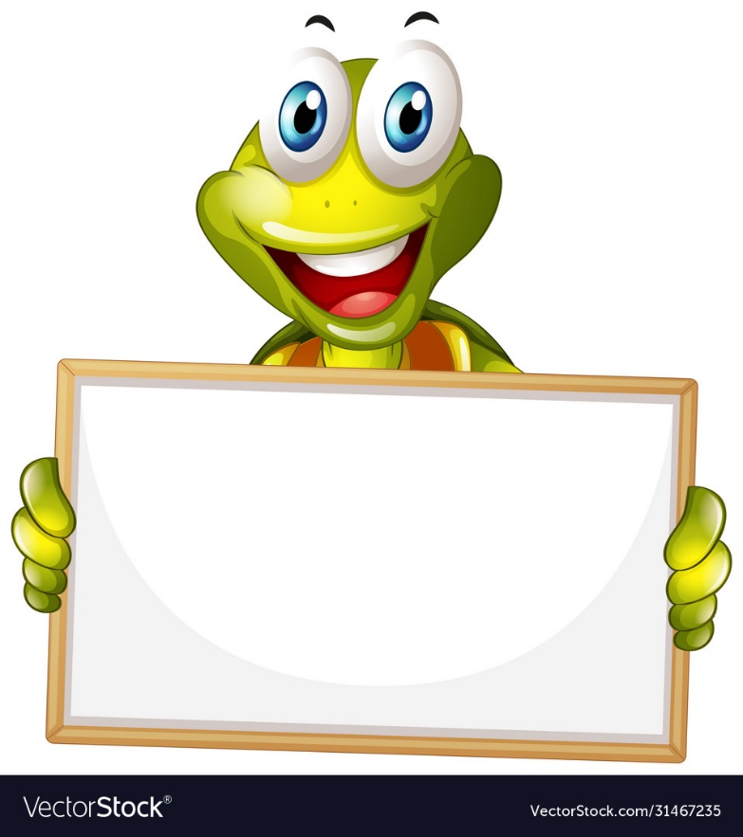
Next
trucks

Slide 8
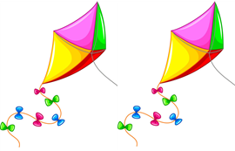
Next
dolls

Slide 9


Next
robbots

Slide 10


Next
planes

Slide 11


teddy
bears
Next

Slide 12


Next
trains

Slide 13


Next
kites

Slide 14
GRAMMAR

Slide 15

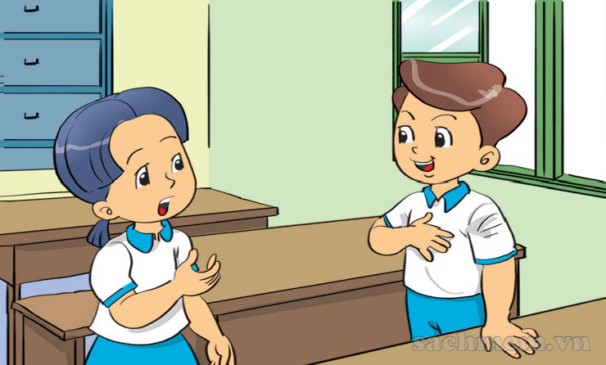
1. Look, listen and repeat
Do you like toys?
Yes, I do.

Slide 16
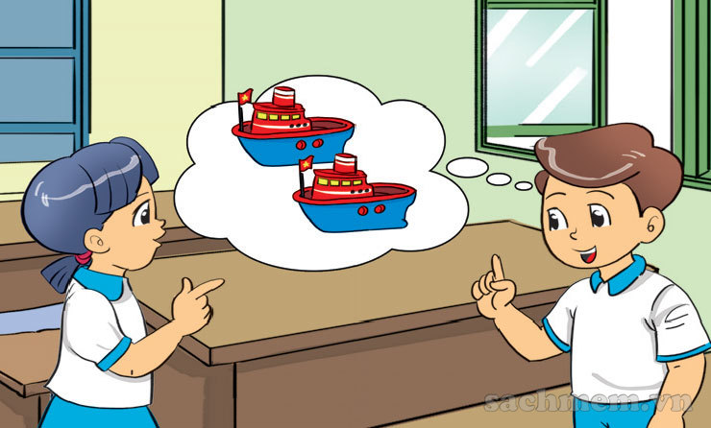
1. Look, listen and repeat
What toys do you like?
I like ships

Slide 17
2. Point and say
What toys do you like?
I like _______.
trucks

Slide 18
2. Point and say
What toys do you like?
I like _______.
dolls

Slide 19
2. Point and say
What toys do you like?
I like _______.
kites

Slide 20


2. Point and say
What toys do you like?
I like _______.
planes

Slide 21
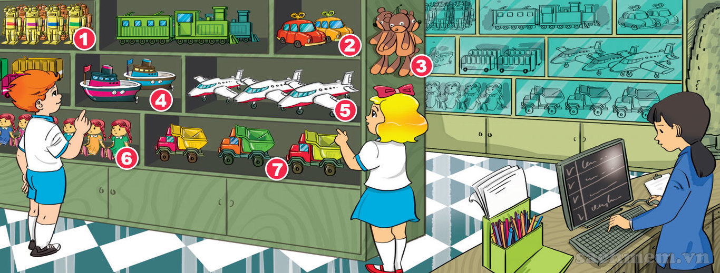
3. Let's talk.
What toys do you like?
I like _______.

Slide 22



What toys do you like?
I like ___________.
planes
dolls
kites
trucks
robbots
trains
teddy bears

Slide 23




4. Listen and tick.
a
b
1.
a
b
2.
a
b
3.

Slide 24
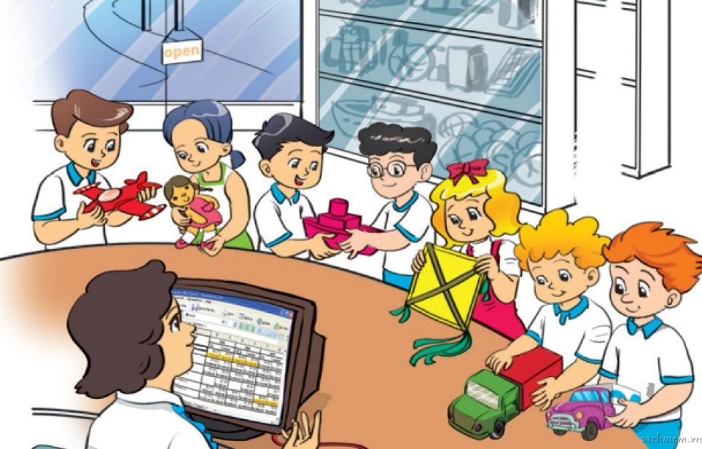
5. Read and write.
Hi. My name is Nam. I am in the playroom with my friends. I like planes. Mai likes dolls. Quan and Phong like ships. Linda likes kites. Peter and Tony like trucks. We have a lot of fun in the playroom.
1. The children are in the ___________.
2. Nam likes ___________.
3. Mai likes ___________.
4. Quan and Phong like ___________.
5. Linda likes ___________.
6. Peter and Tony like ___________.
playroom
planes
dolls
ships
kites
trucks

Slide 25
What toys does she/he like?
She/he likes ___________.
planes
dolls
kites
trucks
robbots
trains
teddy bears

Slide 26
6. Let’s write.
1. What toys do you have? .
2. Do you like trucks / ships / kites / planes? .
3. Where do you keep your toys?

