Slide 1
Unit 16
Do you have any pets?
Lesson 2

Slide 2
VOCABULARY

Slide 3

Vocabulary
flower pot
/ˈflaʊə pɒt/

Slide 4

Vocabulary
TV
/ˌtiː ˈviː/

Slide 5
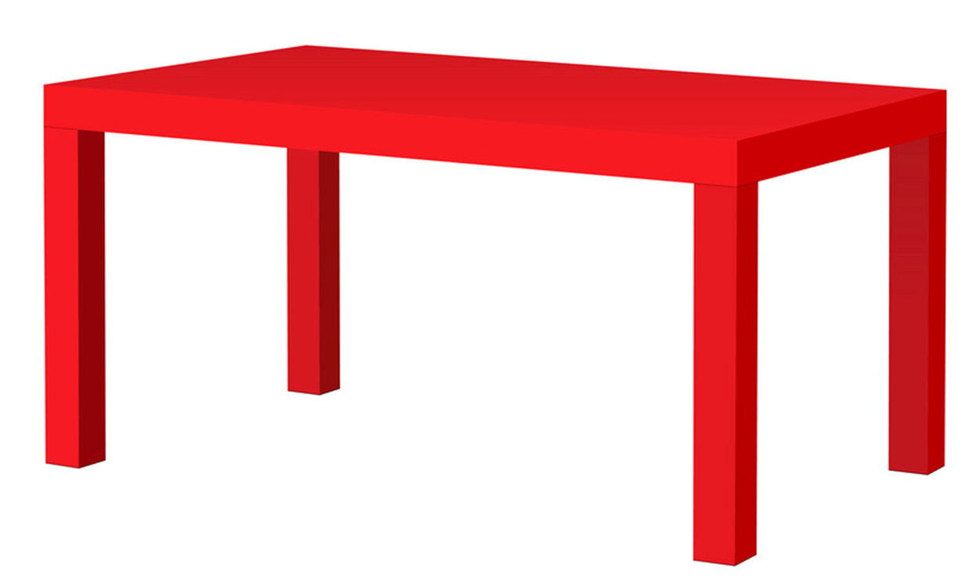
Vocabulary
table
/ˈteɪbl/

Slide 6

Vocabulary
fish tank
/ fɪʃ tæŋk/

Slide 7
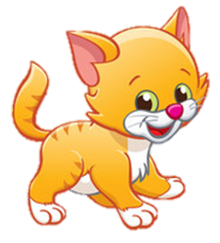
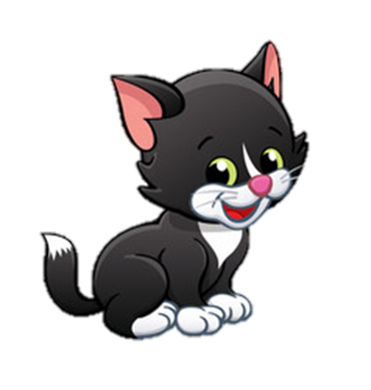
Vocabulary
under
/ˈʌndər/

Slide 8
Vocabulary
next to
/ˈnekst tu/

Slide 9
Vocabulary
behind
/bɪˈhaɪnd/

Slide 10
Vocabulary
in front of
/ɪn frʌnt əv/

Slide 11

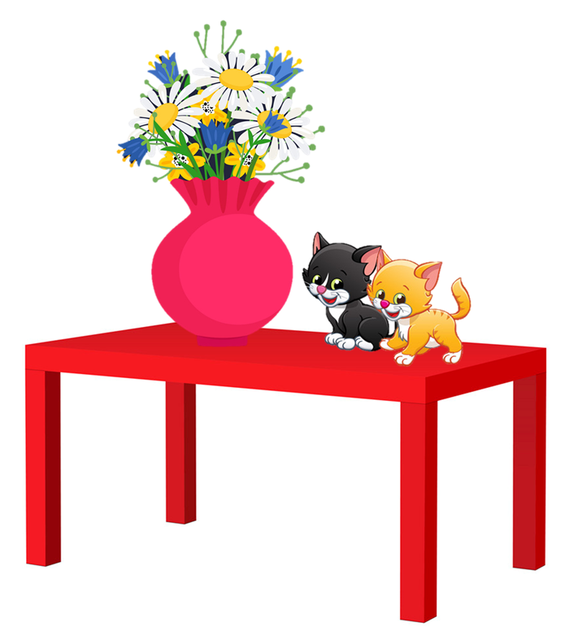
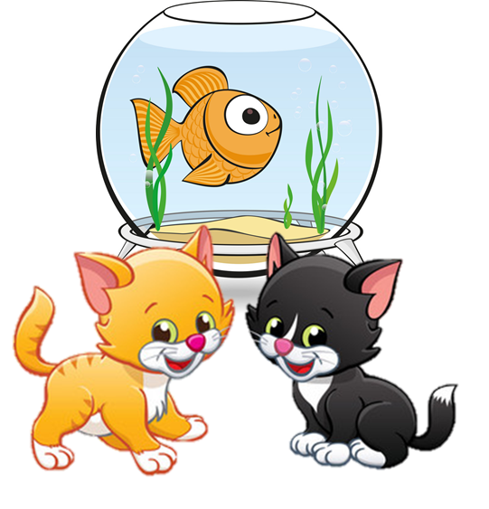
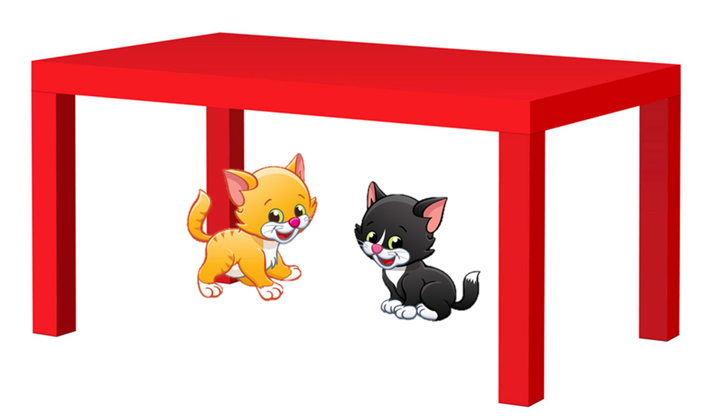



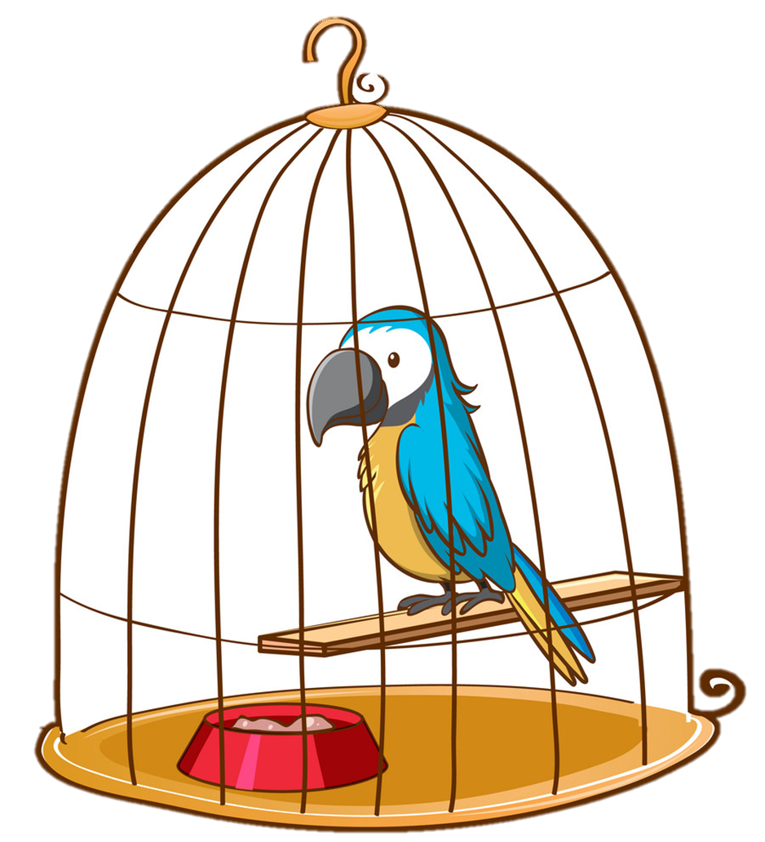
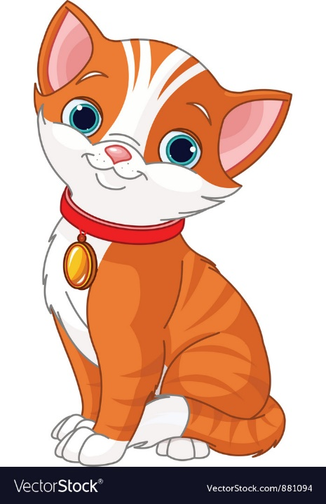
Vocabulary
1
2
3
4
under
behind
in front of
next to
5
6
7
8
flower pot
TV
table
fish tank

Slide 12
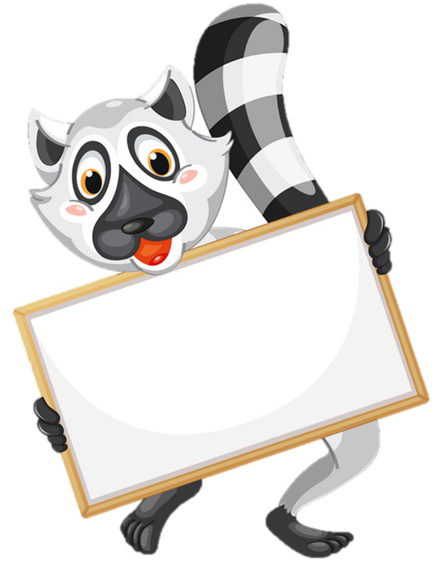


a
b
Next
c
d
TV

Slide 13
a
b
Next
c
d
flower pot

Slide 14
a
b
Next
c
d
fish tank

Slide 15
a
b
Next
c
d
Table

Slide 16
a
b
Next
c
d
next to

Slide 17
a
b
Next
c
d
under

Slide 18
a
b
Next
c
d
in front of

Slide 19
a
b
Next
c
d
behind

Slide 20

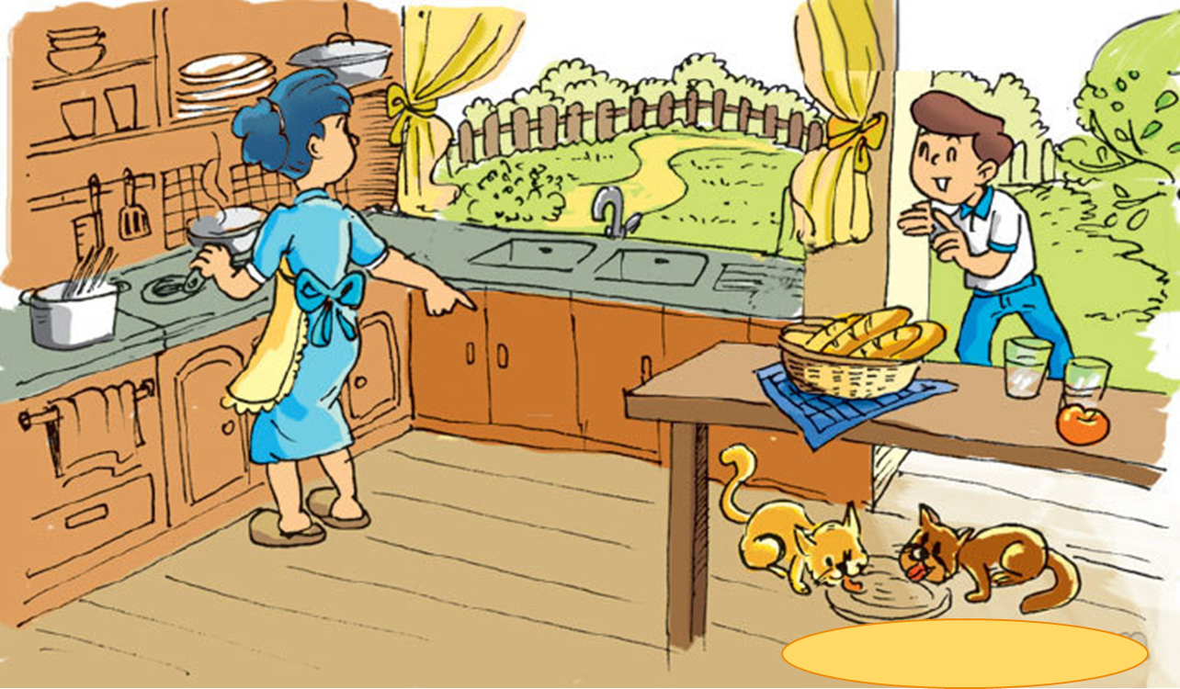

1. Look, listen and repeat
Where are my cats, Mum?
They're over there,
under the table.

Slide 21
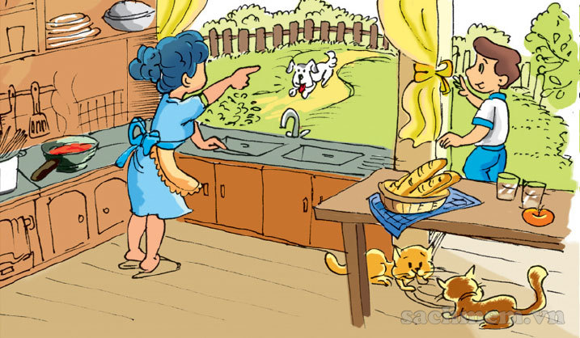

1. Look, listen and repeat
Is the dog there
with the cats, Mum?
No. He's in the garden.
Look! He's there.

Slide 22

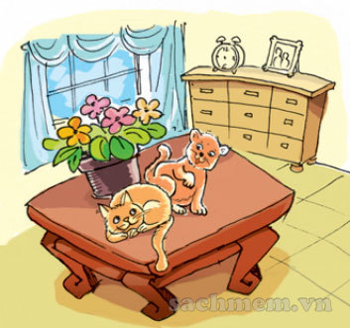
2. Point and say
next to
flower pot
Where are the cats?
They're next to the flower pot.

Slide 23
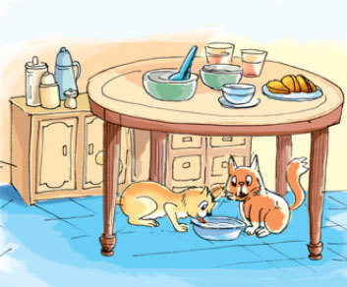
2. Point and say
under
table
Where are the cats?
They're under the table.

Slide 24
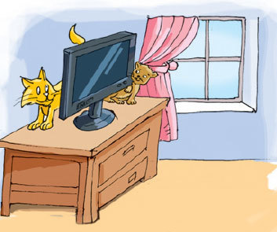
2. Point and say
behind
TV
Where are the cats?
They're behind the TV.

Slide 25
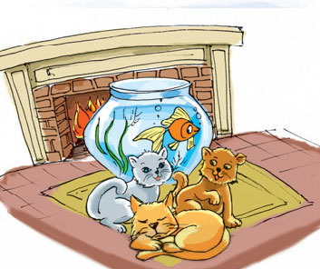
2. Point and say
in front of
Fish tank
Where are the cats?
They're in front of the fish tank.

Slide 26

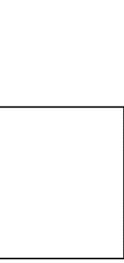
Model sentence
Where are the cats?
They’re ___________.
under
next to
behind
in front of

Slide 27
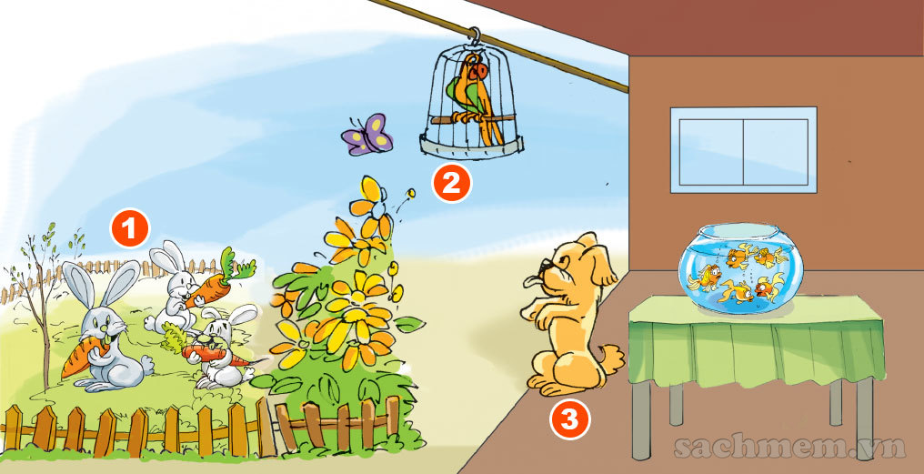
3. Let's talk
Where are the rabbits?
They're in the garden.

Slide 28
3. Let's talk
Where is the parrot?
It’s in the cage.

Slide 29
3. Let's talk
Where is the dog?
It’s next to the cage.

Slide 30
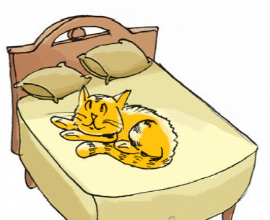
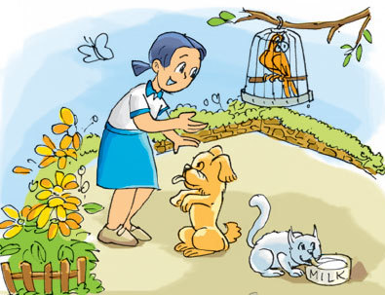
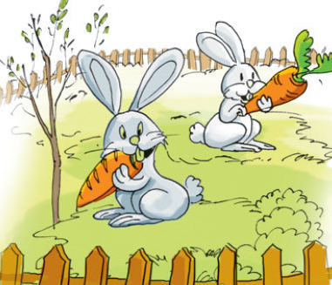
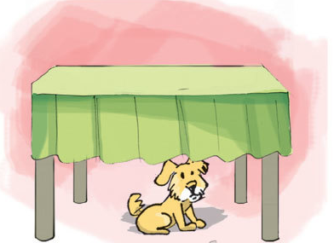
4. Listen and number
a
b
1
2
1
2
c
d
3
4
4
3

Slide 31
5. Read and write
Hi! My name is Nam. I have a lot of pets. This is my cat. It is on the bed. And that is my dog. It is there, under the table. I also have two parrots and a rabbit. They are all in the garden.
1. Nam has a lot of pets.
2. He has a cat . It is on the bed.
3. He has a dog . It is under the table.
4. He has two parrots and a rabbit. They are in the garden.
____________.
_______
_____
_____
_____
_____
_____
_____

Slide 32
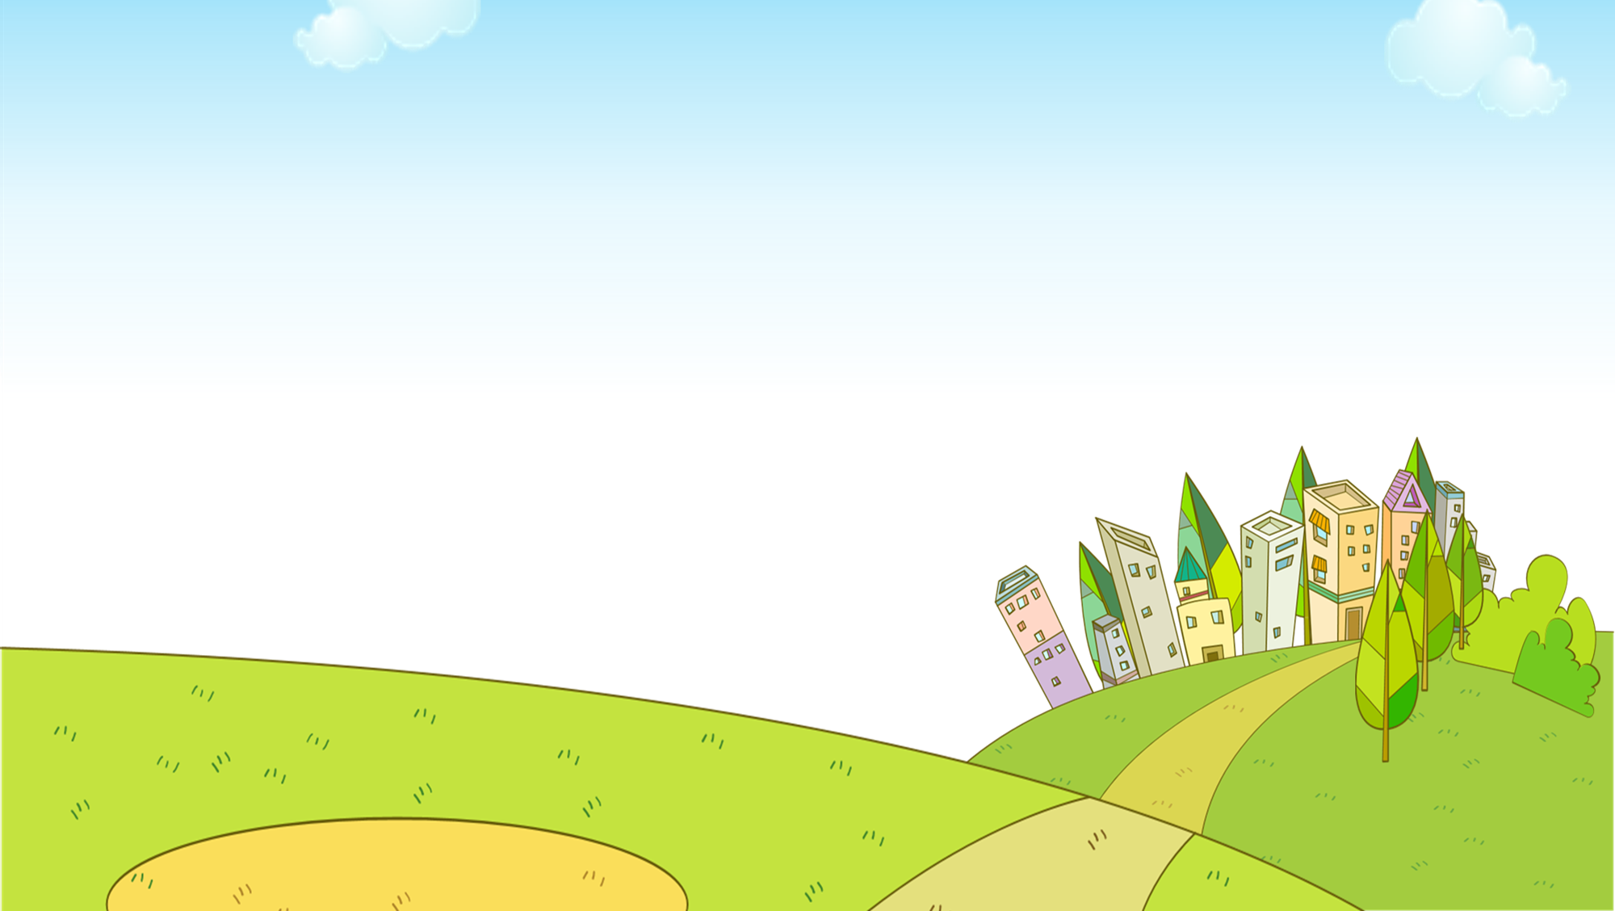


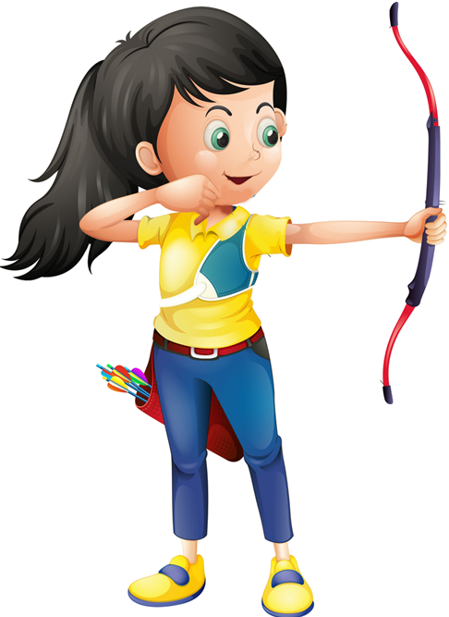




Ms Huyền Phạm
0936.082.789
Notes:
Ms Huyền Phạm - 0936.082.789 – YOUTUBE: MsPham. Facebook: Dạy và học cùng công nghệ.

Slide 33

Where are the cats?
They’re next ___ the table.
on
to
Ms Huyền Phạm
0936.082.789
Notes:
Ms Huyền Phạm - 0936.082.789 – YOUTUBE: MsPham. Facebook: Dạy và học cùng công nghệ.

Slide 34


Where are the balls?
They’re ____ the table.
under
behind
Ms Huyền Phạm
0936.082.789
Notes:
Ms Huyền Phạm - 0936.082.789 – YOUTUBE: MsPham. Facebook: Dạy và học cùng công nghệ.

Slide 35
Where are the rabbits?
They’re ____
the garden.
on
in
Ms Huyền Phạm
0936.082.789
Notes:
Ms Huyền Phạm - 0936.082.789 – YOUTUBE: MsPham. Facebook: Dạy và học cùng công nghệ.

Slide 36
Where are the _____?
They’re in the cage.
parrots
a parrot
Ms Huyền Phạm
0936.082.789
Notes:
Ms Huyền Phạm - 0936.082.789 – YOUTUBE: MsPham. Facebook: Dạy và học cùng công nghệ.

Slide 37
Where are the goldfish?
They’re _____.
Under the cage
In the fish tank
Ms Huyền Phạm
0936.082.789
Notes:
Ms Huyền Phạm - 0936.082.789 – YOUTUBE: MsPham. Facebook: Dạy và học cùng công nghệ.

Slide 38
Where are the dogs?
______ under the bed.
They’re
It’s
Ms Huyền Phạm
0936.082.789
Notes:
Ms Huyền Phạm - 0936.082.789 – YOUTUBE: MsPham. Facebook: Dạy và học cùng công nghệ.

Slide 39
Where ____ the cats?
They’re behind the tank.
is
are
Ms Huyền Phạm
0936.082.789
Notes:
Ms Huyền Phạm - 0936.082.789 – YOUTUBE: MsPham. Facebook: Dạy và học cùng công nghệ.

Slide 40
_____ are the books?
They’s in front of TV.
Where
What
Ms Huyền Phạm
0936.082.789
Notes:
Ms Huyền Phạm - 0936.082.789 – YOUTUBE: MsPham. Facebook: Dạy và học cùng công nghệ.

Slide 41
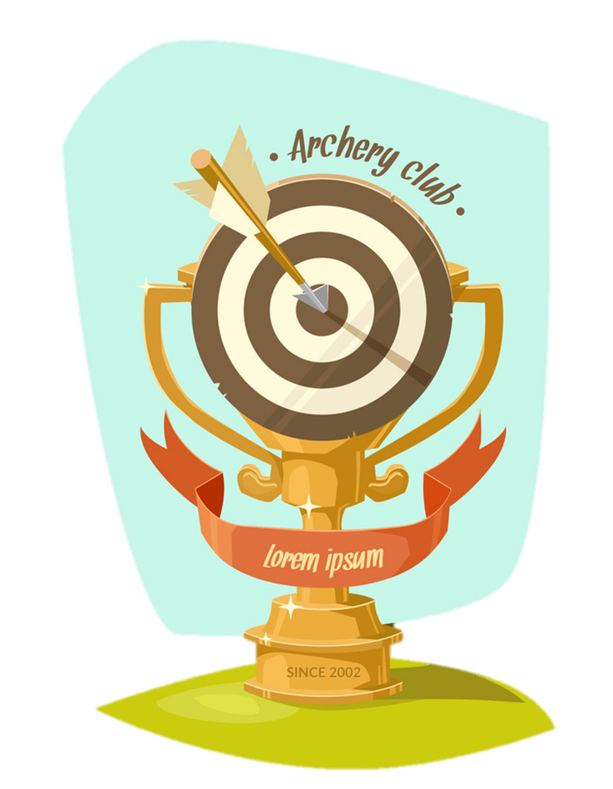
Good job!
Ms Huyền Phạm
0936.082.789
Notes:
Ms Huyền Phạm - 0936.082.789 – YOUTUBE: MsPham. Facebook: Dạy và học cùng công nghệ.

