Slide 1

Unit 15
When is
Children's Day?
Lesson 1

Slide 2





Vocabulary
New year
/ˌnjuː ˈjɜːr/

Slide 3


Vocabulary
Children’s Day
/ˈʧɪldrənz deɪ/

Slide 4

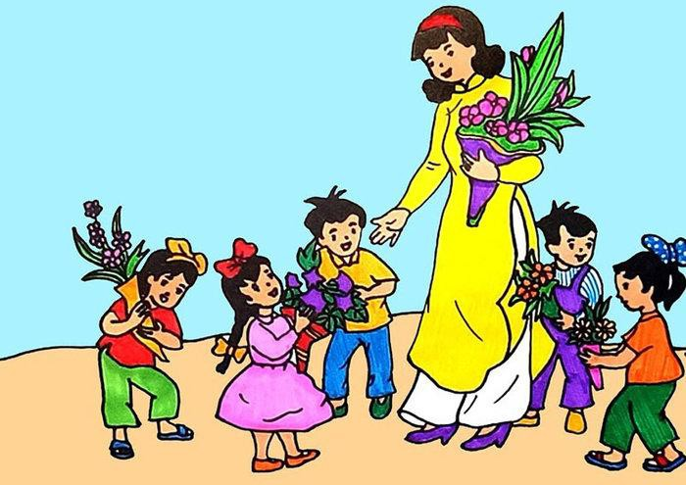
Vocabulary
Teachers’ Day
/ˈti:ʧərz deɪ/

Slide 5



Vocabulary
Christmas
/ˈkrɪsməs/
25
DECEMBER

Slide 6

Vocabulary
New year
Children’s Day
Teachers’ Day
Christmas

Slide 7




Click the best bee.
Children’s Day
1
Christmas
2
Teachers’ Day
3
New year
4

Slide 8
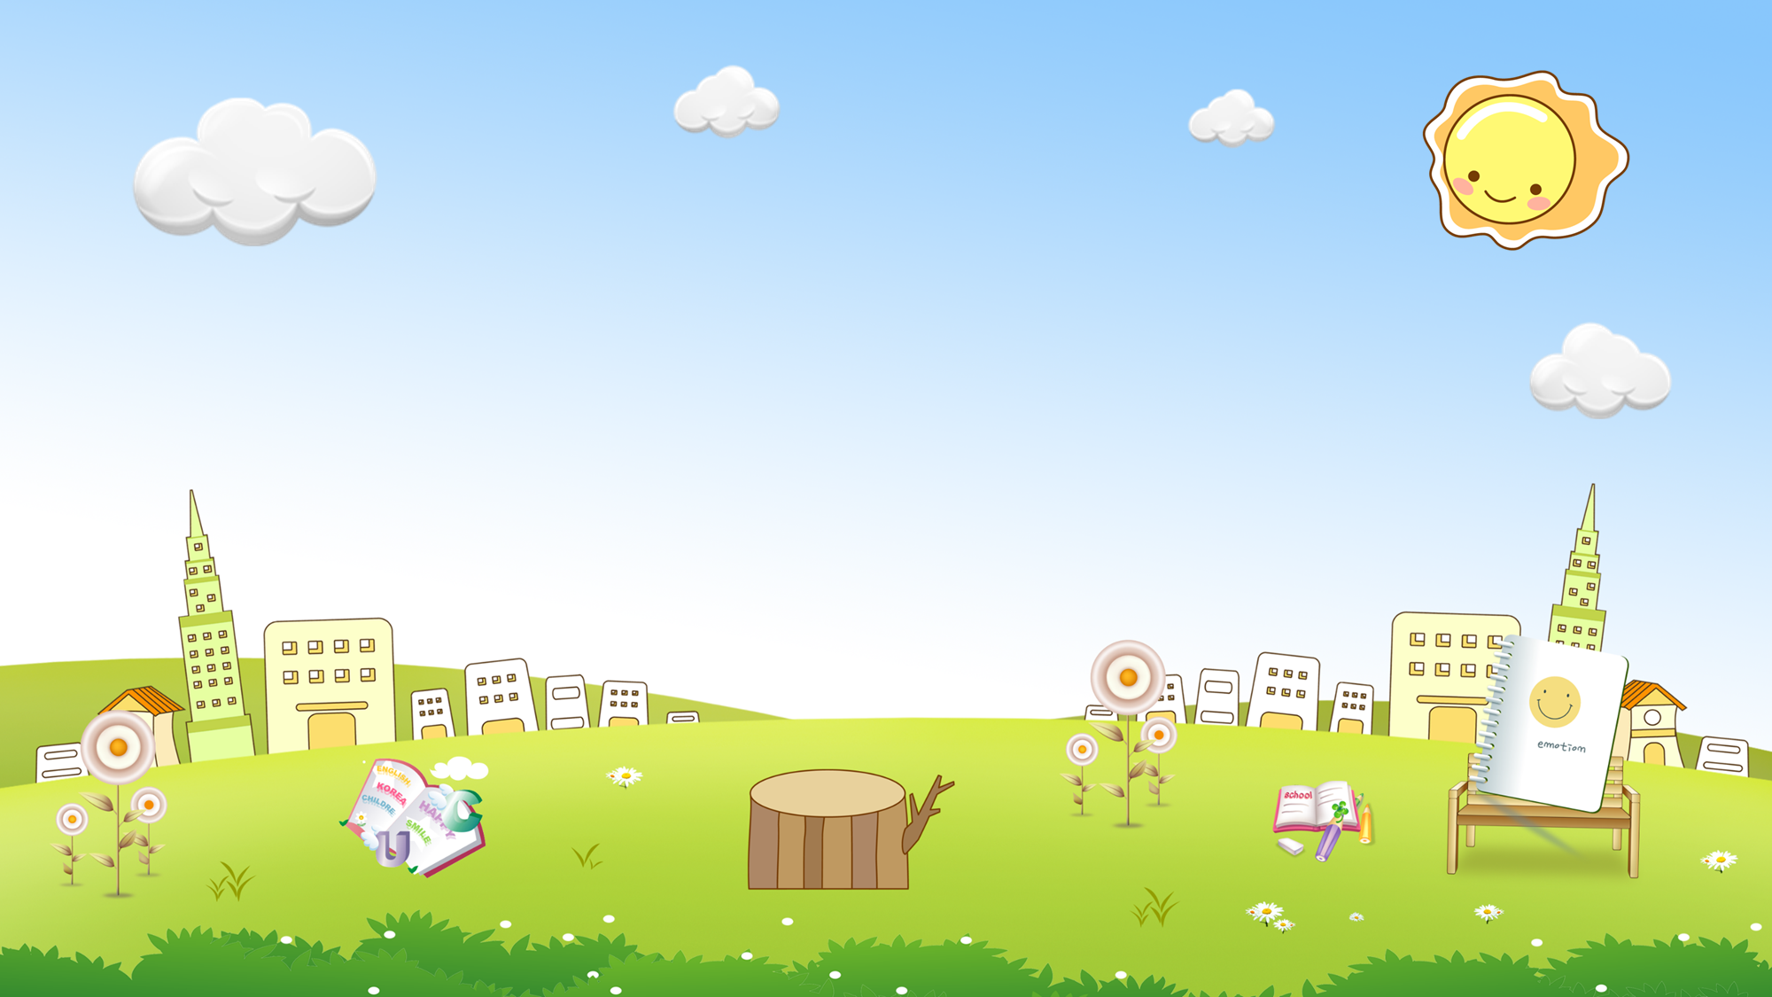





MOLE HUNT
START
Notes:
Ms Huyền Phạm - 0936.082.789 – YOUTUBE: MsPham. Facebook: Dạy và học cùng công nghệ.

Slide 9








a. b. c
a
b
c
Notes:
Ms Huyền Phạm - 0936.082.789 – YOUTUBE: MsPham. Facebook: Dạy và học cùng công nghệ.

Slide 10

a. b. c.
a
b
c
Notes:
Ms Huyền Phạm - 0936.082.789 – YOUTUBE: MsPham. Facebook: Dạy và học cùng công nghệ.

Slide 11
a. b. c.
a
b
c
Notes:
Ms Huyền Phạm - 0936.082.789 – YOUTUBE: MsPham. Facebook: Dạy và học cùng công nghệ.

Slide 12
a. b. c
a
b
c
Notes:
Ms Huyền Phạm - 0936.082.789 – YOUTUBE: MsPham. Facebook: Dạy và học cùng công nghệ.

Slide 13

a. b. c.
a
b
c
Notes:
Ms Huyền Phạm - 0936.082.789 – YOUTUBE: MsPham. Facebook: Dạy và học cùng công nghệ.

Slide 14
a. b. c.
a
b
c
Notes:
Ms Huyền Phạm - 0936.082.789 – YOUTUBE: MsPham. Facebook: Dạy và học cùng công nghệ.

Slide 15
a. b. c.
a
b
c
Notes:
Ms Huyền Phạm - 0936.082.789 – YOUTUBE: MsPham. Facebook: Dạy và học cùng công nghệ.

Slide 16
a. b. c.
a
b
c
Notes:
Ms Huyền Phạm - 0936.082.789 – YOUTUBE: MsPham. Facebook: Dạy và học cùng công nghệ.

Slide 17
a. b. c.
a
b
c
Notes:
Ms Huyền Phạm - 0936.082.789 – YOUTUBE: MsPham. Facebook: Dạy và học cùng công nghệ.

Slide 18
a. Children’s Day b. Christmas
c. New year
a
b
c
Notes:
Ms Huyền Phạm - 0936.082.789 – YOUTUBE: MsPham. Facebook: Dạy và học cùng công nghệ.

Slide 19
New year b. Teachers’ Day
c. Christmas
a
b
c
Notes:
Ms Huyền Phạm - 0936.082.789 – YOUTUBE: MsPham. Facebook: Dạy và học cùng công nghệ.

Slide 20
a. Children’s Day b. Christmas c. New year
a
b
c
Notes:
Ms Huyền Phạm - 0936.082.789 – YOUTUBE: MsPham. Facebook: Dạy và học cùng công nghệ.

Slide 21
a. Christmas b. Teachers’ Day c. Children’s Day
a
b
c
Notes:
Ms Huyền Phạm - 0936.082.789 – YOUTUBE: MsPham. Facebook: Dạy và học cùng công nghệ.

Slide 22
Thank you!
STOP
Notes:
Ms Huyền Phạm - 0936.082.789 – YOUTUBE: MsPham. Facebook: Dạy và học cùng công nghệ.

Slide 23

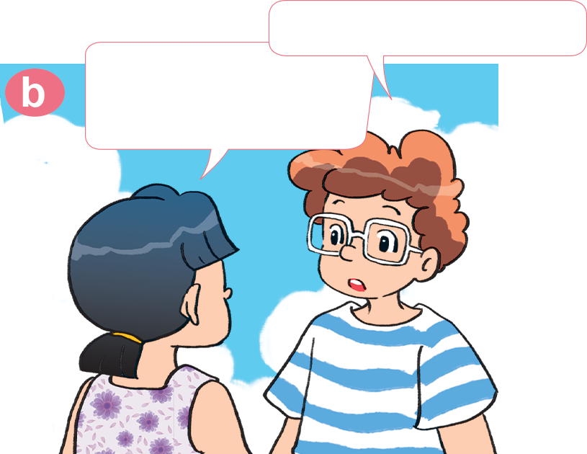

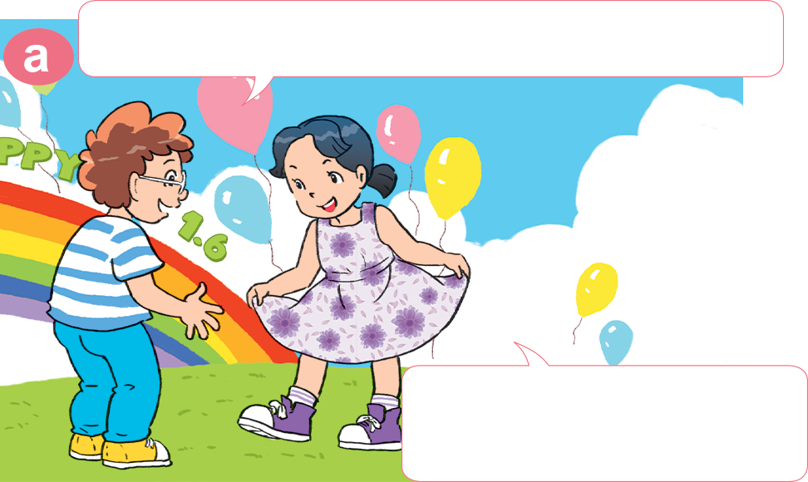
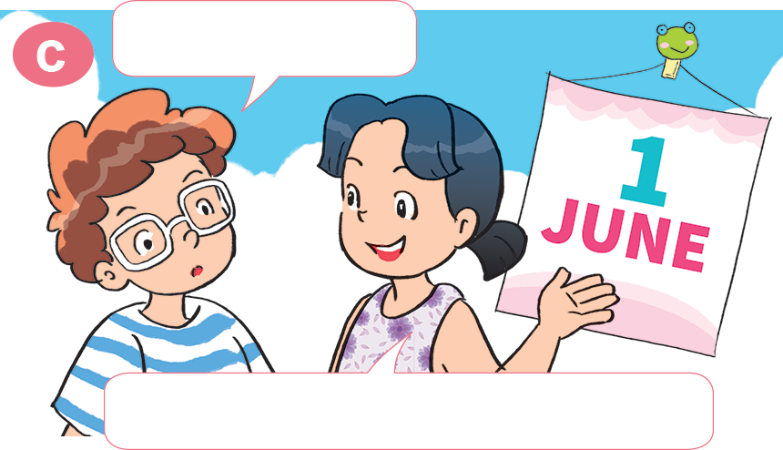
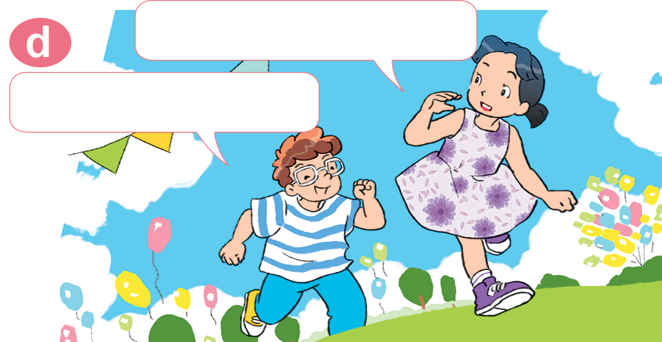
2. Look, listen and repeat
What party is it?
Hi, Mai. You look very smart today!
It's a party for Children's Day.
Yes, because we're having a party.
When is it?
Come and join us.
Yes! Thank you.
It's on the first of June.

Slide 24
2. Point and say
When is _________________?
It's on _______________________.
New Year
on the first of January

Slide 25
2. Point and say
When is _________________?
It's on _______________________.
Children’s Day
the first of June

Slide 26
2. Point and say
When is _________________?
It's on _________________________.
Teacher’s Day
the twentieth of November

Slide 27
2. Point and say
When is _________________?
It's on __________________________.
Christmas
the twenty-fifth of December

Slide 28
When is ________________?
It’s on _____________.
New year
Christmas
Children’s Day
Teacher’s Day
the twenty-fifth
of December
on the first of January
the first of June
the twentieth of November

Slide 29
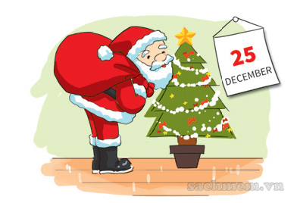
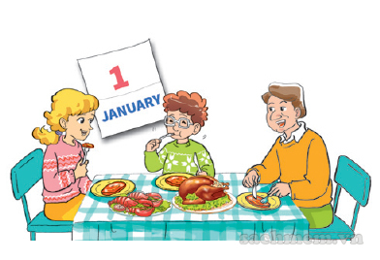
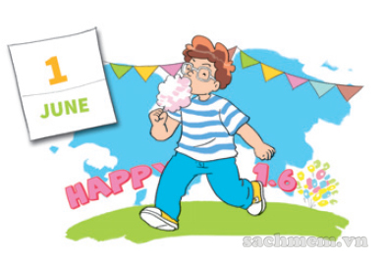

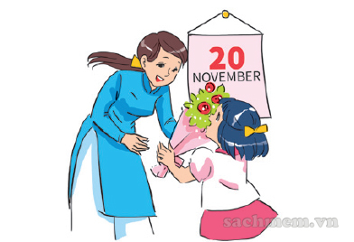
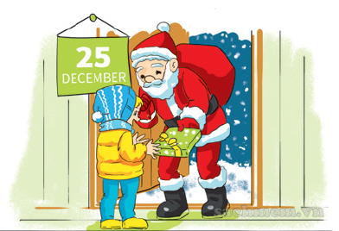

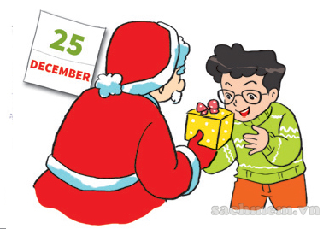
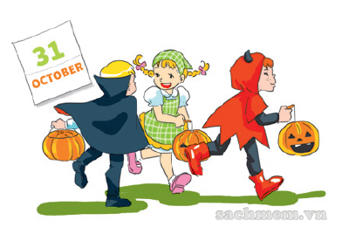
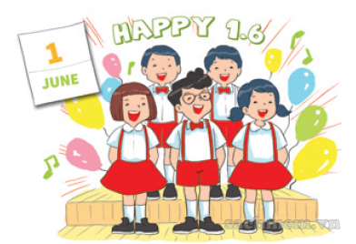
3
2
3. Listen and tick
1
a
b
c
2
a
b
c
3
a
b
c

Slide 30
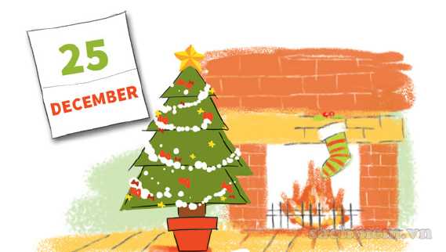
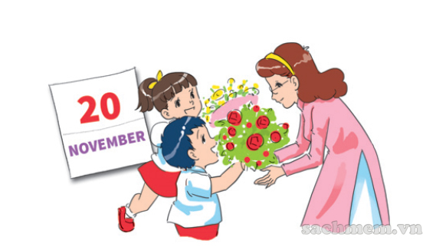
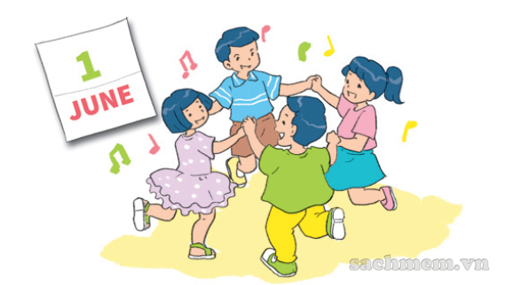
5. Look and write
When is Christmas?
It's on _______________________.
the twenty-fifth of December
When is Teacher's Day?
It's on _______________________.
the twentieth of November
When is Children's Day?
It's on _______________________.
the first of June

Slide 31
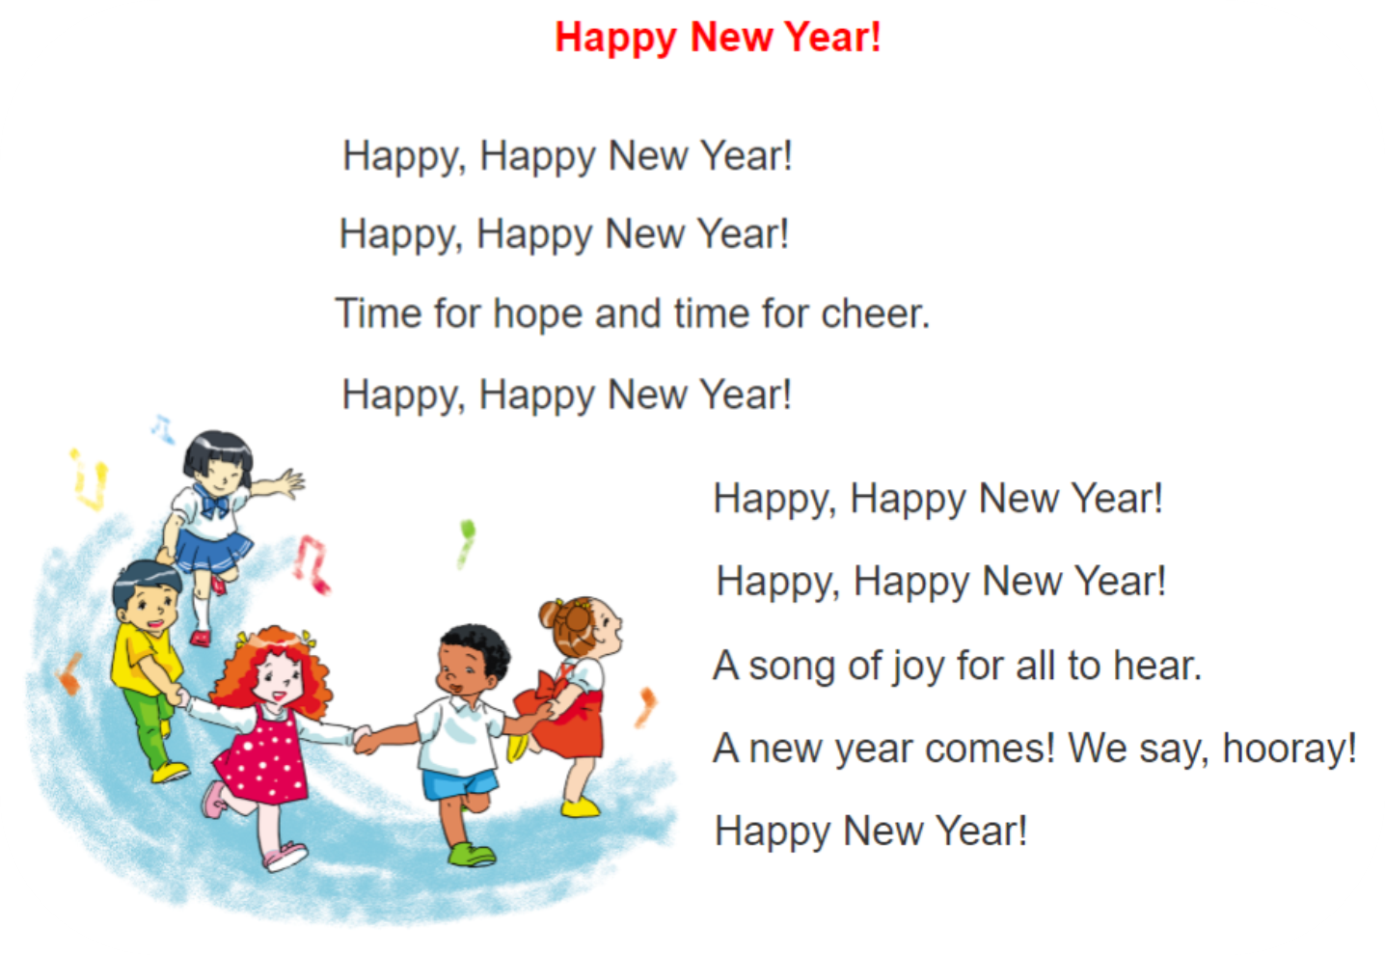

6. Let’s sing

Slide 32




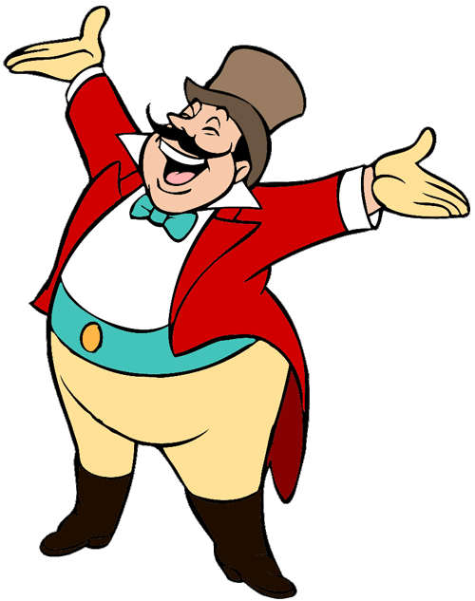
Ms Huyền Phạm
0936.082.789
START

Slide 33


When is Christmas?
It's on ___________.
the first of June
the twentieth of November
the twenty-fifth of December

Slide 34
When is New year?
It's on ___________.
the first of June
the first of December
the first of January

Slide 35
When is Teacher’s Day?
It's on ___________.
the twentieth of Octorber
the twentieth of November
the twentieth of June

Slide 36
When is Children’s Day?
It's on ___________.
the first of June
the first of November
the first of January
Next

Slide 37
When is _________?
It's on the twentieth of November.
Children’s Day
Teacher’s Day
Children’s Day

Slide 38
When is _________?
It's on the twenty-fifth of December.
Children’s Day
Christmas
New year

Slide 39
When is _________?
It's on the first of January.
New year
Children’s Day
Teacher’s Day
Next

Slide 40
When is _________?
It's on the first of June.
Teacher’s Day
Children’s Day
New year

Slide 41
_____ is Mother’s Day?
It's on the eighth of March.
When
What
How
Next

Slide 42
When is Halloween?
It's ____ the thirty-first of Octorber.
in
on
of

Slide 43
When is Teacher’s Day?
It's on the twentieth _____ November.
of
in
on
Next

