Slide 1
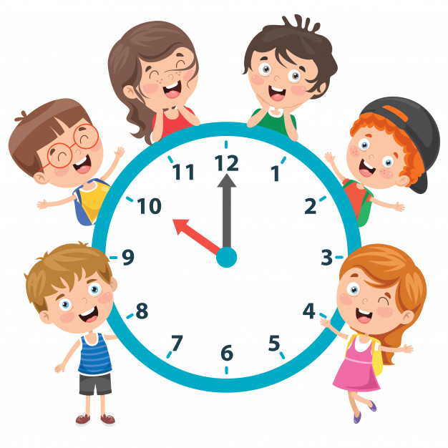
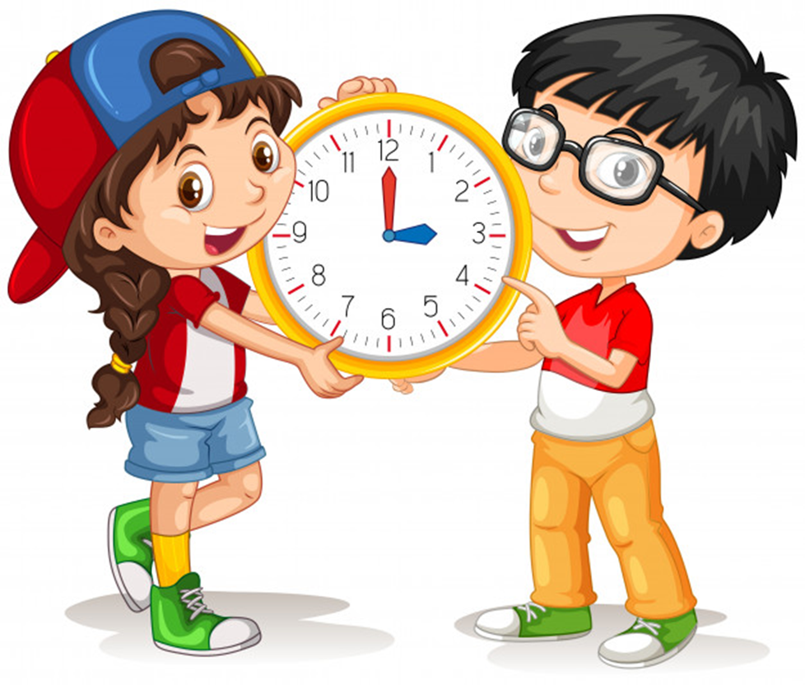
Unit 11
What time is it?
Lesson 1

Slide 2
WARM-UP

Slide 3






PRERENT WHEEL
10
50
30
30
20
Good job!
SPIN/STOP
SPIN/STOP
SPIN/STOP
SPIN/STOP
SPIN/STOP
SPIN/STOP
SPIN/STOP
SPIN/STOP
SPIN/STOP
SPIN/STOP
SPIN/STOP
SPIN/STOP
SPIN/STOP
SPIN/STOP
SPIN/STOP
40
SPIN/STOP
60
60
40
20
30
10
50
Notes:
Ms Huyền Phạm - 0936.082.789 – YOUTUBE: MsPham. Facebook: Dạy và học cùng công nghệ.

Slide 4

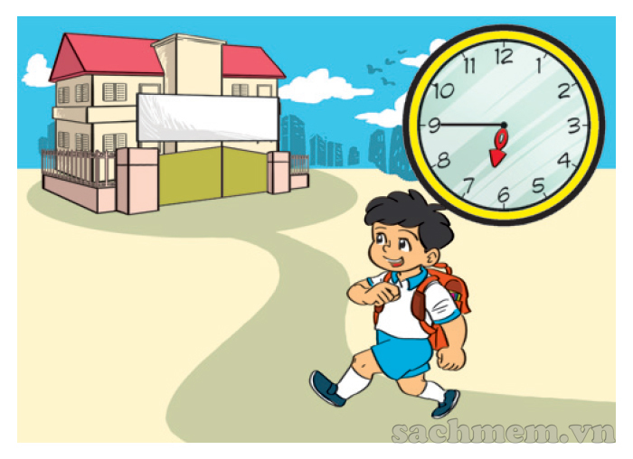

What time do you go to school?
I go to school at
six forty-five.
He goes to school at
six forty-five.
Notes:
Ms Huyền Phạm - 0936.082.789 – YOUTUBE: MsPham. Facebook: Dạy và học cùng công nghệ.

Slide 5
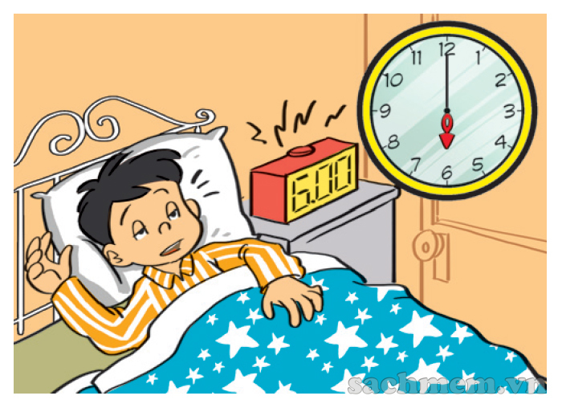
What time does he go to bed?
I go to bed at
six o’clock.
He goes to bed at
six o’clock.
Notes:
Ms Huyền Phạm - 0936.082.789 – YOUTUBE: MsPham. Facebook: Dạy và học cùng công nghệ.

Slide 6
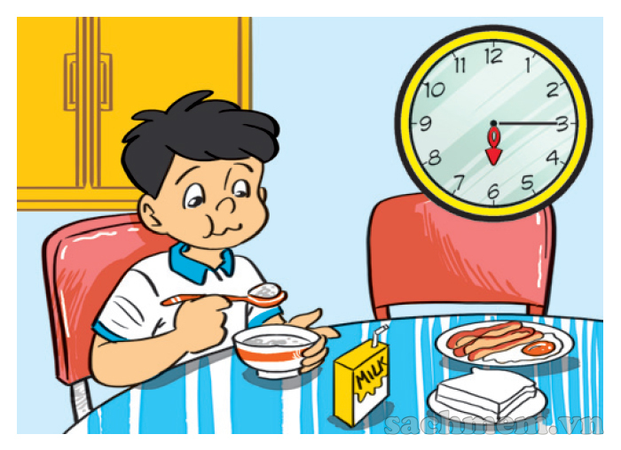
have breakfast
What time does he _______?
He has breakfast at six fifteen.
has breakfast
haves breakfast
Notes:
Ms Huyền Phạm - 0936.082.789 – YOUTUBE: MsPham. Facebook: Dạy và học cùng công nghệ.

Slide 7
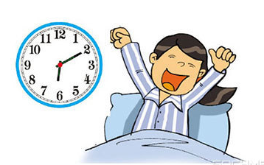
six twenty
I get up at ___________.
six ten
six forty
Notes:
Ms Huyền Phạm - 0936.082.789 – YOUTUBE: MsPham. Facebook: Dạy và học cùng công nghệ.

Slide 8
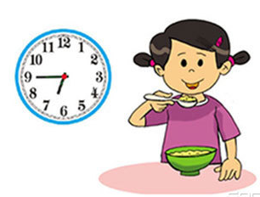
six fifteen
I have breakfast at _________.
six thirty
six forty-five
Notes:
Ms Huyền Phạm - 0936.082.789 – YOUTUBE: MsPham. Facebook: Dạy và học cùng công nghệ.

Slide 9

get up
I __________at
seven o'clock.
have breakfast
go to school
Notes:
Ms Huyền Phạm - 0936.082.789 – YOUTUBE: MsPham. Facebook: Dạy và học cùng công nghệ.

Slide 10
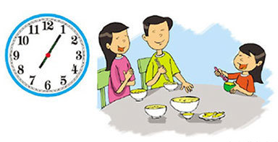
get home
I ___________ at seven five.
have dinner
watch TV
Notes:
Ms Huyền Phạm - 0936.082.789 – YOUTUBE: MsPham. Facebook: Dạy và học cùng công nghệ.

Slide 11
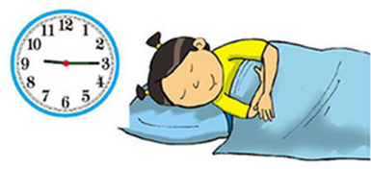
I go to bed at nine fiveteen.
True
False
Notes:
Ms Huyền Phạm - 0936.082.789 – YOUTUBE: MsPham. Facebook: Dạy và học cùng công nghệ.

Slide 12

What time it is?
True
Flase
Notes:
Ms Huyền Phạm - 0936.082.789 – YOUTUBE: MsPham. Facebook: Dạy và học cùng công nghệ.

Slide 13
Answer
What time does she go home?
___________________?
She goes home at four o’clock?
Notes:
Ms Huyền Phạm - 0936.082.789 – YOUTUBE: MsPham. Facebook: Dạy và học cùng công nghệ.

Slide 14

Answer
What time does your father watch TV?
He watches TV at eight fifteen
Notes:
Ms Huyền Phạm - 0936.082.789 – YOUTUBE: MsPham. Facebook: Dạy và học cùng công nghệ.

Slide 15

Answer
What time do you have dinner?
I have dinner at seven thirty.
Notes:
Ms Huyền Phạm - 0936.082.789 – YOUTUBE: MsPham. Facebook: Dạy và học cùng công nghệ.

Slide 16
Answer
What time is it?
It’s eight fifty.
Notes:
Ms Huyền Phạm - 0936.082.789 – YOUTUBE: MsPham. Facebook: Dạy và học cùng công nghệ.

Slide 17
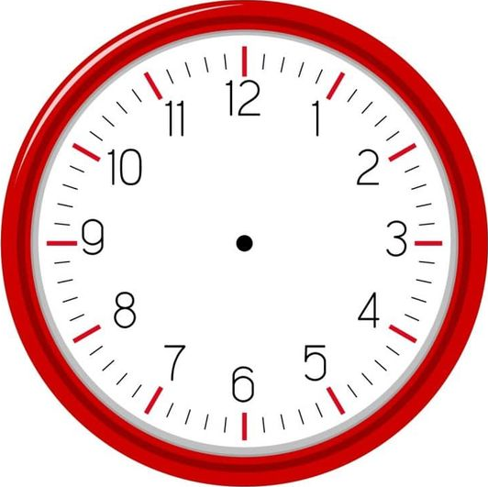

Answer
What time is it?
It’s twelve forty.
Notes:
Ms Huyền Phạm - 0936.082.789 – YOUTUBE: MsPham. Facebook: Dạy và học cùng công nghệ.

Slide 18
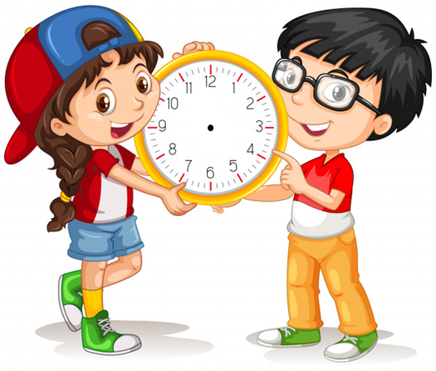
Answer
What time is it?
It’s ten twenty.
Notes:
Ms Huyền Phạm - 0936.082.789 – YOUTUBE: MsPham. Facebook: Dạy và học cùng công nghệ.

Slide 19
PHONICS

Slide 20

1. Listen and repeat.
oo
cook | My mother cooks at six o'clock.
book | Your book is on the table.
noon | I play football at noon.
school | They have lunch at school.
oo

Slide 21
2. Listen and write. Then say aloud.
1. Look! The _______ is red.
2. They usually read books at _________.
3. My big brother can _______.
4. The children usually play football at ________.
book
school
cook
noon

Slide 22
PRACTISE

Slide 23
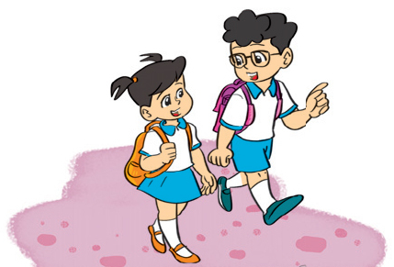
4. Read and complete.
Phong studies at Nguyen Du Primary School. Every day he gets up at 6.30. He goes to school at 7 a.m. School starts at 7.30 a.m. and finishes at 4.30 p.m. He goes home at 5 o'clock. He has dinner at 7.15 in the evening. Then he does his homework or listens to music. He goes to bed at 9.45.
1. Phong goes to school at _________.
2. He goes home at __________.
3. He ____________ at 7.15.
4. He _____________ at 9.45.
7 a.m
5 o'clock
has dinner
goes to bed

Slide 24
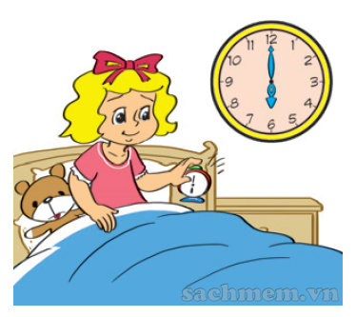
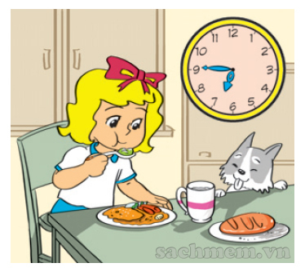
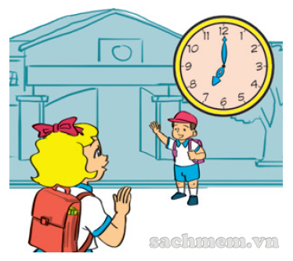
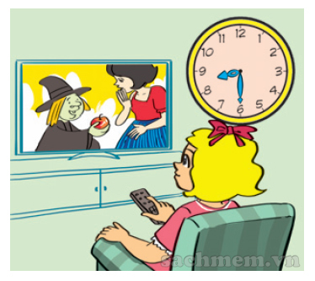
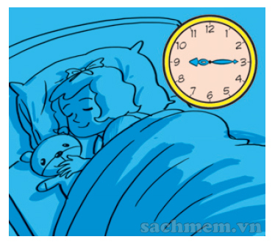
5. Let's write.
Linda gets up at six o'clock. She _____________ _______________. She ______________ _________. She ___________ ____________. And she ____________ ____________ .
has breakfast
at six forty-five
goes to school
at seven
watches TV
at eight thirty
goes to bed
at nine fifteen

Slide 25
6. Project
Write about you.
Hi, my name is _________ . I am from _______.
Every day I get up at _______. I go to school at _____________ and get home at __________.
In the evening, I _____________. I go to bed at ____________.

