Slide 1
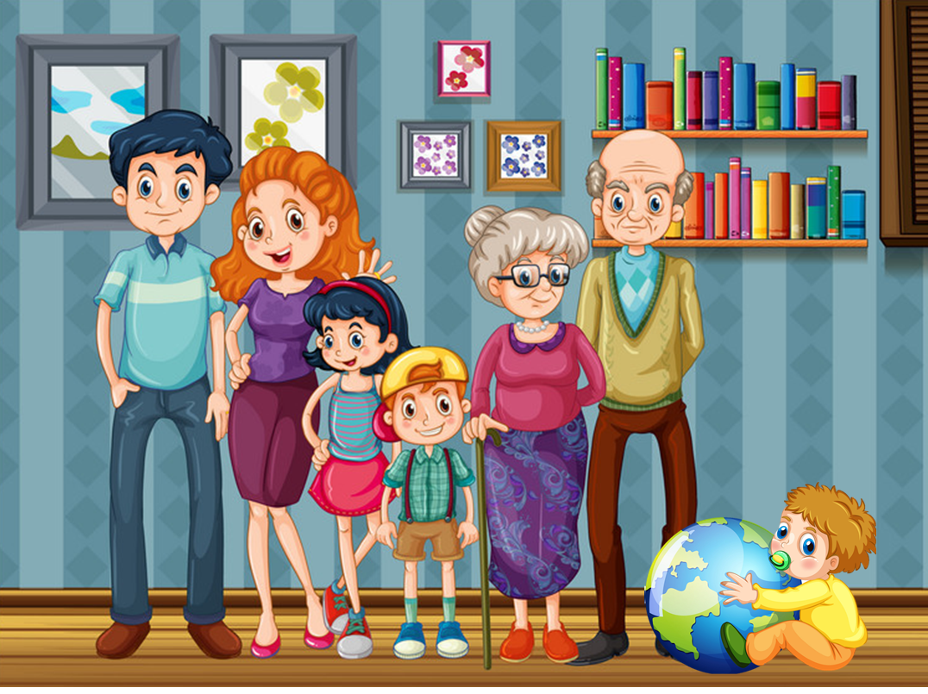
Unit 11
This is my family
Lesson 3

Slide 2
Warm up

Slide 3
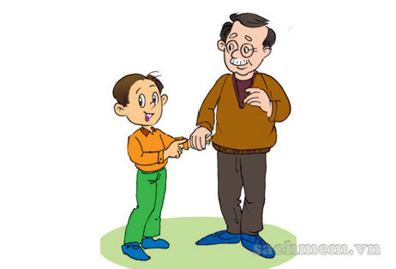
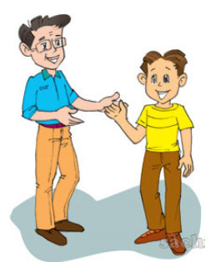
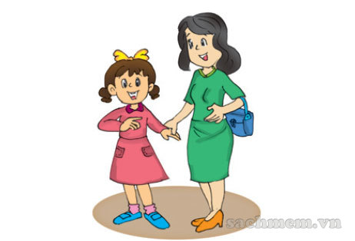
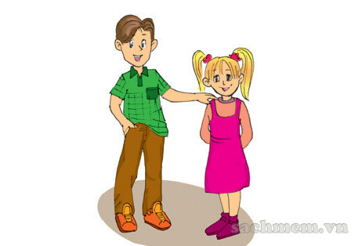
He is my grandfather.
He's sixty-six years old.
She's my mother.
She's forty years old.
He's my son.
He's thirteen years old.
She's my sister.
She's ten years old.

Slide 4
PHONICS

Slide 5

1. Listen and repeat.
br | gr
brother | grandmother
That's my brother. | My grandmother's fifty-five years old.

Slide 6
2. Listen and write.
1. My brother is fifteen.
2. My grandfather is fifty-three years old.
______________
______________

Slide 7
Vocabulary

Slide 8
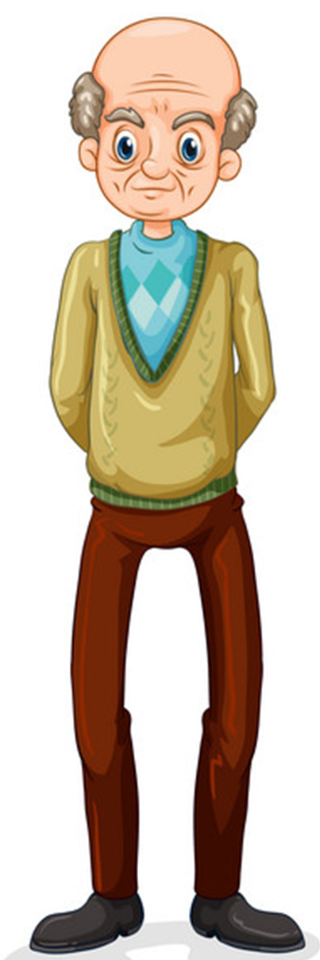
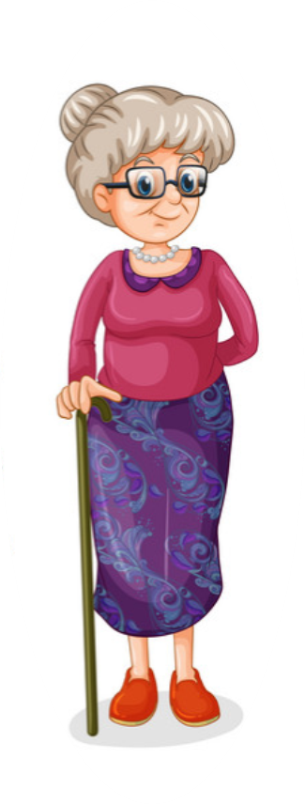
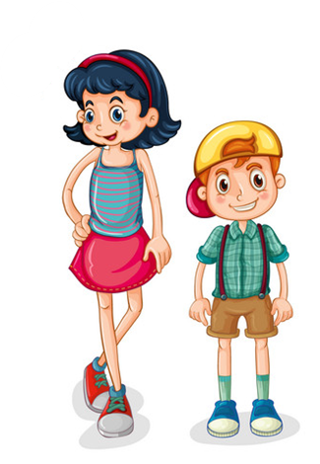
old
/əʊld/
young
/jʌŋ/

Slide 9
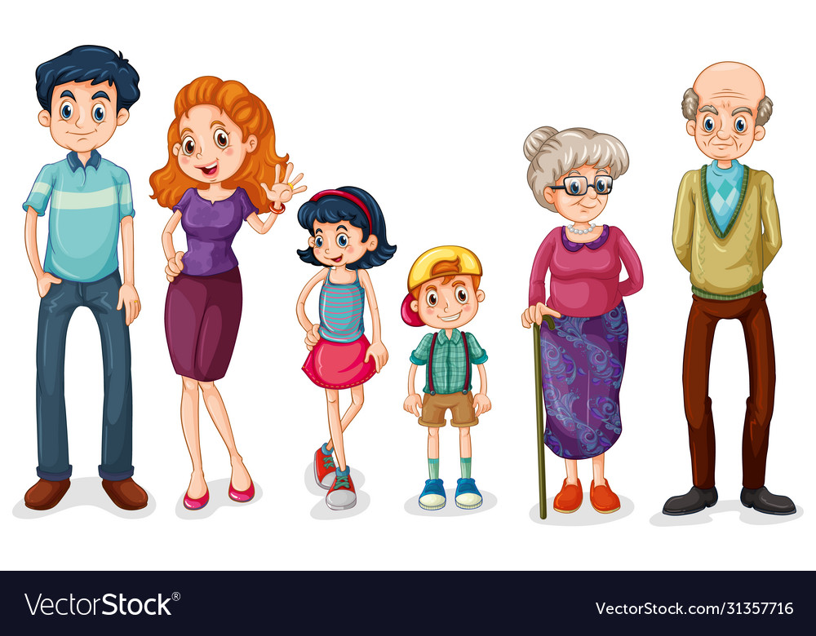
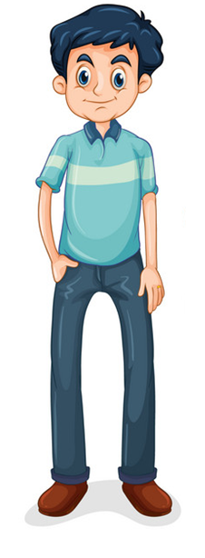
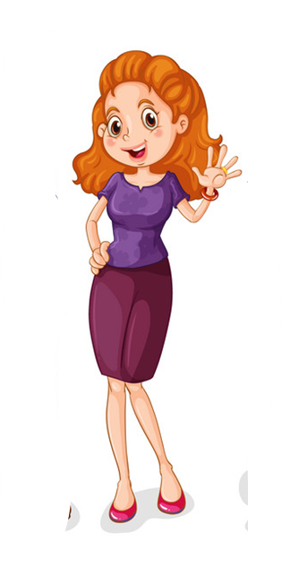
man
/mæn/
woman
/ˈwʊmən/

Slide 10

girl
/ɡɜːl/
boy
/bɔɪ/

Slide 11

man
boy
old
woman
girl
young

Slide 12
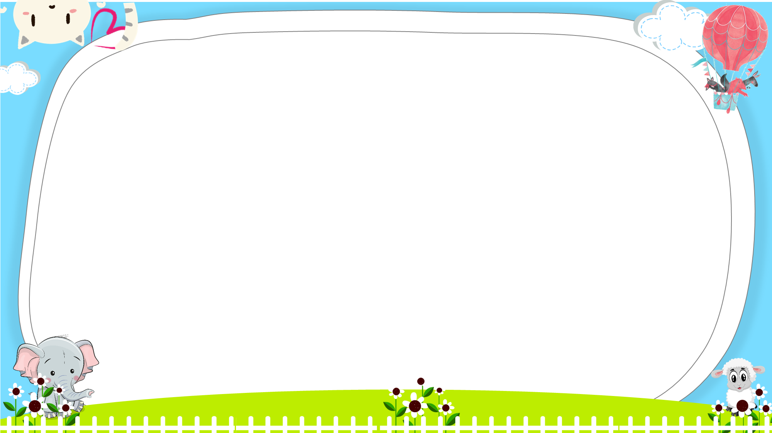





Notes:
Ms Huyền Phạm - 0936.082.789 – YOUTUBE: MsPham. Facebook: Dạy và học cùng công nghệ.

Slide 13





This is a woman.
Yes
No
Notes:
Ms Huyền Phạm - 0936.082.789 – YOUTUBE: MsPham. Facebook: Dạy và học cùng công nghệ.

Slide 14
This is a man.
Yes
No
Notes:
Ms Huyền Phạm - 0936.082.789 – YOUTUBE: MsPham. Facebook: Dạy và học cùng công nghệ.

Slide 15
That boy is old.
Yes
No
Notes:
Ms Huyền Phạm - 0936.082.789 – YOUTUBE: MsPham. Facebook: Dạy và học cùng công nghệ.

Slide 16
My father is young.
Yes
No
Notes:
Ms Huyền Phạm - 0936.082.789 – YOUTUBE: MsPham. Facebook: Dạy và học cùng công nghệ.

Slide 17
Who’s that?
He’s a boy.
Yes
No
Notes:
Ms Huyền Phạm - 0936.082.789 – YOUTUBE: MsPham. Facebook: Dạy và học cùng công nghệ.

Slide 18
My mother is old.
Yes
No
Notes:
Ms Huyền Phạm - 0936.082.789 – YOUTUBE: MsPham. Facebook: Dạy và học cùng công nghệ.

Slide 19
Who’s that?
She’s a girl.
Yes
No
Notes:
Ms Huyền Phạm - 0936.082.789 – YOUTUBE: MsPham. Facebook: Dạy và học cùng công nghệ.

Slide 20
My sister is a boy.
Yes
No
Notes:
Ms Huyền Phạm - 0936.082.789 – YOUTUBE: MsPham. Facebook: Dạy và học cùng công nghệ.

Slide 21

This man is young.
Yes
No
Notes:
Ms Huyền Phạm - 0936.082.789 – YOUTUBE: MsPham. Facebook: Dạy và học cùng công nghệ.

Slide 22
Who’s that?
That’s a man.
Yes
No
Notes:
Ms Huyền Phạm - 0936.082.789 – YOUTUBE: MsPham. Facebook: Dạy và học cùng công nghệ.

Slide 23
My grandmother is old.
Yes
No
Notes:
Ms Huyền Phạm - 0936.082.789 – YOUTUBE: MsPham. Facebook: Dạy và học cùng công nghệ.

Slide 24

Notes:
Ms Huyền Phạm - 0936.082.789 – YOUTUBE: MsPham. Facebook: Dạy và học cùng công nghệ.

Slide 25
Grammar

Slide 26
Who’s that woman?
She’s my grandmother.
Who’s that man?
He’s my grandfather.

Slide 27
Who’s that woman?
She’s my mother.
Who’s that man?
He’s my father.

Slide 28
Who’s that boy?
He’s my brother.
Who’s that girl?
She’s my sister.

Slide 29









Luật chơi: Bạn có 5s để suy nghĩ và
trả lời các câu hỏi.
Trả lời đúng, mũi tiêu tương ứng trúng đích bạn nhận được điểm tương ứng vị trí mũi tiêu.
Trả lời sai, mũi tiêu rơi xuống hoặc không trúng đích và không có điểm.
PLAY
Notes:
Ms Huyền Phạm - 0936.082.789 – YOUTUBE: MsPham. Facebook: Dạy và học cùng công nghệ.

Slide 30
Who’s that woman?
+18
He’s my mother.
She’s my mother.
She’s my father.
He’s my father.
Next
Abc.xyz789
Notes:
Ms Huyền Phạm - 0936.082.789 – YOUTUBE: MsPham. Facebook: Dạy và học cùng công nghệ.

Slide 31
Who’s that girl?
+25
He’s my brother.
He’s my sister.
She’s my brother.
She’s my sister.
Next
Abc.xyz789
Notes:
Ms Huyền Phạm - 0936.082.789 – YOUTUBE: MsPham. Facebook: Dạy và học cùng công nghệ.

Slide 32
Who’s that man?
She’s my mother.
He’s my mother.
+17
He’s my father.
She’s my father.
Next
Abc.xyz789
Notes:
Ms Huyền Phạm - 0936.082.789 – YOUTUBE: MsPham. Facebook: Dạy và học cùng công nghệ.

Slide 33
Who’s that woman?
+13
He’s my grandfather.
She’s my grandfather.
He’s my grandmother.
She’s my grandmother.
Next
Abc.xyz789
Notes:
Ms Huyền Phạm - 0936.082.789 – YOUTUBE: MsPham. Facebook: Dạy và học cùng công nghệ.

Slide 34
Who’s that boy?
+ 20
He’s my brother.
She’s my brother.
He’s my sister.
She’s my sister.
Next
Abc.xyz789
Notes:
Ms Huyền Phạm - 0936.082.789 – YOUTUBE: MsPham. Facebook: Dạy và học cùng công nghệ.

Slide 35
Who’s that man?
+14
She’s my mother.
He’s my mother.
She’s my grandfather.
He’s my grandfather.
Next
Abc.xyz789
Notes:
Ms Huyền Phạm - 0936.082.789 – YOUTUBE: MsPham. Facebook: Dạy và học cùng công nghệ.

Slide 36
He is the son.
+14
Who is that woman?
Who is that boy?
Who is that man?
Who is that girl?
Next
Abc.xyz789
Notes:
Ms Huyền Phạm - 0936.082.789 – YOUTUBE: MsPham. Facebook: Dạy và học cùng công nghệ.

Slide 37
She is the mother.
+15
Who is that girl?
Who is that boy?
Who is that woman?
Who is that man?
Next
Abc.xyz789
Notes:
Ms Huyền Phạm - 0936.082.789 – YOUTUBE: MsPham. Facebook: Dạy và học cùng công nghệ.

Slide 38
He is the father.
+ 9
Who is that man?
Who is that girl?
Who is that woman?
Who is that boy?
Next
Abc.xyz789
Notes:
Ms Huyền Phạm - 0936.082.789 – YOUTUBE: MsPham. Facebook: Dạy và học cùng công nghệ.

Slide 39
She is the daughter.
+50
Who is that boy?
Who is that woman?
Who is that girl?
Who is that man?
Next
Abc.xyz789
Notes:
Ms Huyền Phạm - 0936.082.789 – YOUTUBE: MsPham. Facebook: Dạy và học cùng công nghệ.

Slide 40
WELL DONE!
EXIT
Notes:
Ms Huyền Phạm - 0936.082.789 – YOUTUBE: MsPham. Facebook: Dạy và học cùng công nghệ.

Slide 41
PRACTISE

Slide 42
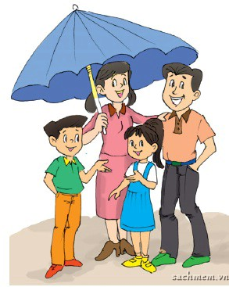
Make questions
1. Who is that man?
He is the father.
2. How old is he?
He is forty-five years old.
3. Who is that woman?
She is the mother.
4. How old is she?
She is forty years old.
___________________________?
5. Who is that boy?
He is the son.
6. How old is he?
He is fifteen years old.
7. Who is that girl?
She is the daughter.
8. How old is she?
She is ten years old.
___________________________?
___________________________?
___________________________?
___________________________?
___________________________?
___________________________?
___________________________?

Slide 43
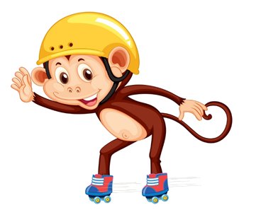

Match
a. years old.
b. my grandmother.
c. is your mother?
d. young.
1. This is
2. How old
3. My father is
4. My sister is seven

Slide 44
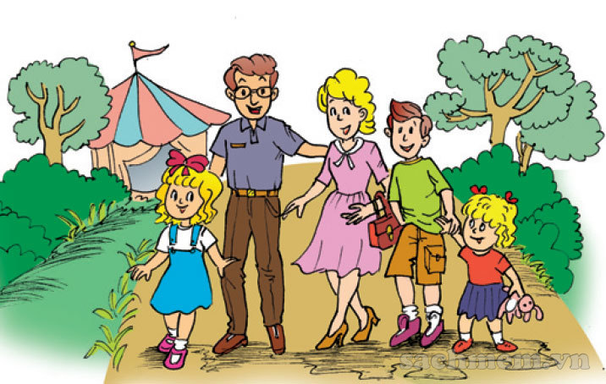
5. Look, read and write.
This is a photo of my (1) family. Look at the man. He is my (2) father. He is forty-four years old. The woman next to him is my (3) mother. She is thirty-nine years old. The boy is my (4) brother. He is fourteen years old. And the little girl is my (5) sister. She is five years old. Can you find me and guess how old I am?
_________
_________
_________
_________
_______

Slide 45
6. Project
There are _______ people in my family.
My father is _________ years old, and my mother _______ is years old.
My sister/brother is _______ years old.
I am _______ years old.
We are a happy _______.

