Slide 1


Unit 9
What colour is it?
Lesson 2

Slide 2
VOCABULARY

Slide 3
red

Slide 4
green

Slide 5
yellow

Slide 6
blue

Slide 7
pink

Slide 8
black

Slide 9
brown

Slide 10
orange

Slide 11
purple

Slide 12
gray

Slide 13
white

Slide 14
COLOUR
red
blue
gray
pink
black
green
yellow
brown
orange
purple
white

Slide 15
GRAMMAR

Slide 16
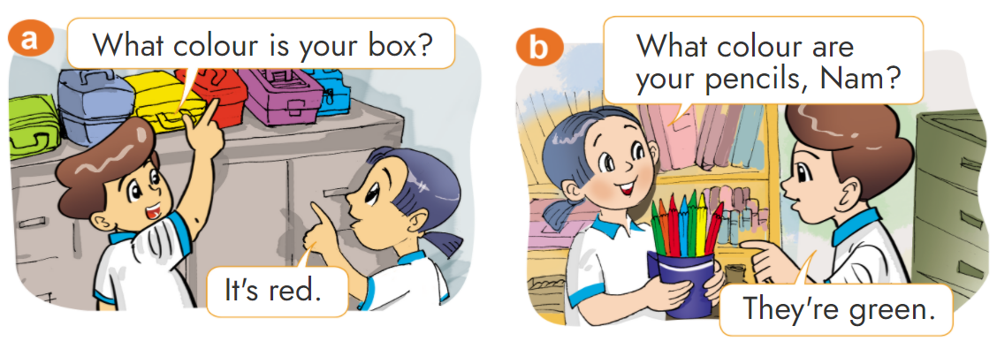

1. Look, listen and repeat.

Slide 17


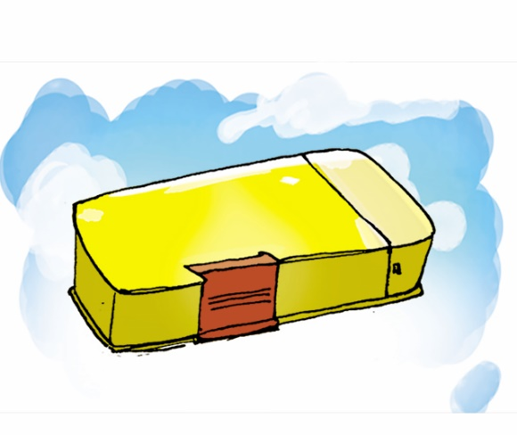
2. Point and say
What colour is your ________?
It's ____________.
pencil case, yellow
pen, blue
ruler, white

Slide 18
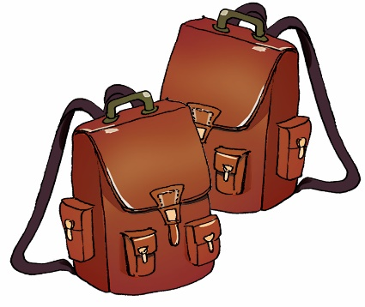
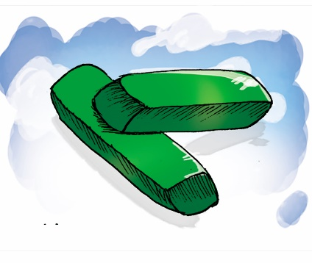

2. Point and say
What colour are your ______?
They’re ____________.
school bags, brown
rubbers, green
notebooks, orange

Slide 19
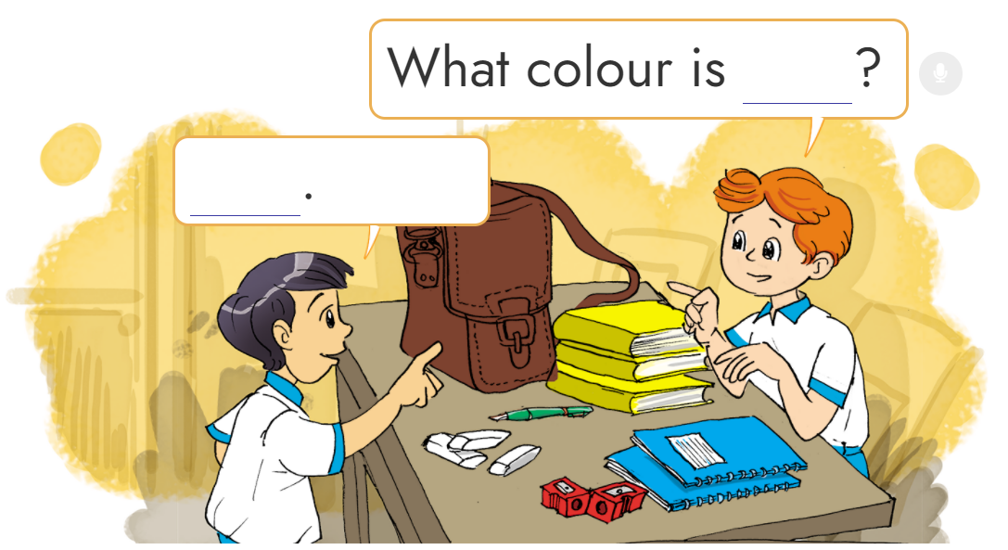
3. Let’s talk
1
6
3
2
4
5

Slide 20


START

Slide 21





What colour are your school bags?
They’re yellow.
Check
Next

Slide 22
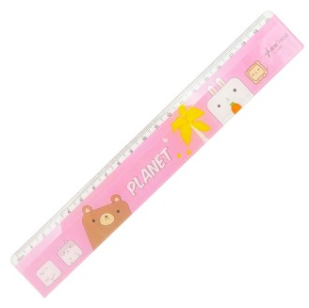
What colour is your ruller?
It’s pink.
Check
Next

Slide 23
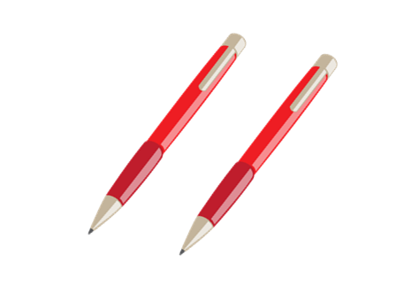
What colour are your pens?
They’e red.
Check
Next

Slide 24
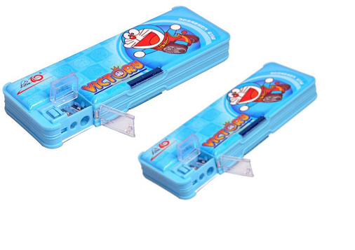
What colour are your pencil cases?
They’e blue.
Check
Next

Slide 25

MsPham
What colour are your pencils?
They’e purple.
Check
Next

Slide 26
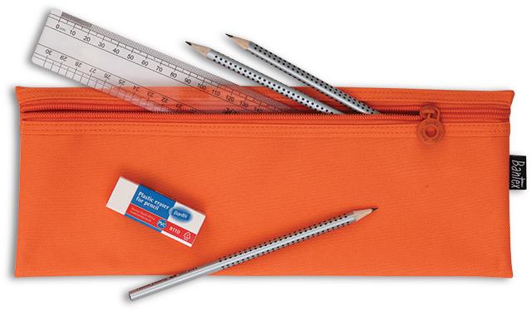
MsPham
What colour is your pencil case?
It’s orange.
Check
Next

Slide 27
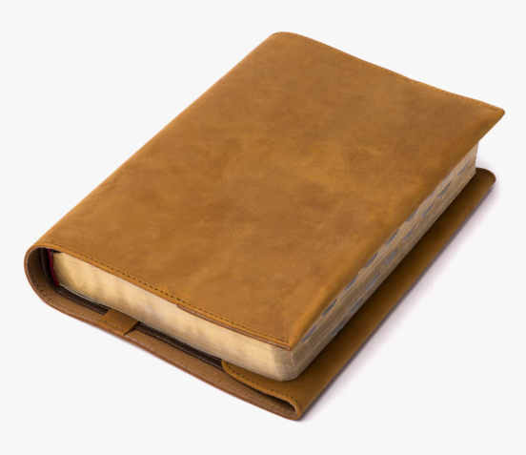
What colour is your notebook?
It’s brown.
Check
Next

Slide 28
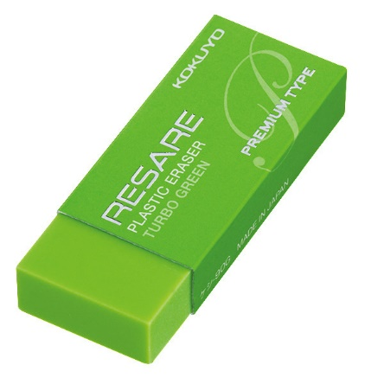
MsPham
What colour is your rubber?
It’s green.
Check
Next

Slide 29
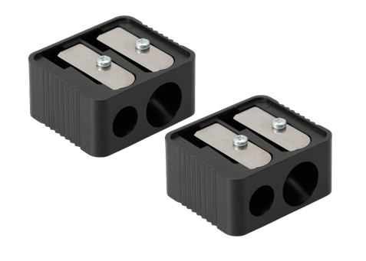
MsPham
What colour is your pencil sharpener?
They’e black.
Check
Next

Slide 30
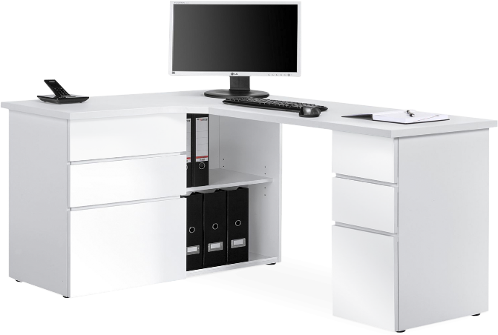
MsPham
What colour is your desk?
It’s white.
Check
Next

Slide 31
Good job!
End

Slide 32
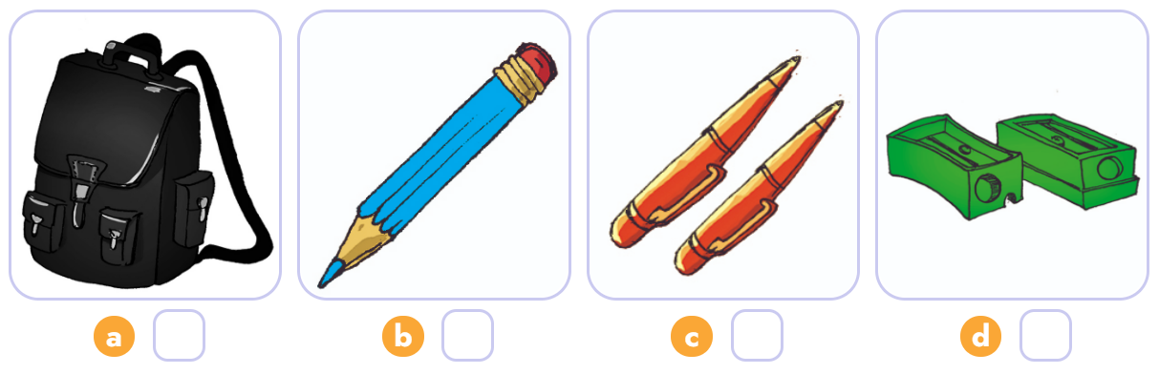
4. Listen and number.
3
2
4
1
1
2
3
4

Slide 33
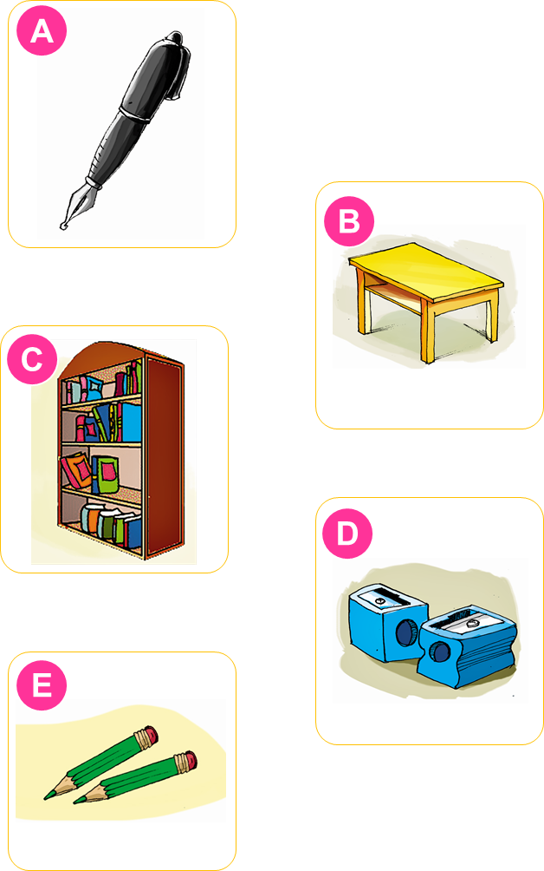
5. Read and match.
This is my desk. It is yellow.
These are my pencil sharpeners. They are blue.
That is my pen. It is black.
Those are my pencils. They are green.
That is my bookcase. It is brown.
1
2
3
4
5

Slide 34
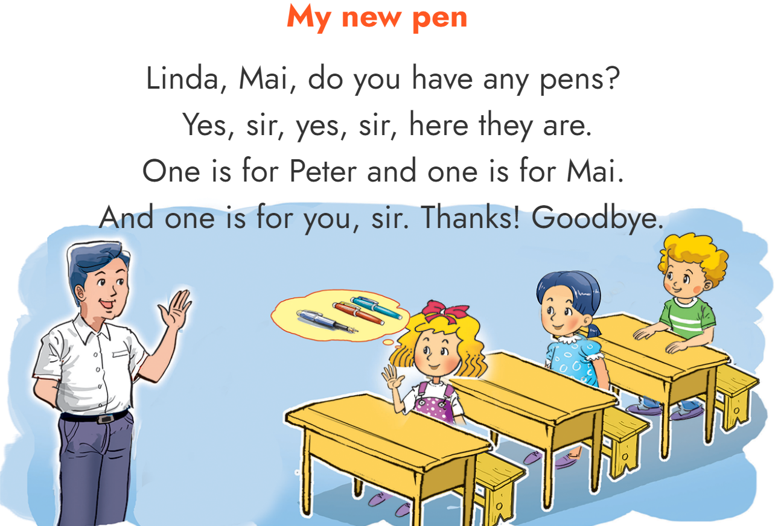
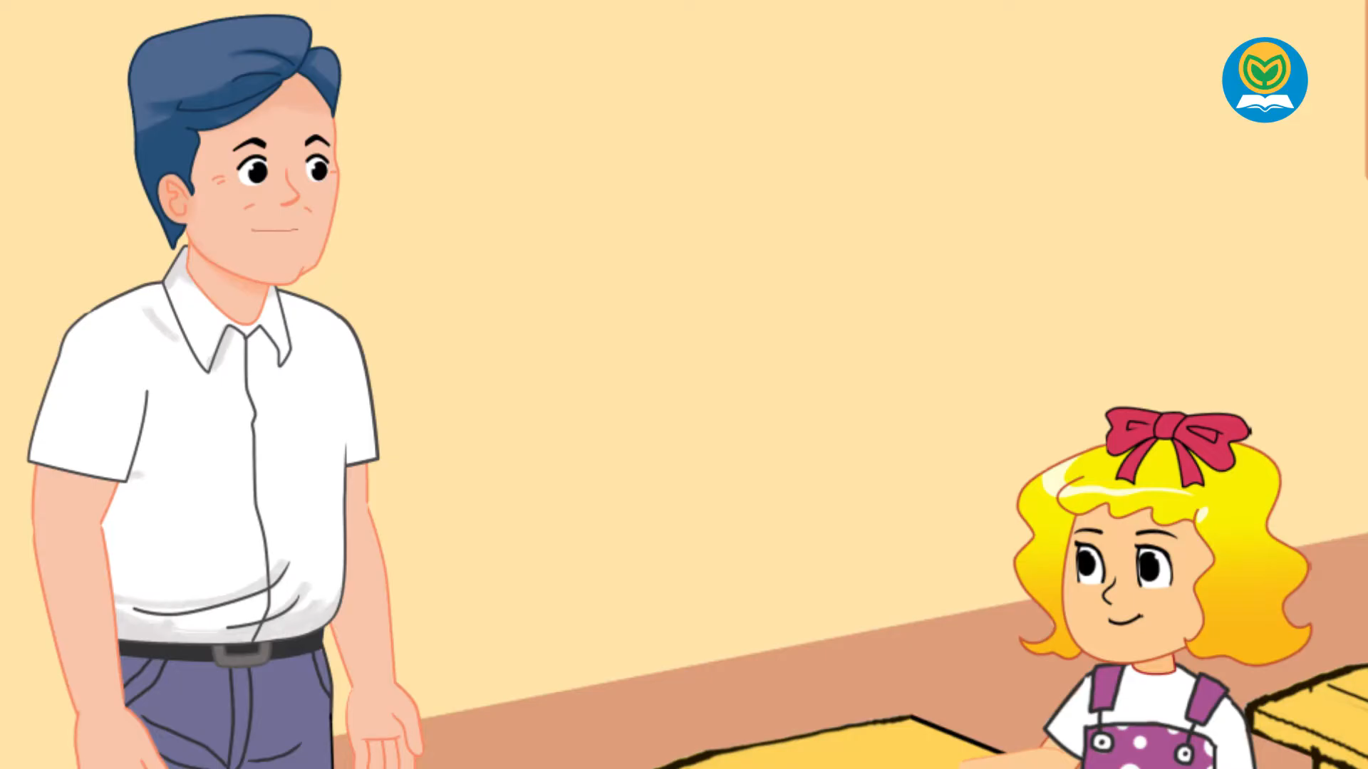

6. Let’s sing.

