Slide 1





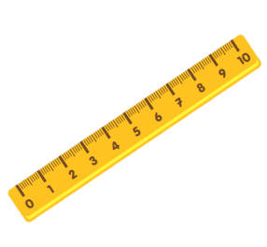

Unit 8:
This is my pen
Lesson 3

Slide 2
Warm-up

Slide 3
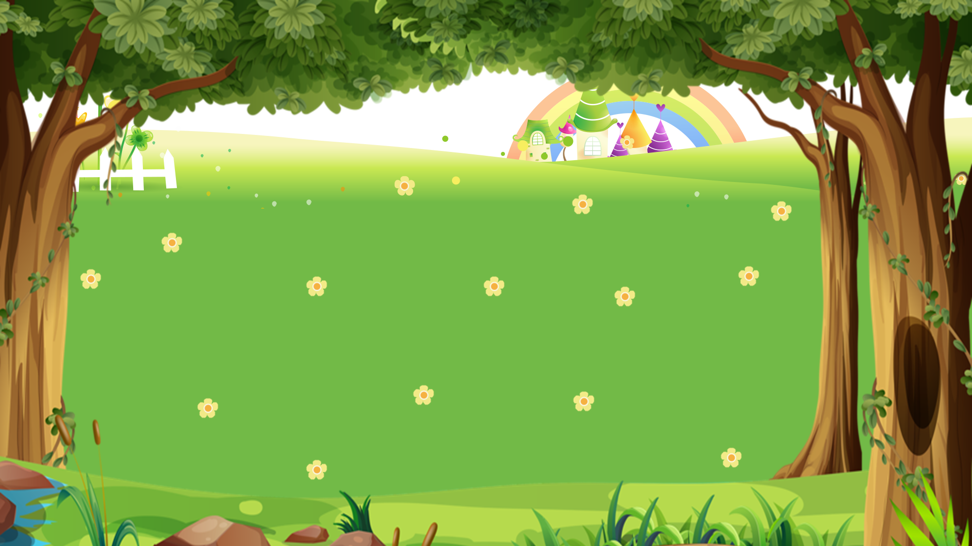

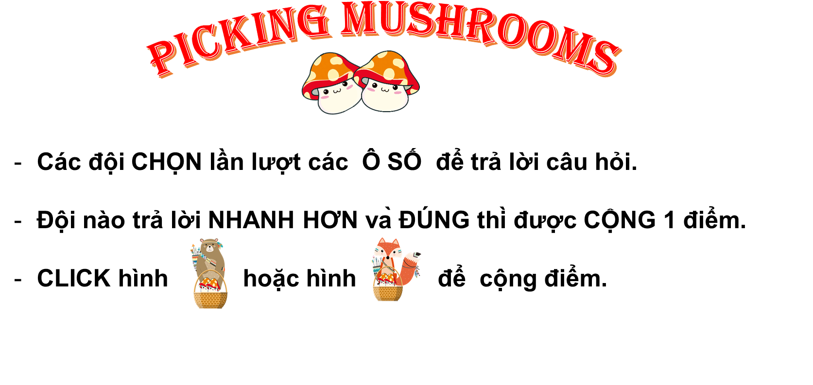


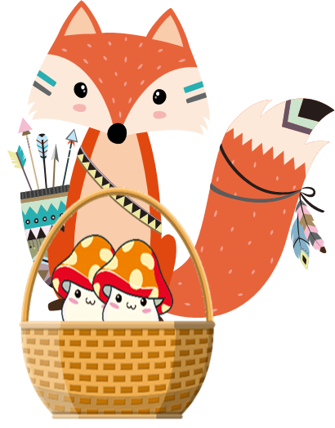





PICKING MUSHROOMS
1
2
3
Các đội CHỌN lần lượt các Ô SỐ để trả lời câu hỏi.
Đội nào trả lời NHANH HƠN và ĐÚNG thì được CỘNG 1 điểm.
CLICK hình hoặc hình để cộng điểm.
4
5
6
7
8
9
10
End

Slide 4








Time’s up
1
2
3
4
5
6
7
8
9
10
This is my _____.
Back
A. pen
B. pens
C. pencil
A.

Slide 5

Time’s up
1
2
3
4
5
6
7
8
9
10
_____ are my pencil sharpeners.
Back
A. This
B. Those
C. That
A.

Slide 6
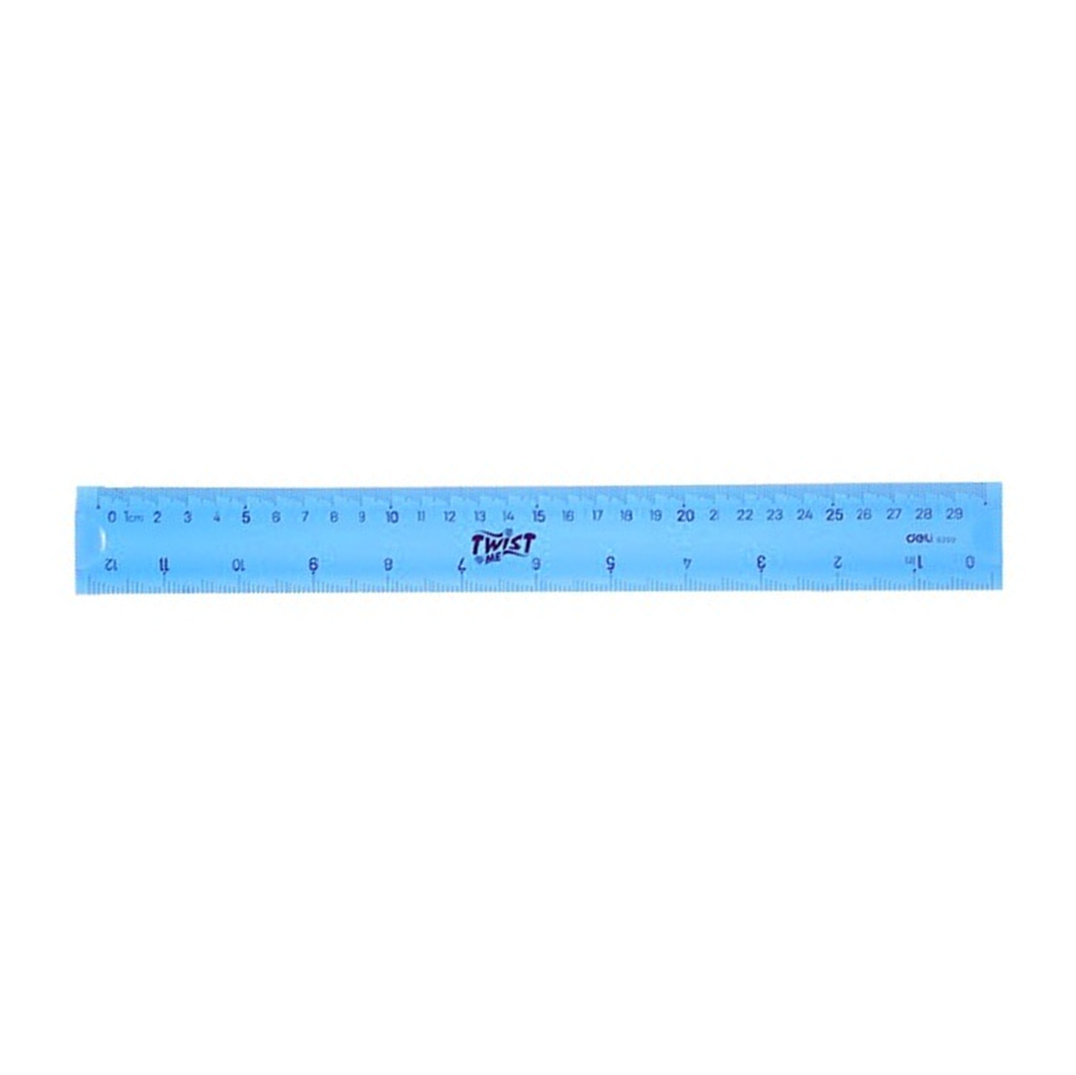
Time’s up
1
2
3
4
5
6
7
8
9
10
That is my _____.
Back
A. rubber.
B. pen.
C. ruler
A.

Slide 7
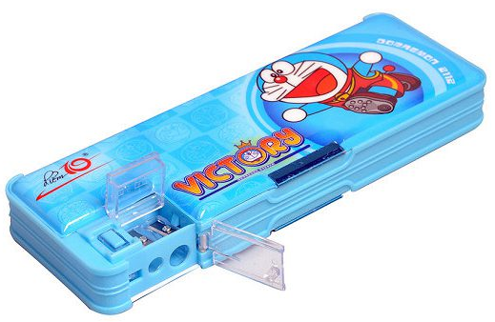
Time’s up
1
2
3
4
5
6
7
8
9
10
_____ is my pencil case.
Back
A. Those
B. These
C. That
A.

Slide 8
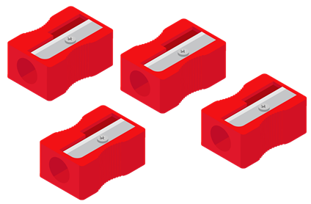
Time’s up
1
2
3
4
5
6
7
8
9
10
_____ are my pencil sharpeners.
Back
A. That
B. These
C. This
A.

Slide 9

Time’s up
1
2
3
4
5
6
7
8
9
10
____ is my school bag.
Back
A. These
B. This
C. Those
A.

Slide 10

Time’s up
1
2
3
4
5
6
7
8
9
10
These are my_____.
Back
A. Pencil cases
B. rulers
C. rubbers
A.

Slide 11

Time’s up
1
2
3
4
5
6
7
8
9
10
Those are my_____.
Back
A. book
B. books
C. notebooks
A.

Slide 12
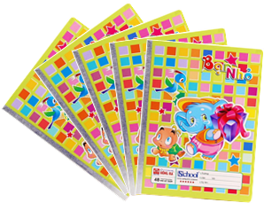
Time’s up
1
2
3
4
5
6
7
8
9
10
These are my_____.
Back
A. notebook
B. notebooks
C. books
A.

Slide 13
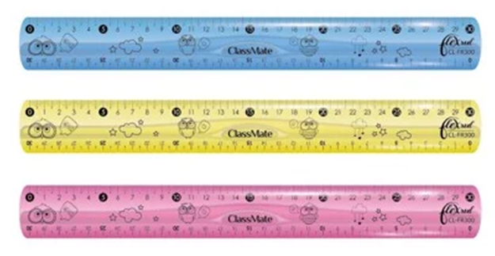
Time’s up
1
2
3
4
5
6
7
8
9
10
Those are my _____.
Back
A. pen
B. ruler
C. rulers
A.

Slide 14
PHONICS

Slide 15
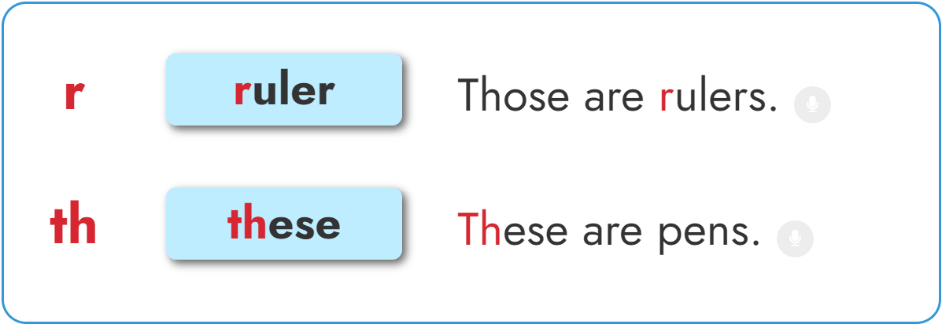

1. Listen and repeat.

Slide 16
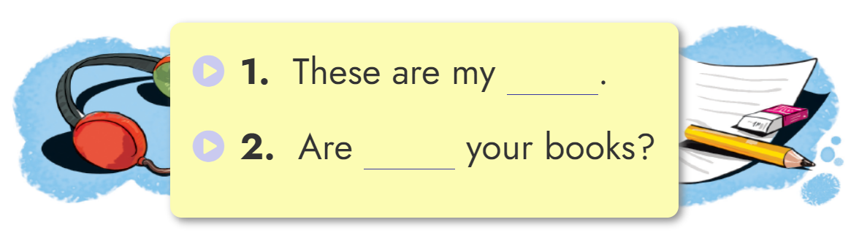
2. Listen and write.
rulers
these

Slide 17
PRACTISE

Slide 18
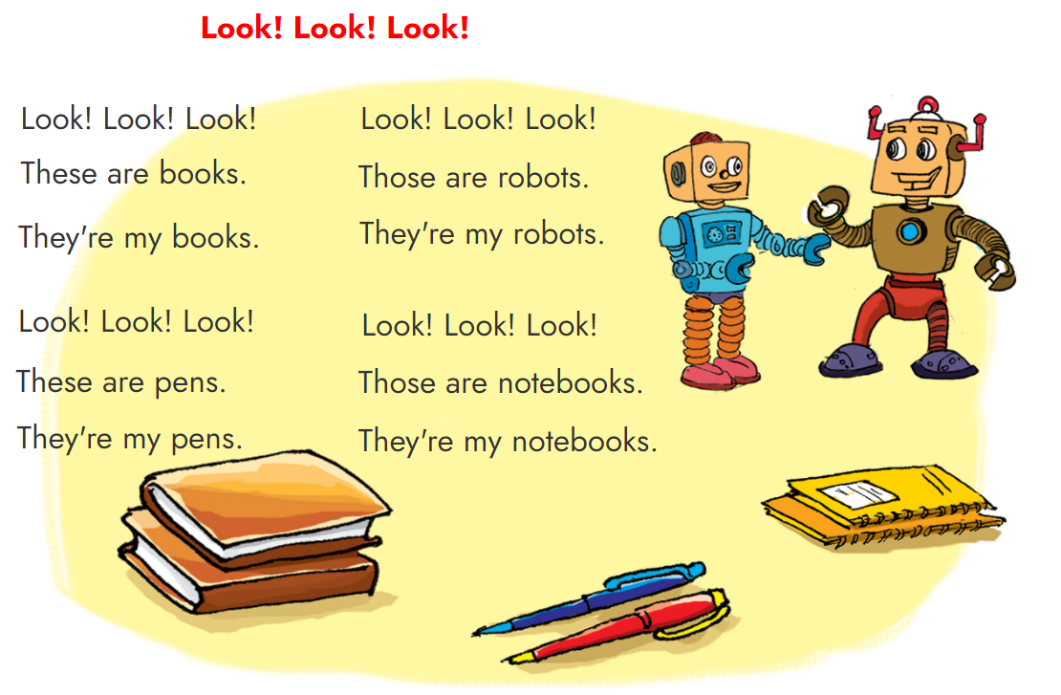


3. Let’s sing.

Slide 19
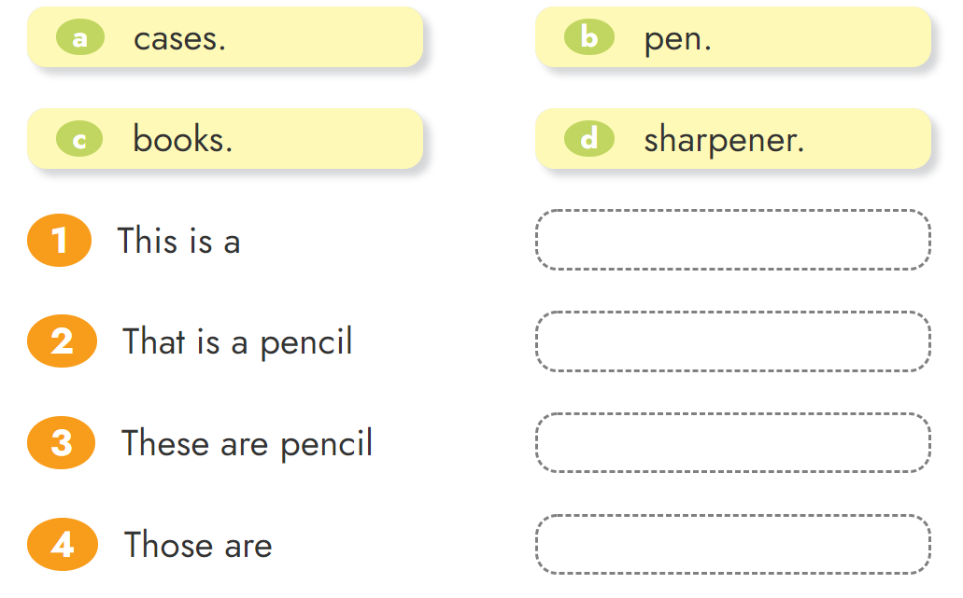





4. Read and match.

Slide 20
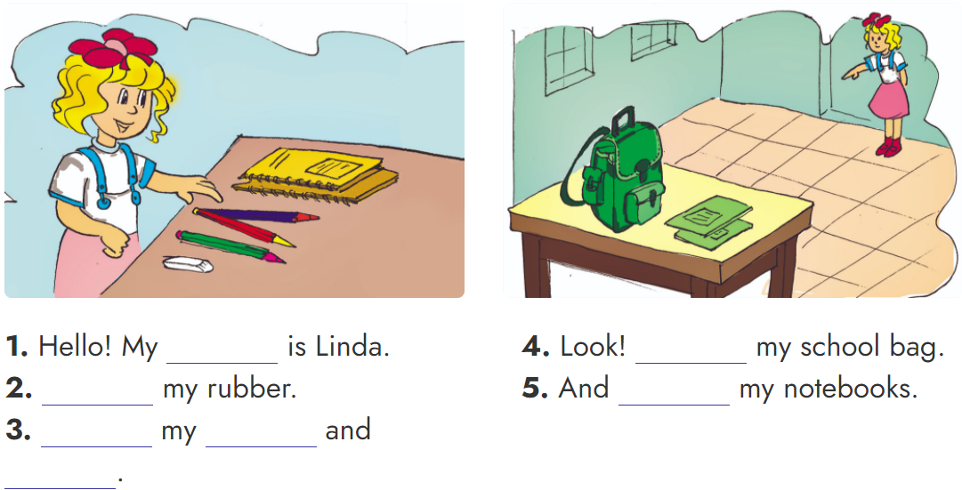
5. Read and match.
name
That is
This is
Those are
These are
notebooks
pencils

Slide 21
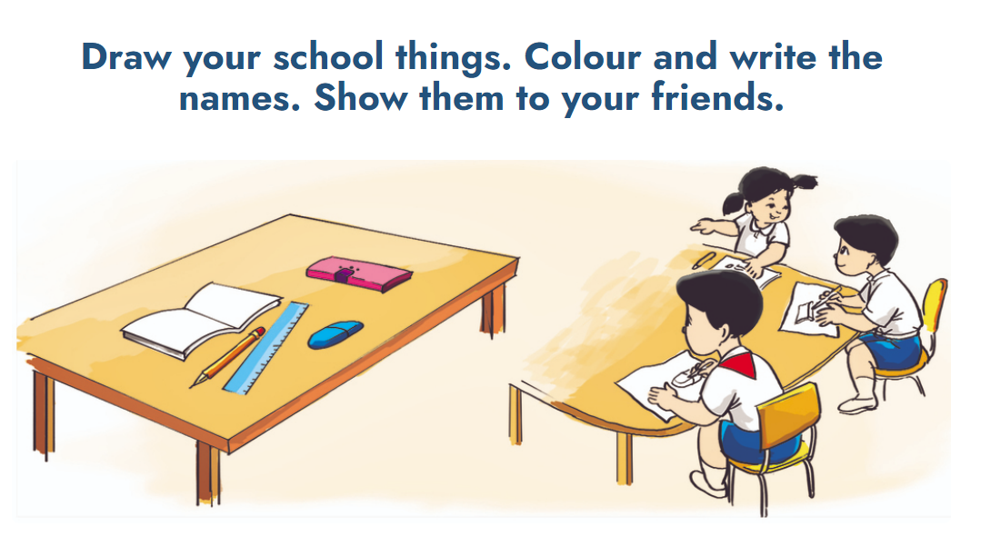
6. Project

