Slide 1


ỦY BAN NHÂN DÂN QUẬN LONG BIÊN
TRƯỜNG MẦM NON THẠCH CẦU
LĨNH VỰC PHÁT TRIỂN NHẬN THỨC
TÌM HIỂU VỀ MÀU SẮC
GIÁO VIÊN: TRẦN THỊ BÍCH NGỌC
LỨA TUỔI: 3 - 4 TUỔI
NĂM HỌC 2022 - 2023

Slide 2

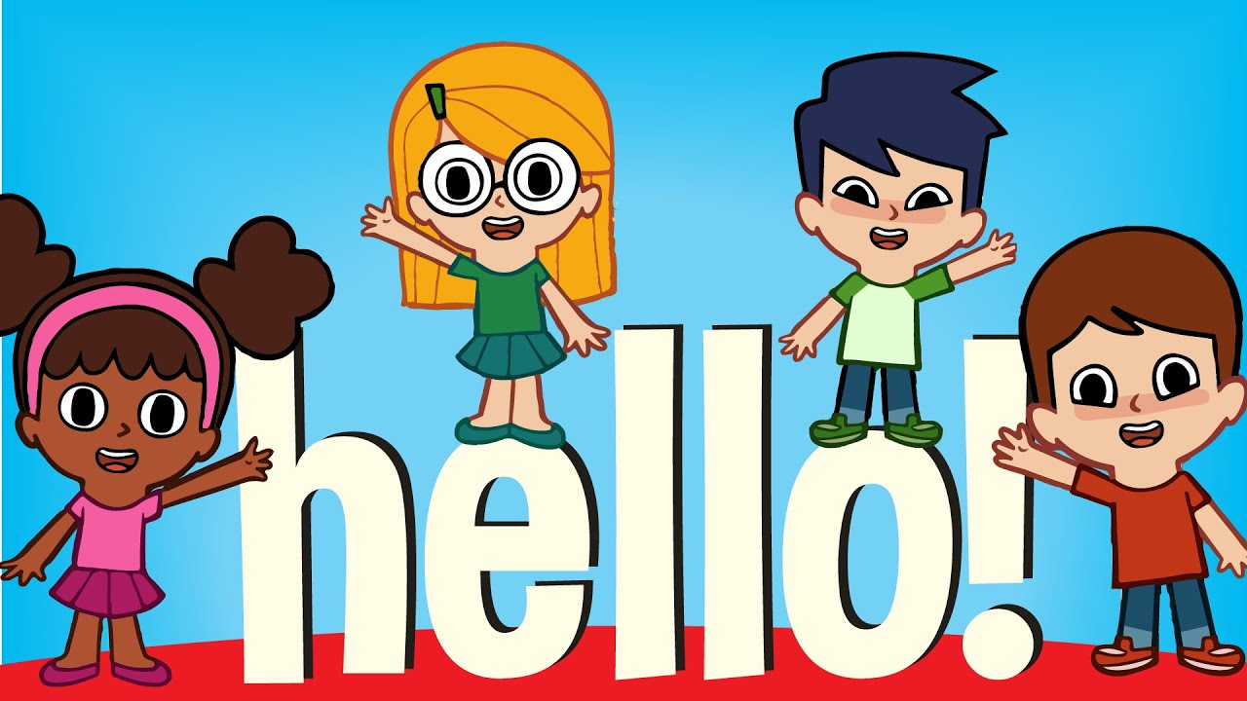

Slide 3
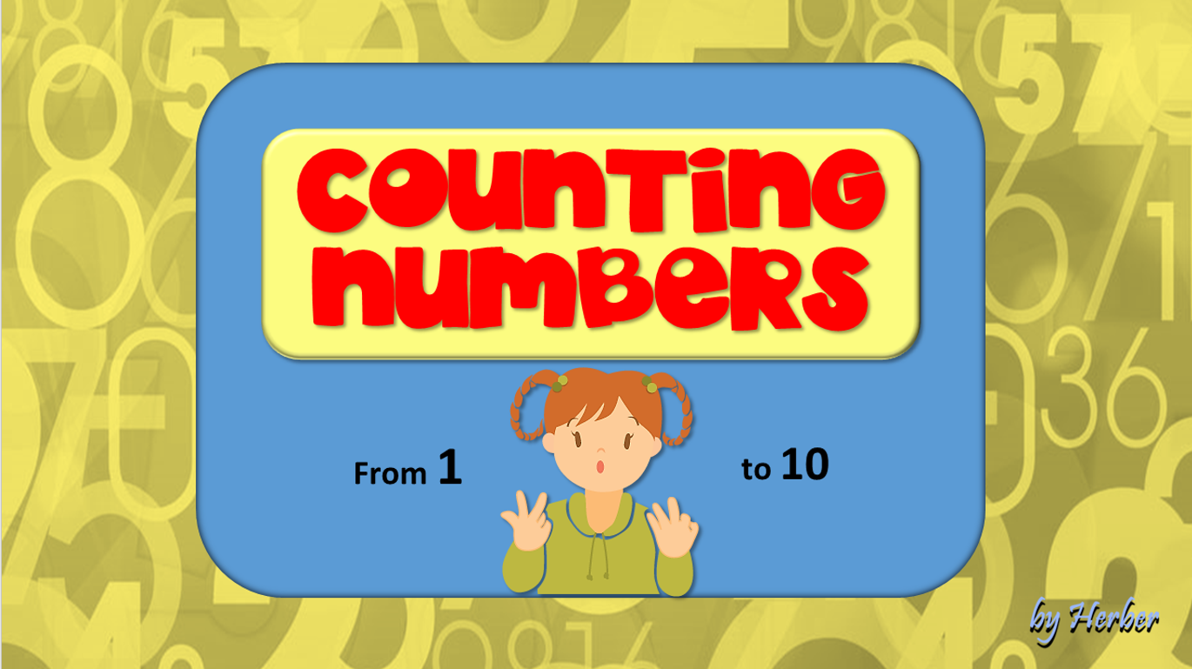

Slide 4



Slide 5
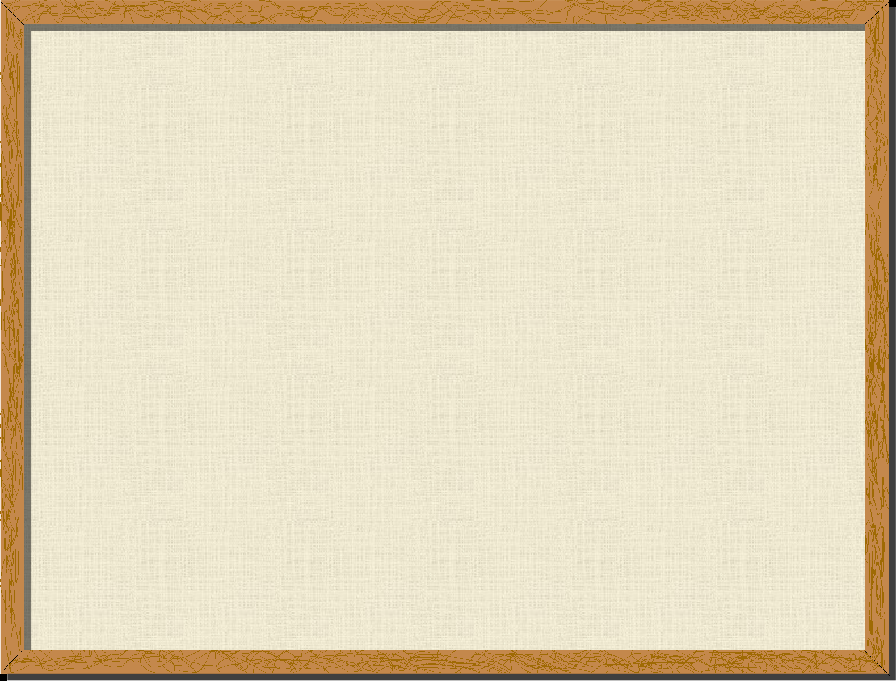

BASSIC COLORS
MIX THE COLORS
GUESS THE COLORS

Slide 6
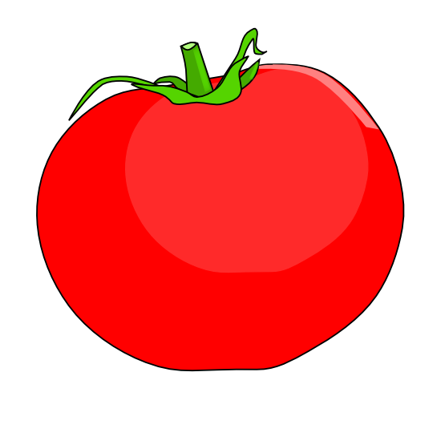
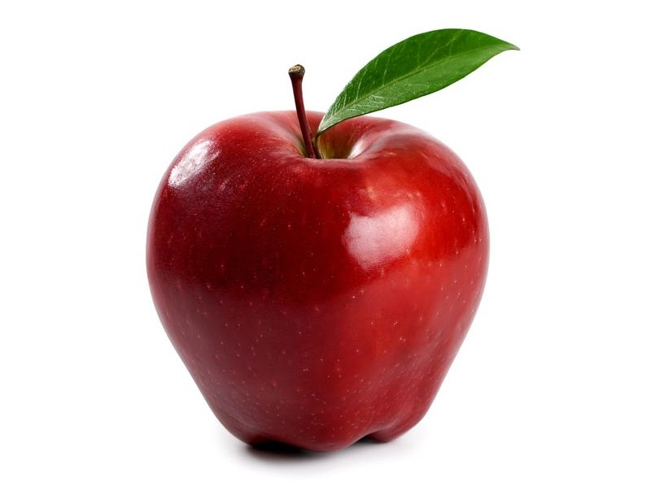



What are these?
tomato
Apple
Fire Truck

Slide 7

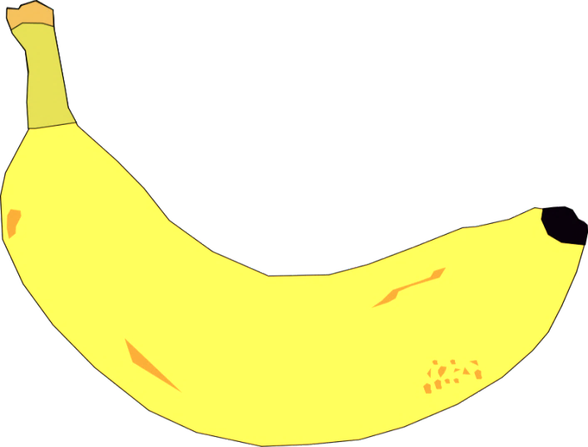

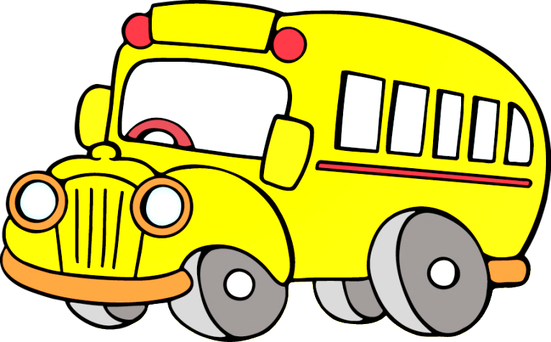
What are these?
lemon
banana
school bus

Slide 8
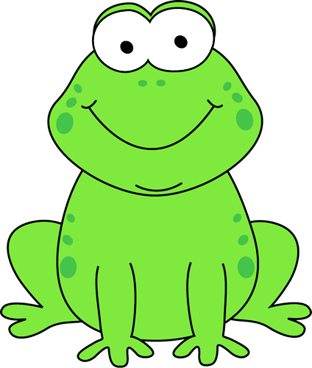
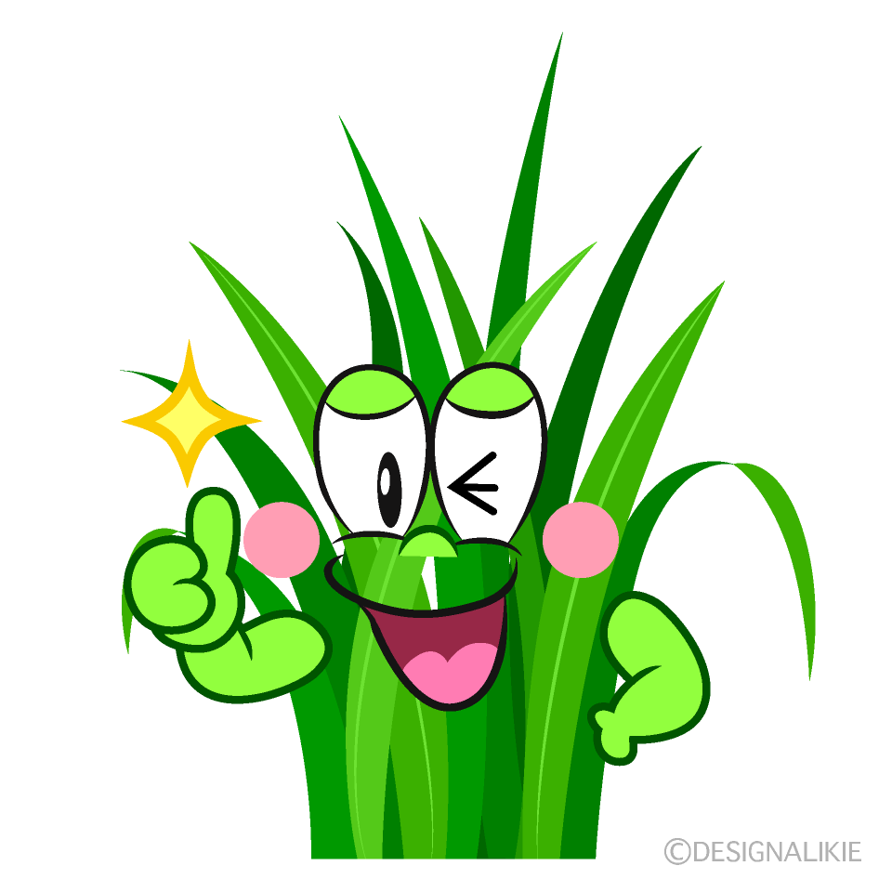


What are these?
frog
grass
clover

Slide 9
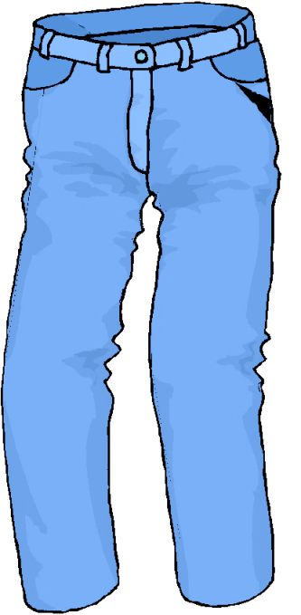



What are these?
jeans
blueberry
sky

Slide 10
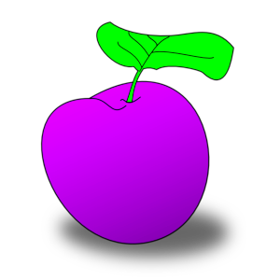


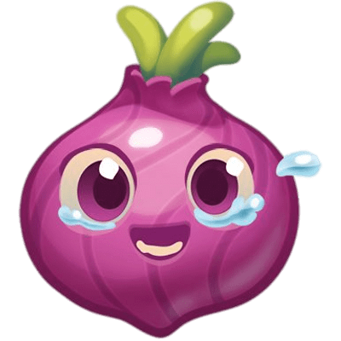
What are these?
plum
violet
ornion

Slide 11




What are these?
orange
carrot
pumpkin

Slide 12
What colour do you get by mixing these ones?
yellow
green
blue

Slide 13
What colour do you get by mixing these ones?
red
orange
yellow

Slide 14
What colour do you get by mixing these ones?
red
purple
blue

Slide 15
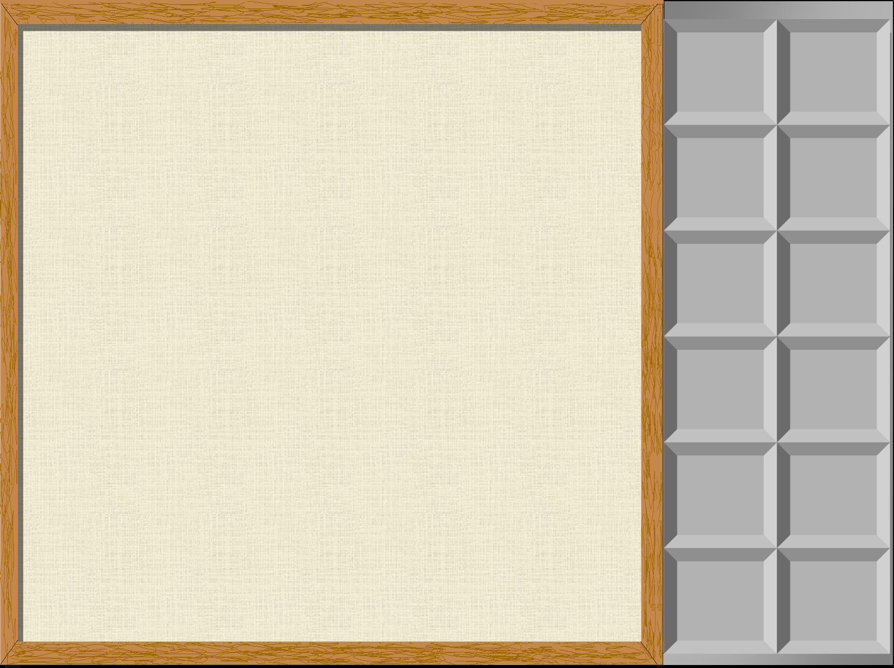




This pen is …
1
2
3
4
5
6
7
8
9
10
RED

Slide 16
This flower is …
1
2
3
4
5
6
7
8
9
10
YELLOW

Slide 17


This jumper is …
1
2
3
4
5
6
7
8
9
10
GREEN

Slide 18
This book is …
1
2
3
4
5
6
7
8
9
10
BLUE

Slide 19
This crayon is …
1
2
3
4
5
6
7
8
9
10
ORANGE

Slide 20
This ball is …
1
2
3
4
5
6
7
8
9
10
PURPLE

Slide 21


