Slide 1
Unit 13
WHAT DO YOU DO
IN YOUR FREE TIME?
Lesson 2

Slide 2
Vocabulary

Slide 3
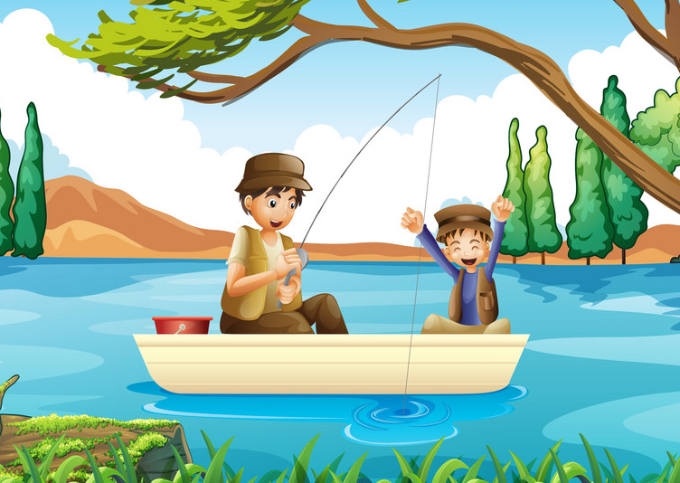

Vocabulary
go fishing
/goʊ ˈfɪʃɪŋ/

Slide 4
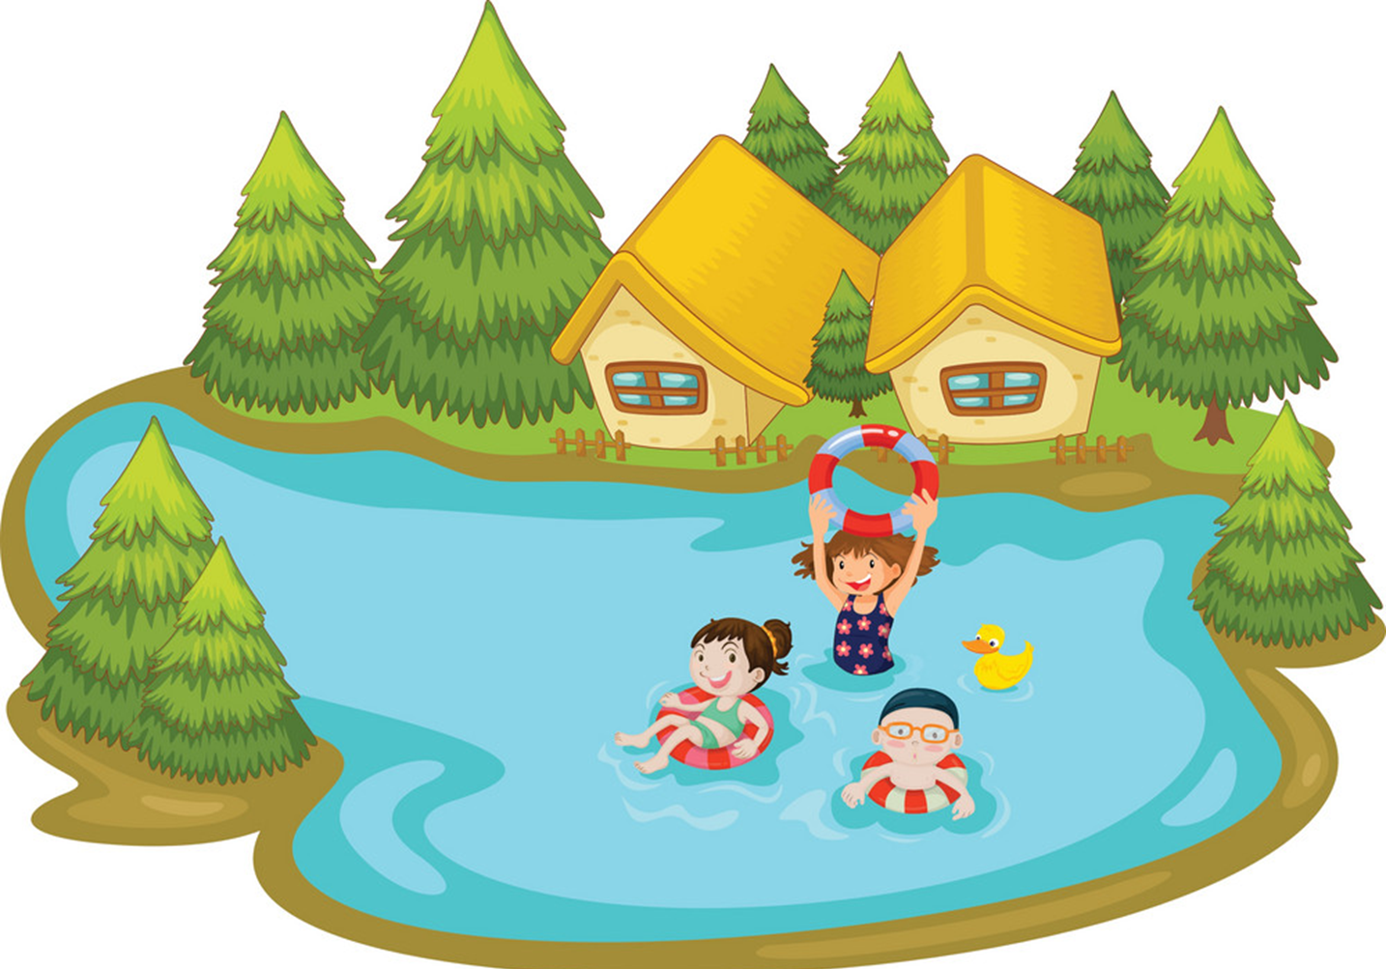
Vocabulary
go swimming
/goʊ ˈswɪmɪŋ/

Slide 5
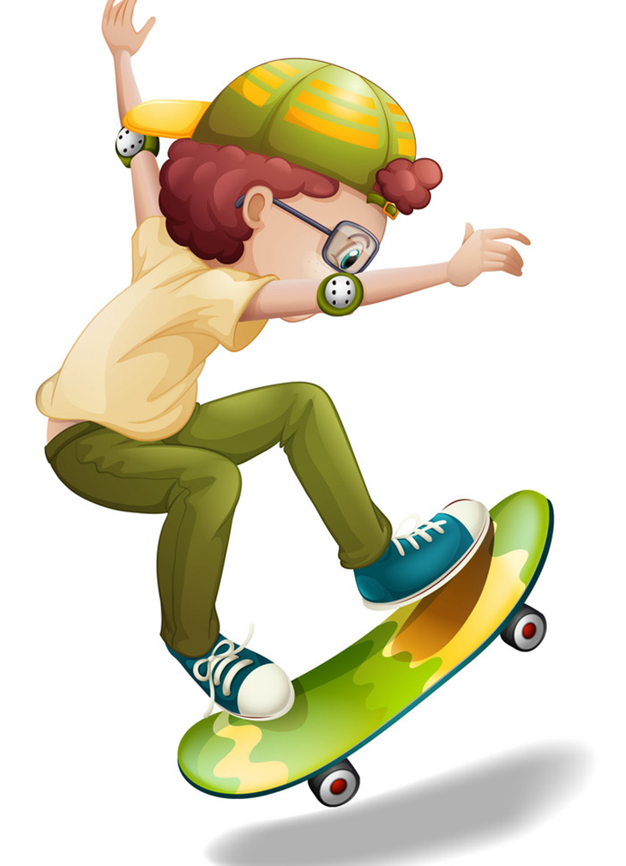
Vocabulary
go skating
/goʊ ˈskeɪtɪŋ /

Slide 6
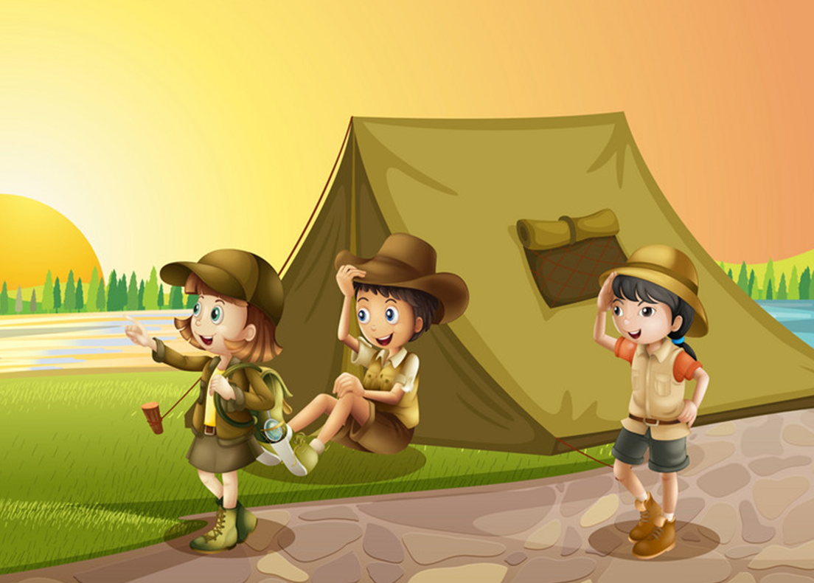
Vocabulary
go camping
/goʊ ˈkæmpɪŋ/

Slide 7

Vocabulary
go fishing
go swimming
go skating
go camping

Slide 8
Grammar

Slide 9
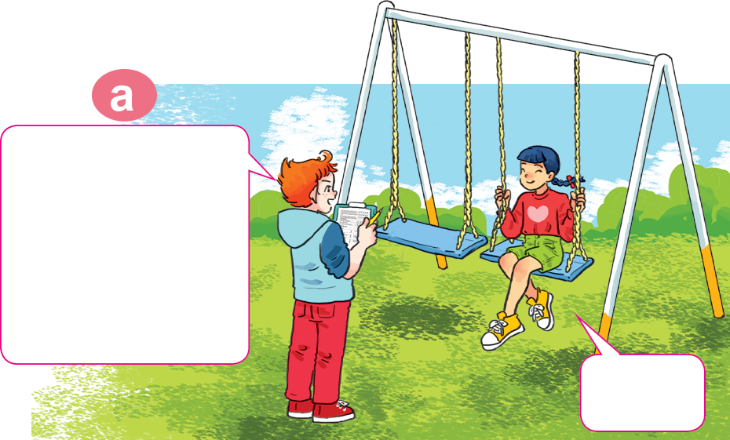
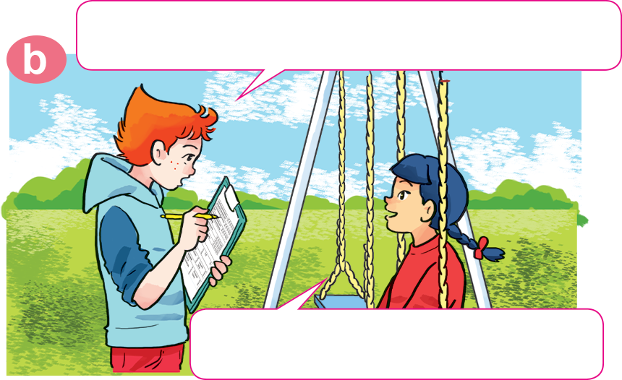
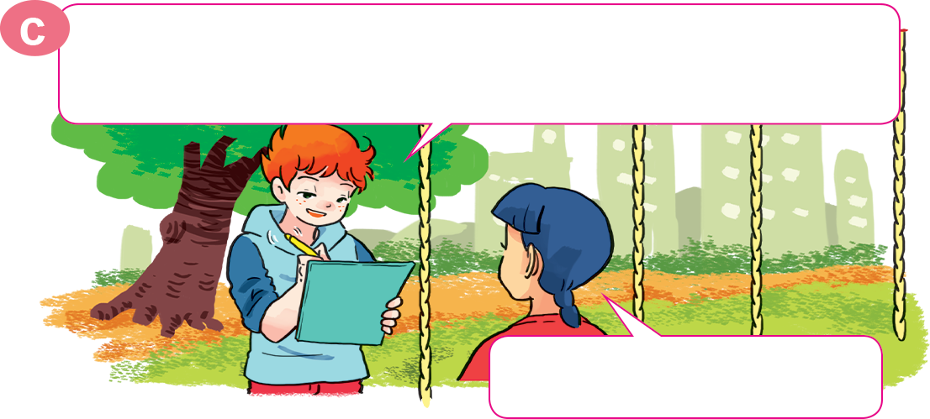
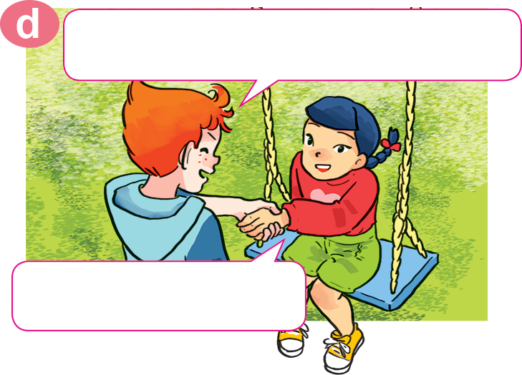
1. Look, listen and repeat
What do you do in your free time?
Hello, Akiko.
May I ask you some questions for my survey?
Sure.
I watch cartoons on TV.
OK, watching cartoons. How about your mother? What does she do in her free time?
OK. Thank you very much.
She goes shopping.
You're welcome.

Slide 10
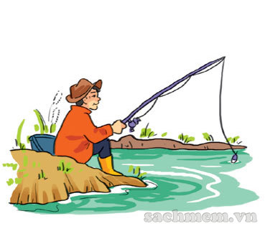
2. Point and say.
father
his
What does your ________ do in ____ free time?
goes fishing
He ______________________.

Slide 11
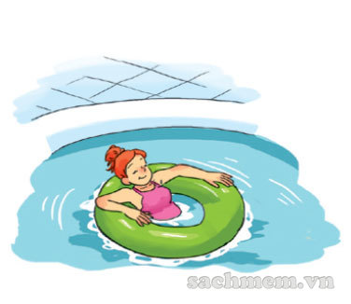
2. Point and say.
her
What does your ________ do in ____ free time?
mother
goes swimming
She ______________________.

Slide 12
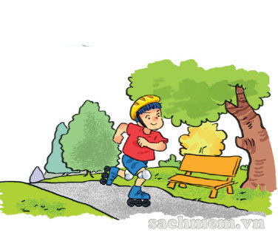
2. Point and say.
brother
his
What does your ________ do in ____ free time?
goes skating
He ______________________.

Slide 13
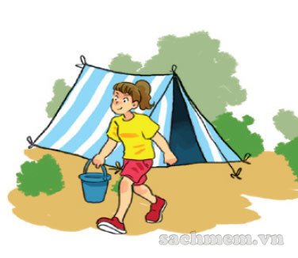
2. Point and say.
sister
her
What does your ________ do in ____ free time?
goes camping
She ______________________.

Slide 14


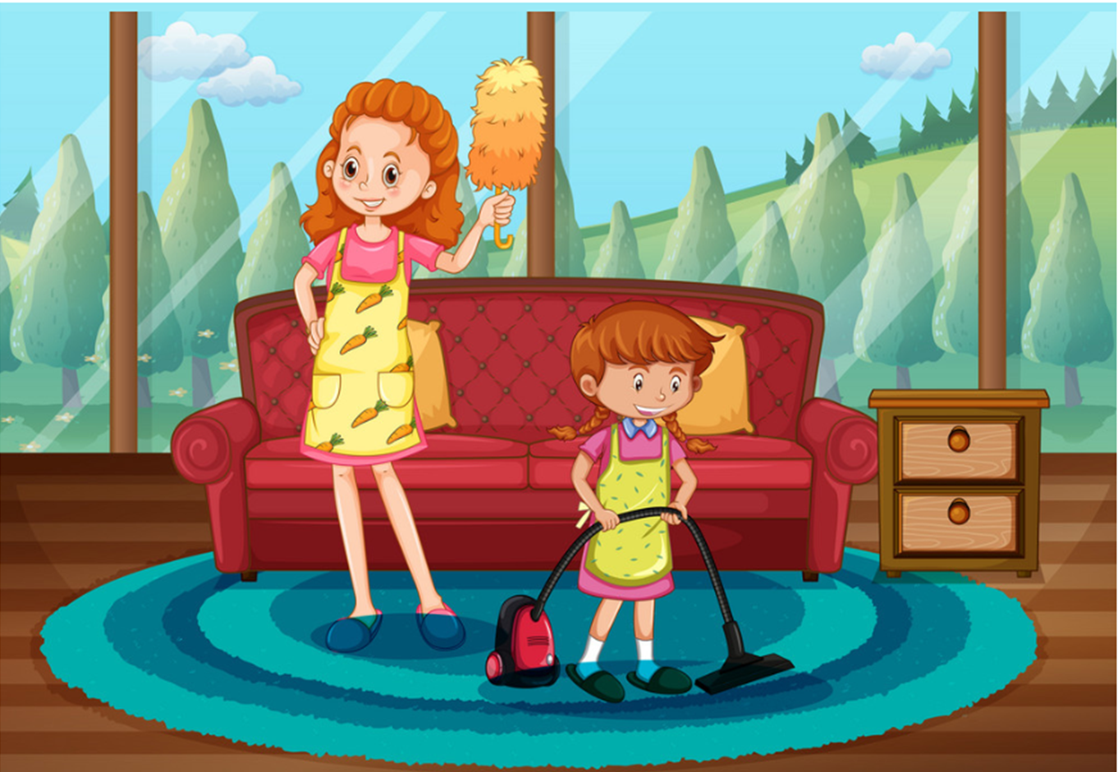

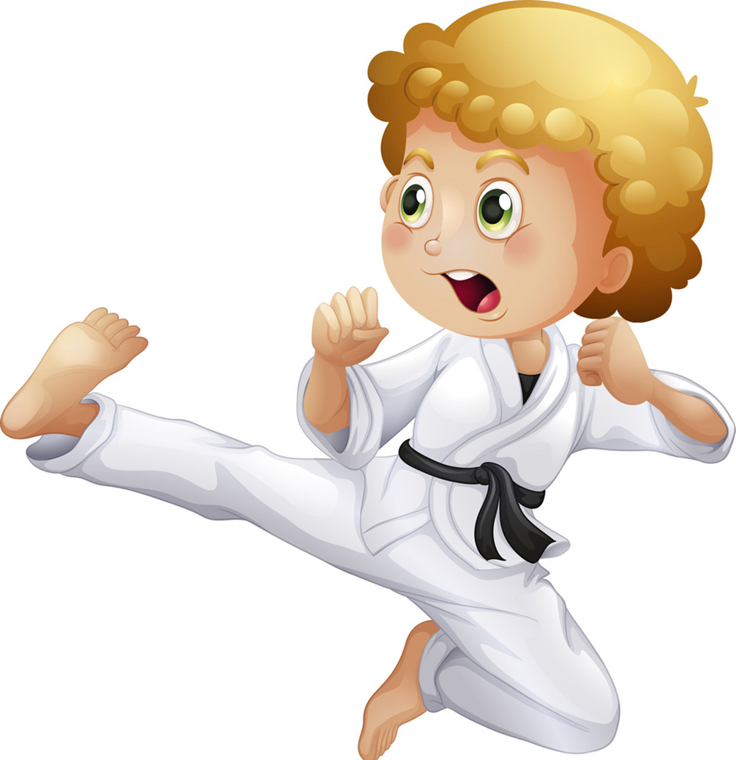
Model sentence
What does your ________ do in ____ free time?
She/he ______________________.
surfs the Internet
goes fishing
goes swimming
cleans the house
goes to the cinema
goes camping
does karate
goes skating

Slide 15
4. Listen and circle a, b or c.
1. Phong often goes ___________ in his free time.
a. fishing b. camping c. skating
2. His father ___________ twice a week.
a. does karate b. plays football c. works in the garden
3. His mother goes ___________ at weekends.
a. swimming b. Shopping c. camping
4. His sister ___________ in her free time.
a. surfs the Internet b. does homework
c. cleans the house

Slide 16
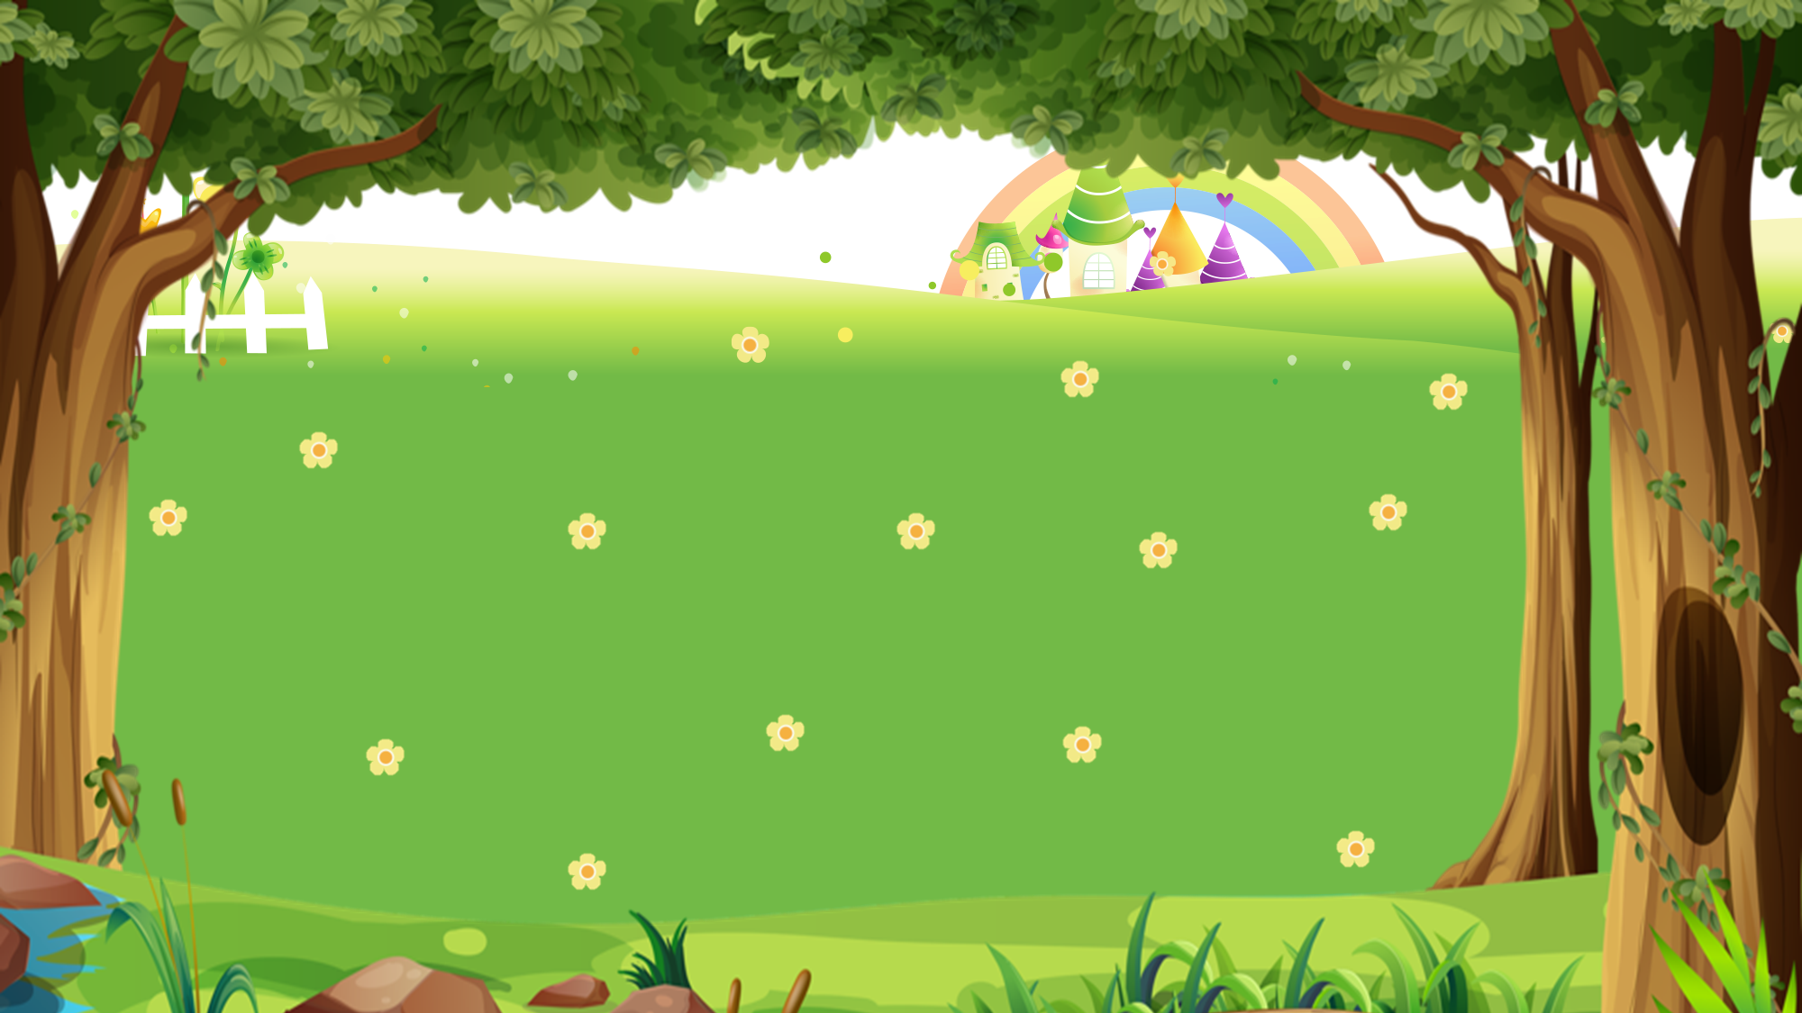

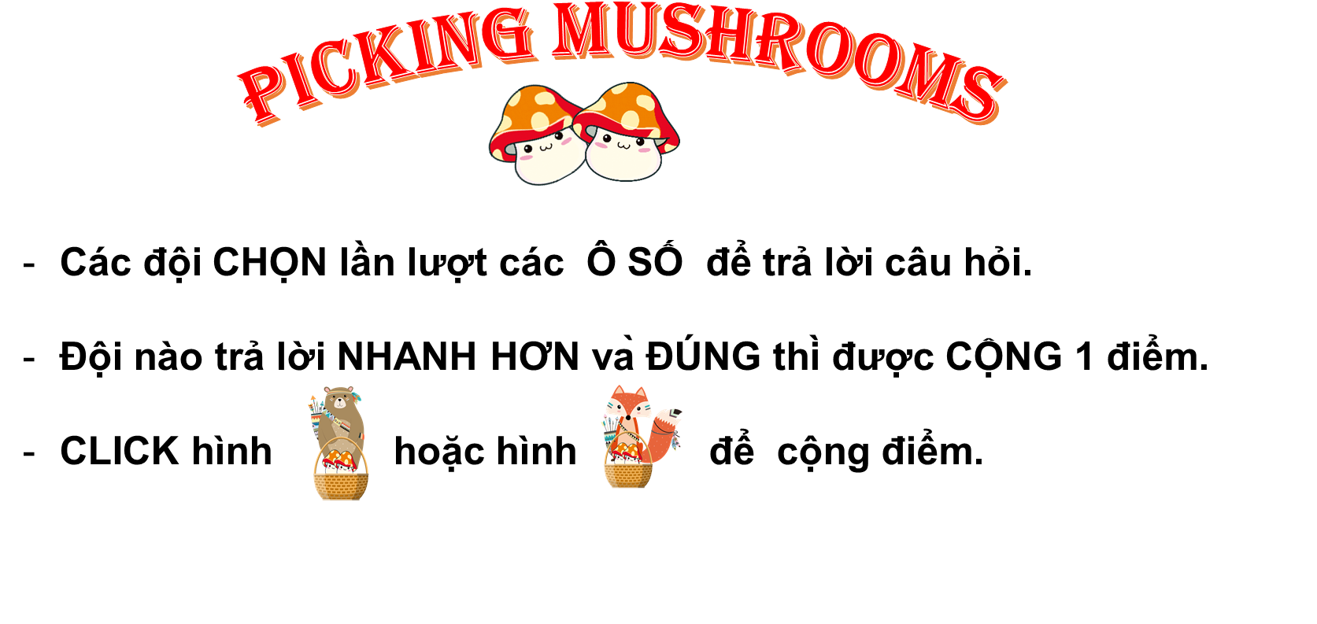






PICKING MUSHROOMS
1
2
3
Các đội CHỌN lần lượt các Ô SỐ để trả lời câu hỏi.
Đội nào trả lời NHANH HƠN và ĐÚNG thì được CỘNG 1 điểm.
CLICK hình hoặc hình để cộng điểm.
4
5
6
7
8
9
10

Slide 17







Time’s up
1
2
3
4
5
6
7
8
9
10
What does _____ do in her free time?
Back
A. she
B. he
C. you
A.

Slide 18
Time’s up
1
2
3
4
5
6
7
8
9
10
What does _____ do
in his free time?
Back
A. you
B. he
C. she
A.

Slide 19
Time’s up
1
2
3
4
5
6
7
8
9
10
What does she do
in _____ free time?
Back
A. your
B. his
C. her
A.

Slide 20
Time’s up
1
2
3
4
5
6
7
8
9
10
What _____ you do
in your free time?
A. Do
Back
B. Does
A.
C. Sai

Slide 21
Time’s up
1
2
3
4
5
6
7
8
9
10
What _____ your father do
in his free time?
B. does
Back
A. do
B. Sai
D. Sai

Slide 22
Time’s up
1
2
3
4
5
6
7
8
9
10
What does your uncle do in his free time?
He ______ camping.
Back
A. goes
B. go
B. Sai
D. Sai

Slide 23
Time’s up
1
2
3
4
5
6
7
8
9
10
What does your mother
do in her free time?
She _______ swimming.
B. goes
Back
A. go
B. Sai
D. Sai

Slide 24


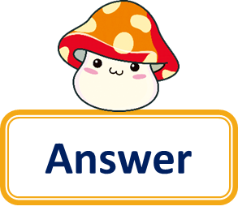

Time’s up
1
2
3
4
5
6
7
8
9
10
Question
What does your teacher do in her free time?
She goes skating.
Back
Answer

Slide 25
Time’s up
1
2
3
4
5
6
7
8
9
10
What does your friend do in his free time?
Question
He does karate.
Back
Answer

Slide 26
Time’s up
1
2
3
4
5
6
7
8
9
10
What do you do
in your free time?
Question
I go fishing.
Back
Answer

Slide 27
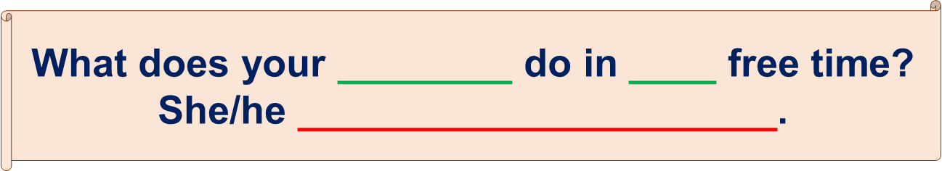
1.Vocabulary:
go fishing: đi câu
go swimming: đi bơi
go skating: đi trượt pa tanh
go camping: đi cắm trại
2.Model sentence:

Slide 28
Thank you!

