Slide 1

Unit 2
WHAT I CAN DO
LESSON 3.1 - PAGE 26

Slide 2
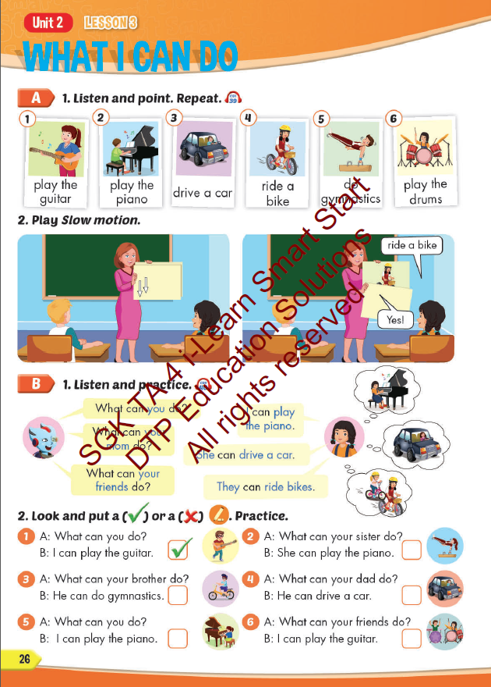
Lesson Outline
Warm-up
Vocabulary
Structure
Consolidation
Wrap-up

Slide 3
Objectives
By the end of this lesson, students will be able to say what their friends and family can do.
Vocabulary: play the guitar, play the piano, drive a car, ride a bike, do gymnastics, play the drums.
Structure:
What can you do? - I can play the piano.
What can your mom do?- She can drive a car.
What can your friends do?- They can ride bikes.

Slide 4

WARM UP

Slide 5
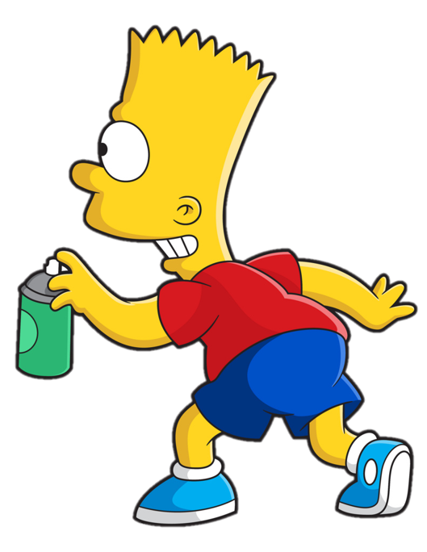


Slide 6












> Someone has deleted some words.
> Guess the deleted word within the time limit (12 seconds).

Slide 7
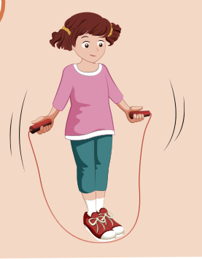

Y
Can she jump rope?
CHECK
Notes:
7

Slide 8
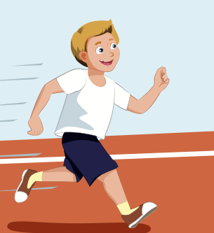
Can he run?
CHECK
Notes:
8

Slide 9
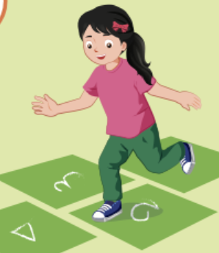
Can she hop?
CHECK
Notes:
9

Slide 10
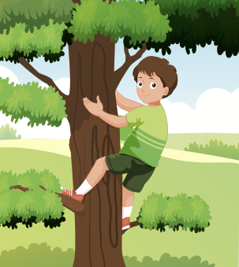
Y
Can he climb a tree?
CHECK
Notes:
10

Slide 11
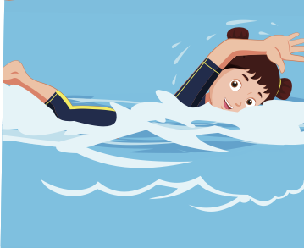
Y
Can she swim?
CHECK
Notes:
11

Slide 12

It’s time to learn …

Slide 13

New words
play the guitar, play the piano, drive a car,
ride a bike,
do gymnastics, play the drums.

Slide 14

Presentation

Slide 15


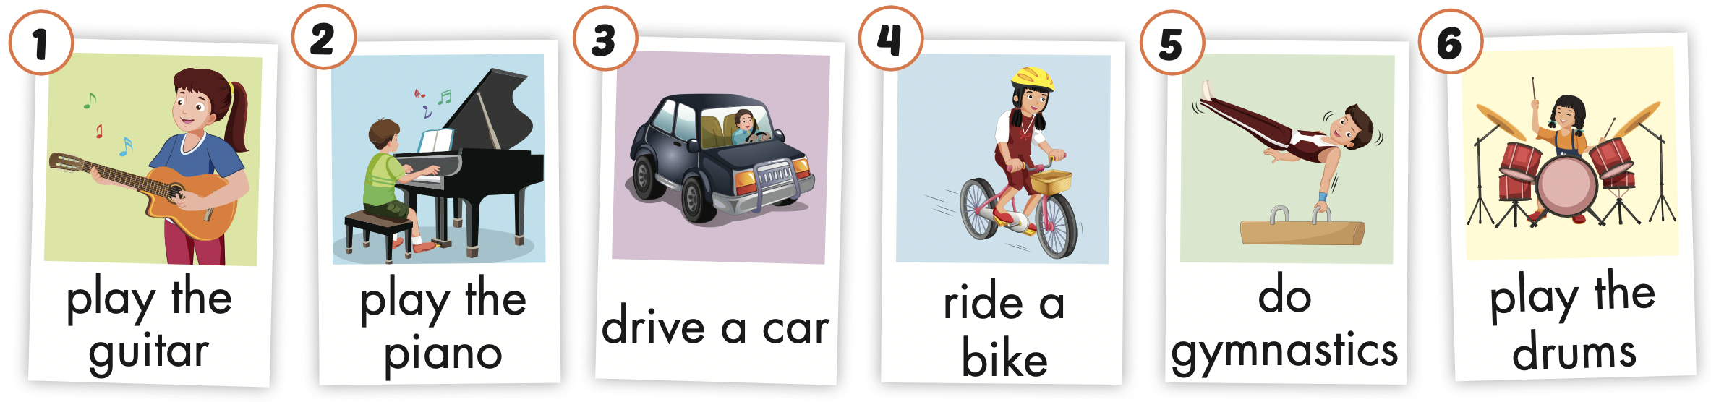
Click the icon to hear the sound.

Slide 16
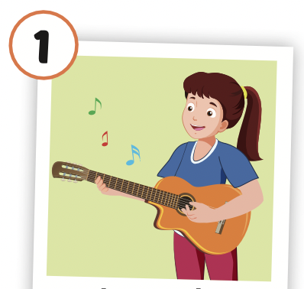
Click the picture to hear the sound.
play the guitar
/pleɪ ðə ɡɪˈtɑːr/
chơi đàn ghi-ta

Slide 17
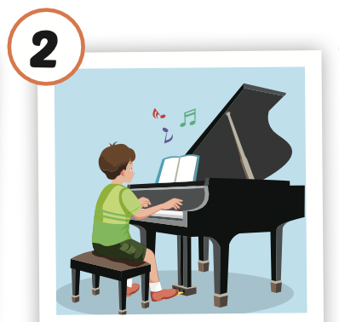
Click the picture to hear the sound.
play the piano
/pleɪ ðə piˈænoʊ/
chơi dương cầm/ đàn pi-a-nô

Slide 18
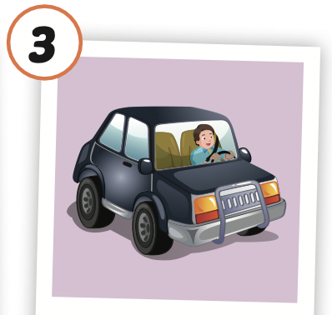
Click the picture to hear the sound.
drive a car
/draɪv ə kɑːr/
lái xe (4 bánh)

Slide 19
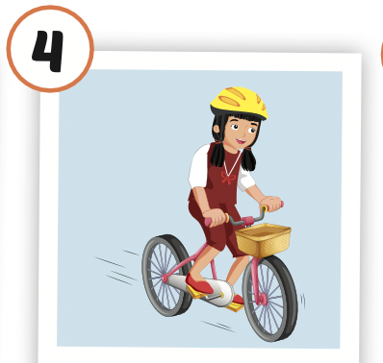
Click the picture to hear the sound.
ride a bike
/raɪd ə baɪk /
cưỡi xe đạp

Slide 20
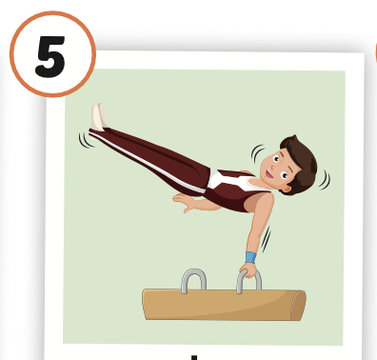
Click the picture to hear the sound.
do gymnastics
/duː dʒɪmˈnæstɪks/
tập thể dục dụng cụ

Slide 21
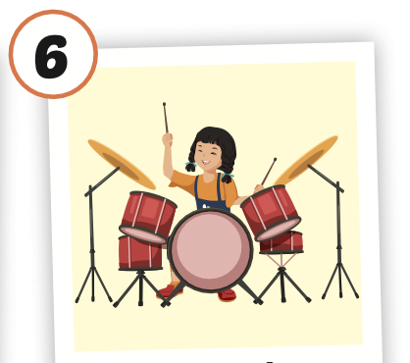
Click the picture to hear the sound.
play the drums
/pleɪ ðə drʌmz/
chơi trống

Slide 22

Practice

Slide 23



LISTEN AND CHOOSE

Slide 28

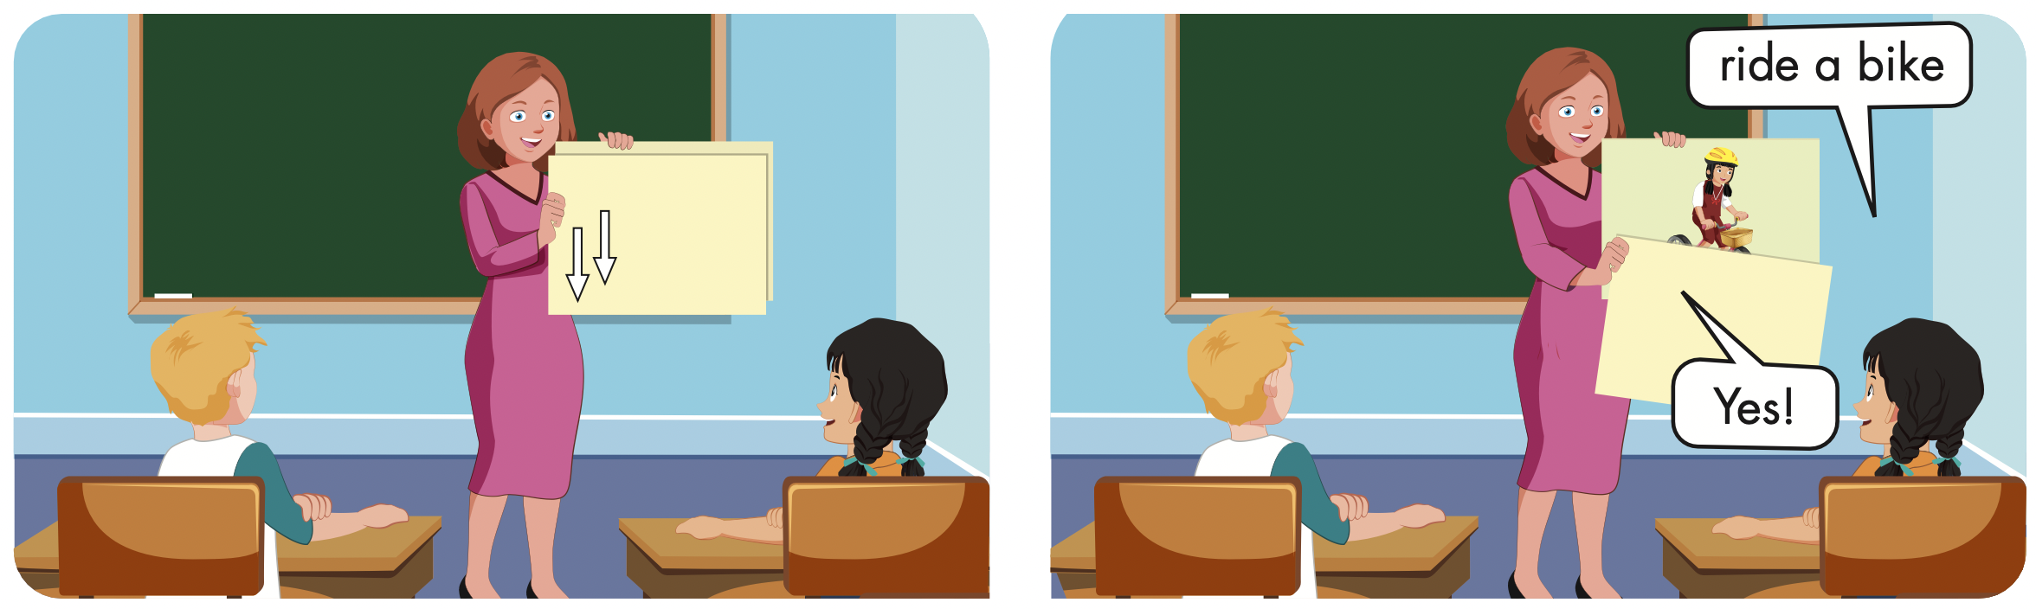

Slide 29
Structures
What can you do?
- I can play the piano.
What can your mom do?
- She can drive a car.
What can your friends do?
- They can ride bikes.

Slide 30
Presentation

Slide 31

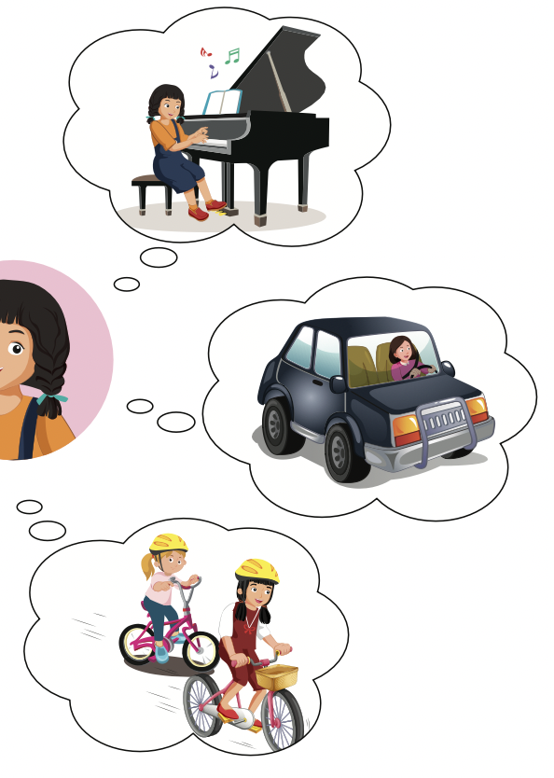
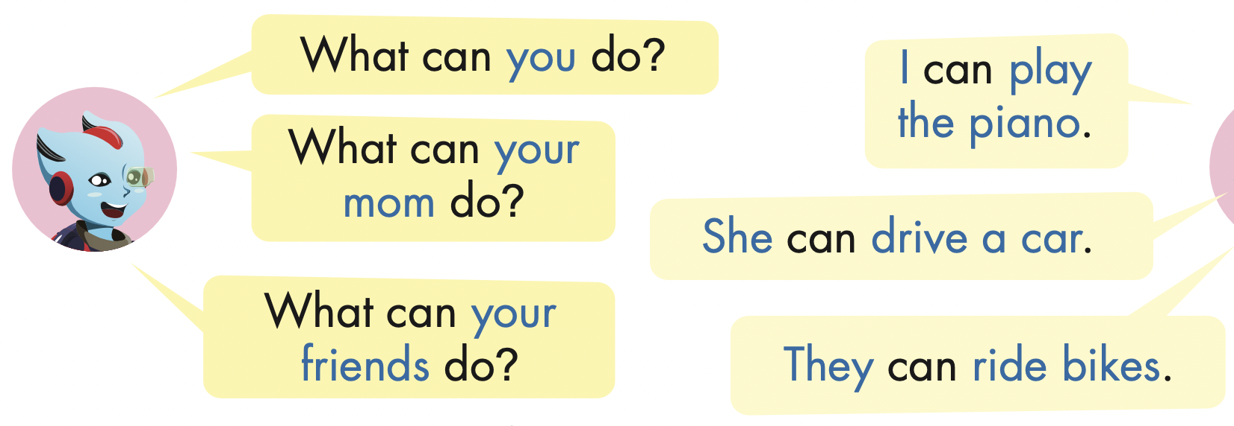
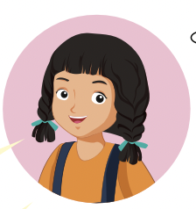

Slide 32
Practice

Slide 33
What can your brother do?
He can do gymnastics.

Slide 34
What can your sister do?
She can ride a bike.

Slide 35
What can your father do?
He can drive a car.

Slide 36
What can your friend do?
She can play the guitar.

Slide 37

Writing

Slide 38
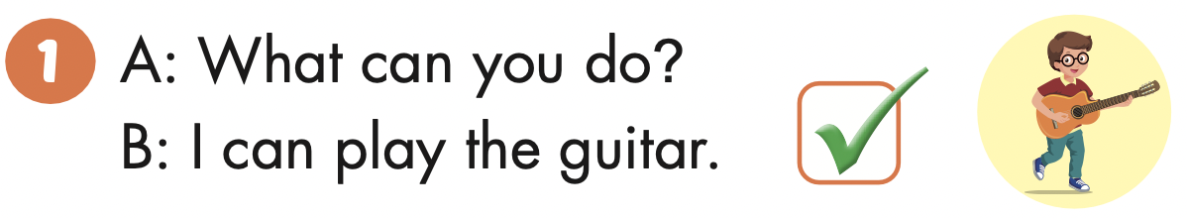

Slide 39
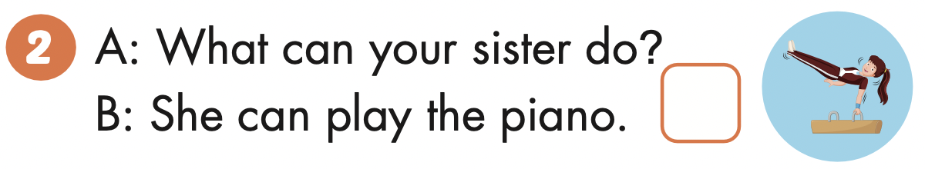

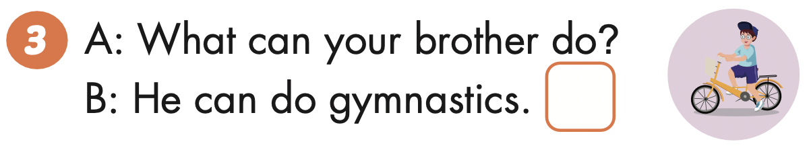

Slide 40
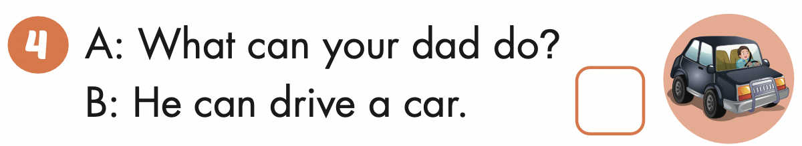

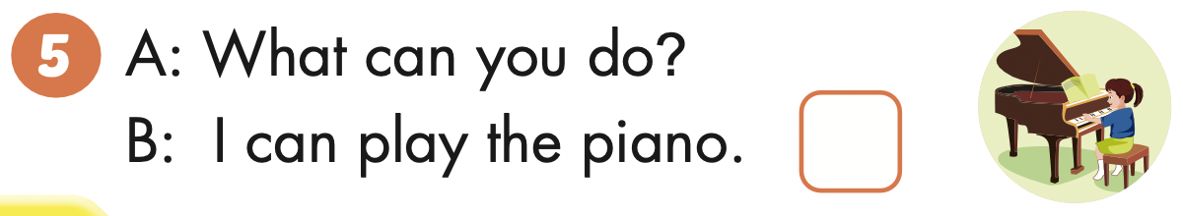

Slide 41
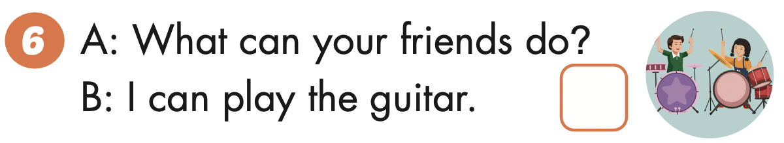

Slide 42

Production

Slide 43

Read and write

Slide 44

Next
CHECK
What can your mom do?
She can play the piano.
…………….………………….

Slide 45
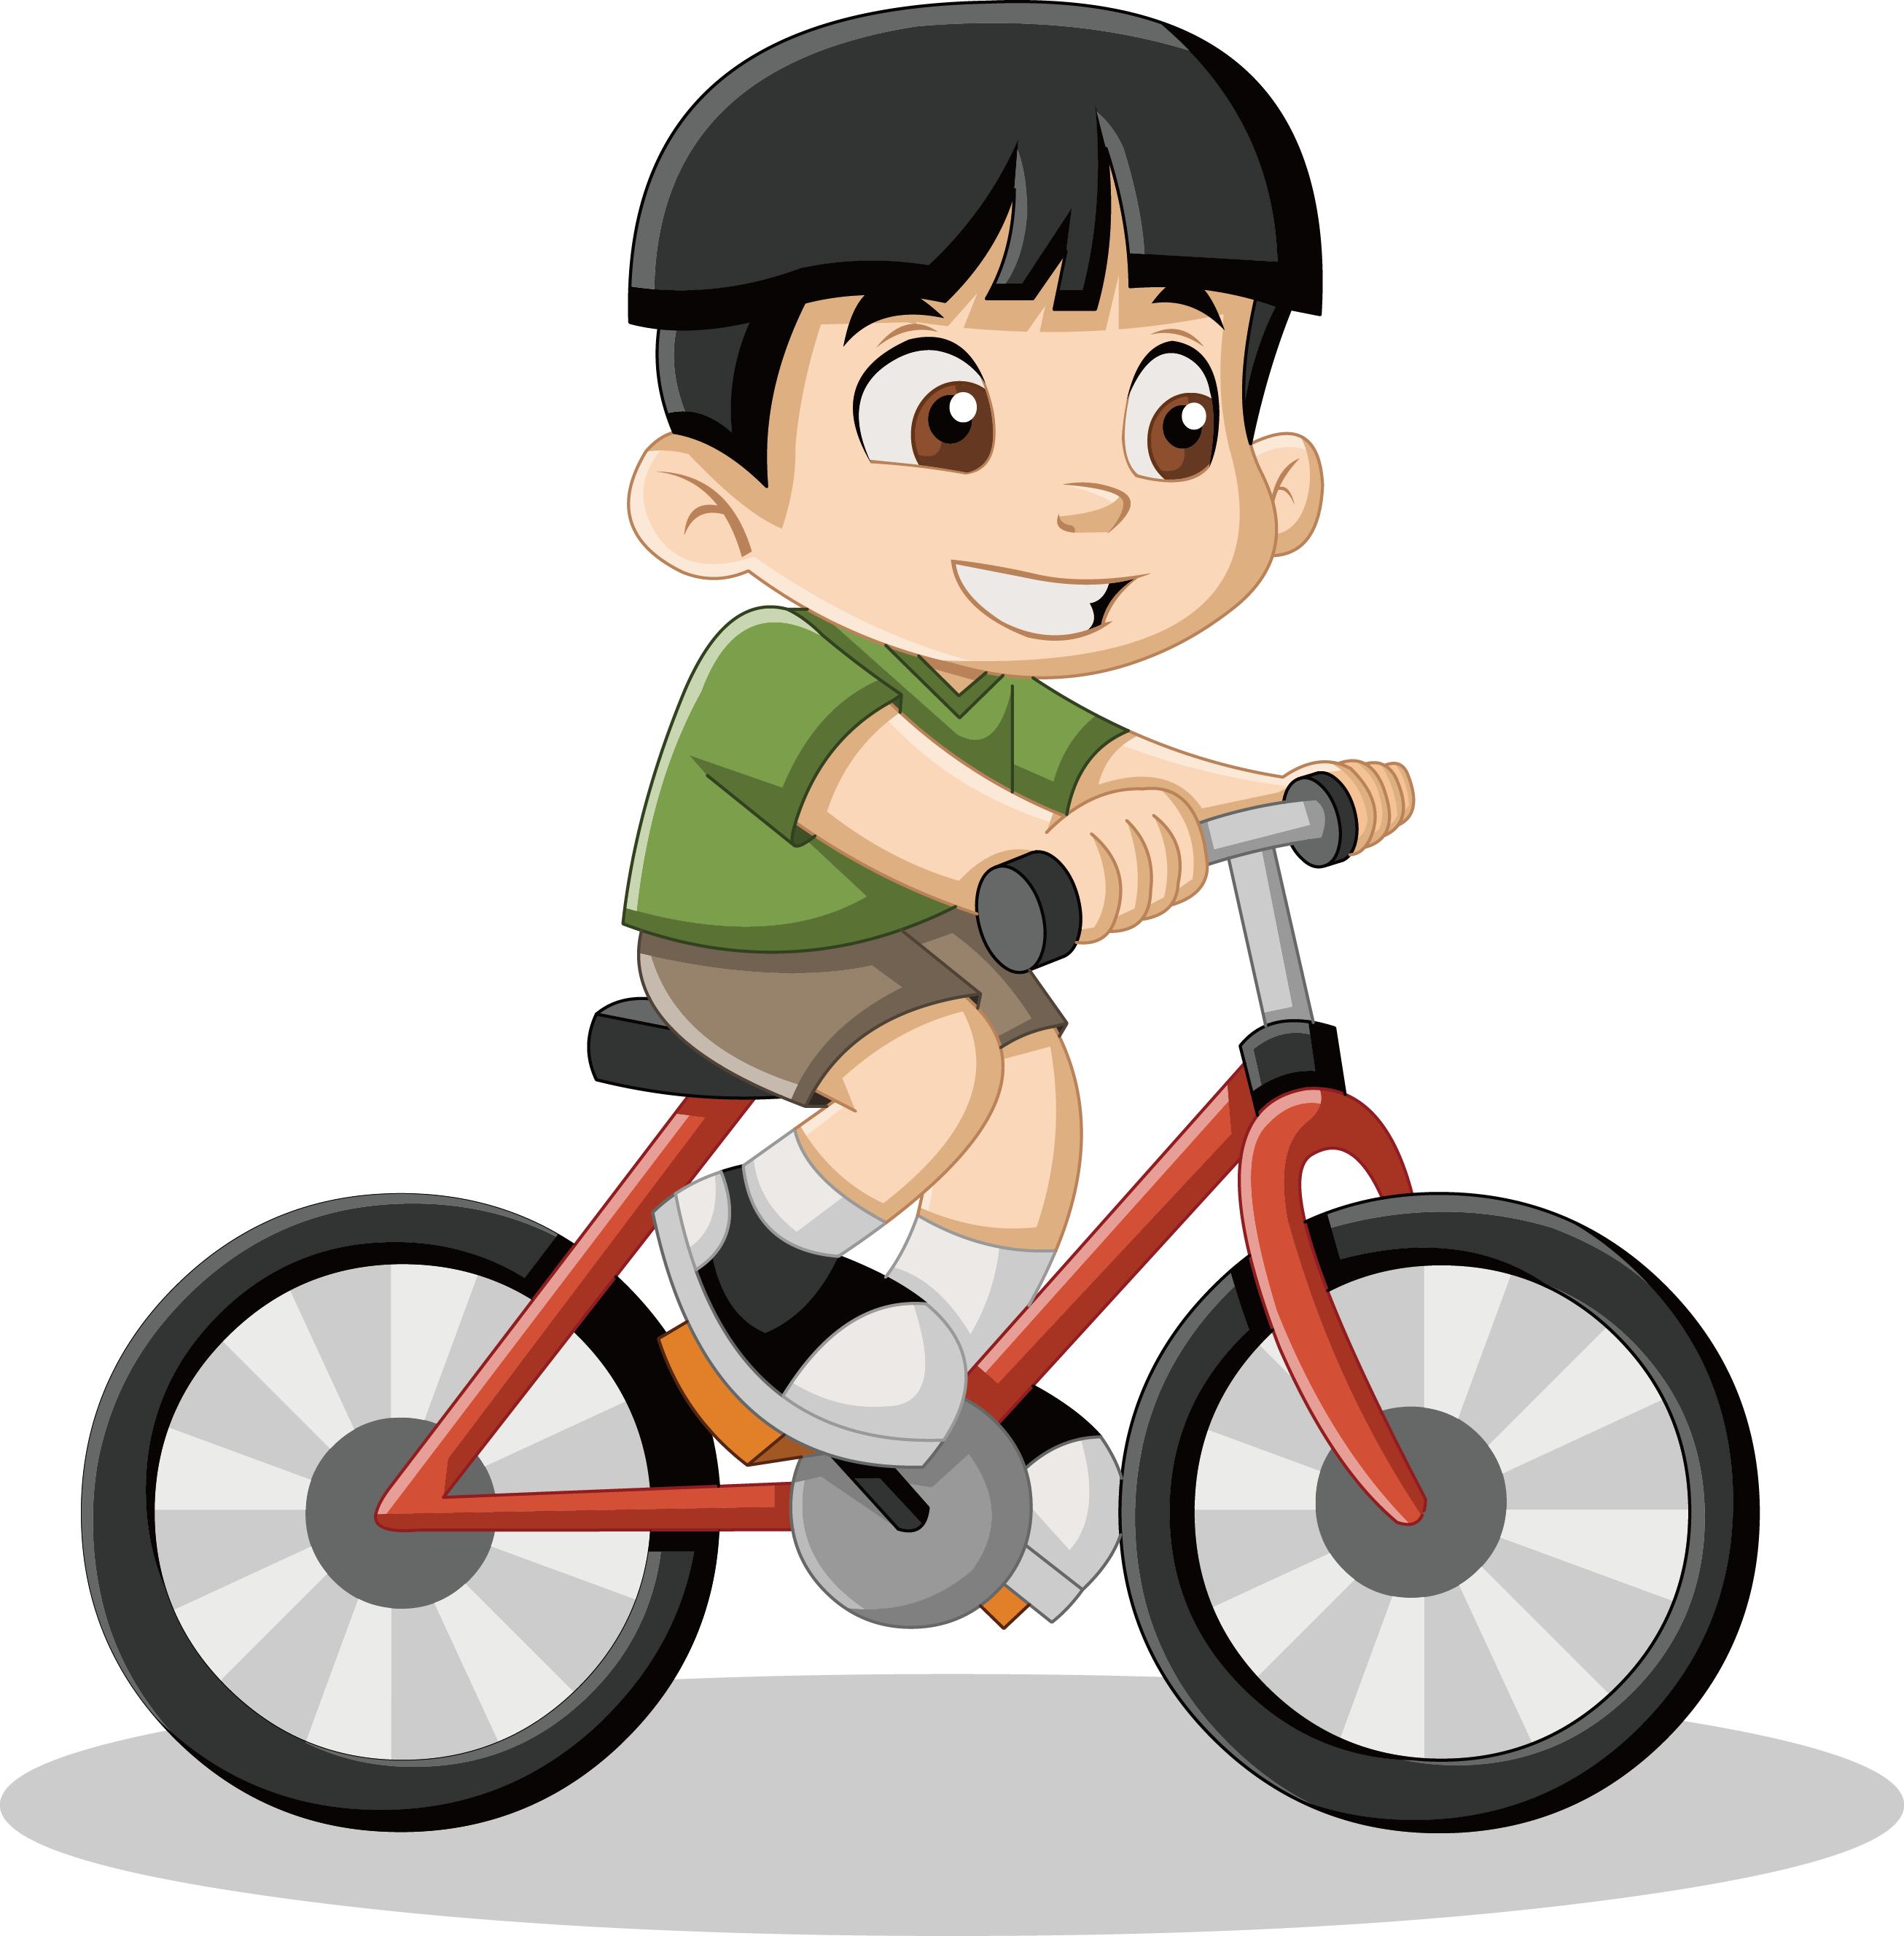
Next
CHECK
What can your friend do?
He can ride a bike.
…………….………………….

Slide 46

Next
CHECK
What can you and your sister do?
We can swim.
…………….………………….

Slide 47

Next
CHECK
What can your brother do?
He can play the drums.
…………….………………….

Slide 48

CONSOLIDATION

Slide 49

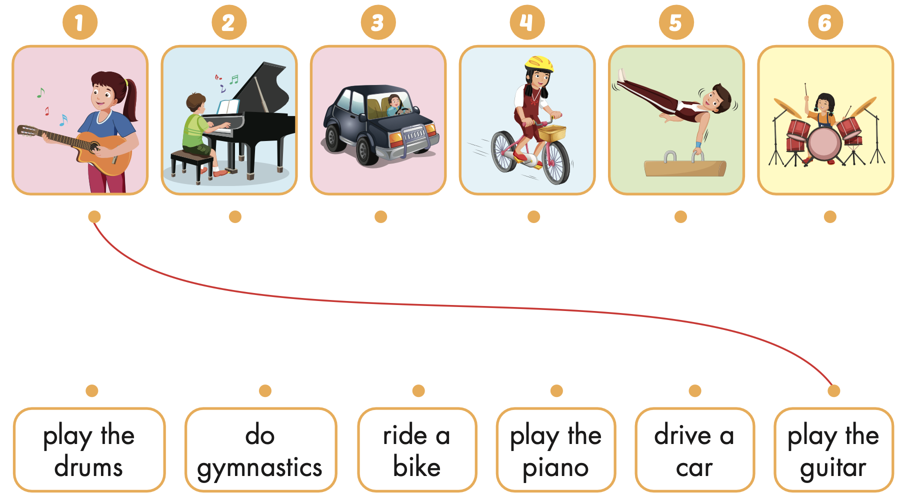





Extra Practice
WB, page 16

Slide 50

WRAP-UP

Slide 51
Today’s lesson
Vocabularies
play the guitar, play the piano, drive a car,
ride a bike,
do gymnastics, play the drums.
Structures/ Sentence patterns
What can you do?
- I can play the piano.
What can your mom do?
- She can drive a car.
What can your friends do?
- They can ride bikes.

Slide 52
Homework
Practice the vocabularies and structure; and make sentences using them.
Do the exercises in Tiếng Anh 4 i-Learn Smart Start WB (page 16)
Do the exercises in Tiếng Anh 4 i-Learn Smart Start Notebook (page 12)
Prepare the next lesson (page 27 SB) Play the consolidation games in Tiếng Anh 4 i-Learn Smart Start DHA App on www.eduhome.com.vn

Slide 53

Enjoy your day!

