Slide 1

Unit 3: School
Lesson 1.1
Page 38

Slide 2
Lesson Outline
Warm-up
Vocabulary
Structure
Consolidation
Wrap-up

Slide 3
Objectives
By the end of this lesson, students will be able to identify 5 school supplies and use them in questions.
Vocabulary: eraser, ruler, pencil, notebook, pencil case
Structure: Is this your eraser?
- Yes, it is./No, it isn't.
Are these your notebooks?
- Yes, they are./No, they aren't.

Slide 4

WARM UP

Slide 5

LET’S PLAY!
What’s missing?
Notes:
Put three or four FLASHCARDS (family members) on the board and tell your child to look at them. Ask them to close their eyes and take one card away. When your child opens their eyes, ask them to guess what is missing.

Slide 6

It’s time to learn …

Slide 7

New words
eraser
ruler
pencil
notebook
pencil case

Slide 8

Presentation

Slide 9


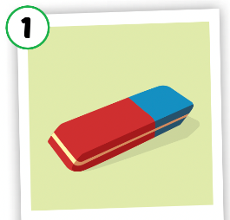
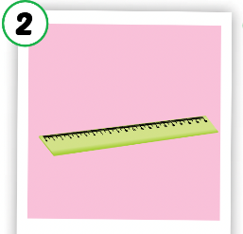
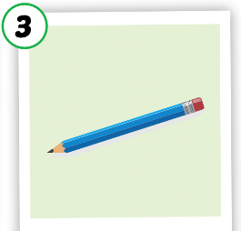

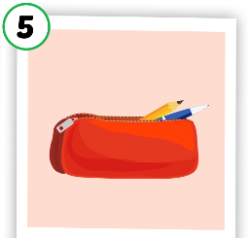
Listen and point.
Click the icon to hear the sound.

Slide 10

Listen and repeat.
Click each picture to hear the sound.
eraser
/ɪˈreɪsər/
cục tẩy

Slide 11

Listen and repeat.
Click each picture to hear the sound.
ruler
/ˈruːlər/
cái thước kẻ

Slide 12
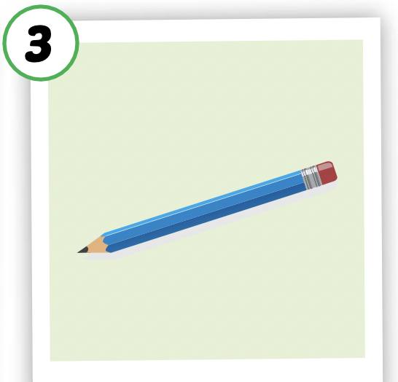
Listen and repeat.
Click each picture to hear the sound.
pencil
/ˈpensl/
cây bút chì

Slide 13

Listen and repeat.
Click each picture to hear the sound.
notebook
/ˈnəʊtbʊk/
quyển vở, quyển sổ

Slide 14
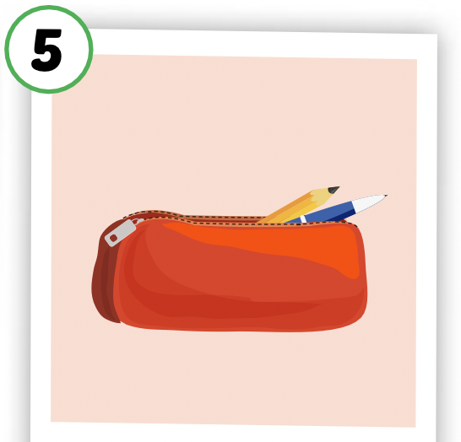
Listen and repeat.
Click each picture to hear the sound.
pencil case
/ˈpensl keɪs/
cái hộp bút

Slide 15

Practice

Slide 16

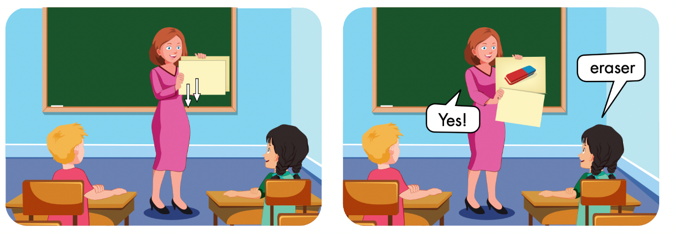

Slide 17

WHAT IS IN THE CLOCK?
START
HOW TO PLAY
Press START to play
Press CHECK to see the answer

Slide 18


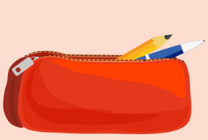
START
CHECK

Slide 19

START
CHECK

Slide 20

START
CHECK

Slide 21

START
CHECK

Slide 22
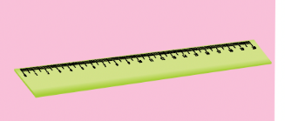
START
CHECK

Slide 23

Structures
Is this your eraser?
Yes, it is./No, it isn’t.
Are these your notebooks?
Yes, they are./No, they aren't.

Slide 24
Presentation

Slide 25



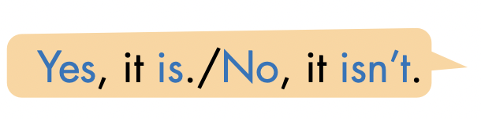




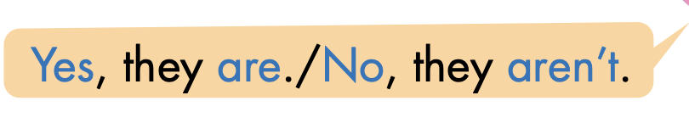
Click here to hear the sound.

Slide 26
Practice

Slide 27
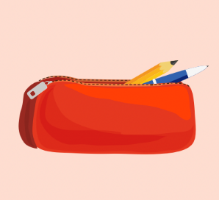


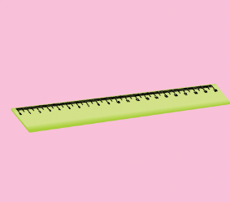

LET’S PRACTICE!
Is this your…………?
Yes, it is.
No, it isn’t.
No, it isn’t.
Yes, it is.
No, it isn’t.

Slide 28

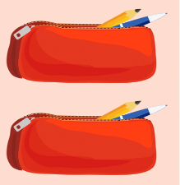
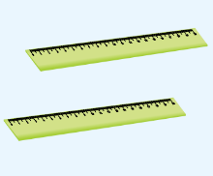
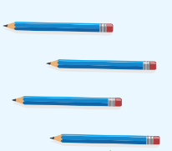
Are these your ………………?
No, they aren’t.
No, they aren’t.
Yes, they are.
Yes, they are.

Slide 29

Production

Slide 30


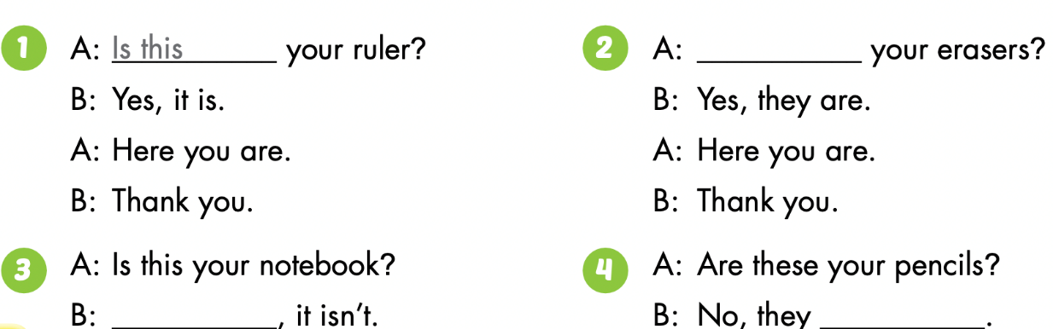

Slide 31
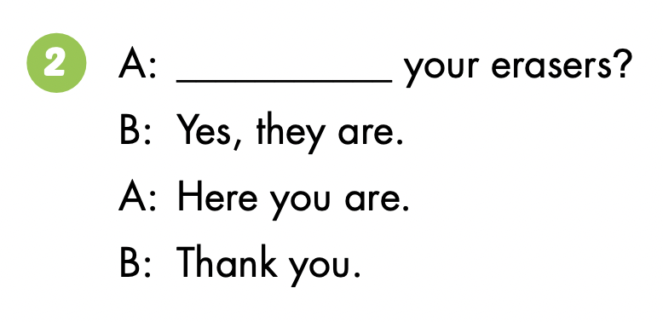
Are these

Slide 32

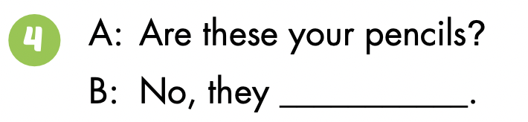
No
aren’t

Slide 33

CONSOLIDATION

Slide 34

Guessing game
Notes:
Choose one flashcard, and don’t show the students. Then ask them to try to guess what the word is while using the target expression.
For example, students guess they can ask the teacher ‘Is this a ruler?’, and the teacher can respond ‘Yes, it is. / No, it isn’t.’.

Slide 35

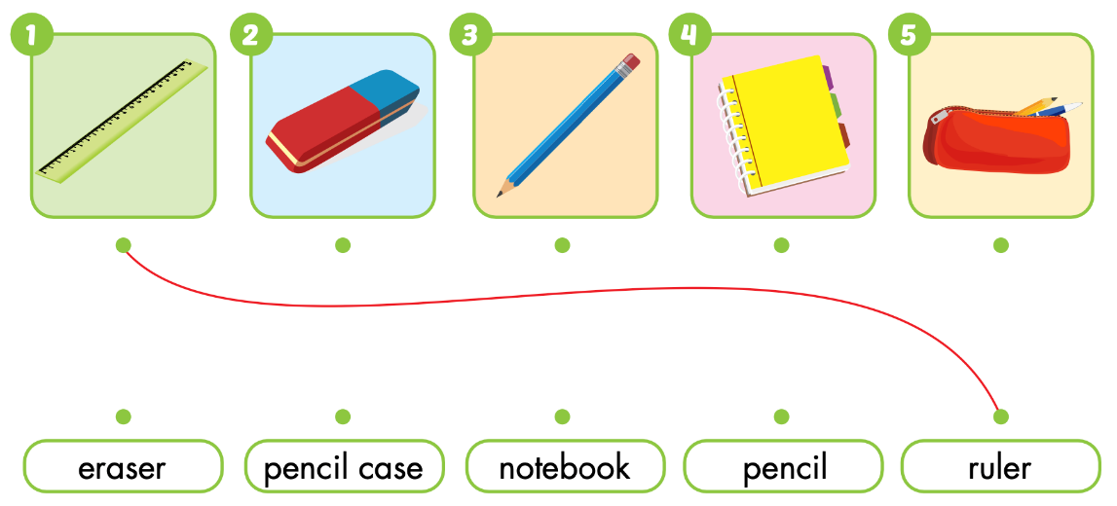
Extra Practice
WB p. 28

Slide 36
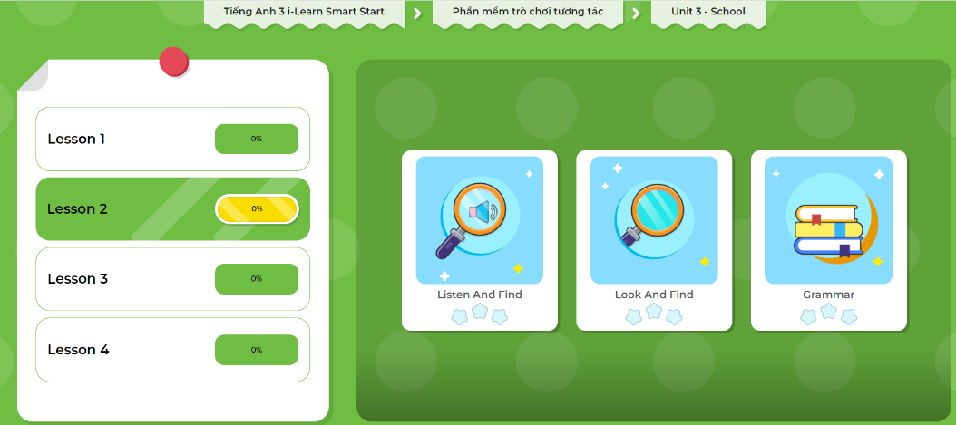
Extra Practice
DHA App
Let’s play!
Click on the picture below

Slide 37

WRAP-UP

Slide 38
Lesson 3
Today’s lesson
Vocabularies
eraser, ruler, pencil, notebook, pencil case
Structures/ Sentence patterns
Is this your eraser?
- Yes, it is./No, it isn’t.
Are these your notebooks?
- Yes, they are./No, they aren't.

Slide 39
Lesson 3
Homework
Learn by hearts vocabularies, the structures and make sentences using them.
Do the exercises on page 28 WB
Do the exercises in Tiếng Anh 3 i-Learn Smart Start Notebook on page 22.
Prepare the next lesson (page 39 SB)
Play the consolidation games in Tiếng Anh 3 i-Learn Smart Start DHA App on www.eduhome.com.vn

Slide 40

Enjoy your day!

Slide 41

Have a nice day!

