Slide 1

Unit 1: My Friends
Lesson 2
Page 14

Slide 2
Lesson Outline
Warm-up
Phonics
Listening
Consolidation
Wrap-up

Slide 3
Objectives
By the end of this lesson, students will be able to use ….
Vocabulary: the USA, the UK, Italy, India, Japan, Alpha
Structure: Where are you from?
I'm from the USA.
Where's she from?
She's from Japan.
Aim: Students will be able to ask where people are from.

Slide 4

WARM UP

Slide 5



GUESSING GAMES!
Where are you from?
I’m from the USA.
Notes:
Instructions:
Click the picture to open. Click ? To show question. Click the light bulb to show the answer.
Explain the game to students.
Make sure students pronounce the word correctly.
Review structure from previous questions.

Slide 6


GUESSING GAMES!
Where are you from?
I’m from the UK.
Notes:
Instructions:
Click the picture to open. Click ? To show question. Click the light bulb to show the answer.
Explain the game to students.
Make sure students pronounce the word correctly.
Review structure from previous questions.

Slide 7
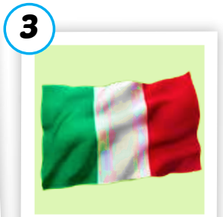

GUESSING GAMES!
Where’s he from?
He’s from Italy.
Notes:
Instructions:
Click the picture to open. Click ? To show question. Click the light bulb to show the answer.
Explain the game to students.
Make sure students pronounce the word correctly.
Review structure from previous questions.

Slide 8

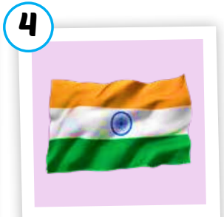
GUESSING GAMES!
Where’s he from?
He’s from India.
Notes:
Instructions:
Click the picture to open. Click ? To show question. Click the light bulb to show the answer.
Explain the game to students.
Make sure students pronounce the word correctly.
Review structure from previous questions.

Slide 9


GUESSING GAMES!
Where’s she from?
She’s from Japan.
Notes:
Instructions:
Click the picture to open. Click ? To show question. Click the light bulb to show the answer.
Explain the game to students.
Make sure students pronounce the word correctly.
Review structure from previous questions.

Slide 10
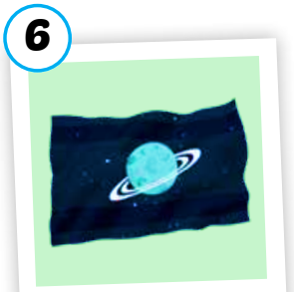

GUESSING GAMES!
Where’s she from?
She’s from Alpha.
Notes:
Instructions:
Click the picture to open. Click ? To show question. Click the light bulb to show the answer.
Explain the game to students.
Make sure students pronounce the word correctly.
Review structure from previous questions.

Slide 11

It’s time to learn …

Slide 12

Phonics
/ə/ sound

Slide 13

Presentation

Slide 14




c
1. Listen and repeat
India
Alpha
Notes:
Click the speakers to listen.
Click the light bulb to show the words.
Get student to pay attention to highlighted “a” which is /ə/ sound . Pronounce it correctly.

Slide 15











c
2. Listen and chant.
/ə/, /ə/, /ə/,
/ə/, /ə/, /ə/,
India, Alpha,
/ə/, /ə/, /ə/.
(x2)
Notes:
Click the mic to listen.
Get student to listen and repeat carefully.
Click to show the lyrics.

Slide 16
Practice

Slide 17




Activity 1
Listen and repeat.
1
2
3
4
Japan
Italy
India
Alpha
Notes:
Instructions: Click the hearts to listen. Click the smiling face to show pictures behind. Click the pictures to show the words.
Get student to listen and repeat.
Focus on the sound of each word.

Slide 18
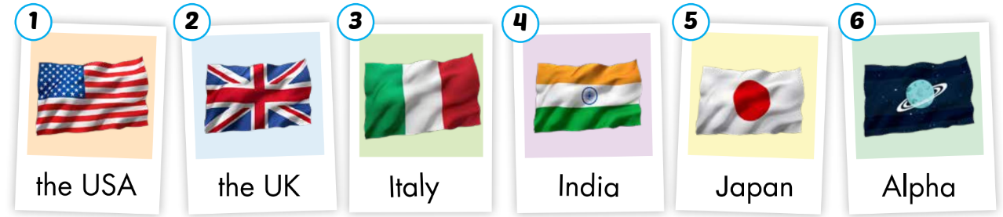
Activity 2
Look, read and circle the words with / ə / sound.
Notes:
Show pictures and get students to say one by one.
Give students some time to choose the words that have the /ə/ sound.
Show answer and check students’ answers.

Slide 19

Listening
Where are you from?
I’m from….
Where’s he from?
He’s from….

Slide 20

Presentation

Slide 21

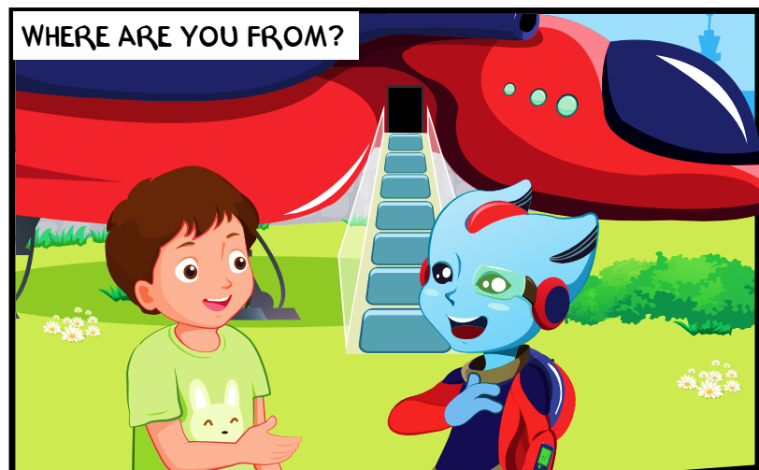
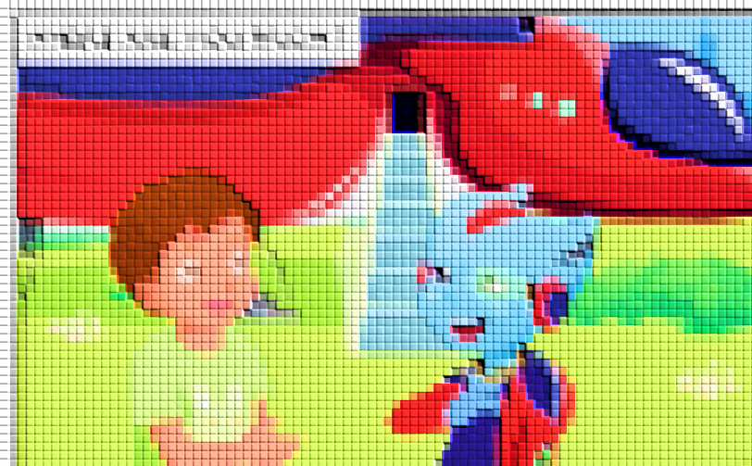
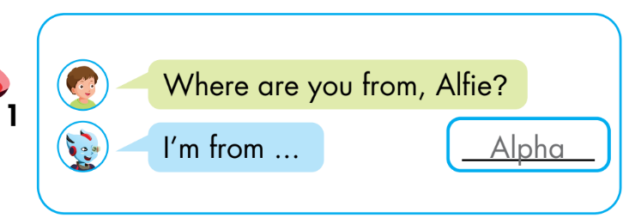
Notes:
Instructions:
Let students guess who are in the picture. Then click on the picture to open it. Say their names.
Ask:
What are they doing? ( talking)
Can you read the question? (Where are you from?)
- Click to show the conversation. Read and then listen. (click the conversation to listen) Explain to students what they have to do.

Slide 22
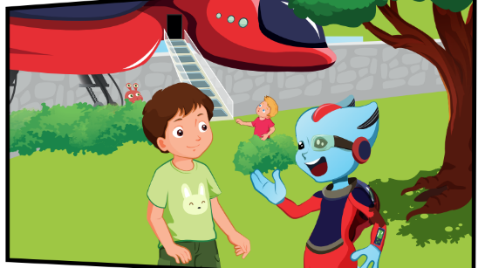
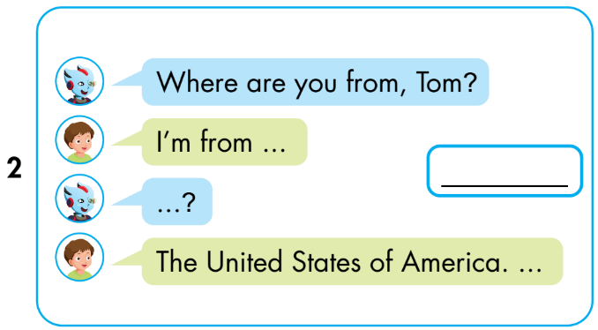
the USA.
U-S-A?
Notes:
Instructions:
Let students guess who are in the picture. Then click on the picture to open it. Say their names.
Ask:
What are they doing? ( talking)
Can you read the question? (Where are you from?)
- Click to show the conversation. Read and then listen. (click the conversation to listen) Explain to students what they have to do.

Slide 23
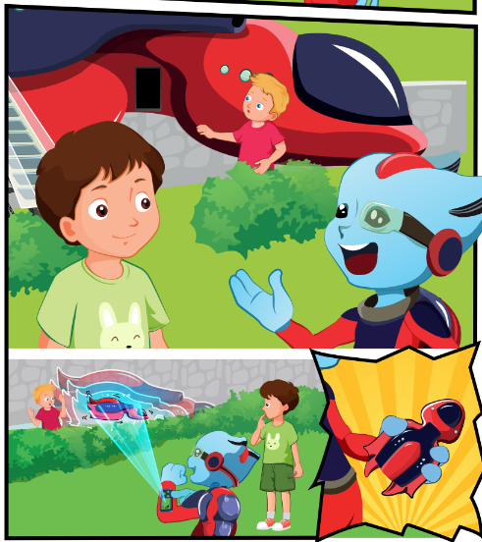
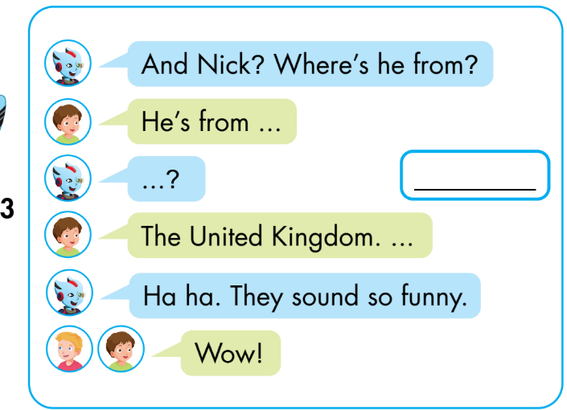
U-K?
the UK.
the UK.
Notes:
Instructions:
Let students guess who are in the picture. Then click on the picture to open it. Say their names.
Ask:
What are they doing? ( talking)
Can you read the question? (Where are you from?)
- Click to show the conversation. Read and then listen. (click the conversation to listen) Explain to students what they have to do.

Slide 24
Practice

Slide 25
Activity 1
Guess what country behind the wall?
Where’s Alfie from?
He’s from Alpha.
Notes:
Instruction:
Get students read the question.
Say that there’s a flag of a country behind the wall and they need to guess it first.
Click on the wall piece by piece to open it.
Click on the heart to show answer.

Slide 26
Activity 1
Guess what country behind the wall?
Where’s she from?
She’s from Japan.
Notes:
Instruction:
Get students read the question.
Say that there’s a flag of a country behind the wall and they need to guess it first.
Click on the wall piece by piece to open it.
Click on the heart to show answer.

Slide 27
Activity 1
Guess what country behind the wall?
Where are you from?
I’m from India.
Notes:
Instruction:
Get students read the question.
Say that there’s a flag of a country behind the wall and they need to guess it first.
Click on the wall piece by piece to open it.
Click on the heart to show answer.

Slide 28
Activity 1
Guess what country behind the wall?
Where’s he from?
He’s from Italy.
Notes:
Instruction:
Get students read the question.
Say that there’s a flag of a country behind the wall and they need to guess it first.
Click on the wall piece by piece to open it.
Click on the heart to show answer.

Slide 29
Activity 1
Guess what country behind the wall?
Where’s Nick from?
He’s from the UK.
Notes:
Instruction:
Get students read the question.
Say that there’s a flag of a country behind the wall and they need to guess it first.
Click on the wall piece by piece to open it.
Click on the heart to show answer.

Slide 30

Activity 1
Guess what country behind the wall?
Where are you from?
I’m from the USA
Notes:
Instruction:
Get students read the question.
Say that there’s a flag of a country behind the wall and they need to guess it first.
Click on the wall piece by piece to open it.
Click on the heart to show answer.

Slide 31

Activity 2
look, read and choose the right answer.
Red: Where are you from?
Blue: I’m from _ _ _ _ _ _.
a. the UK b. the USA

Slide 32

Activity 2
look, read and choose the right answer.
Red: Where’s she from?
Blue: She’s from _ _ _ _ _ _.
a. the UK b. the KU

Slide 33
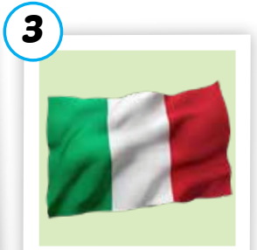
Activity 2
look, read and choose the right answer.
Red: Where’s she from?
Blue: She’s from _ _ _ _ _ _.
a. Italy b. India

Slide 34
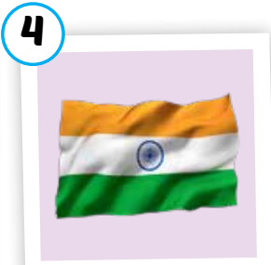
Activity 2
look, read and choose the right answer.
Red: Where’s Dan from?
Blue: He’s from _ _ _ _ _ _.
a. Italy b. India

Slide 35

Activity 2
look, read and choose the right answer.
Red: Where’s Akiko from?
Blue: She’s from _ _ _ _ _ _.
a. Japan b. China

Slide 36




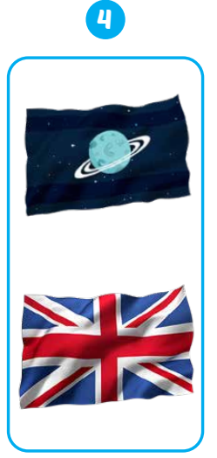
Extra Activity
WB p.11

Slide 37
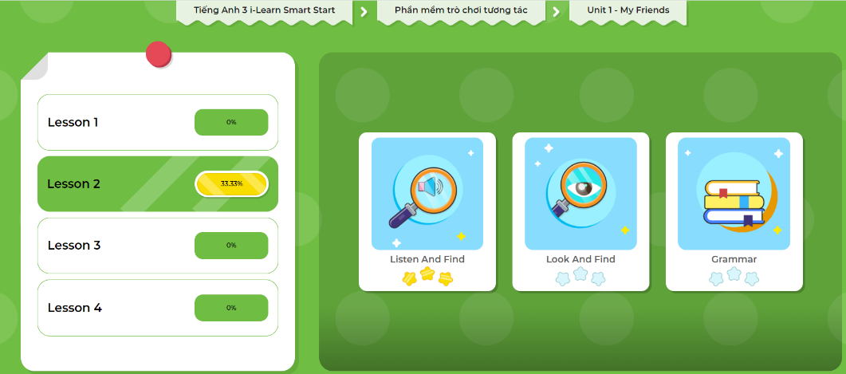
Extra-Act2. DHA app.
Click here to play the games

Slide 38
Consolidation

Slide 39

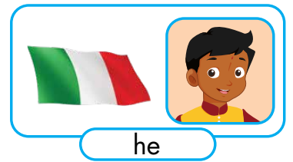
Draw your friends on an A4 paper and tell me where they are from.
Akiko
Dan
Hello, class. My name’s Anna. I’m 8. I’m in class 3A6.
Today, I’m talking about my friends.
This is Akiko. She’s from Japan.
This is Dan. He’s from India.

Slide 40

WRAP-UP

Slide 41
Lesson 3
Today’s lesson
Vocabulary
The USA
The UK
Italy
India
Japan
Alpha
Structures/ Sentence patterns
Where are you from?
I’m from…
Where’s she from?
She’s from….
Where’s he from?
He’s from…..

Slide 42
Homework
Learn by hearts vocabularies and make sentences using them.
Do the exercises on page 11 WB
Do exercises in Tiếng Anh 3 i-Learn Smart Start Notebook on page 11
Prepare the next lesson (page 15) SB)
Play the consolidation games in Tiếng Anh 3 i-Learn Smart Start DHA App on www.education.com.vn

Slide 43
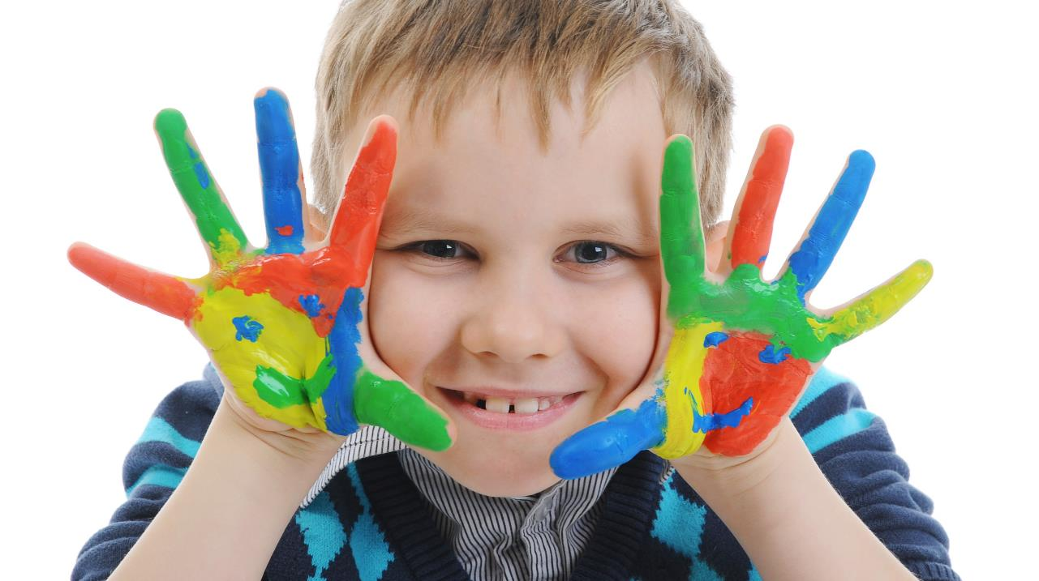
Enjoy your day!

