Slide 1
Unit 5
What will you do this weekend?
Lesson 3

Slide 2
Review

Slide 3









Luật chơi:
Các đội lần lượt chọn các số từ 1-10.
Trả lời đúng được cộng, trả lời sai bị trừ số điểm đã mở.
Ngôi sao xanh được +200 điểm khi trả lời đúng, trả lời sai không bị trừ điểm
Ngôi sao đen bị -200 điểm khi trả lời sai, trả lời đúng không bị trừ điểm.
Lucky number
PLAY
Notes:
Ms Huyền Phạm - 0936.082.789 – YOUTUBE: MsPham. Facebook: Dạy và học cùng công nghệ.

Slide 4


2
100
200
4
1
100
-200
3
100
7
5
6
+200
200
8
100
100
9
10
200
Notes:
Ms Huyền Phạm - 0936.082.789 – YOUTUBE: MsPham. Facebook: Dạy và học cùng công nghệ.

Slide 5



What will you do this weekend?
Back
I swim in the sea.
I’ll swim in the sea.
I don’t swim in the sea.
Notes:
Ms Huyền Phạm - 0936.082.789 – YOUTUBE: MsPham. Facebook: Dạy và học cùng công nghệ.

Slide 6
What will you do at Ha Long Bay?
Back
I don’t know I may explore the cave.
I don’t know
I explore the cave.
I didn’t know I may explore the cave.
Notes:
Ms Huyền Phạm - 0936.082.789 – YOUTUBE: MsPham. Facebook: Dạy và học cùng công nghệ.

Slide 7
What will you do tomorrow?
Back
I think know I’ll be at home.
I know I’ll be at home.
I think I’ll be at home.
Notes:
Ms Huyền Phạm - 0936.082.789 – YOUTUBE: MsPham. Facebook: Dạy và học cùng công nghệ.

Slide 8
What ________ this weekend?
Back
Do you do
Did you do
Will you do
Notes:
Ms Huyền Phạm - 0936.082.789 – YOUTUBE: MsPham. Facebook: Dạy và học cùng công nghệ.

Slide 9
I’ll be Ha Long Bay.
Back
What will you be this weekend?
Where will you be this weekend?
What are you be this weekend?
Notes:
Ms Huyền Phạm - 0936.082.789 – YOUTUBE: MsPham. Facebook: Dạy và học cùng công nghệ.

Slide 10
Where will you be _____?
Back
Yesterday
This weekend
Last weekend
Notes:
Ms Huyền Phạm - 0936.082.789 – YOUTUBE: MsPham. Facebook: Dạy và học cùng công nghệ.

Slide 11
___________ this weekend?
I’ll at the park.
Back
What will you be
When will you be
Where will you be
Notes:
Ms Huyền Phạm - 0936.082.789 – YOUTUBE: MsPham. Facebook: Dạy và học cùng công nghệ.

Slide 12
What will you do this weekend?
I _____ go to the zoo.
Back
a. will
b. went
c. am
Notes:
Ms Huyền Phạm - 0936.082.789 – YOUTUBE: MsPham. Facebook: Dạy và học cùng công nghệ.

Slide 13
Where will you be this weekend?
I ____ on the beach.
Back
Will
Will be
am
Notes:
Ms Huyền Phạm - 0936.082.789 – YOUTUBE: MsPham. Facebook: Dạy và học cùng công nghệ.

Slide 14
Where will you ___ this friday?
I will be at school.
Back
go
be
do
Notes:
Ms Huyền Phạm - 0936.082.789 – YOUTUBE: MsPham. Facebook: Dạy và học cùng công nghệ.

Slide 15
PRONUNCIATON

Slide 16

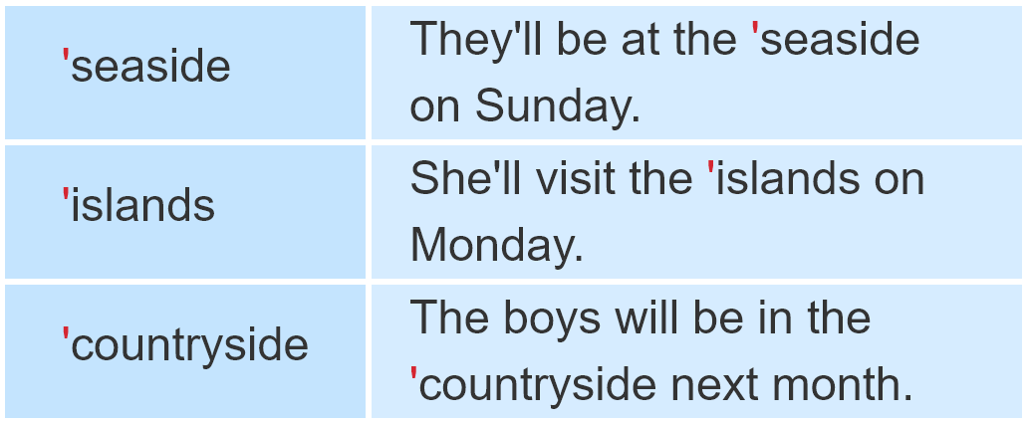
1. Listen and repeat

Slide 17
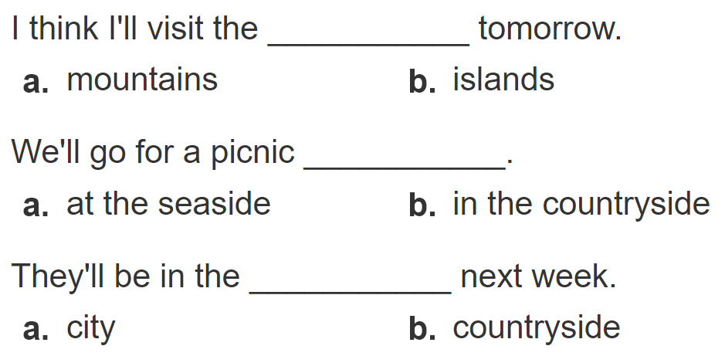
2. Listen and circle a or b. Then say the sentences aloud.
1
2
3
Clcik số để nghe từng câu

Slide 18
PRACTISE

Slide 19
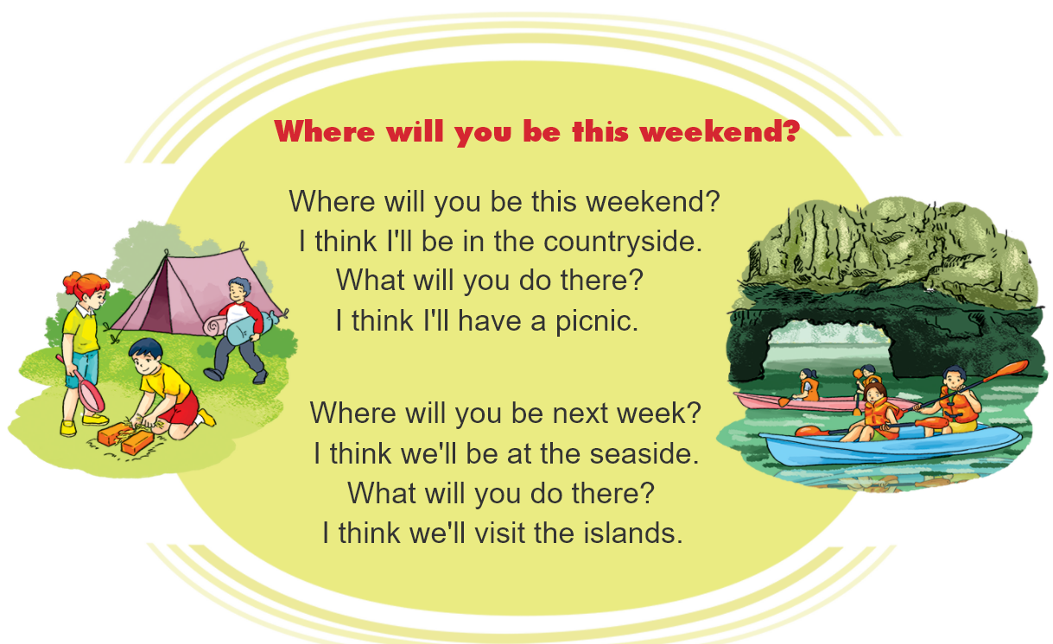



3. Let’s chant.

Slide 20
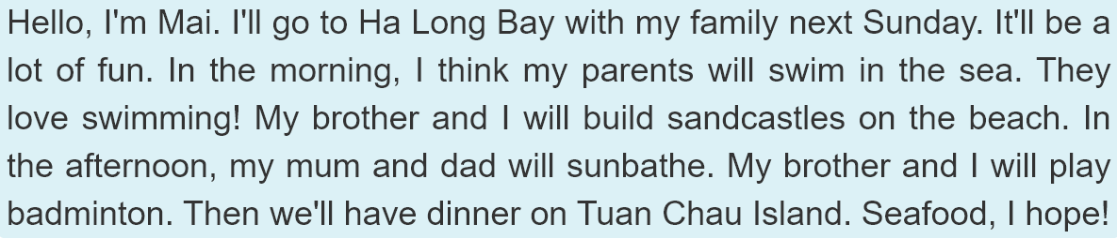
4. Read and answer.
 | Morning | Afternoon | Evening
Mai's parents | will swim in the sea
Mai and her brother
will sunbathe
will have dinner on
Tuan Chau Island
will build
sandcastles
will play
badminton
will have dinner on
Tuan Chau Island

Slide 21
5. Write about you.
Hi. My name's ____________________ .
Next Sunday, I think I will be ________________.
In the morning, I will _______________________.
In the afternoon, __________________________.
In the evening, ___________________________.

Slide 22
6. Project.

