Slide 1


I always get up early.
How about you?
Unit
02
Lesson 2

Slide 2
Vocabulary

Slide 3
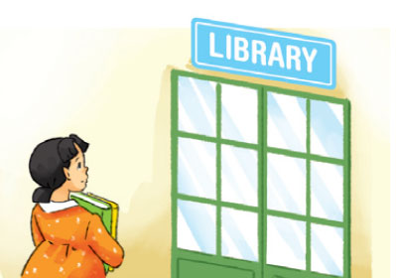
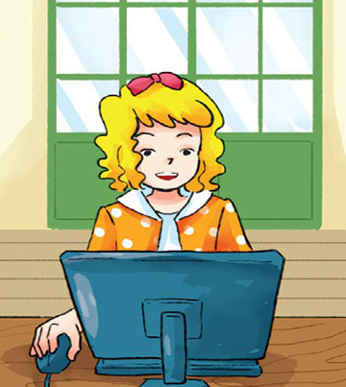
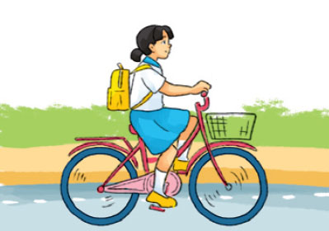
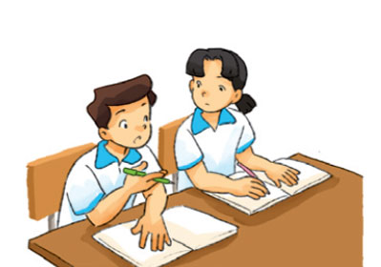

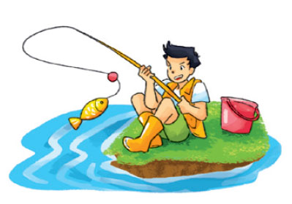
Vocabulary
Go to the library
Surf the Internet
Ride a bicycle
Đi thư viện
Lướt web
Đạp xe đạp
Study
Look for
Go fishing
Học
Tìm kiếm
Đi câu cá

Slide 4
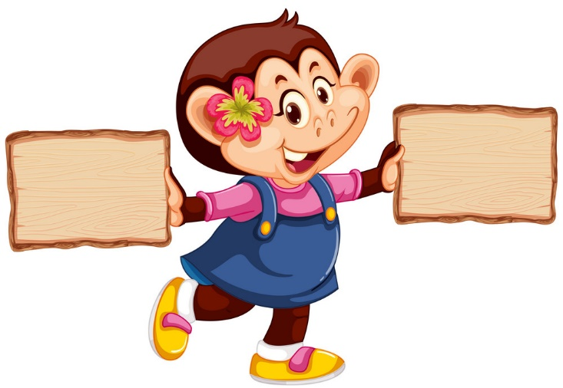

right
left

Slide 5
Play
Study

Slide 6
Ride the bicycle
Ride the motobike

Slide 7
Look for
Study

Slide 8
Play game
Surf the Internet

Slide 9
Go swimming
Go fishing

Slide 10
Go to the library
study

Slide 11
JOB!
GOOD

Slide 12
Grammar

Slide 13









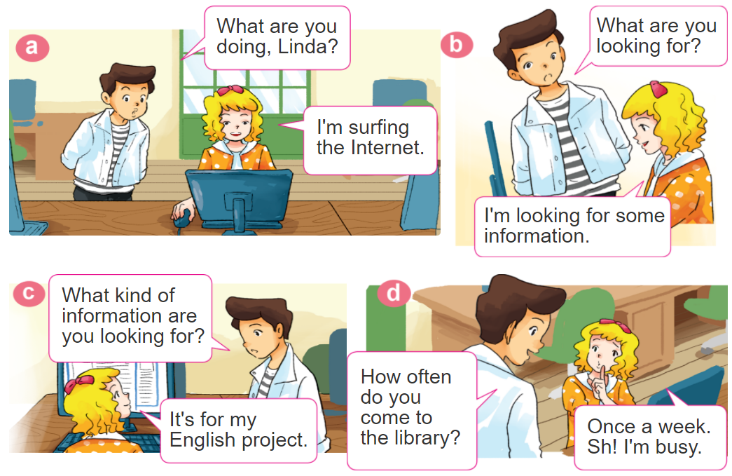

1. Look, listen and repeat

Slide 14





2. Point and say
study with
a partner
every day
go to the library
once a week
go fishing
once a month
ride a bicycle
to school
twice a week
How often do you ____?
I _____ _____________.

Slide 15
Grammar
Trạng từ thời gian:
Đứng cuối câu
every day
: Mỗi ngày
once
: Một lần
twice
: Hai lần
Three times
: 3 lần

Slide 16
Grammar
Hỏi và trả lời với HOW OFTEN
(thường xuyên như thế nào?)
How often do you __________?
+ an activity
I _________ ______.
+ the activity
+ adv

Slide 17












Ms Huyền Phạm
0936.082.789
Ms Huyền Phạm
0936.082.789
Ms Huyền Phạm
0936.082.789
Ms Huyền Phạm - 0936.082.789 – YOUTUBE: MsPham. Facebook: Dạy và học cùng công nghệ.
Ms Huyền Phạm
0936.082.789
Notes:
Ms Huyền Phạm - 0936.082.789 – YOUTUBE: MsPham. Facebook: Dạy và học cùng công nghệ.

Slide 18
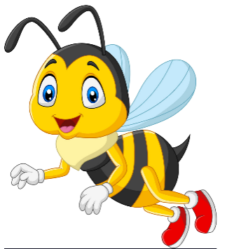





______ do you study with a partner?
Next
How often
What often
How
Oten
Notes:
Ms Huyền Phạm - 0936.082.789 – YOUTUBE: MsPham. Facebook: Dạy và học cùng công nghệ.

Slide 19
How often do you go fishing?
Next
Two
a month
Twice
Twice
a month
A month
Notes:
Ms Huyền Phạm - 0936.082.789 – YOUTUBE: MsPham. Facebook: Dạy và học cùng công nghệ.

Slide 20
How often _____ you ride the bicycle to school?
Next
is
do
are
does
Notes:
Ms Huyền Phạm - 0936.082.789 – YOUTUBE: MsPham. Facebook: Dạy và học cùng công nghệ.

Slide 21
How _____ do you go swimming?
Next
always
many
much
often
Notes:
Ms Huyền Phạm - 0936.082.789 – YOUTUBE: MsPham. Facebook: Dạy và học cùng công nghệ.

Slide 22
How often do you cook dinner?
Next
Three times
Three times
a week
A week
Three
a week
Notes:
Ms Huyền Phạm - 0936.082.789 – YOUTUBE: MsPham. Facebook: Dạy và học cùng công nghệ.

Slide 23
How often do ______ ride the bicycle to school?
Next
you
Your partner
Your sister
she
Notes:
Ms Huyền Phạm - 0936.082.789 – YOUTUBE: MsPham. Facebook: Dạy và học cùng công nghệ.

Slide 24
How often do you go to school the library?
Next
Every
One
One a week
Once a week
Notes:
Ms Huyền Phạm - 0936.082.789 – YOUTUBE: MsPham. Facebook: Dạy và học cùng công nghệ.

Slide 25
How often do you do morning exercise?
Next
One day
Two day
Every day
Every
Notes:
Ms Huyền Phạm - 0936.082.789 – YOUTUBE: MsPham. Facebook: Dạy và học cùng công nghệ.

Slide 26








Notes:
Ms Huyền Phạm - 0936.082.789 – YOUTUBE: MsPham. Facebook: Dạy và học cùng công nghệ.

Slide 27
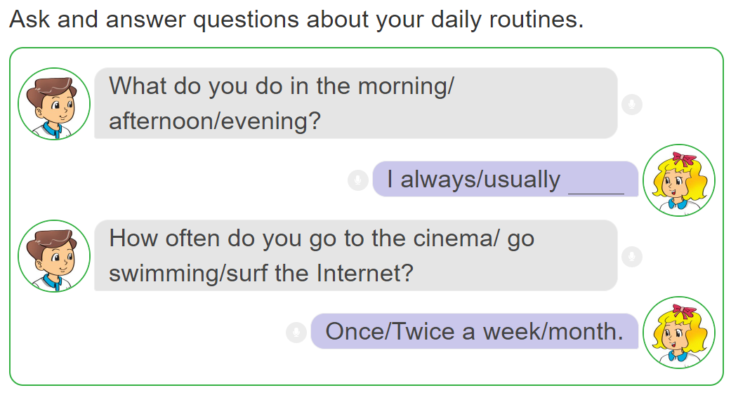
3. Let’s talk.

Slide 28
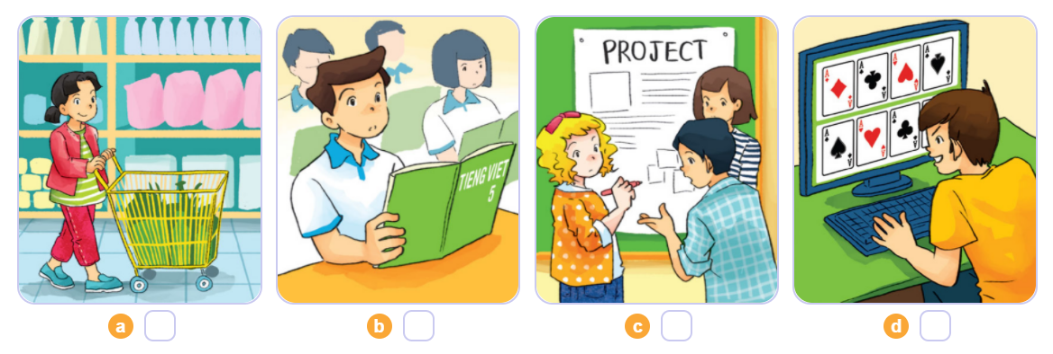
4. Listen and number
4
1
2
3
1
2
3
4

Slide 29
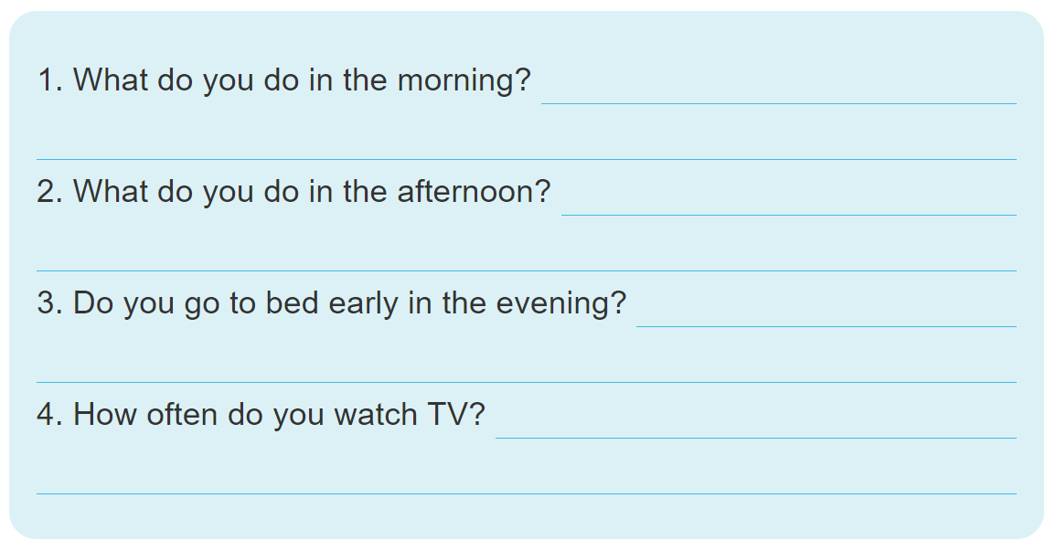
5. Write about your daily routines.

Slide 30
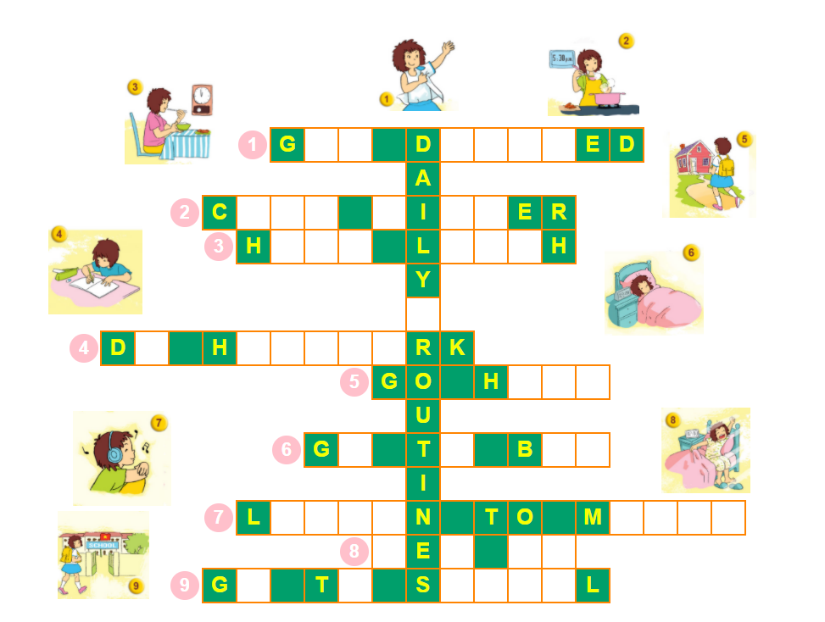
6. Let’s play.

