Slide 1
Unit 6
Where’s
your school?
Lesson 1

Slide 2
Review

Slide 3





Play

Slide 4






1
2
3
4
5
6
7
8
1
2
3
4
5
6
7
8
1
2
3
4
5
6
7
0
8
1
0
2
3
4
5
6
7
8
0
Exit

Slide 5




A
the
B
my
What's ___ name of your school?
C
your
Back

Slide 6
A
are
B
is
Where ___ your school?
C
as
Back

Slide 7
A
He’s in class 4A2.
B
She’s in class 4A2.
What class are you in?
C
I’m in class 4A2.
Back

Slide 8
A
I’m in class 4G.
B
He’s in class 4G.
What class is he in?
C
She’s in class 4G.
Back

Slide 9
A
He’s in class 1E.
B
She’s in class 1E.
What class is she in?
C
I’m in class 1E.
Back

Slide 10
are
XEM ĐÁP ÁN
What class ___ you in?
Back

Slide 11
is
XEM ĐÁP ÁN
What class ____ he in?
Back

Slide 12
is
XEM ĐÁP ÁN
What class _____ she in?
Back

Slide 13
Phonics

Slide 14
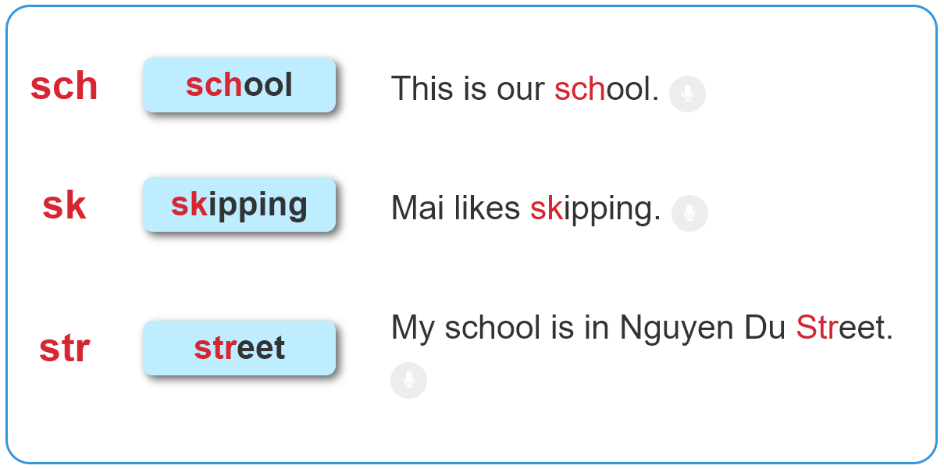

1. Listen and repeat.

Slide 15
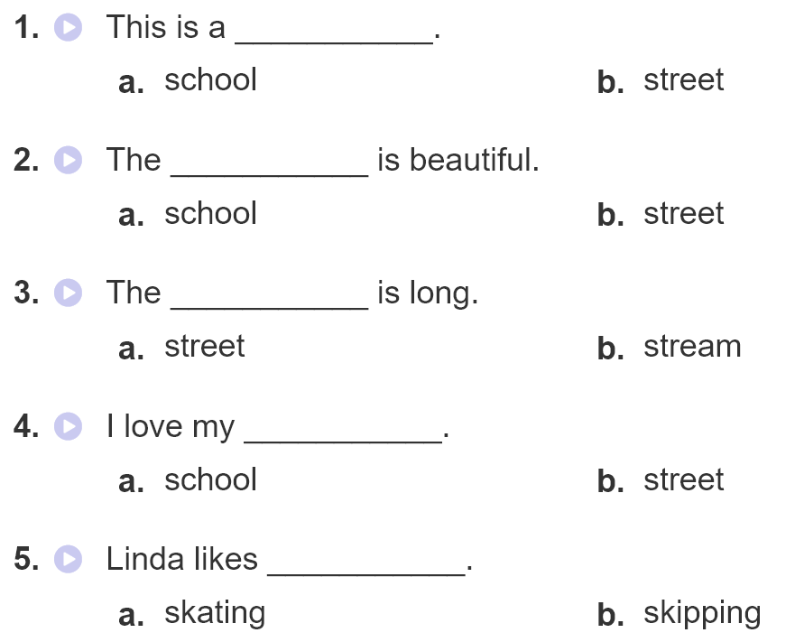
2. Listen and circle. Then write and say aloud

Slide 16
Practise

Slide 17
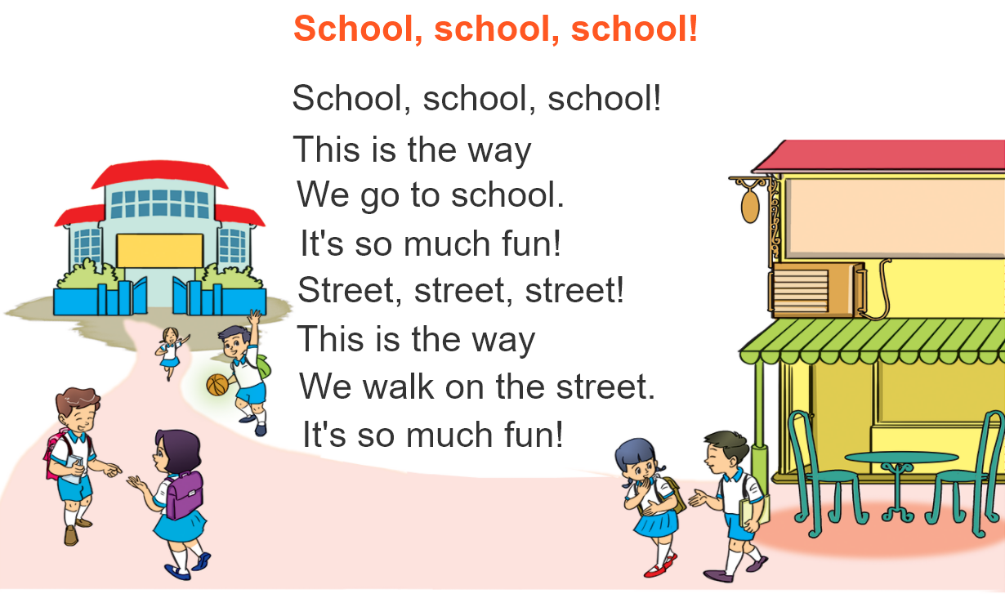



3. Let’s chant

Slide 18
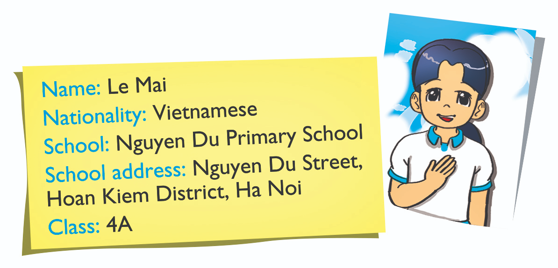
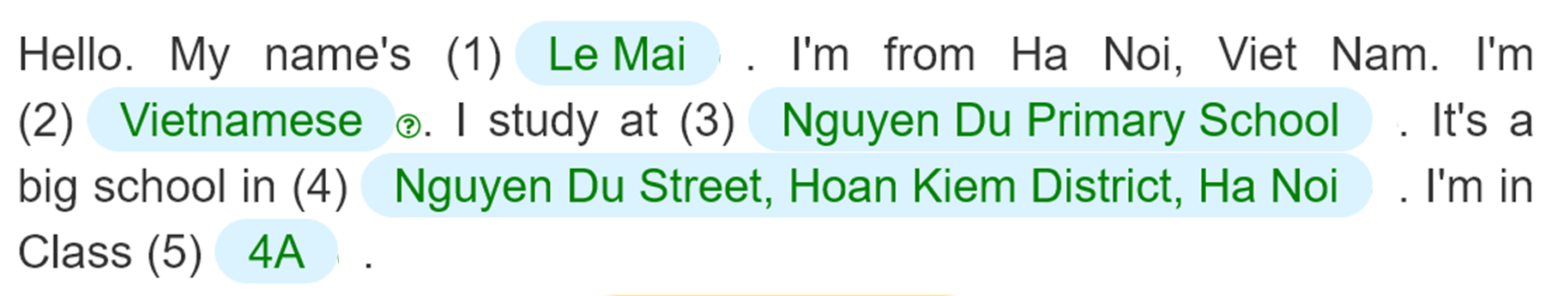
4. Read and complete.
___________
_________________
____________________________________
____________________________________________________________
______

Slide 19
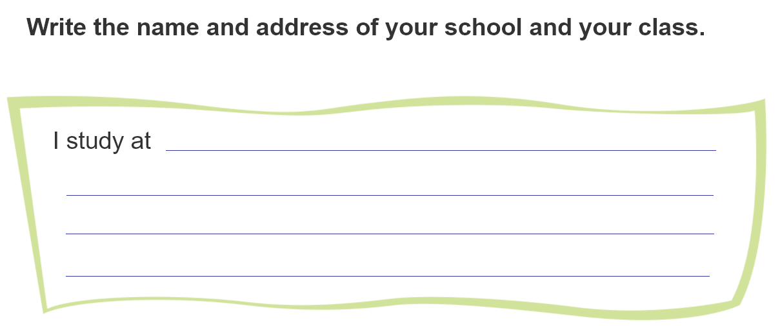
5. Write about your school

Slide 20
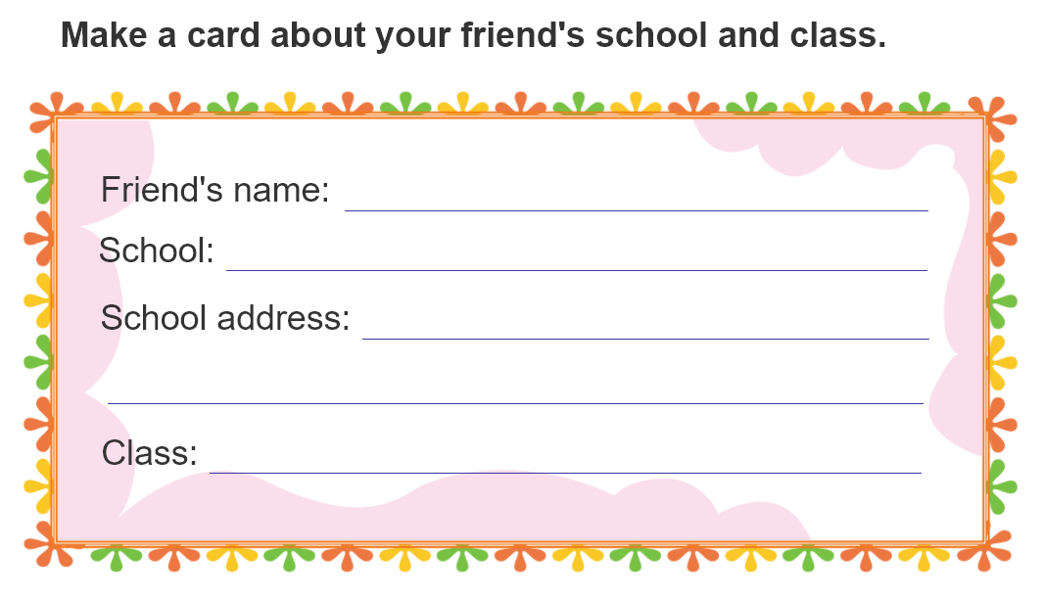
6. Project

