Slide 1
Unit 5
CAN YOU SWIM?
Lesson 1

Slide 2
VOCABULARY

Slide 3
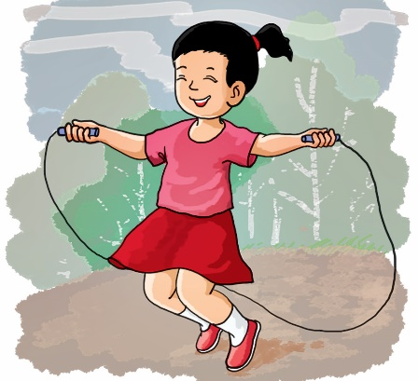
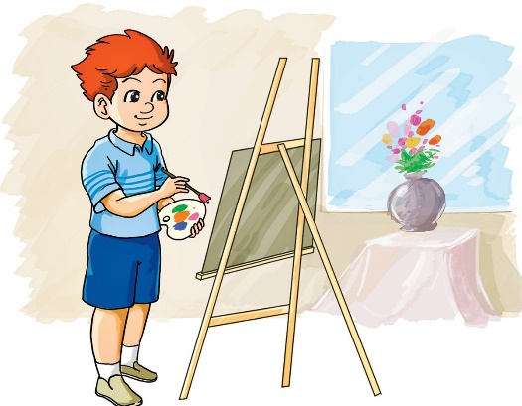


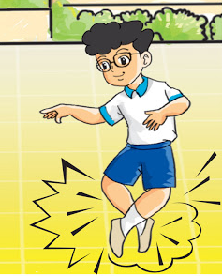
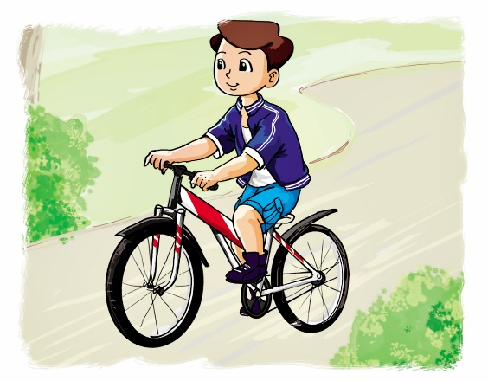
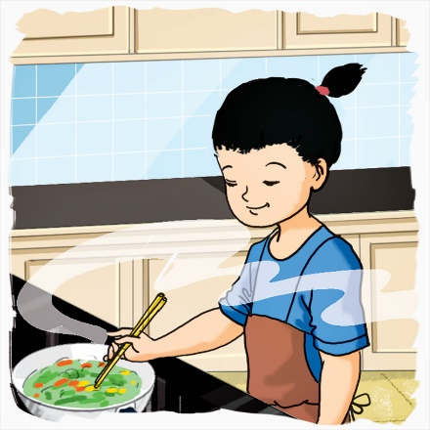
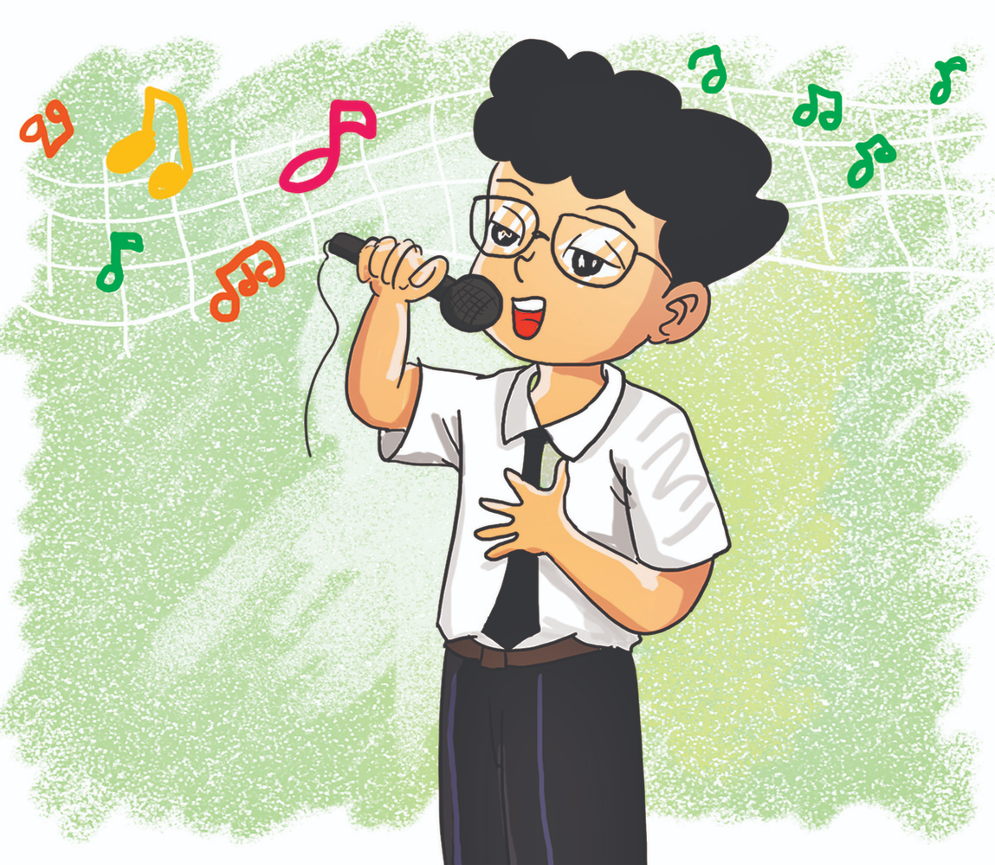
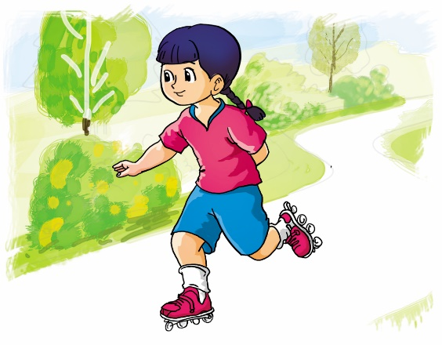
Vocabulary
skip
draw
read
swim
dance
ride
cook
sing
skate

Slide 4




Tick or cross
swim
ride
draw
dance
read

Slide 5



Tick or cross
read
dance
skate
draw
skip

Slide 6


Tick or cross
skip
ride
sing
cook

Slide 7
GRAMMAR

Slide 8
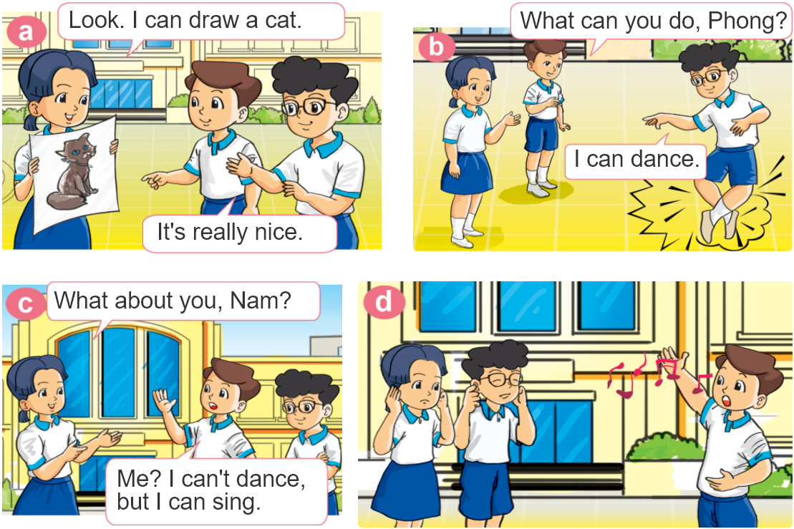

1. Look, listen and repeat.

Slide 9




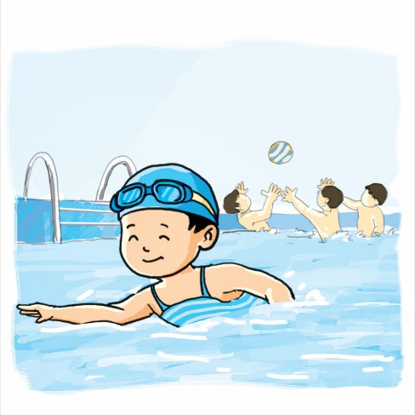

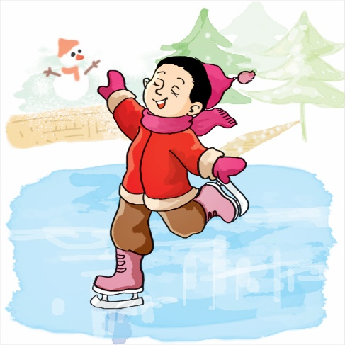

2. Point and say
What can you do?
I can __________.
swim
skip
skate
cook

Slide 10
Structures:
Cách hỏi bạn có thể làm gì
What can you do?
(Bạn có thể làm gì?)
+ V
I can __________.
(Tôi có thể _________)
Extra Structures:
Cách hỏi chị ấy/ anh ấy có thể làm gì
What can she/he do?
(Cô ấy/ Anh ấy có thể làm gì?)
+ V
She/he can __________.
(Cô ấy/ Anh ấy có thể _________)

Slide 11

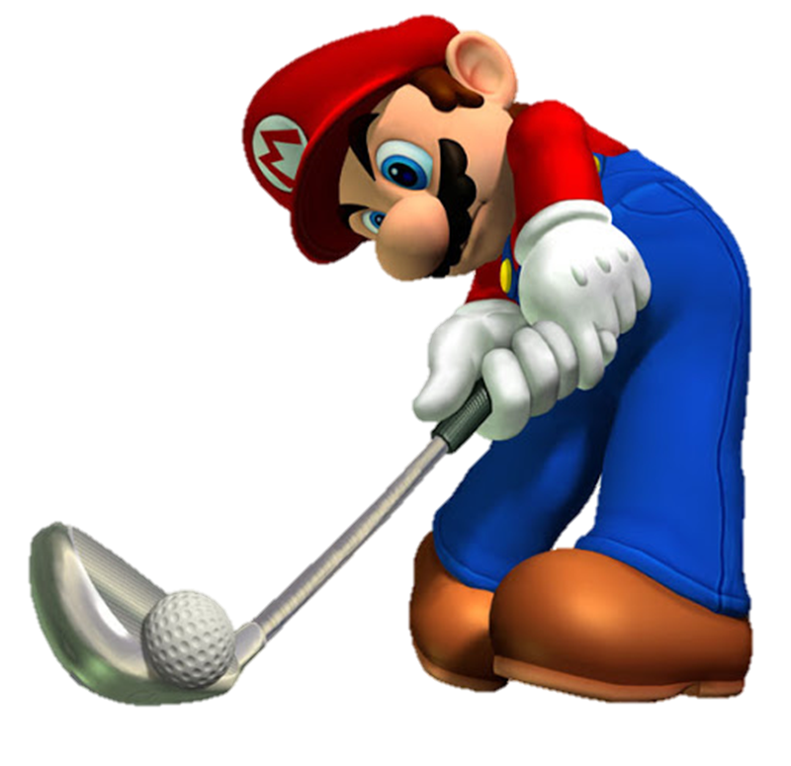





Slide 12






What can you do?
She can swim.
I can swim.
He can swim.

Slide 13
What can she do?
He can cook.
I can cook.
She can cook.

Slide 14
What can you do?
He can skate.
I can skate.
She can skate.

Slide 15
What can she do?
She can skip.
He can skip.
You can skip.

Slide 16

What he you do?
He can draw.
She can draw.
You can draw.

Slide 17
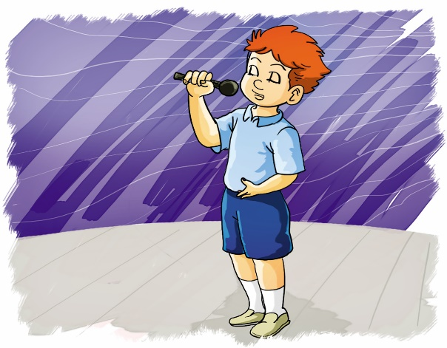
What can you do?
He can talk.
He can dance.
I can sing.

Slide 18
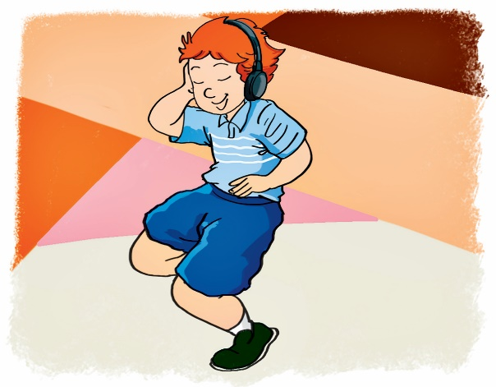
What can you ____?
I can dance.
do
is
are

Slide 19
What can ____ do?
He can ride a bike.
you
he
she

Slide 20
What can you do?
___ read.
I
She can
I can

Slide 21



Slide 22
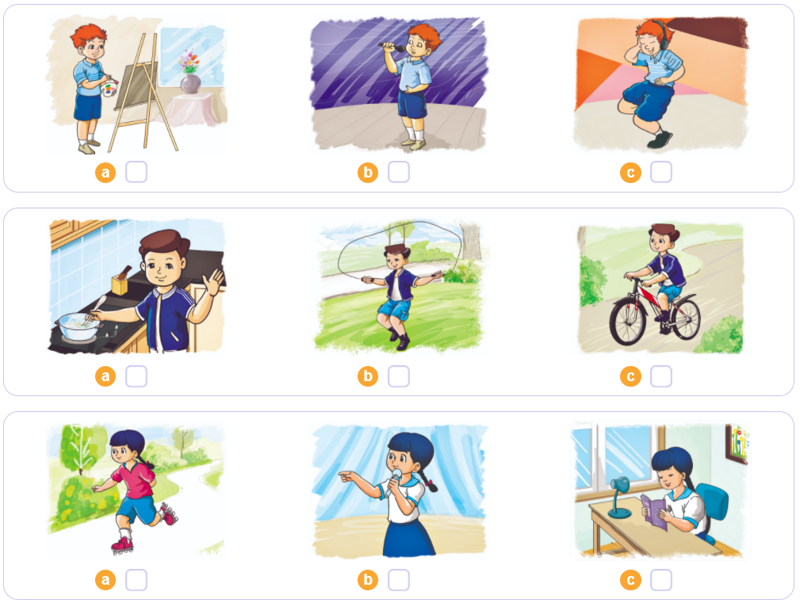

3. Listen and tick
1
2
3

Slide 23
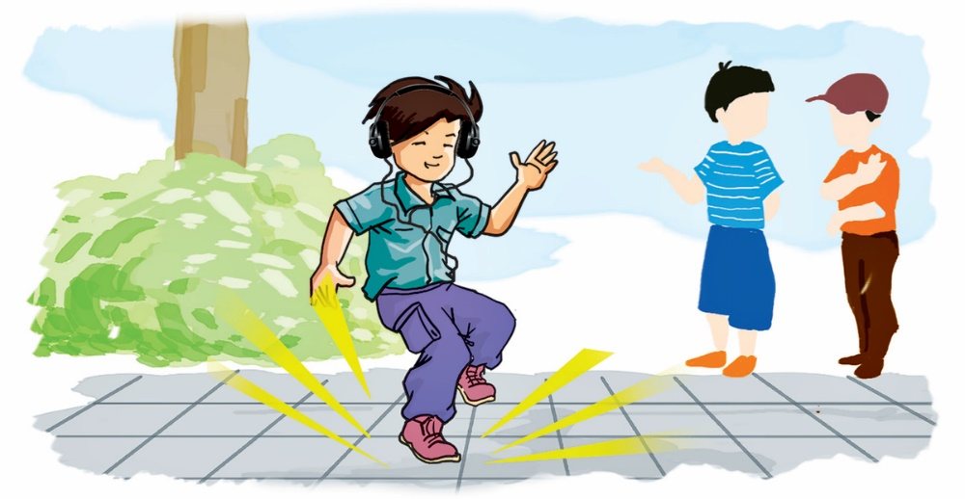
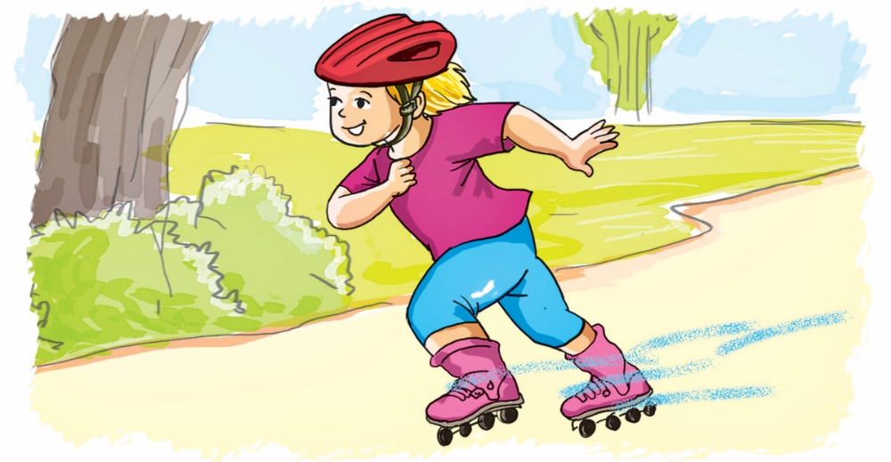
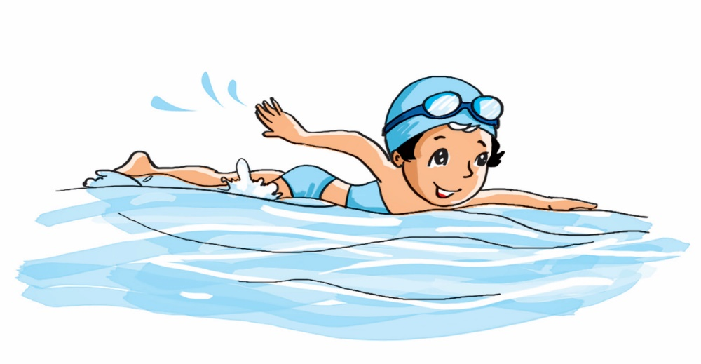
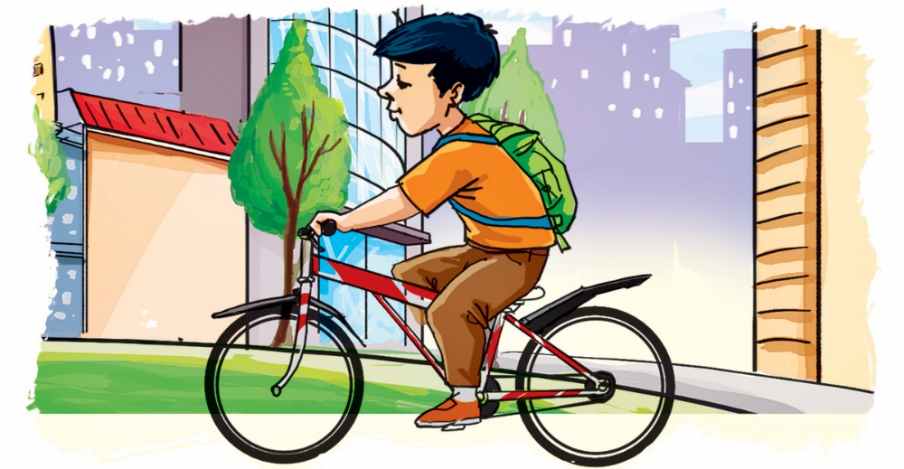
4. Look, read and write.
______.
1. I can dance.
2. I can skate.
______.
3. I can swim.
______.
______.
4. I can cycle.

Slide 24
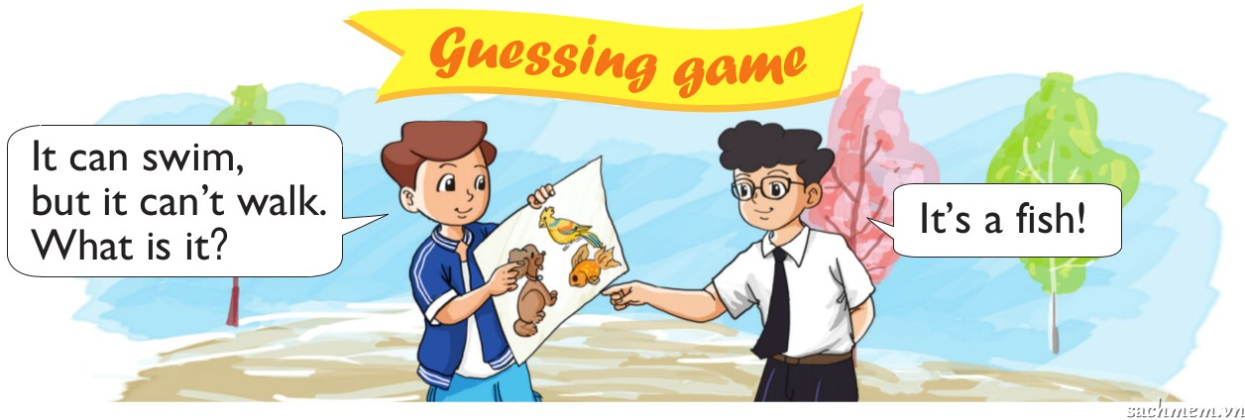
5. Let's play

