Slide 1
Unit 3
What day is it to day ?
Lesson 3

Slide 2









Hoa Mặt Trời
Notes:
Ms Huyền Phạm - 0936.082.789 – YOUTUBE: MsPham. Facebook: Dạy và học cùng công nghệ.

Slide 3



What day is it today, Nam? It's ___________.
A
B
C
D
Tuesdays
Fridays
Thursdays
Wednesdays
Notes:
Ms Huyền Phạm - 0936.082.789 – YOUTUBE: MsPham. Facebook: Dạy và học cùng công nghệ.

Slide 4

What day is it today? It's ___________.
A
B
C
D
there
Octorbers
Three days
Wednesdays
Notes:
Ms Huyền Phạm - 0936.082.789 – YOUTUBE: MsPham. Facebook: Dạy và học cùng công nghệ.

Slide 5
________ is it today?
It’s Mondays.
A
B
C
D
What day
What
What number
What your
Notes:
Ms Huyền Phạm - 0936.082.789 – YOUTUBE: MsPham. Facebook: Dạy và học cùng công nghệ.

Slide 6
What do you do on Sundays?
A
B
C
D
It’s second
In the morning
I go to school on the morning.
I listen to music in the morning.
Notes:
Ms Huyền Phạm - 0936.082.789 – YOUTUBE: MsPham. Facebook: Dạy và học cùng công nghệ.

Slide 7
__________ do you do on Fridays?
In the morning, I go to school.
A
B
C
D
Where
What day
What
How
Notes:
Ms Huyền Phạm - 0936.082.789 – YOUTUBE: MsPham. Facebook: Dạy và học cùng công nghệ.

Slide 8
____ Wednesday afternoons, I go to the English Club
A
B
C
D
In
On
At
By
Notes:
Ms Huyền Phạm - 0936.082.789 – YOUTUBE: MsPham. Facebook: Dạy và học cùng công nghệ.

Slide 9

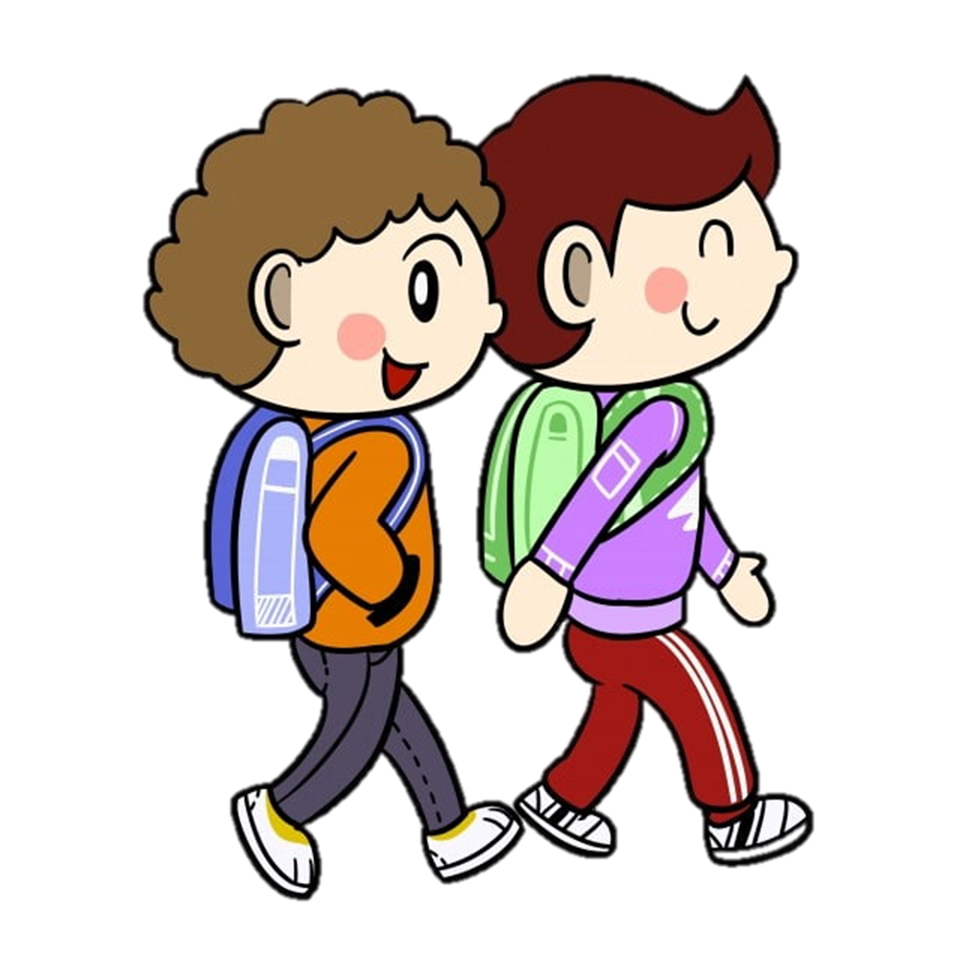
I go to the zoo.
A
B
C
D
What are you do on Saturdays?
What day do you do?
What do you do on Sunday?
What do you do on Saturdays?
Notes:
Ms Huyền Phạm - 0936.082.789 – YOUTUBE: MsPham. Facebook: Dạy và học cùng công nghệ.

Slide 10
___________? On Saturdays, I help my parents at home.
A
B
What do you do?
What are you do?
Notes:
Ms Huyền Phạm - 0936.082.789 – YOUTUBE: MsPham. Facebook: Dạy và học cùng công nghệ.

Slide 11
_______ , I visit my grandparents
A
B
On Sunday
On Sundays
Notes:
Ms Huyền Phạm - 0936.082.789 – YOUTUBE: MsPham. Facebook: Dạy và học cùng công nghệ.

Slide 12


Notes:
Ms Huyền Phạm - 0936.082.789 – YOUTUBE: MsPham. Facebook: Dạy và học cùng công nghệ.

Slide 13
phonics

Slide 14
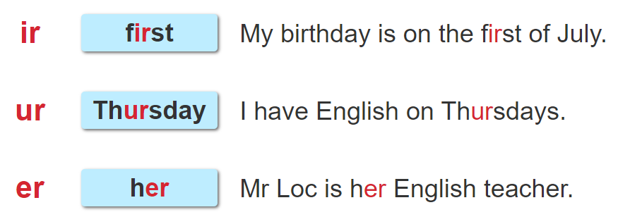

1. Listen and repeat.

Slide 15
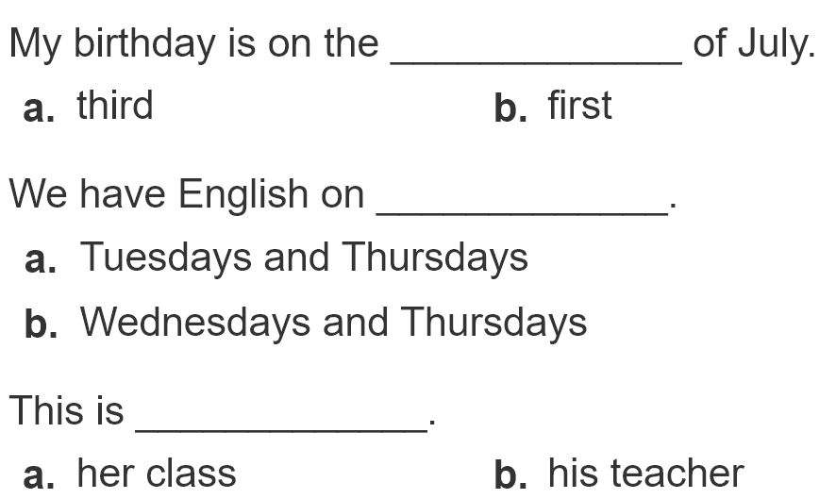
2. Listen and circle. Then say aloud.
1
2
3

Slide 16
practise

Slide 17
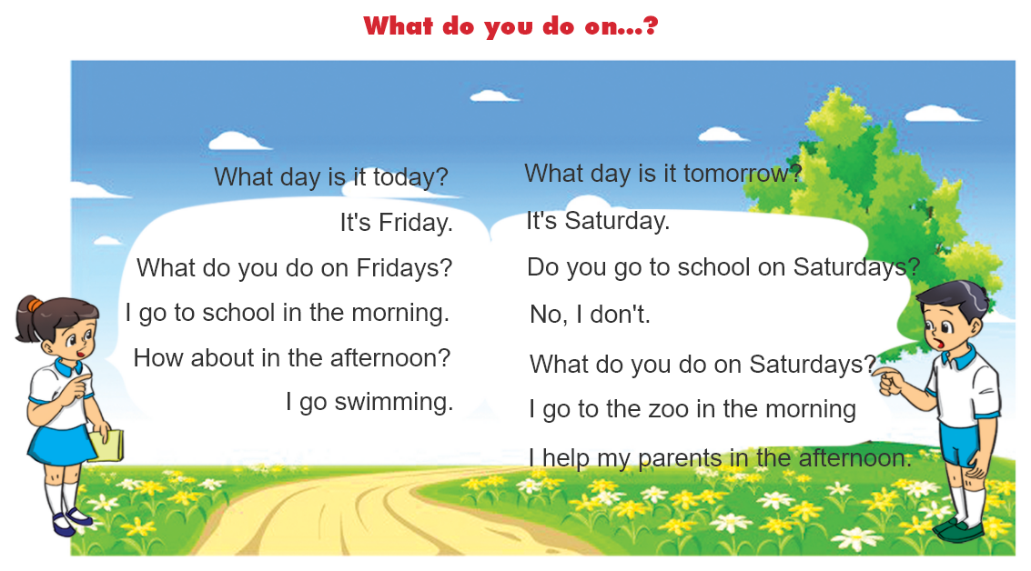

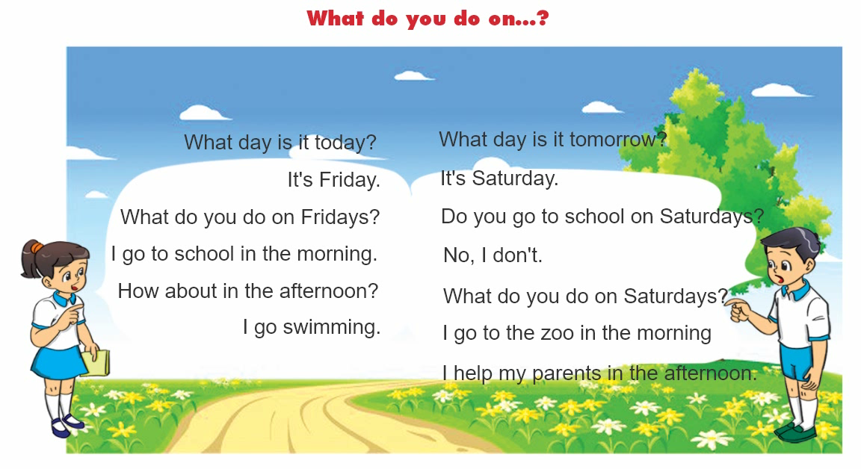
3. Let's chant.

Slide 18
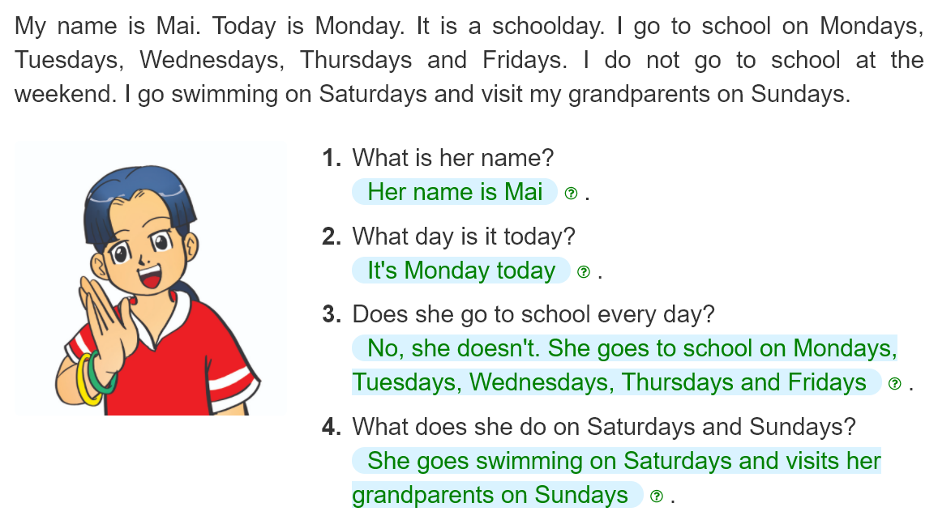
4. Read and answer.
________________________________________________.
________________________________________________.
__________________________________________________.
___________________________________________________.

Slide 19
5. Let's write.
What class are you in?
_______________________________.
What day is it today?
_______________________________.
What do you do at the weekend?
_______________________________
_______________________________
_______________________________.

Slide 20
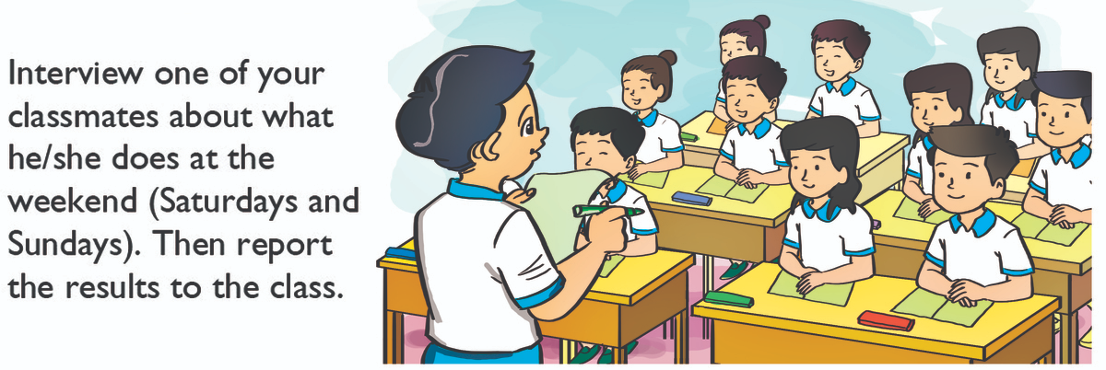
6. Project

