Slide 1
MINDMAP
ENGLISH GRADE 4

Slide 2

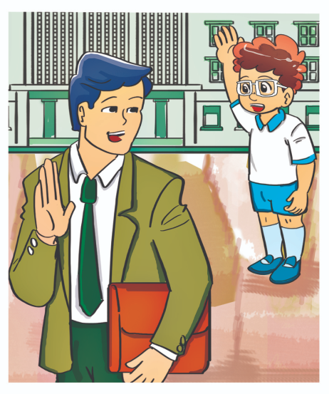
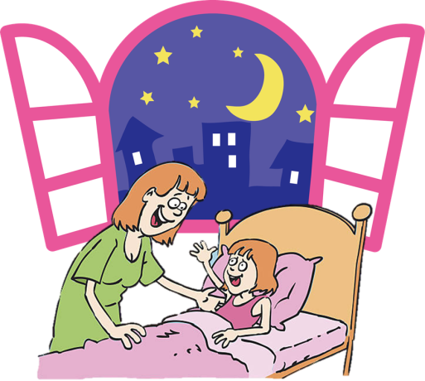
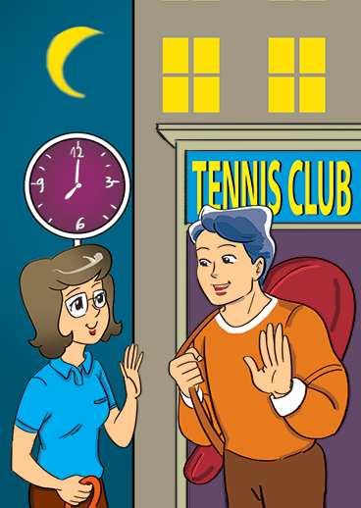
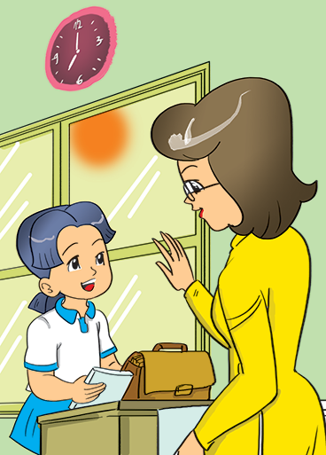
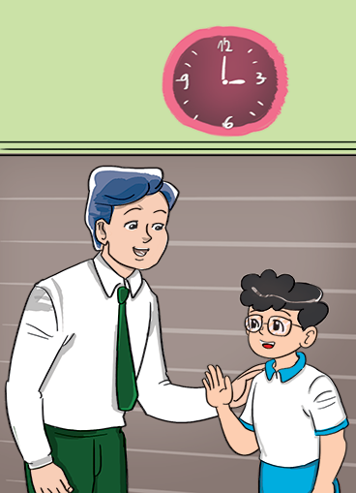
Unit 1
Good _________.
night
bye
evening
morning
afternoon

Slide 3


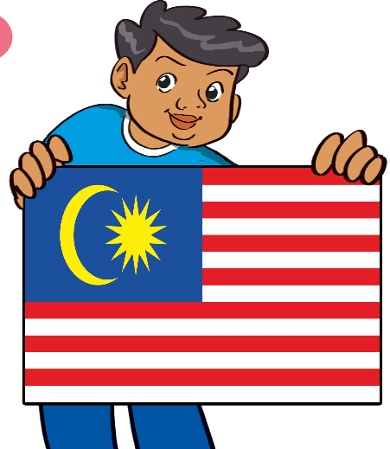
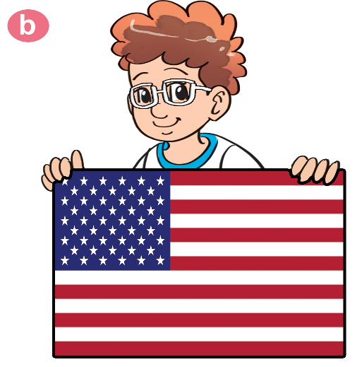


Unit 2
Where are you from?
I'm from _______.
Malaysia
America
Australia
England

Slide 4

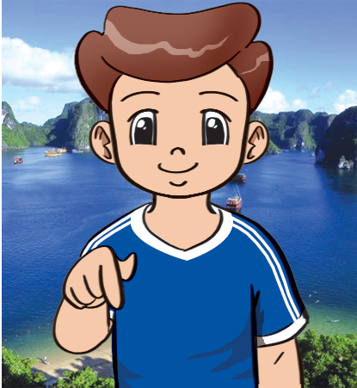
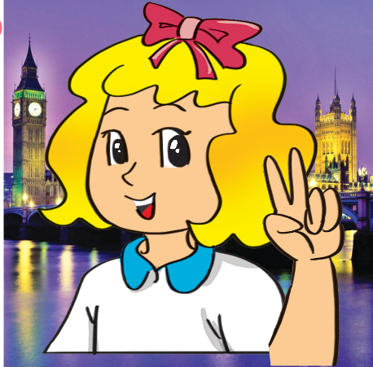
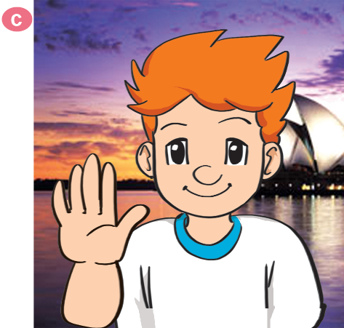
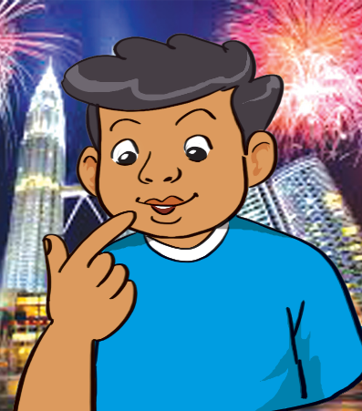
Unit 2
What nationality are you?
I'm ___________.
Vietnamese
English
Australian
Malaysian

Slide 5
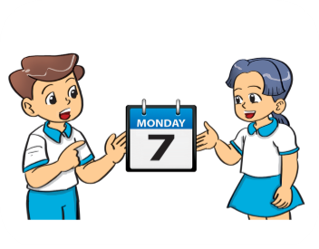

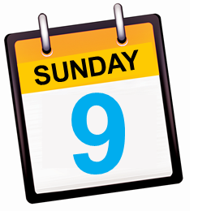



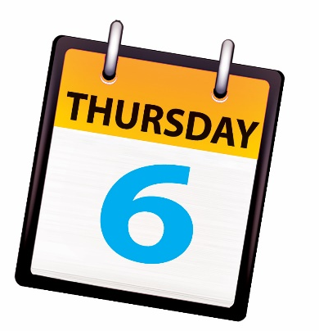
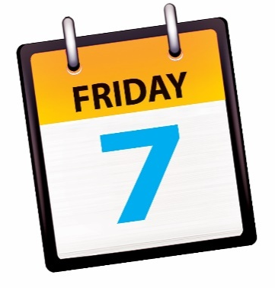

Unit 3
What day is it today?
It’s ___________.

Slide 6
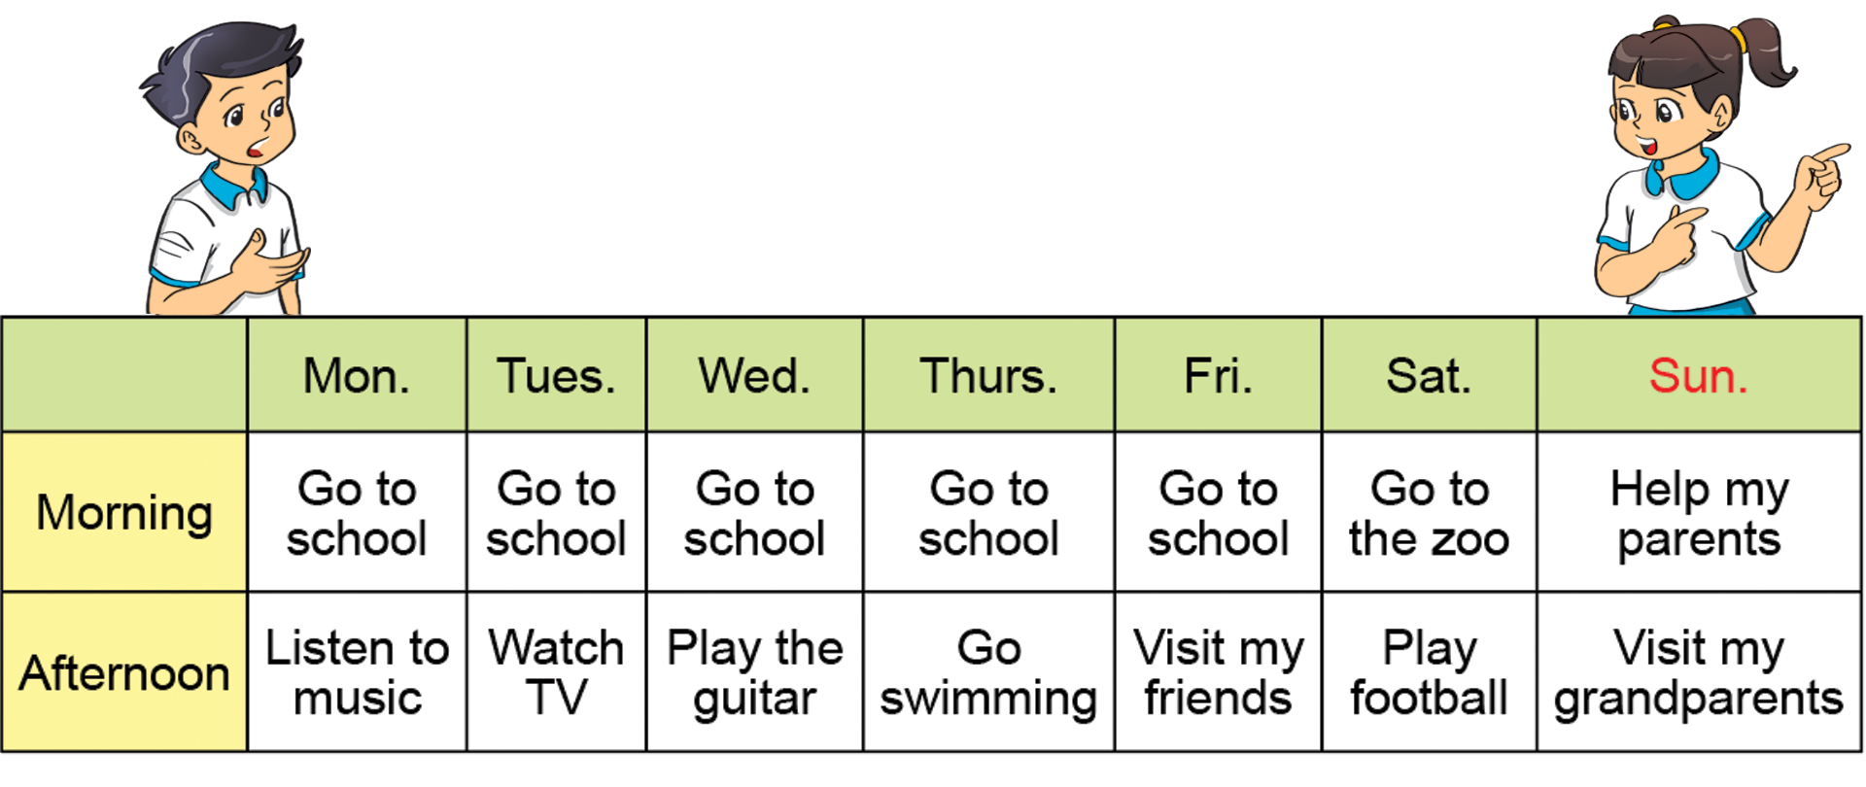
Unit 3
What do you do on ________ ?
I ________in the morning and _________in the afternoon.

Slide 7
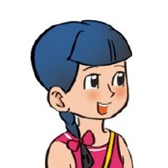
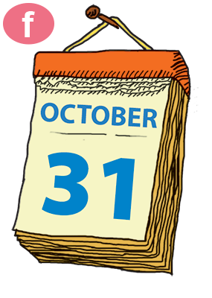
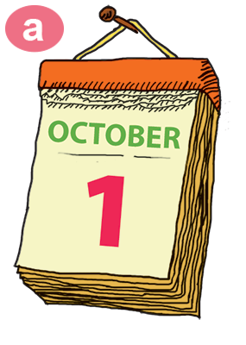
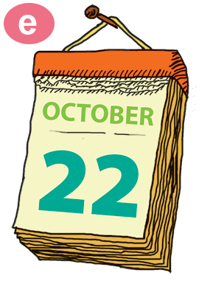
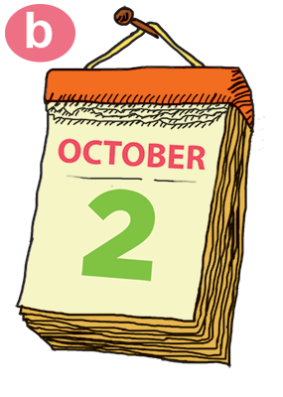
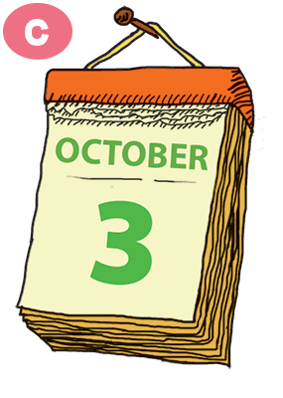
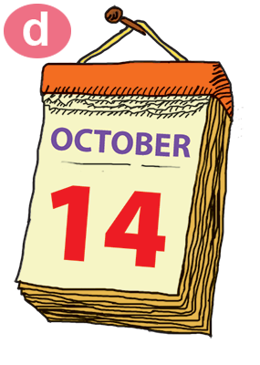
Unit 4
What is the date today?
It’s the ____ of _____.
thirty-first
first
twenty-second
second
third
fourteenth

Slide 8
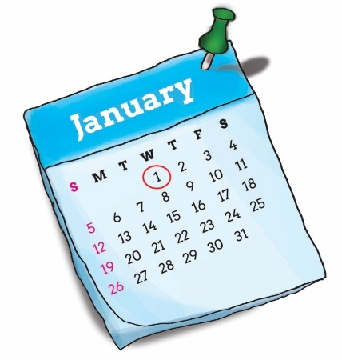
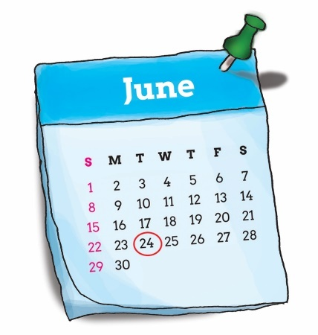
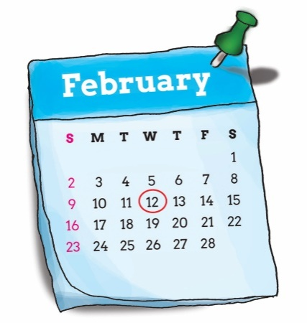
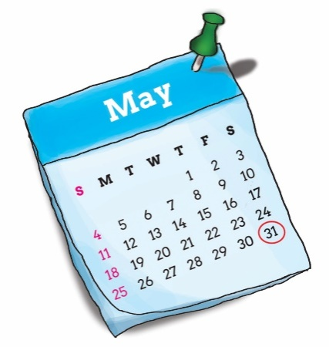
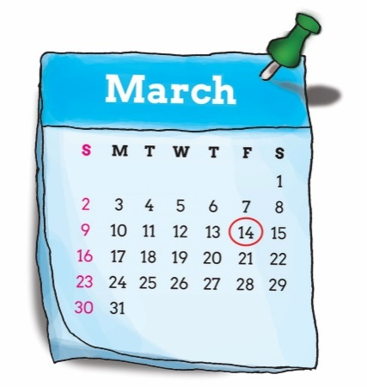
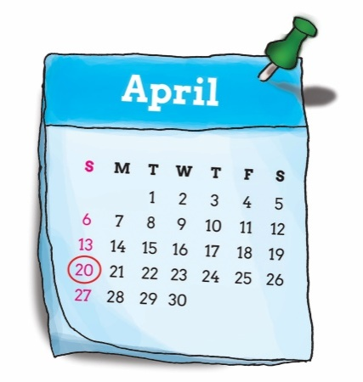
Unit 4
When’s your birthday?
It’s on the ____ of _____.
first
twenty-fourth
January
twelveth
thirty-first
June
February
fourteenth
twentieth
May
March
April

Slide 9
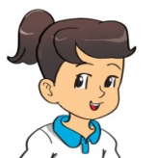
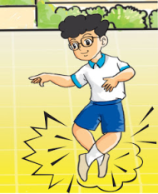
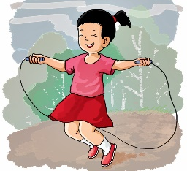
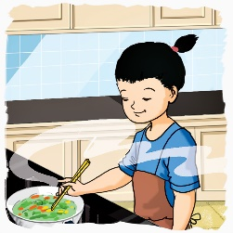
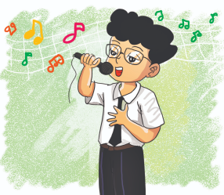
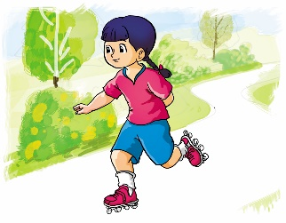
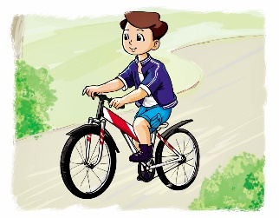
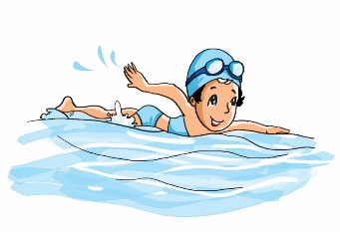
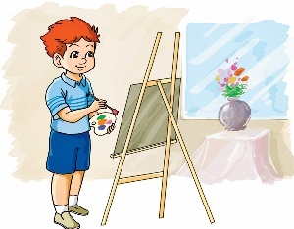
Unit 5
What can you do?
I can __________.
dance
skip
cook
sing
skate
ride a bike
draw
swim

Slide 10
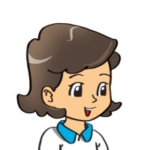
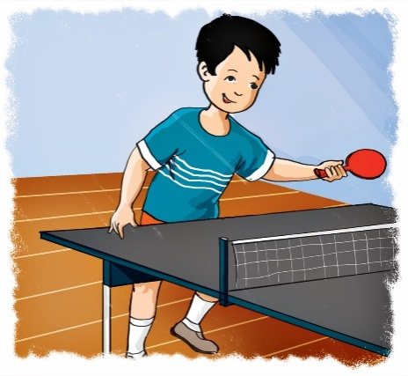
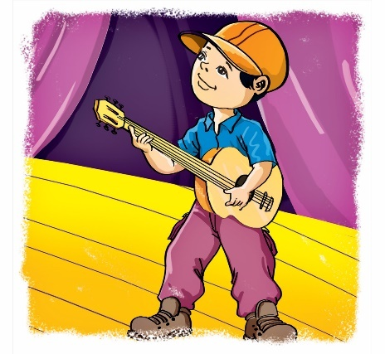
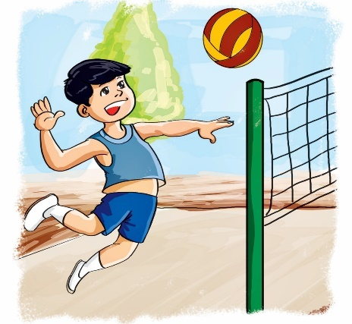
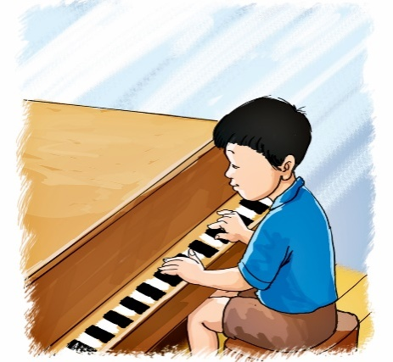


Unit 5
Can you ________?
play table tennis
play the guitar
Yes, I can.
play volleyball
No, I can’t.
play the piano
Yes, I can.
No, I can’t.

Slide 11


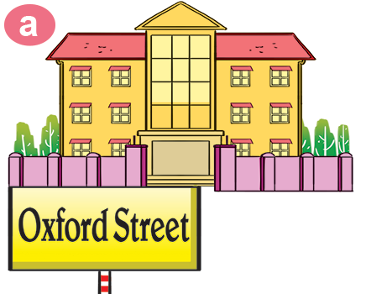
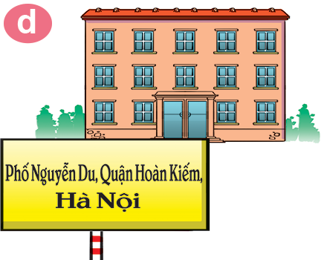
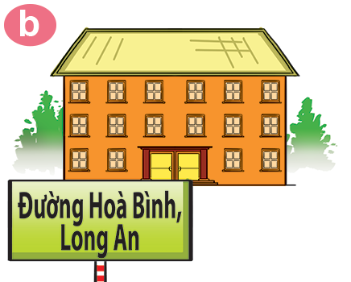
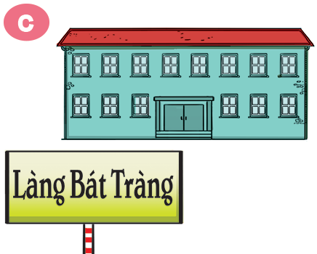
Unit 6
Where's your school?
It’s in ___________.
Oxford Street
Hoan Kiem District
Hoa Binh Street
Bat Trang Village

Slide 12
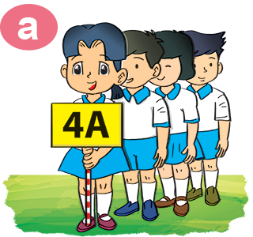
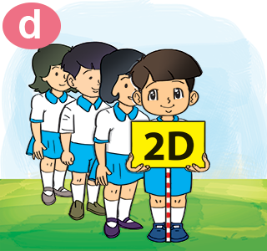
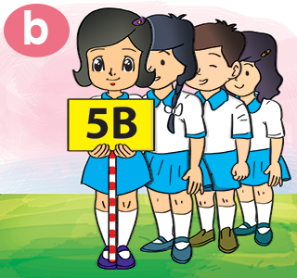

Unit 6
What class is she/he in?
She/He’s in Class ____.

Slide 13






Unit 7
What do you like doing?
I like ___________.
swimming
playing
chess
cooking
collecting
stamps

Slide 14






Unit 7
What's your hobby?
I like ___________.
watching TV
taking
photos
playing
badminton
flying a kite

Slide 15








Unit 8
What subjects do you have today?
I have ___________.
Sciences
Art
IT
Vietnamese

Slide 16

Unit 8
When do you have __________?
I have it on ___________.
Ms. Huyền Phạm

Slide 17






Unit 9
What's she / he doing?
She / he’s _________.
watching
a video
reading a text
listening to music
writing a dictation

Slide 18




Unit 9
What are they doing?
They’re _________.
making paper planes
painting
mask
making puppet
playing badminton

Slide 19




Unit 10
Where were you yesterday?
I was _________.
in the
school libray
at the zoo
on the beach

Slide 20



Unit 10
What did you do yesterday?
I ________________.
played badminton
watered the flowers
painted a picture

