Slide 1

NGOC LAM PRIMARY
Teacher: HauLe
Unit 4: ACTIVITIES
Lesson 3.2
Page 55

Slide 2

WARM UP

Slide 3

SING &FREEZE!!!

Slide 4
1
4
6
1
SPIN
2
5
2
5
4
3
3
6
Next Part

Slide 5
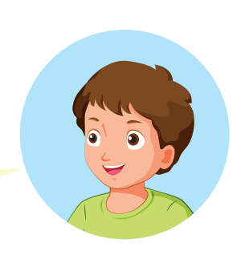
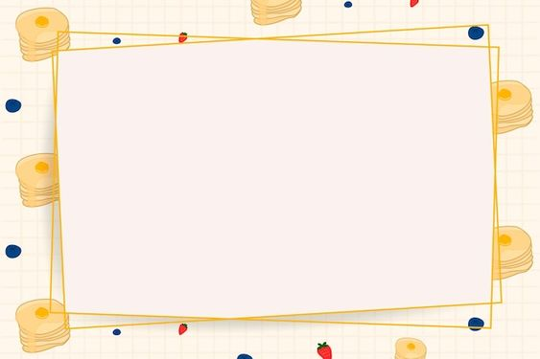

I’m reading books at the
____________________
library.
Go back

Slide 6
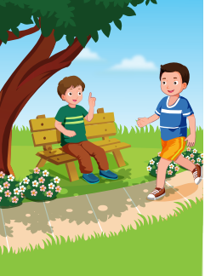
I’m running at the
____________________
park.
Go back

Slide 7
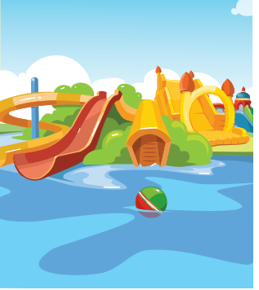
I’m playing at the
____________________
water park.
Go back

Slide 8
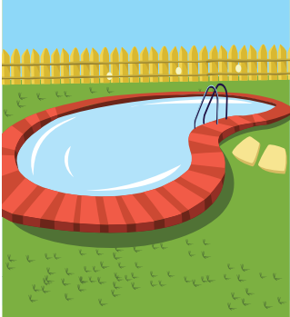
I’m swimming at the
____________________
pool.
Go back

Slide 9
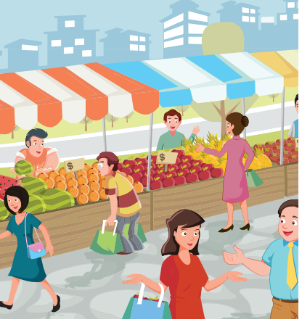
We’re eating at the
____________________
market.
Go back

Slide 10

We’re doing martial arts at
the _________________
school.
Go back

Slide 11

It’s time to learn …

Slide 12

Listening

Slide 13

BEFORE YOU LISTEN

Slide 14
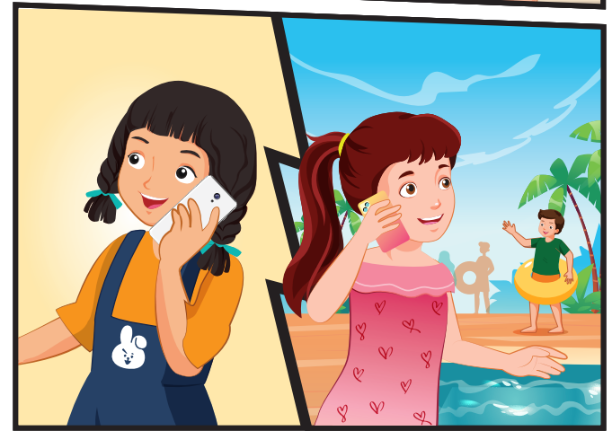
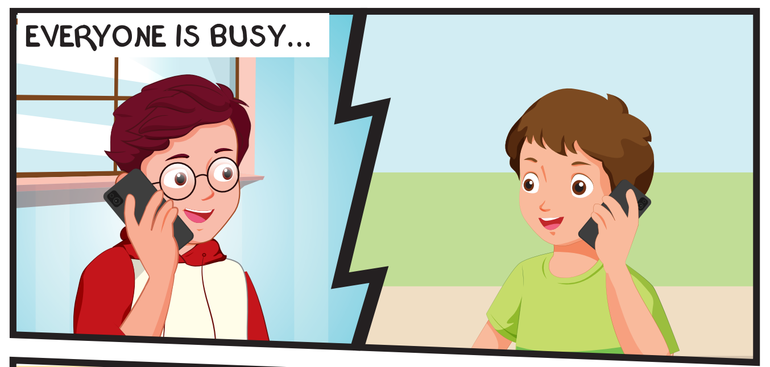
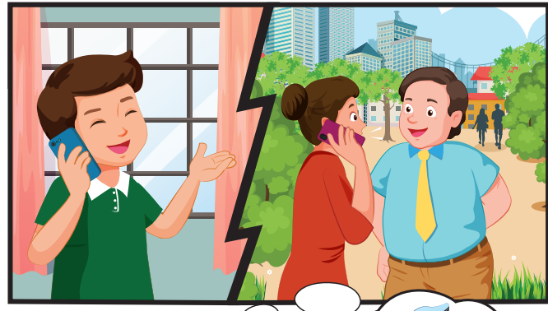
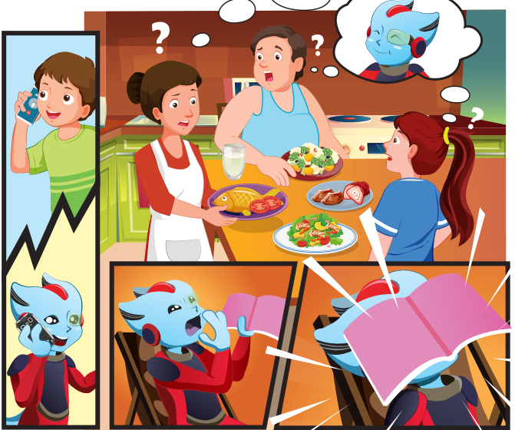
Notes:
Encourage Ss to guess

Slide 15



Slide 19

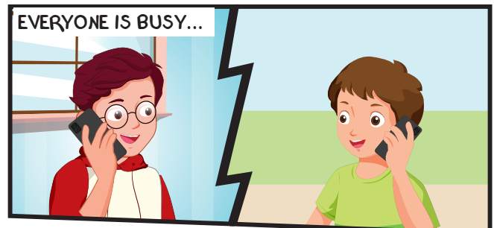
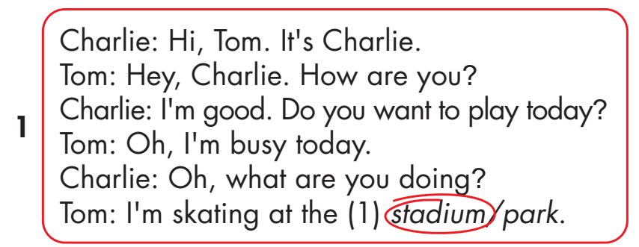
Click on the headphone icon to hear the sound.
Click on number 1
to show the answer.

Slide 20
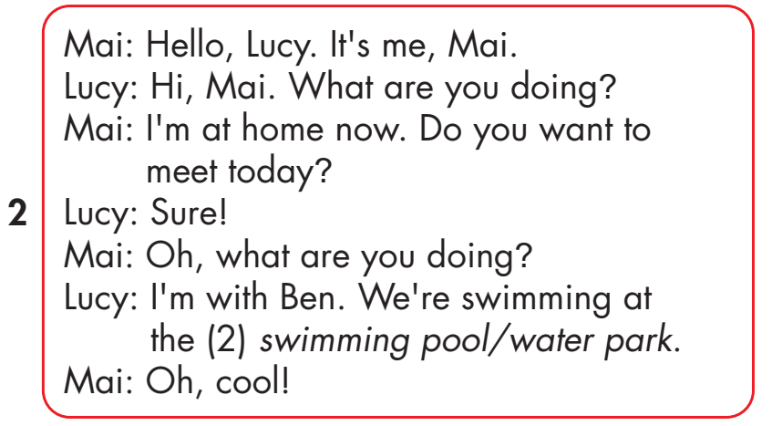
Click on the headphone icon to hear the sound.
Click on number 2
to show the answer.

Slide 21
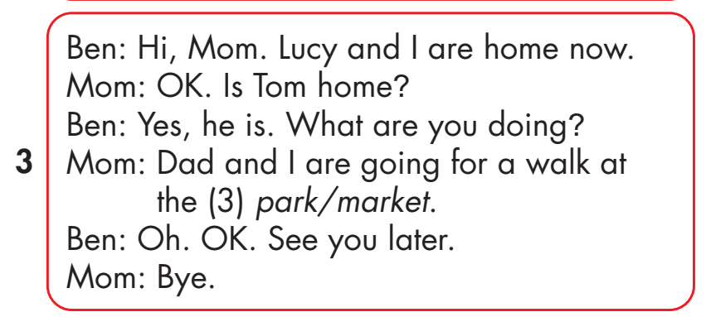
Click on the headphone icon to hear the sound.
Click on number 3
to show the answer.

Slide 22
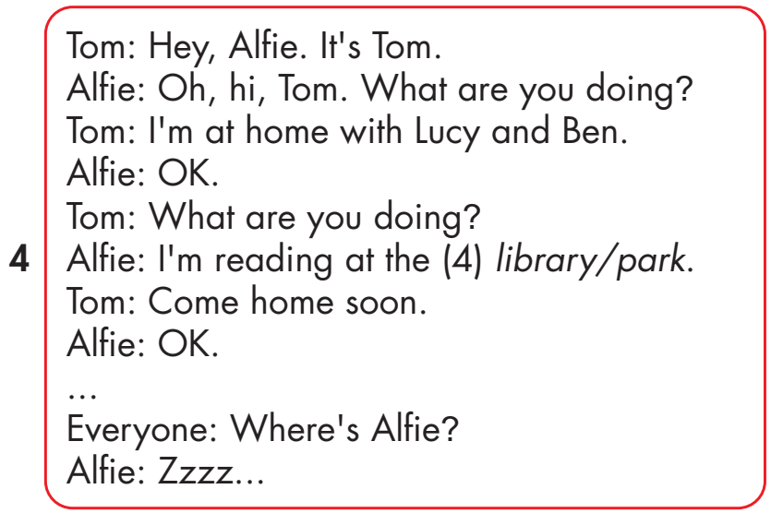
Click on the headphone icon to hear the sound.
Click on number 4
to show the answer.

Slide 23

Practice

Slide 24
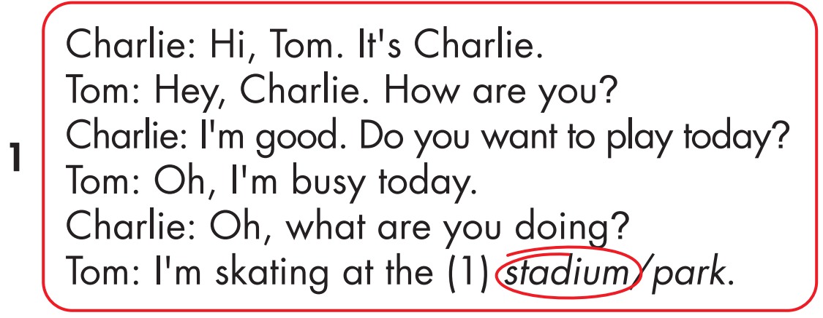

Slide 28
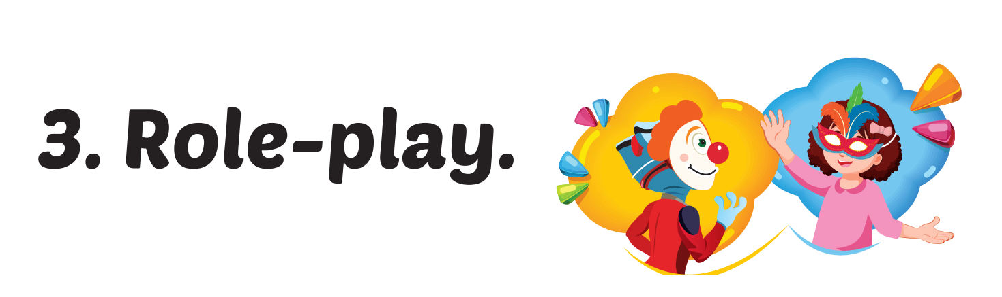

Slide 30

Phonics
/m/

Slide 31
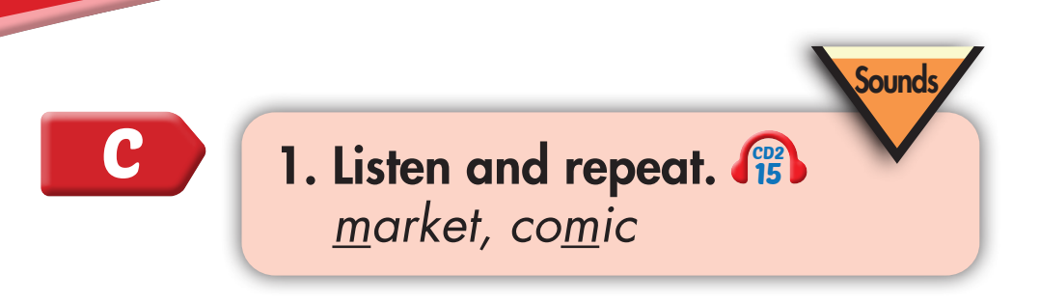
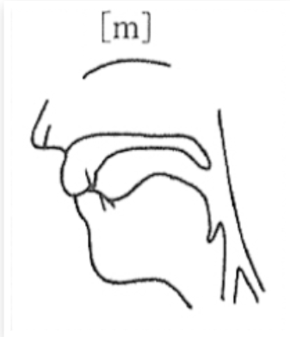
m, m, market
m, m, comic

Slide 32

I’m reading a comic book at home
What are you doing, Lucy?
I’m reading a comic book at home.
What are you doing, Tom?
I’m swimming the swimming pool.
What are you doing, Mom and Dad?
We’re walking at the market.
Notes:
1. Listen.
2. Listen and chant.

Slide 33
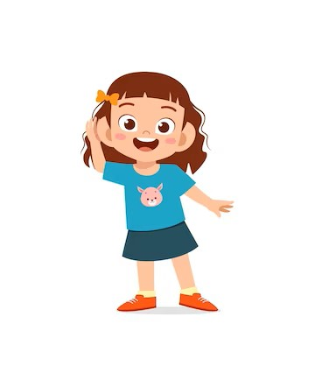
Listen. Clap and repeat when you hear /m/ sound.
Notes:
T says
Chess
Market
Comic
Library
Park
Swimming pool
Stadium
music

Slide 35

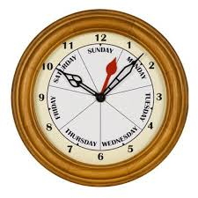
30
00
01
02
03
04
05
06
07
08
09
10
11
12
13
14
15
16
17
18
19
20
21
22
23
24
25
26
27
28
29

Slide 36


Click the earphone to hear the sound.
MAKING A CHANT

Slide 37

Click the earphone to hear the sound.

Slide 38

CONSOLIDATION

Slide 39
Today’s lesson:
Phonics:
Sentence patterns:
Beginning, middle sound /m/
Q- What are you doing?
A- I’m reading at the library.
market, comic
A- We’re swimming at the pool.

Slide 40
Home-link:
Practice the vocabulary and structure and make sentences using them.
Do the exercises in WB (page 37).
Prepare the next lesson (page 56-SB).
Play the consolidation games on www.eduhome.com.vn

Slide 41
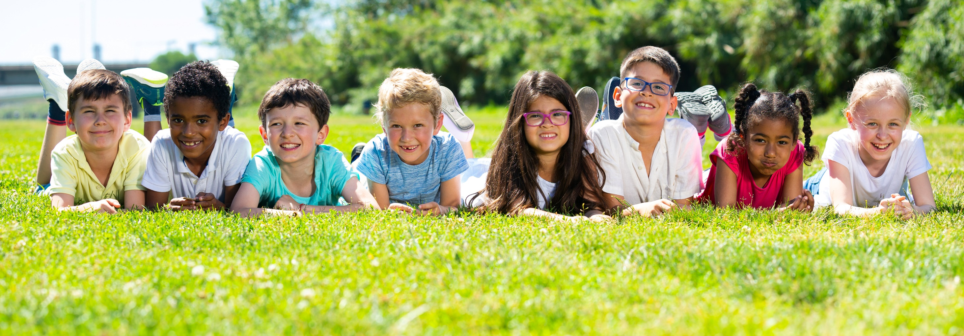
Thank you and have a great day!

Slide 42

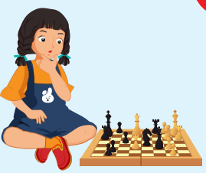
REVIEW 2
Look and say.
What are you doing?
I’m playing chess at home.

Slide 43
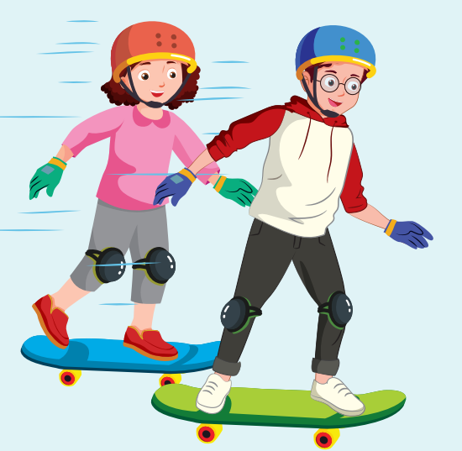
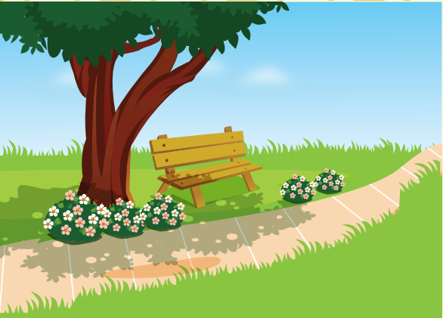
REVIEW 2
Look and say.
What are you doing?
We’re skating at the park.

Slide 44
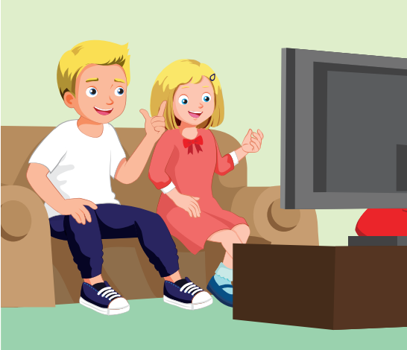
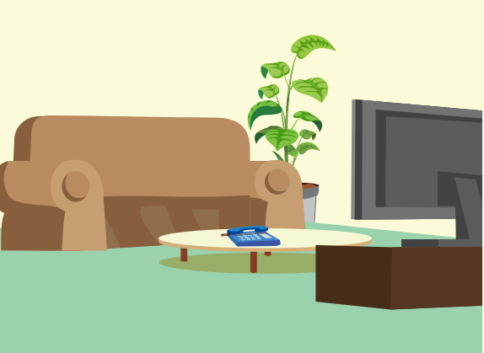
REVIEW 2
Look and say.
What are you doing?
We’re watching TV at home.

Slide 45
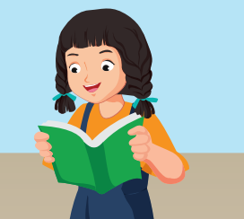

REVIEW 2
Look and say.
What are you doing?
We’re reading at the library.

Slide 46
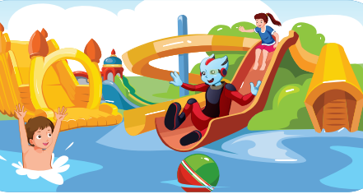
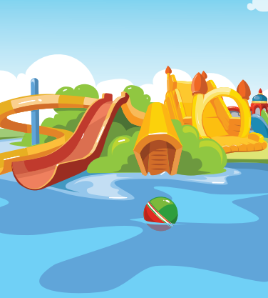
REVIEW 2
Look and say.
What are you doing?
We’re playing at the water park.

Slide 47
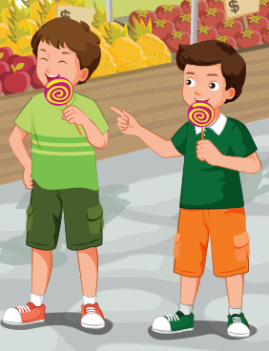
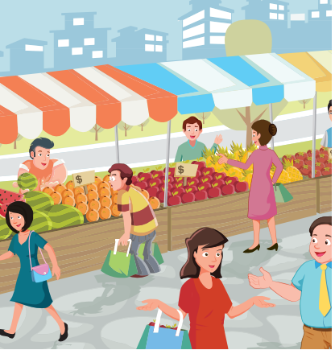
REVIEW 2
Look and say.
What are you doing?
We’re eating at the market.

Slide 48
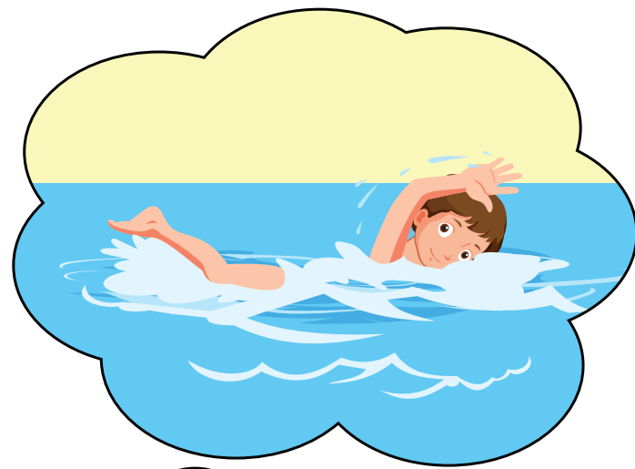
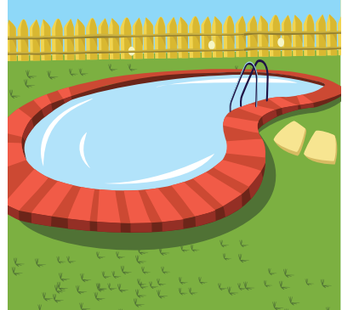
REVIEW 2
Look and say.
What are you doing?
We’re swimming at the pool.

Slide 49

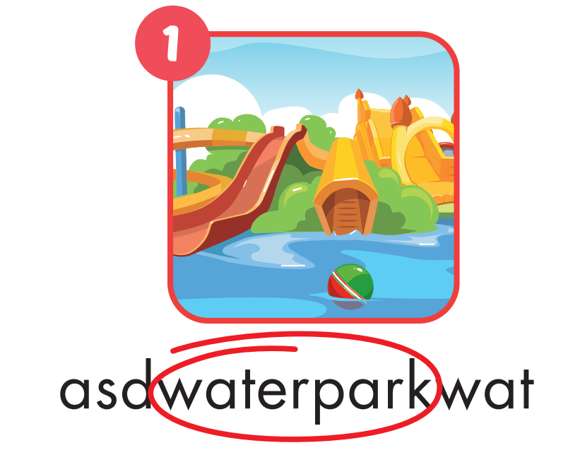
Notes:
WB page 32

Slide 50
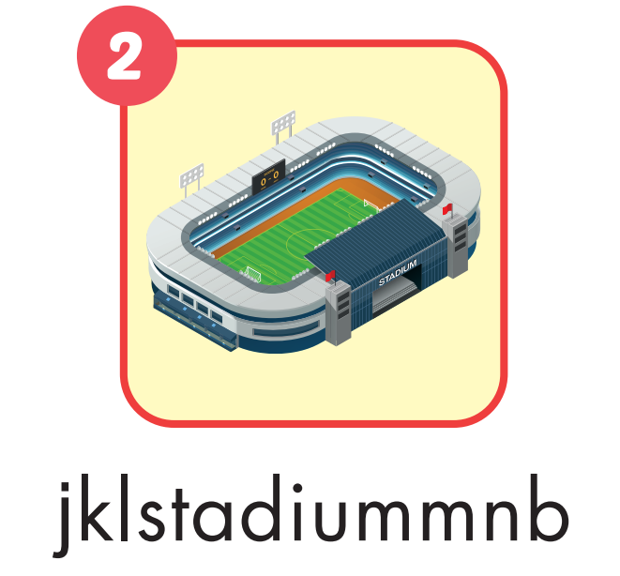
Notes:
WB page 32

Slide 51

Notes:
WB page 32

Slide 52

Notes:
WB page 32

Slide 53
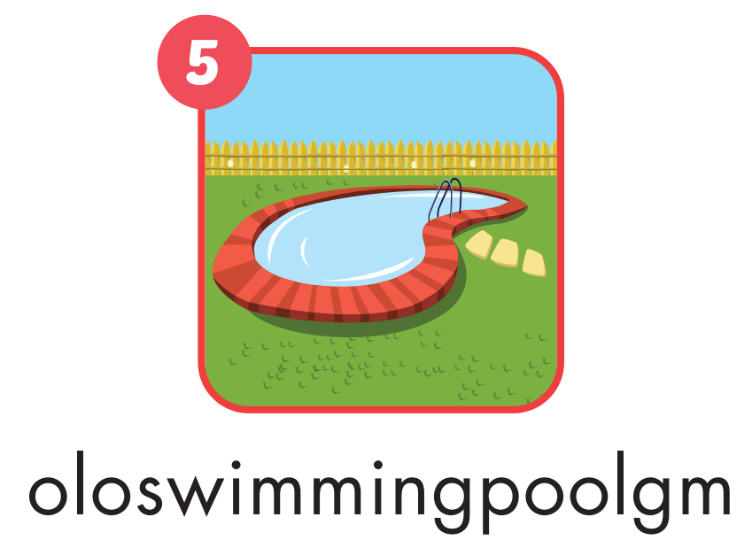
Notes:
WB page 32

Slide 54

Notes:
WB page 32

Slide 55

WRAP-UP

Slide 56
Today’s lesson
Vocabularies
library, stadium, park, water park, market, swimming pool.
Structures/ Sentence patterns
What are you doing?
I’m swimming at the pool.
What are you doing?
We are reading at the library.

Slide 57
Homework
Practice the vocabularies and structure, and make sentences using them.
Do the exercises in Tiếng Anh 4 i-Learn Smart Start WB (page 37)
Do the exercises in Tiếng Anh 4 i-Learn Smart Start Notebook (page 24).
Prepare the next lesson (page 56 SB)
Play the consolidation games in Tiếng Anh 4 i-Learn Smart Start DHA App on www.eduhome.com.vn

Slide 58

Lesson 3
Stay positive and have a nice day!

